Slide 1
CAREER and ENTERPRISE
Teachers –
Ms Chamizo, Mr Md Diyah, Mrs Little,
Mr Lucas and Ms Schwartz.

Slide 2
CAREER and Enterprise

Slide 3
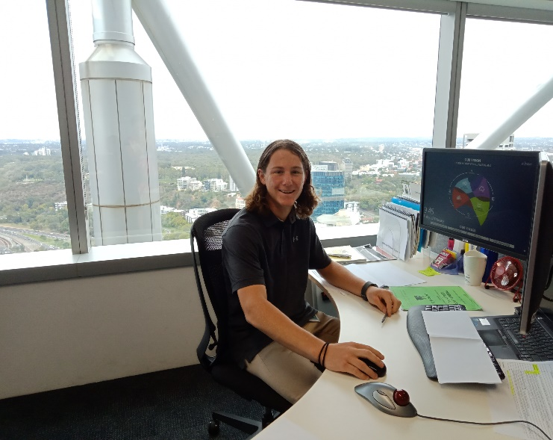
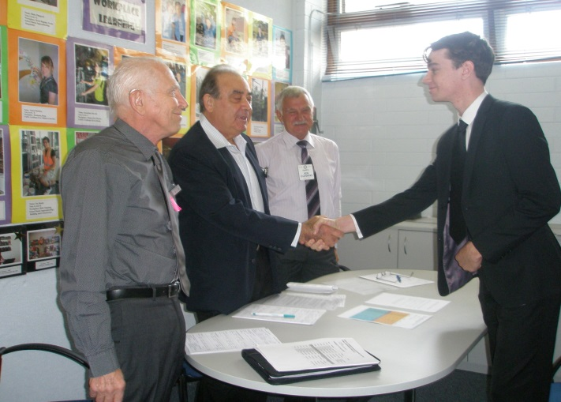
CAREER and ENTERPRISE
Careers-what you are suited to, how to find and keep.
Skills
Job searching
Resumes/ application letters
Interviews – U-Mat, jobs
Portfolio
Trends & influences on business & workforce
Legal, political, social

Slide 4
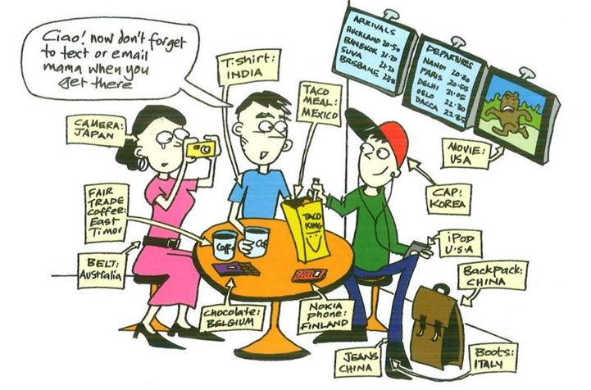
Global citizenship
Career and Enterprise teaches you about;
Awareness of the world
Relevant now & to your future
Current events – globally & domestically
Impacts on business & workforce

Slide 5
Results
Exhibition winner 2019
Mariam Abdulatiff
Consistent performance in ATAR results over 10 years.
62% ATAR students used Career and Enterprise as their 1st or 2nd highest ATAR score in 2019!
ATAR 98.75 Pharmacy 2020.

Slide 6
past winners
Exhibition Winner-
ATAR Career and Enterprise;
2019,2018,2017,2015,2014,2011.
Certificate of Excellence;
2019 , 18, 17, 16,15, 14, 13, 12, 11 10.
No other Department gets close to this achievement!
Stephanie went on to become Dux of Notre Dame University.

Slide 7
Workload
Designed to have minimal homework
Complete in class
Task books
Information
Activities
Revision books
Note taking guides of key points
Past exam questions & suggested answers
Moodle/SEQTA
Additional reading suggestions
Course work

Slide 8
Benefits
How to get a job, keep a job & get promoted
Employability skills
Class activities to improve – e.g. Teamwork, communication, problem solving
Attractive to employers
Knowledge current events, industry trends, skills
Improve self awareness & confidence
Online quizzes
Self reflection activities
Notes:
Emotional level for alumni
Way of attracting quality staff.

Slide 9
Make it work for you
Strong awareness of what’s happening globally & domestically
Impact on workforce
Strong writing skills – highly beneficial
Relates well to Economics course
List A subject
Complete majority work in class - VERY limited homework

