Slide 1
Australia & International Law
Civics and Citizenship

Slide 2
International Law
The world is becoming increasingly globalised
This can be both a positive and negative event
International law is concerned with setting standards of acceptable behaviour for nations and their citizens when dealing with issues that cross borders or issues of concern to society in general

Slide 3
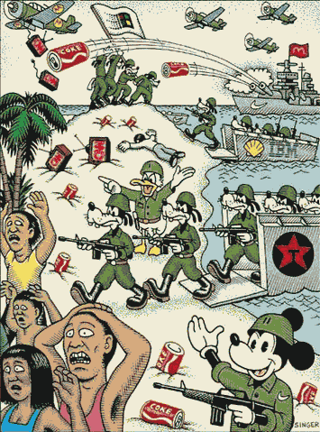

Slide 4
International Law
One of the roles of the United Nations is the enforcement of international law
There are generally considered to be two types of international law:
public international law, which concerns itself only with questions of rights between several nations, or between nations and the citizens or subjects of other nations
private international law, which deals with controversies between private persons arising out of situations involving more than one nation.

Slide 5
International Law
Is developed from a number of sources but it is primarily derived from treaties and conventions between countries
A treaty is a form of contract between two parties (two countries or two international organisations from different countries) – eg Treaty of Versailles
Other sources of international law include the Charter of the United Nations, international customs and the general principles of law that apply in the majority of countries.

Slide 6
Enforcing International Law
Once method of enforcing international law is through Peacekeeping
Another is through the International Court of Justice

Slide 7
International Court of Justice
Is the Judicial branch of the UN
Its main functions are to:
settle legal disputes between states (member countries of the United Nations); and
to provide legal advice to the UN
161 cases have currently been heard by the ICJ, such as Australia and New Zealand accusing Japan of exceeding its whaling limits
Japan was banned from whaling in the Antarctic

Slide 8
Important Australian Treaties
Include:
atmosphere and outer space
criminal matters
defence and security
human rights
international trade
labour.
The signing of international treaties can cause problems within a country, and limits a governments ability to govern.

Slide 9
ANZUS Treaty
The Second World War strengthened Australia’s foreign relations with both the United States and New Zealand
The formalization of this close relationship was shown in the signing in 1951 of the ANZUS (Australia, New Zealand, United States Security) Treaty
This treaty bound the three nations to cooperate on defence matters in the Pacific Ocean region.
While the treaty was modified in 1984 due to New Zealand’s objections to American nuclear warships entering its ports, the agreement is still in effect and annual meetings are held to confirm the relationship.

