Slide 1
Geology
Plate Tectonics

Slide 2
Plate Tectonics
The theory of plate tectonics and continental drift were proposed by a German scientist, Alfred Wegener.
It took more than 50 years for Wegener’s theory to be accepted.
Difficult to work out what the mechanism was that could make whole continents move

Slide 3
Evidence for plate tectonics
So what was the evidence for Wegener's theory?
Plate tectonics explained why earthquakes and volcanoes were concentrated in specific places
The match in shape of the continents shows they once were part of a single continent
There are similar patterns of rocks and similar fossils on both sides of the Atlantic

Slide 5
Plate Boundaries
3 types of plate boundaries
Convergent plate boundaries
Divergent plate boundaries
Transform plate boundaries

Slide 6
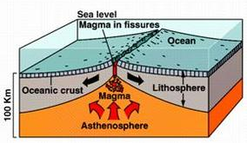
Divergent Plate Boundaries
Divergent Plate Boundaries occur where two tectonic plates move away from each other.
New crust is forming from magma that rises to the Earth's surface between the two plates.
Produces new crust
Mid Ocean Ridge

Slide 7
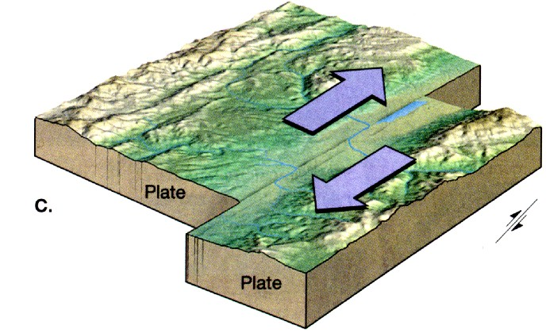
Transform Plate Boundaries
Transform Plate Boundaries occurs where two plates slide sideways past each other.
Crust is neither created or destroyed
Results in earthquakes

Slide 8
Convergent Plate Boundaries
Convergent Plate Boundaries occurs where two tectonic plates are moving toward each other.
There are 2 ways this can happen

Slide 9
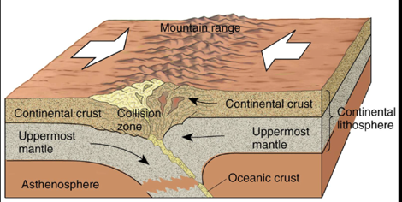
Convergent Plate Boundaries
If the two plates are of equal density, they will push up against each other, forming a mountain chain.
Produces a mountain chain

Slide 10
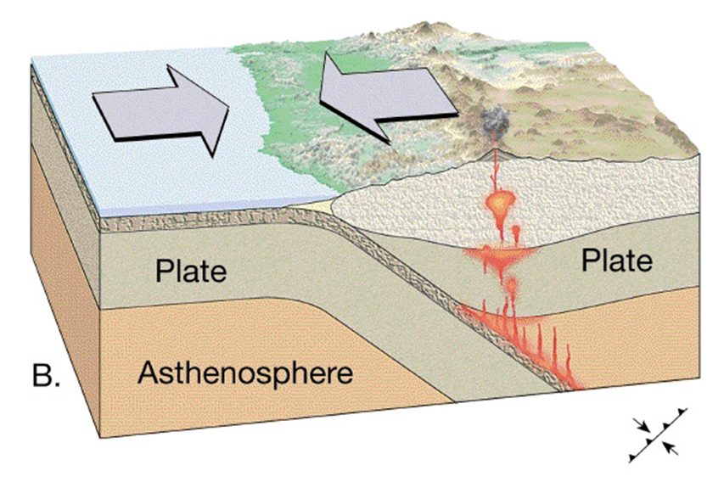
Convergent Plate Boundaries
If they are of unequal density, one plate usually sinks beneath the other in a subduction zone.
Produces a chain of volcanos

Slide 11
http://www.learner.org/interactives/dynamicearth/convergentboundaries/
http://www.scootle.edu.au/ec/viewing/R8945/index.html

Slide 12
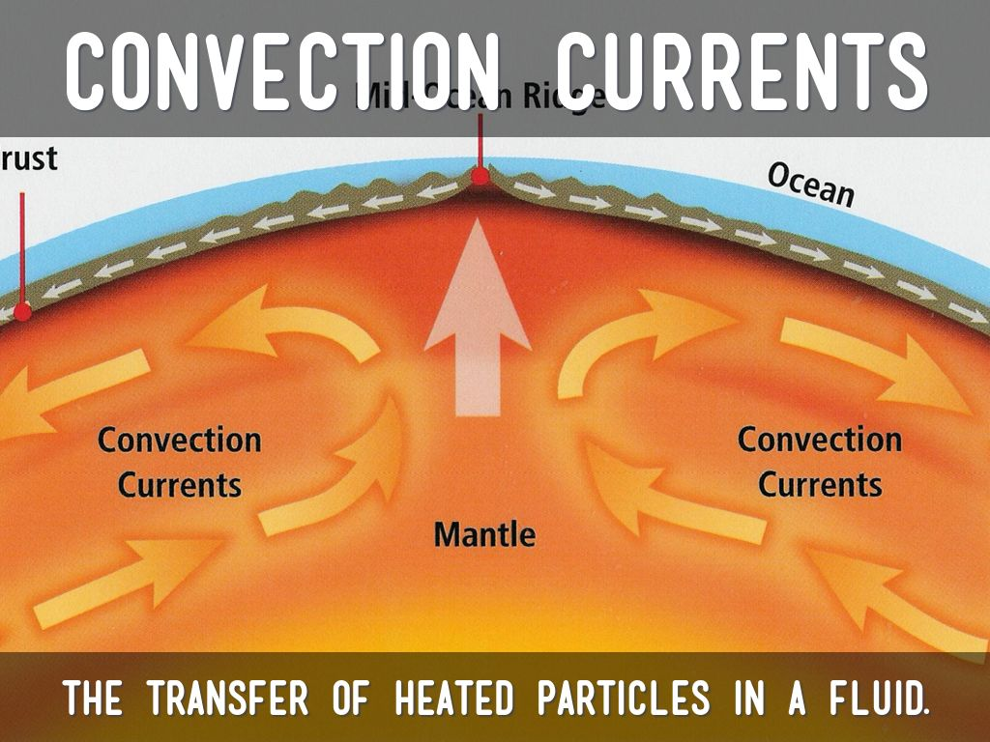
How do the tectonic plates move?
Scientists believe that the plates move because of convection currents in the mantle.
Magma is semi molten rock and moves in a circular motion like boiling water in a pan
Causes tectonic plates to move
Direction of currents influence what direction the plates move in

Slide 14
Convection Currents
https://www.youtube.com/watch?v=HK1DvM26jzM

Slide 15
Things to do
Handout – The ring of fire
Interactive dynamic earth test skills
Tectonic boundaries challenge

Slide 16
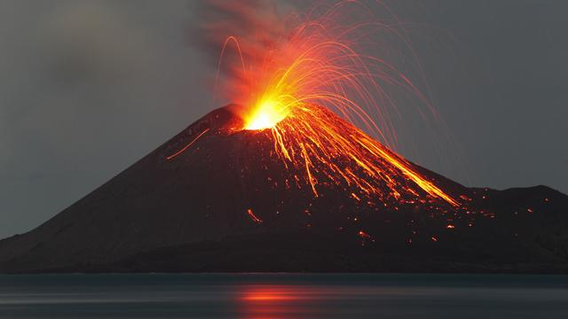
Volcanoes

Slide 17
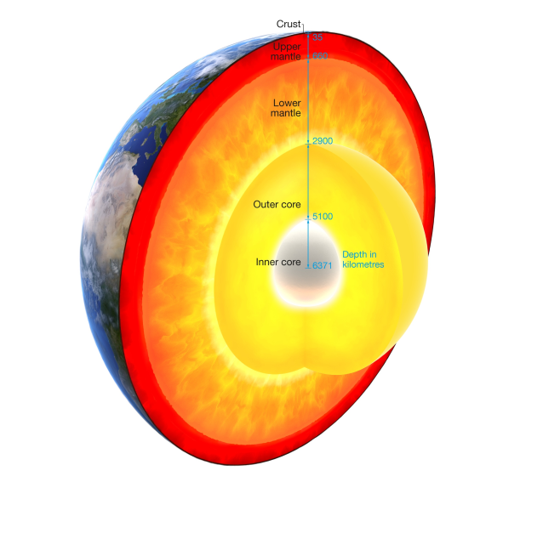
What is a Volcano?
A combination of molten rock and gases called magma lies between the Earth's crust and the mantle.
A volcano is a mountain that is formed when molten rock / magma is transferred to the crust from the mantle.

Slide 18
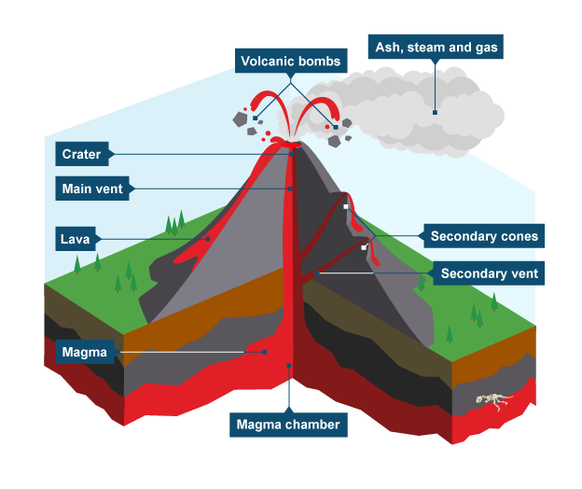

Slide 19
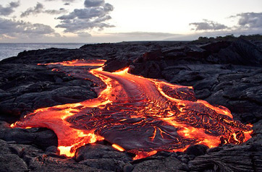
Magma vs Lava
When magma flows out or erupts from a volcano it is called lava.
Lava is the material which builds up the cone surrounding the vent.

Slide 20
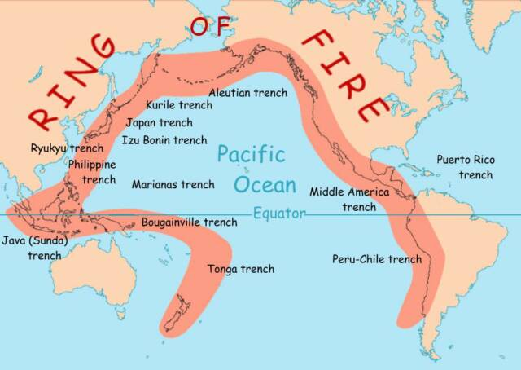
How Do Volcanoes Form?
Volcanoes are formed as a result of tectonic plate movement
Often occur at the same place as earthquakes
Volcanoes can occur at:
Divergent boundaries
Convergent boundaries
Hot spots

Slide 22
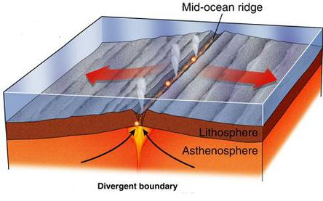
Volcanoes – Divergent Boundaries
Volcanoes form where plates move away from each other at spreading or divergent plate boundaries
Magma rises to fill the space created by seafloor spreading
Gentle extrusions of basaltic lava
Occurs at a rate of about 10 centimetres a year

Slide 23
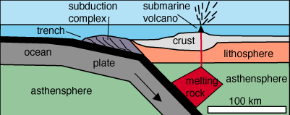
Volcanoes – Convergent Boundaries
When two plates move towards one another, they form either a subduction zone or a continental collision.
Volcanoes form at subduction zones at convergent boundaries

Slide 24
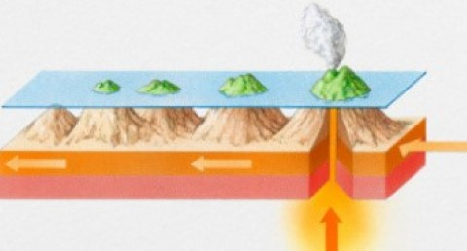
Volcanoes – Hot Spots
Hot spots are places within the mantle where rocks melt to generate magma
Not associated with a plate boundary
Eg - Hawaiian volcanoes

Slide 25
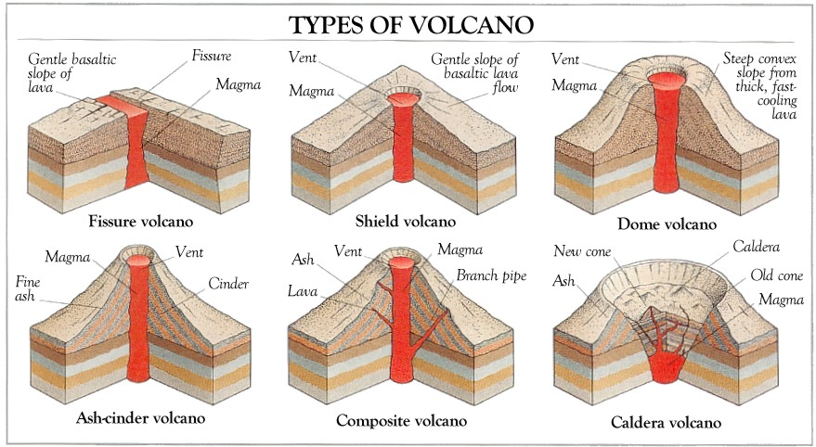

Slide 26
Volcano activity
Erupting volcano - is an active volcano that is erupting
Dormant volcano - is an active volcano that is not erupting, but supposed to erupt again
Extinct volcano - has not had an eruption for at least 10,000 years and is not expected to erupt again in the future

Slide 27
https://www.youtube.com/watch?v=jRfEGvp6wDU

Slide 28
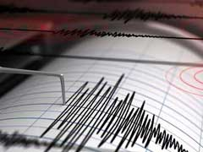
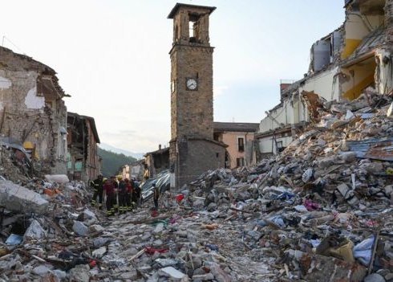
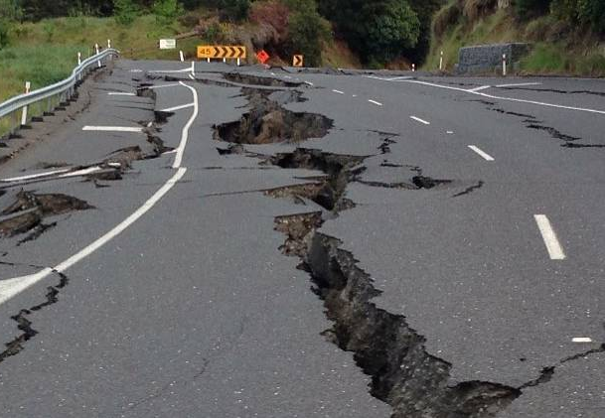
Earthquakes

Slide 29
What is an Earthquake?
An earthquake is the shaking and vibration of the Earth's crust due to movement of the Earth’s tectonic plates
Friction causes the plates to get stuck. This causes pressure to build up within the plate.
Earthquakes occur when this tension/ stress is released from inside the crust.

Slide 30
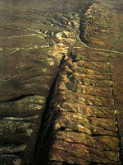
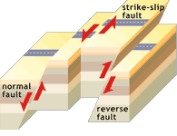
Earthquakes can happen along any type of plate boundary
Can also occur far from the edges of plates boundaries, along faults
Faults are cracks in the earth where 2 tectonic plates move in different directions

Slide 31
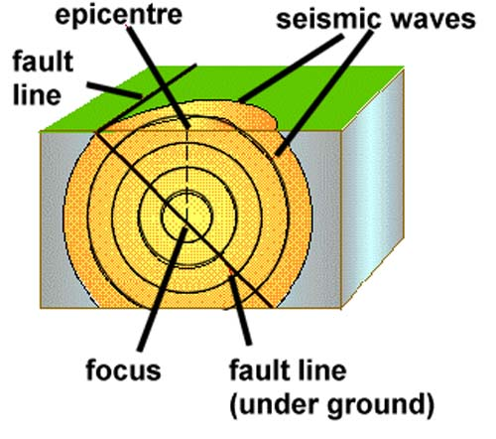

Slide 32
Where do Earthquakes Occur?

Slide 33
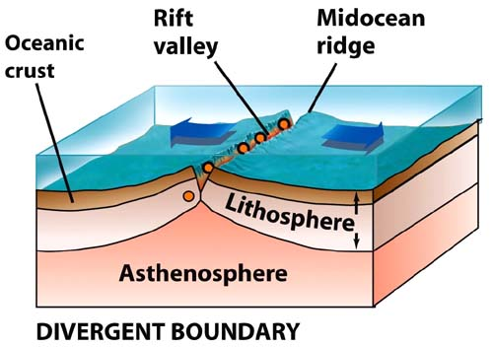
Earthquakes at Divergent Plate Boundaries
At divergent plate boundaries, earthquakes tend to be weak and shallow

Slide 34
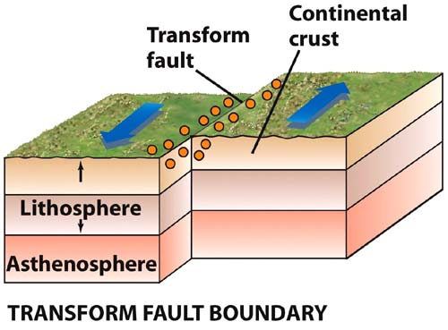
Earthquakes at Transform Plate Boundaries
Transform plate boundaries, have shallow, but very powerful earthquakes

Slide 35
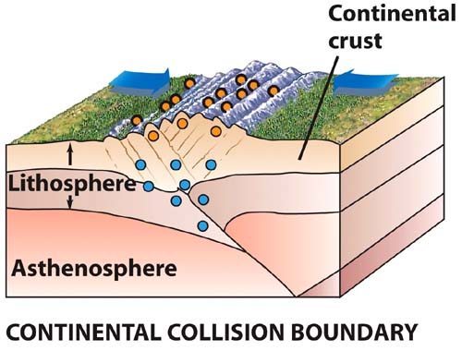
Earthquakes at Convergent Plate Boundaries
At convergent plate boundaries, where two continental plates collide earthquakes are deep and also very powerful

Slide 36
Earthquakes at Convergent Plate Boundaries
In general, the deepest and the most powerful earthquakes occur at plate collision (or subduction) zones at convergent plate boundaries

Slide 37
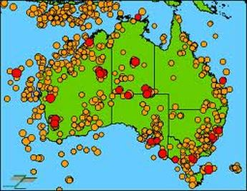
90% of the Earth’s earthquakes occur at plate boundaries
Australia is not on a plate boundary yet we still experience earthquakes here
http://www.ga.gov.au/earthquakes/
Why?

Slide 38
Earthquakes occur at:
Plate boundaries
Within plates
As plates move, plate boundaries change over time
Weakened boundary regions become part of the interiors of the plates
These zones of weakness can cause earthquakes in response to stresses

Slide 39
Description | Magnitude | Frequency per year
Great | 8.0+ | 1
Major | 7.0-7.9 | 18
Large (destructive) | 6.0-6.9 | 120
Moderate (damaging) | 5.0-5.9 | 1,000
Minor (damage slight) | 4.9-4.0 | 6,000
Generally felt | 3.0-3.9 | 49,000
Potentially perceptible | 2.0-2.9 | 300,000
Imperceptible | less than 2.0 | 600,000+

Slide 40
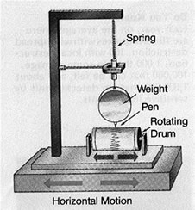
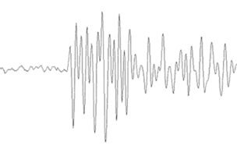
How do we measure Earthquakes?
Earthquakes are recorded by instruments called seismograph
The recording they make is called a seismogram

Slide 41
https://earthquake.usgs.gov/earthquakes/map/#%7B%22autoUpdate%22%3A%5B%22autoUpdate%22%5D%2C%22basemap%22%3A%22grayscale%22%2C%22feed%22%3A%221day_m25%22%2C%22listFormat%22%3A%22default%22%2C%22mapposition%22%3A%5B%5B-86.40197606876063%2C-168.046875%5D%2C%5B86.357579368499%2C567.421875%5D%5D%2C%22overlays%22%3A%5B%22plates%22%5D%2C%22restrictListToMap%22%3A%5B%22restrictListToMap%22%5D%2C%22search%22%3Anull%2C%22sort%22%3A%22newest%22%2C%22timezone%22%3A%22utc%22%2C%22viewModes%22%3A%5B%22list%22%2C%22map%22%5D%2C%22event%22%3Anull%7D

Slide 42
https://ed.ted.com/on/tAG67exm#watch

