Slide 1
Contraception
r. Johansen 2021

Slide 2
Detection of ovulation

Slide 3
Detection of ovulation
Rhythm method: based on calendar predictions of ovulation based on menstruation. Abstain from sexual intercourse 4 days before and after ovulation.
Temperature method: Based on body temperature. Ovulation is accompanied by a sharp drop in body temperature and then a rise. Safe for intercourse 3 days after temperature rise.
Mucus method: based on change in mucus secreted from cervix, as ovulation approaches mucus can be detected.
Symptothermal method: Uses a combination of the above methods to predict ovulation accurately.
75% effectiveness (25 pregnancies per 100 women)

Slide 4
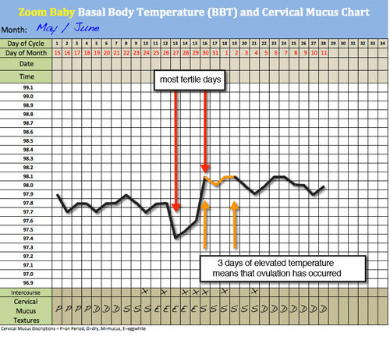

Slide 5
Natural methods

Slide 6
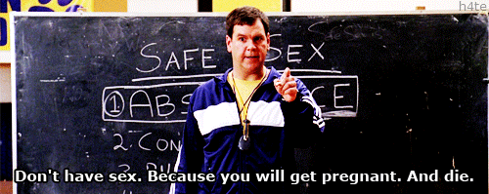
Natural methods
Abstinence: not having sexual intercourse. This is the only option that have no risks or either pregnancy or side-effects.
Lactational amenorrhoea: temporary infertility following the birth of a child. Female is fully breastfeeding and not menstruating. Affects production of hormones. 91-98% effective.
Coitus interruptus (withdrawal): removal of penis before ejaculation. Old method- very unreliable. 75-85% effective.
Obviously, not true!

Slide 7
Mechanical barriers

Slide 8
Mechanical barriers
Condom: prevents semen from entering the vagina. Effective if doesn’t tear or slip off. Protection against STIs. 75-85% effective.
Diaphragm: thin rubber cap fits across the top of the vagina. Normally used with spermicidal cream to increase effectiveness. 75-85% effective.
Cervical cap: fits directly over cervix. Prevent sperm from reaching ovaries, must remain for 6 hours after intercourse. 75-85% effective.
Femidom: lubricated polyurethane sheath that lines vagina. One closed ring fits over cervix, other sits over entrance of vagina. Protection against STIs. 75-85% effective.
Spermicide: used in conjunction with condom, diaphragm and cervical cap. Available in creams, tablets, aerosol foam. Immobolise and destroy sperm. Very unreliable when used alone. 75% effective.

Slide 9
Hormonal contraception

Slide 10
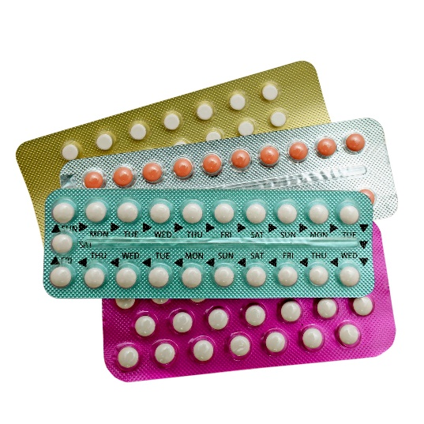
Hormonal contraception for women
Combined Pill: Prevents ovulation occurring. Synthetic oestrogen and progesterone. Cervical mucus becomes thick and sticky. Alter uterine lining to prevent implantation. Continue with menstruation. Not effective if missed or taken at different times of day. 91-98% effective.
Mini pill: Synthetic progesterone. Cervical mucus thick preventing sperm entering uterus. Alter uterine lining to prevent implantation. 91-98% effective.

Slide 11
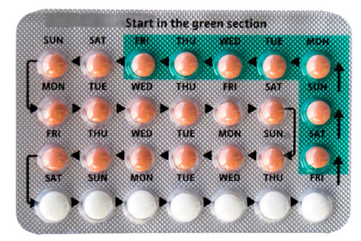

Slide 12
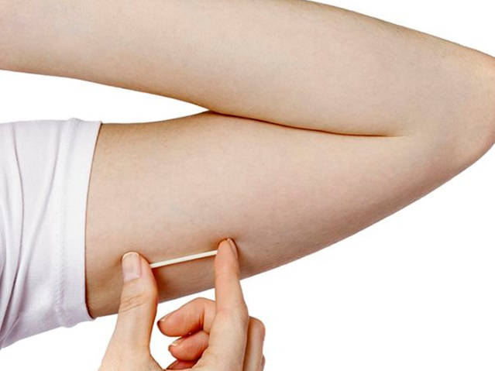
Hormonal contraception for women
Depo-Provera and Depo-Ralovera: forms of hormone injected. Lasts for 12 weeks, works similar way to mini pill. 91-98% effective.
Implanon: Synthetic progesterone. Under local anaesthetic implanon inserted into arm. Progestogen diffuses through capsule wall and provides contraception for 3 years. 99% effective
NuvaRing: Oestrogen and progesterone delivered by vaginal ring. Left in for 3 weeks and removed for 1 week. Prevent ovulation, cause cervix mucus to thicken, change in uterine lining to prevent implantation. 91-98% effective.
Side effects.

Slide 13
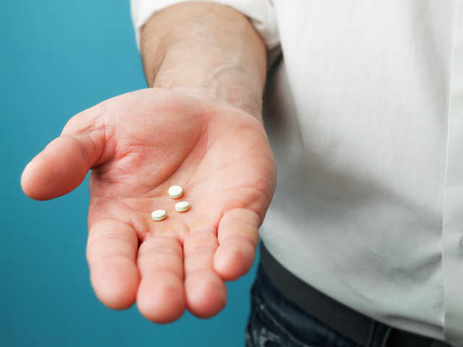
Hormonal contraception for males
Male hormonal pill: being developed. Implant and injection. Suppresses sperm production. Effectiveness still being tested.

Slide 14
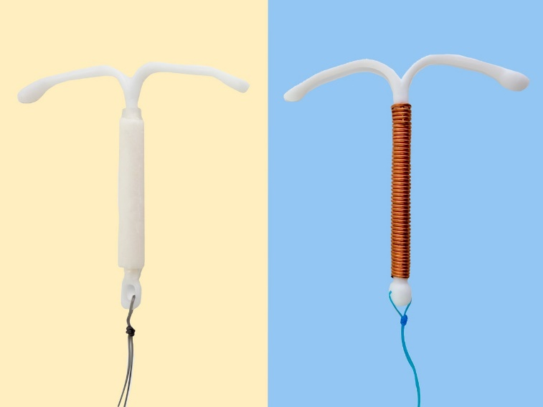
Intrauterine devices (IUD)
Small device made from plastic and often contain copper. Inserted into uterus. Slowly releases synthetic progesterone making endometrium thin and unsuitable for implantation. Thick mucus. Can prevent ovulation. Not felt by woman or partner. Threads allow for easy removal by doctor. Can provide between 5 & 10 years protection. 99 % effective. 2 main types:
Hormonal IUD(Mirena).
Copper IUD (can be used as emergency form of contraception up to 5 days after)

Slide 16
Emergency contraception

Slide 17
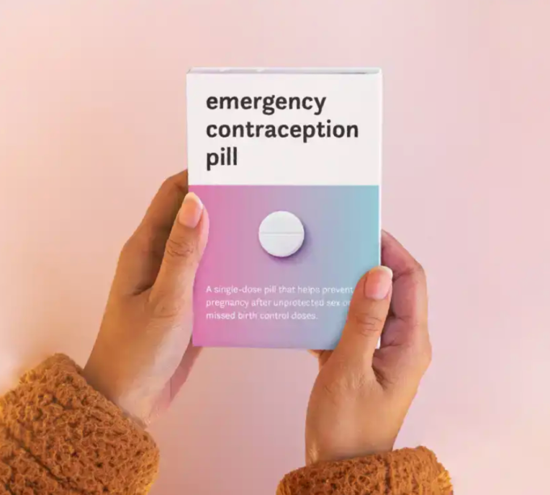
Emergency contraception
Morning after pill: 1 or 2 tablets of progesterone.
Available over the counter at pharmacy.
Can be taken 4 or 5 days after sex but is more effective when taken up to 72 hours after.
Prevents or delays ovulation, prevent sperm from reaching egg and prevent implantation of embryo.
Side effects: nausea, vomiting, head ache, dizziness.

Slide 18
STERALISATION

Slide 19
sterilisation
Permanent method of birth control. 99-100% effective.
Vasectomy (male): removal of piece of vas deferens.
Castration (male): removal of testes.
Oophorectomy (female): removal of the ovaries.
Hysterectomy (female): removal of the uterus.
Tubal ligation (female): removal of piece of uterine tube.
Essure (female): device consisting of inner wire inserted through cervix and uterus to entrance of uterine tubes. Uterine tubes grow around device.
For more information read page 343 of your text

Slide 20
How to choose a contraception method?

Slide 21
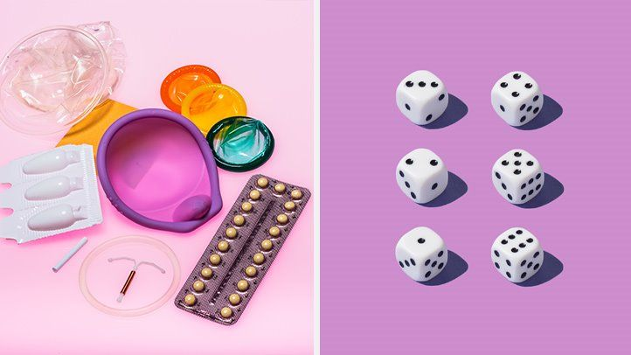
How to choose a contraception method?
There are many factors to take into consideration!
Reliability
Side-effects
Convenience
Cost
Availability
Permanence
Personal preference
Religious beliefs
Relationship status
Read the summary table on page 344 of your text!

Slide 22
Sexually transmitted infections

Slide 23
What are sti’s?
Sexually transmitted infections (STI’s) are infections that are transmitted by close body contact, usually with the genital organs.
They are caused by viruses, bacteria or fungi (pathogens).
Different STI’s can have varying symptoms, treatment and short/long term effects
Watch:
https://www.youtube.com/watch?v=vYtV_Hf29RE
https://www.youtube.com/watch?v=JFa1ggB37Rc

Slide 24
Use the text to complete the table…(page 346 – 355)
Infection | Symptoms | Long term effects | Prevention
Chlamydia
Genital Herpes
Genital Warts
HIV
Trichomoniasis
Pubic Lice and Scabies
Gonorrheoa
Syphilis

