Slide 1
Heat
R. Johansen

Slide 2
What is heat?
We have learnt that heat is a form of energy!
We can also refer to heat as THERMAL ENERGY
All energy can be TRANSFERRED and TRANSFORMED (CONVERTED)

Slide 3
Particle theory of matter
We know that the physical world is made up of particles.
We can explain the process of heating using the KINETIC THEORY OF MATTER.
This theory has 4 assumptions:
All matter is made up of particles
The particles are constantly moving
The particles are attracted to each other when they get close enough
The particles have elastic collisions

Slide 4
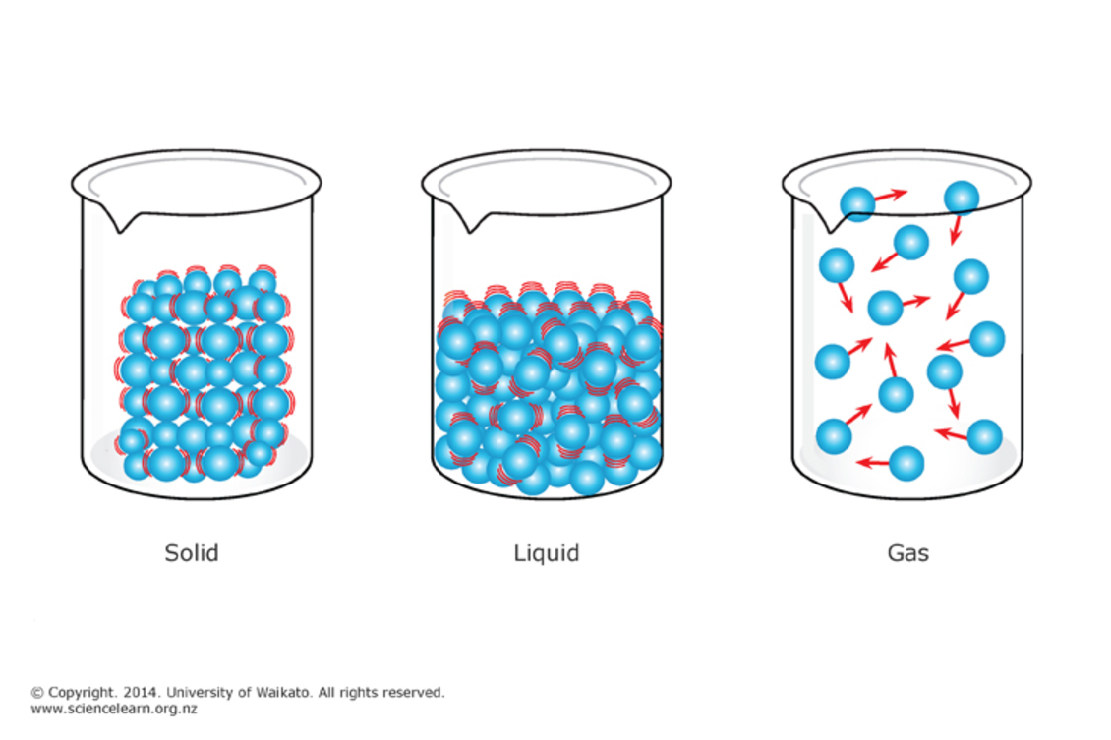

Slide 5
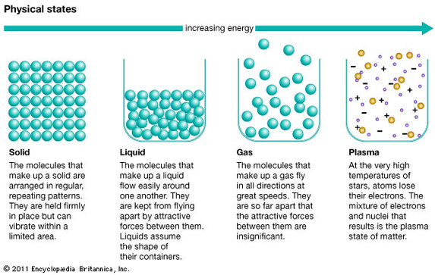

Slide 6
Temperature
Temperature is measurement we take to see how much kinetic energy particles have
The units used to measure temperature are Kelvin, Celsius and Fahrenheit
High temperatures = particles move fast
Low temperatures = particles move slow
At the temperature absolute zero the amount of thermal energy is also zero

Slide 7
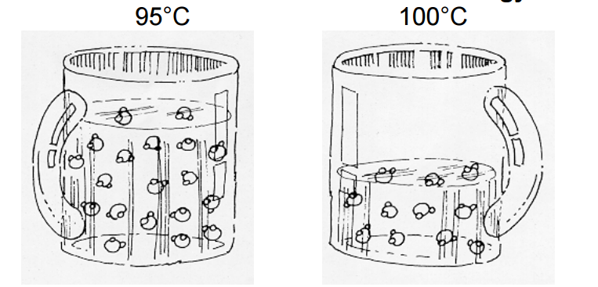
Thermal energy
Thermal energy is the total kinetic energy of all particles in a material
More molecules = more thermal energy
Which cup of tea has more thermal energy?

Slide 8
Thermal energy
Question…..
A lake has a water temperature of 1 degree Celsius
A cup of boiled water has a temperature of 95 degrees Celsius
The mug is placed next to the lake on a below freezing day (- temperature)
Which freezes first? The lake or the mug of water?

Slide 9
Temperature and thermal energy
What is the difference between Temperature and Thermal Energy?
• Thermal energy is not a directly measurable quantity whereas temperature is a measurable quantity.
• The temperature of an object can take negative values depending on the unit system used to measure the temperature, but the thermal energy of a system cannot be negative.
• Temperature is measured in Kelvin whereas thermal energy is measured in Joule.
• An object can lose or gain thermal energy in a state transition without changing the temperature of the system.

Slide 10
Watch
https://www.youtube.com/watch?v=AqDsAVPjgS4

Slide 11
Thermal equilibrium
Lets say we have a bath full of room temperature water.
We then add some hot stones to the bath.
Thermal energy is transferred from the stones to the water. This is known as a heat transfer.
During heat transfer cold objects gain heat and hot objects lose heat.
The water will continue to gain heat and the stones will continue to lose heat until both the stones and the water are the same temperature.
When two objects reach the same temperature they are said to be at thermal equilibrium

Slide 12
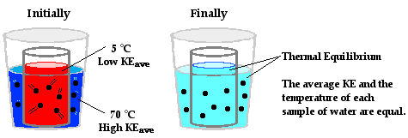

Slide 13
Activities
Oxford Textbook
Page 97 - Compete ‘Check your learning’ questions 1- 5 in exercise book

Slide 14
Heat transfer
All energy can be TRANSFERRED and TRANSFORMED
Objects with a higher temperature TRANSFER heat to objects at lower temperatures
Thermal energy can be TRANSFERRED through objects or to other objects in three (3) ways:
- Conduction
- Convection
- Radiation

Slide 15
Conduction
Heat transfer by direct collision of particles
Occurs mainly in solids
The rate of transfer will depend on the type of materials:
- Thermal Insulators
- Thermal Conductors
Can you think of some thermal insulators/conductors?

Slide 16
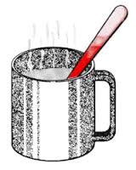
Conduction
Discussion Question:
Why does a spoon feel hot to touch if we have left it in a hot cup of tea too long?
Did the part of the spoon that we touched come in contact with the original heat source (hot water)?

Slide 17
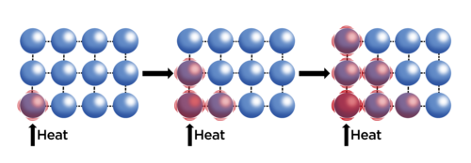
Conduction – what happens to the particles?
The particles closest to the heat source start to vibrate more rapidly (they gain kinetic energy)
This movement of the particles causes collisions with the particles next to them
A chain reaction occurs and all the particles start to move faster (gaining kinetic energy)

Slide 18
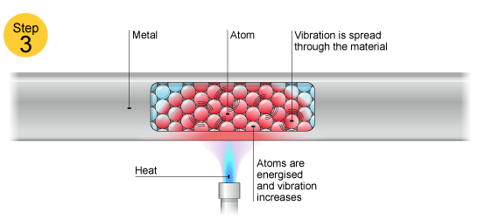
Conduction – what happens to the particles?

Slide 19
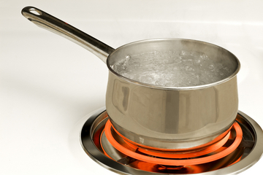
Conduction
Can you think of everyday examples where conduction is used for heat transfer?

Slide 20
Watch
https://www.youtube.com/watch?v=w_IbPRNZ6ho

Slide 21
do
Complete HEAT CONDUCTION Practical activity
Record your observations in your exercise book
Answer the ‘Check it Out’ questions in your exercise book

Slide 22
Read
Oxford Textbook
Page 98
(Take down notes in your exercise book)

Slide 23
Convection
Transfer of heat by movement of particles
Occurs in fluids (liquids and gases)
Hot fluids rise due to expansion. The particles taking up more volume due to the additional kinetic energy and space between particles
Cold fluids fall. The particles are losing kinetic energy and therefore volume is reduced as the space between the particles reduces
This rising and falling of particles can be called a convection current

Slide 24
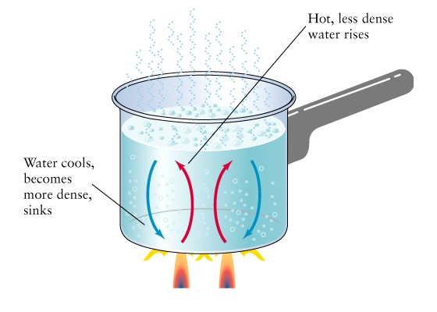

Slide 25
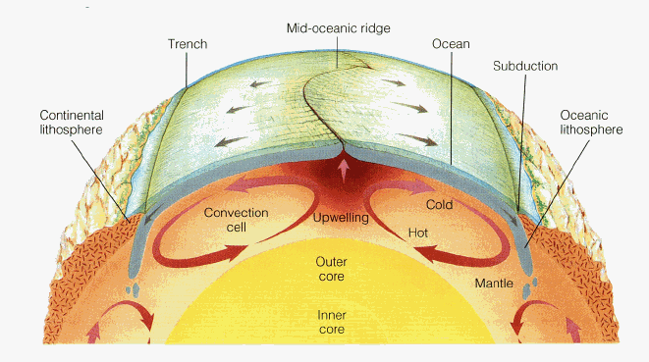
Convection
Can you think of some examples of convection currents??
What items used around the home use the process of convection for heat transfer?

Slide 26
Watch
https://www.youtube.com/watch?v=v62ilJCaMFk

Slide 27
Do
Complete HEAT CONVECTION Practical activity
Record your observations in your exercise book
Answer the ‘Check it Out’ questions in your exercise book

Slide 28
Read
Oxford Textbook
Page 99
(Take down notes in your exercise book)

Slide 29
Activities
Oxford Textbook
Page 99 - Compete ‘Check your learning’ questions 1- 5 in exercise book

Slide 30
Radiation
Heat is transferred using infrared rays
Infrared radiation is not hot until it is absorbed by an object which converts it to increased kinetic energy of particles
Does not involve the transfer of matter
Rate of infrared radiation depends on colour and texture of objects
The sun is a source of the Earth’s heat by radiation

Slide 31
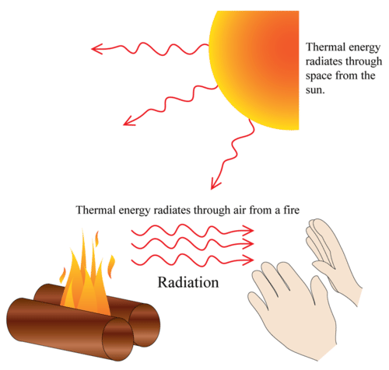

Slide 32
DO
Complete HEAT RADIATION Practical activity
Record your observations in your exercise book
Answer the ‘Check it Out’ questions in your exercise book

Slide 33
Read
Oxford Textbook
Page 100-101

Slide 34
Activities
Oxford Textbook
Page 101 - Complete ‘Check your learning’ questions 1- 5

Slide 35
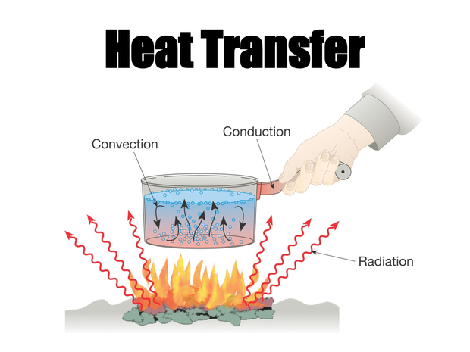

Slide 36
REVIEW
Complete 4.1 Unit Review Questions Handout
Write the answers to your questions in your exercise book

