Slide 1
Agricultural Revolution
In the Industrial Revolution

Slide 2
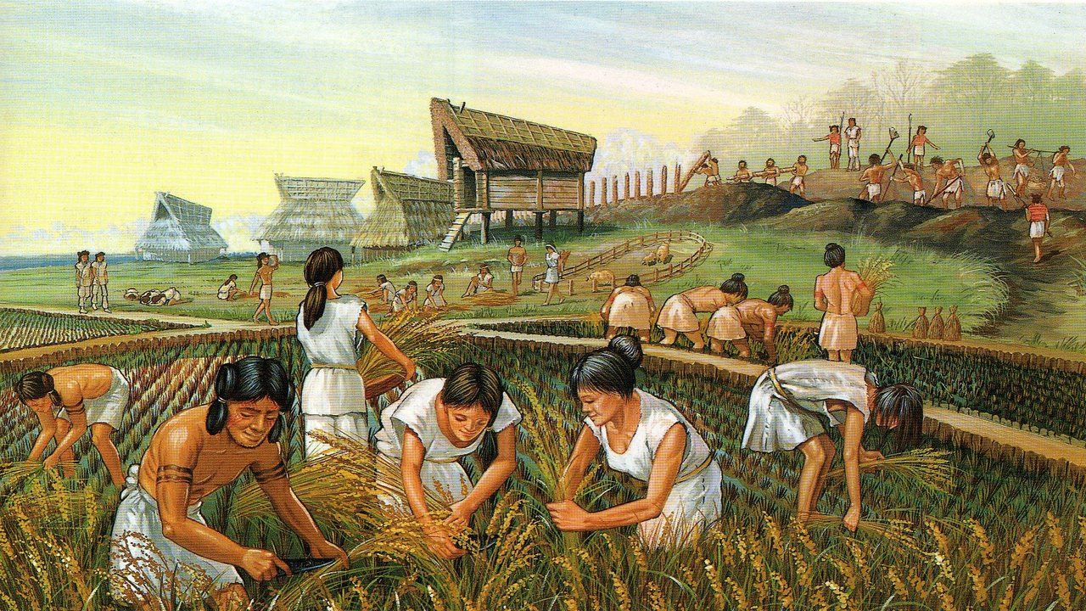
Notes:
Textile: Cloth/woven material. Fleece, cotton, Linen

Slide 5
Industrial Revolution
5th Century →15th C: Medieval Ages
15th C → 1750: Early Modern Period
1750 → current: Modern Period

Slide 6
Industrial Revolution Overview
For about 1000 years during the Middle Ages, technology and lifestyles did not change significantly
In Britain, during the 18th & 19th C's, great technological changes were made and implemented into society.
These changes completely reshaped the way in which food, clothing and other necessities were produced.
Notes:
To observers the nature and speed of the changes around them were ‘revolutionary’ because they brought about radical
changes in the way many people lived.

Slide 7
Industrial Revolution Overview
New materials and sources of power, along with new forms of transport, transformed their society
Britain provided an inspiration for the other countries of Europe and North America, which soon experienced industrial revolutions of their own.
In more recent times, countries such as China and India are making their own transitions to modern industrialised nations.

Slide 8
Agricultural Revolution
At the time of the Industrial Revolution, major changes took place in farming practices.
Increase in farm production provided food for a growing population, especially an urban one.
Increasing automation freed people from farms to work in factories

Slide 9
Why was so much food necessary?
How do we measure a nations population?
Through a census
British Population Growth
1761 | 6 146 000
1781 | 7 042 000
1801 | 8 893 000
1821 | 12 000 000
1841 | 15 914 000
1861 | 20 066 000
1881 | 25 974 000
Notes:
Images are important for storage recall. Think of elephant. You likely imagined a picture, not imagined the word. We think in pictures

Slide 10
British Population

