Slide 1
Investigating Skills
Year 9

Slide 2
So many questions….
Scientists conduct experiments to solve problems, answer questions and prove theories.
Experiments need to be conducted in a certain way to ensure that results are valid and reliable

Slide 3
What is the question?
Scientists star off with a question… this question is the aim of the experiment!
Some examples include:
To determine if type of soil effects plant growth
To see if taller people have more mass
To find out whether boys are fitter than girls
To see if studying for longer periods of time helps you receive better marks

Slide 4
Variables
Variables are the different factors that will influence your experiment.
Once you know what you want to test (you have an aim), you need to consider the factors that will influence your results
We control our variables to ensure we have a valid test

Slide 5
Variables
There are 3 types of variables we need to consider:
Independent Variable
Dependent Variable
Controlled Variables

Slide 6
Independent Variable
This is the variable we want to test
Changing this variable will influence the measurements you receive for the dependent variable
In other words, the changes we make to the independent variable will effect the dependant variable

Slide 7
Dependent Variable
This is the variable we want to measure
The measurements will change (or are dependent on)the independent variable

Slide 8
Identifying Variables
With 2 different coloured highlighters, identify (highlight) the independent and dependent variable for each aim…..
To determine if type of soil effects plant growth
To see if taller people have more mass
To find out whether boys are fitter than girls
To see if studying for longer periods of time helps you receive better marks

Slide 9
Identifying Variables
Independent variable
Dependent variable
To determine if type of soil effects plant growth
To see if taller people have more mass
To find out whether boys are fitter than girls
To see if studying for longer periods of time helps you receive better marks

Slide 10
Controlled Variables
Controlled variables are any variables that may influence the measurements you receive for the dependent variable
These are things you are not looking at testing now
You must keep these variables the same

Slide 11
Controlled Variables
For the aim below, list 2 variables that you may need to control:
To determine if type of soil effects plant growth
Think about what other factors may effect plant growth, other than soil type…..

Slide 12
Controlled Variables
Some examples may include:
Amount of water given to plants
Type of plants testing
Amount of sunlight available to plants

Slide 13
Writing a Hypothesis
This is a testable statement based on your aim and prediction
You must be specific about the effect you think the independent variable will have on the dependent variable….
For example:
Plants grown in potting mix will grow taller than plants grown in sand

Slide 14
Writing a Hypothesis
Now you try and write a hypothesis based on the following aim (note the I.V and D.V):
To see if taller people have more mass

Slide 15
Writing a Hypothesis
To see if taller people have more mass
Taller people will weigh more than short people
Taller people will weigh less than short people

Slide 16
Recording Results
After conducting an experiment you will record your results in a table
Tables must be drawn using a ruler and a pencil

Slide 17
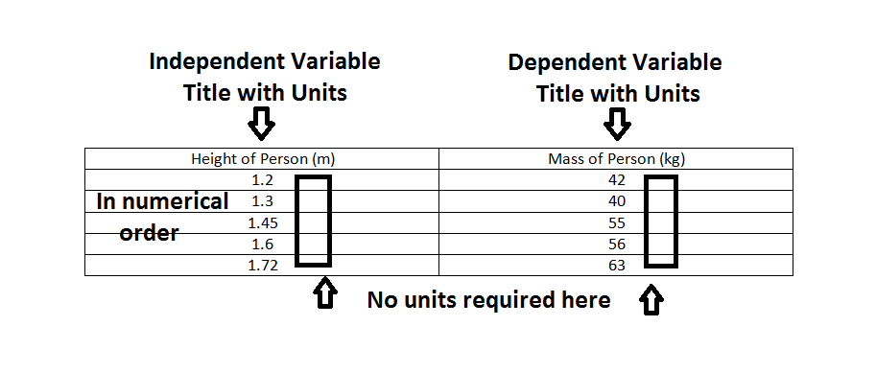
Results Tables

Slide 18
Graphing
Now that you have your results in a table, you must now draw a graph
There are 2 types of graphs:
Bar Graph (discrete data)
Line Graph (continuous data) *

Slide 19
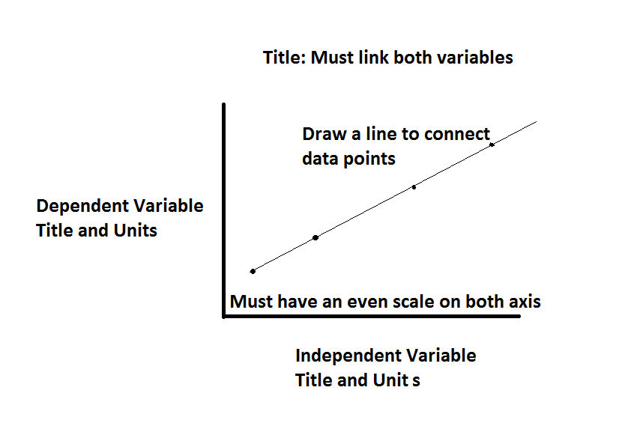
Graphing

Slide 20
Analysing a Graph
Describe the graph using words
Always include specific data points to support your answer
Usually needed to discuss 2 things:
What is the relationship between the Independent and Dependent variable (what does the whole line tell us)?
Are there any patterns or trends within the line?

Slide 21
Evaluating the Experiment
This is the part where we assess whether we conducted a fair test.
We must assess 2 aspects of our experiment:
Validity
Reliability

Slide 22
Validity
Here we are assessing whether it was the independent variable that caused the change on the dependent variable or whether there were other factors that caused change
To do this we discuss how well we controlled our variables
V for Validity……V for Variables

Slide 23
Reliability
Here we are assessing whether our results can be replicated
Some ways we can increase reliability:
Conduct the test multiple times in one experiment and find an average
Repeat the experiment more than once
Increase the sample size
R for Reliability…. R for Repeatability

