Slide 1
New Generations
Part 2

Slide 2
Lets review inheritance….
Incomplete dominance
This occurs when offspring show intermediate characteristics to those of their parents.
Can also be referred to as ‘blending’
No gene is dominant to another
In this case the genotypes of both pure – bred phenotypes is represented by capital letters
E.g. YY (Yellow coat) WW (White coat)
YW (Cream Coat)

Slide 3
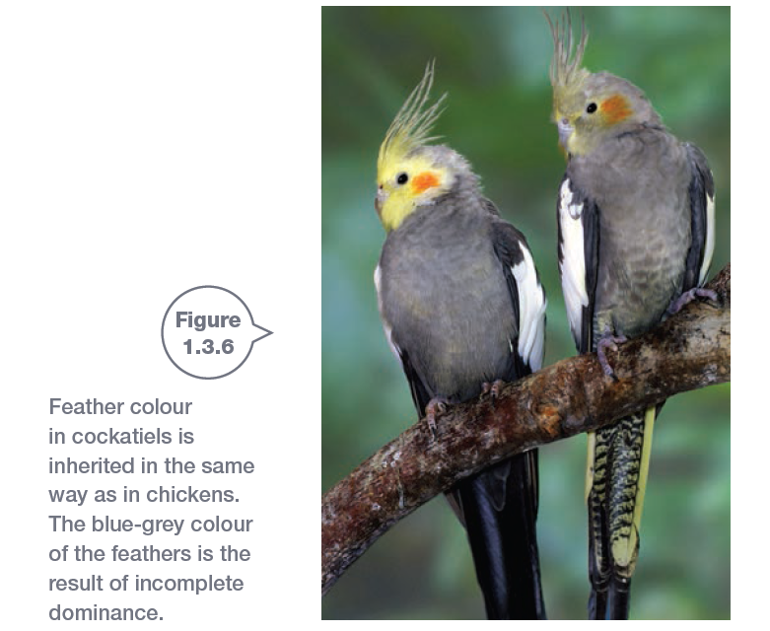

Slide 4
Lets review inheritance….
Co – Dominance
Pure bred parents produce offspring that show characteristics of both parents
E.g. A male bull with a pure – bred red coat mates with a female cow with a pure – bred white coat. The offspring have a coat showing patches of red and white. (Roan Coat)

Slide 5
Lets review inheritance….
Dominant – Recessive
One gene is dominant and the other is recessive. If the dominant gene is present it ‘hides’ the effect of the recessive gene.
Strong gene is ‘Dominant’ and represented by a capital letter
Weak gene is ‘Recessive’ and represented by a lowercase letter
E.g. Mendel's peas

Slide 6
Homework Task
You are to examine the phenotypes of your family members….
Using a family picture you task is to identify the features that are common, and the features that are different between your family members
Determine which characteristics might be dominant and which might be recessive
This can be done in dot points
If possible please include a copy of the photo (not the original)
Due next lesson

Slide 7
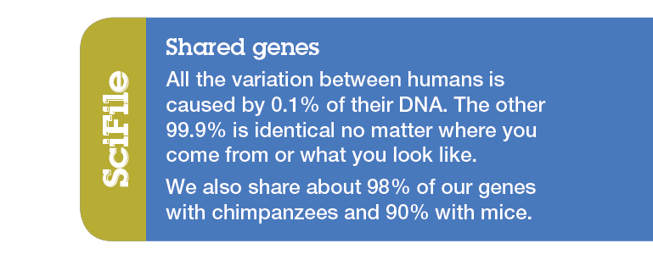

Slide 8
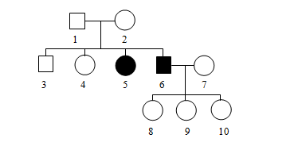
Pedigree Charts
Squares represent males
Circles represent females
These lines represent mating
These lines represent offspring

Slide 9
Pedigree Charts
http://www.youtube.com/watch?v=Wuk0W10EveU

Slide 10
Sex determination
We know that in order to be a male you need to have a Y chromosome.
This means that females have 2 X chromosomes and males have 1 X and 1 Y chromosome
The male determines the sex of the offspring depending on whether the sperm that fertilises the egg is carrying an X or Y chromosome

Slide 11
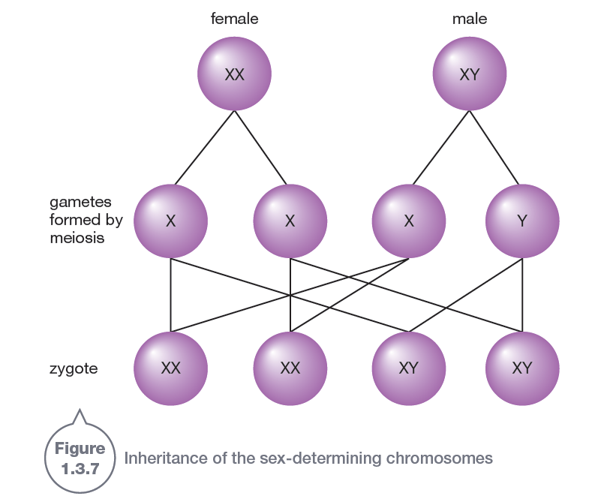

Slide 12
Sex determination punnet square
X
Y
X
X
X
X
Y
1:1 Males to Females
50% Chance
X
X
X
X
Y

Slide 13
Karyotype
The karyotype is the number and appearance of chromosomes in the nucleus of a cell
Normal cells have 22 pairs of body chromosomes and 1 pair of sex chromosomes

Slide 14
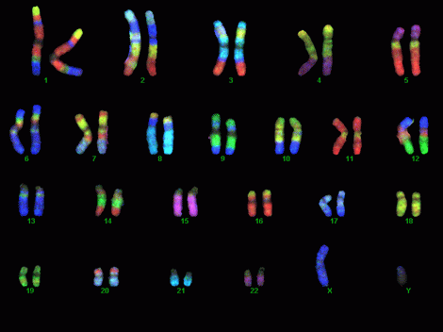

Slide 15
Sex linked inheritance
Parents pass on traits such as eye and hair colour through their genes
Genetic diseases are passed to offspring via their parents
Genetic disorders are usually (not always) recessive

Slide 16
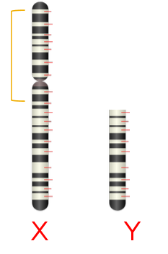
Sex linked inheritance
Some diseases appear on the X chromosome only
Colour blindness
Haemophilia
Duchene Muscular Dystrophy

Slide 17
Sex linked inheritance
Males who receive this gene from their mother have that particular disease
Females however can either have the disease or be a carrier (as they also receive an X chromosome from their father)
Lets take a closer look……

Slide 18
Worked example
If an affected male has a child with a normal female, what are the chances the child will be affected?

Slide 19
Worked example
If an affected male has a child with a normal female, what are the chances the child will be affected?
X _{a}
Y
X
X _{a}
X
X
Y
0% Chance
X
X _{a}
X
X
Y

Slide 20
Worked example
If an affected male has a child with a carrier female, what are the chances their child will be affected?

Slide 21
Worked example
If an affected male has a child with a carrier female, what are the chances their child will be affected?
X _{a}
Y
X
X _{a}
X
X
Y
50 % Chance
Half the females will be carriers
X _{a}
X _{a}
X _{a}
X _{a}
Y

Slide 22
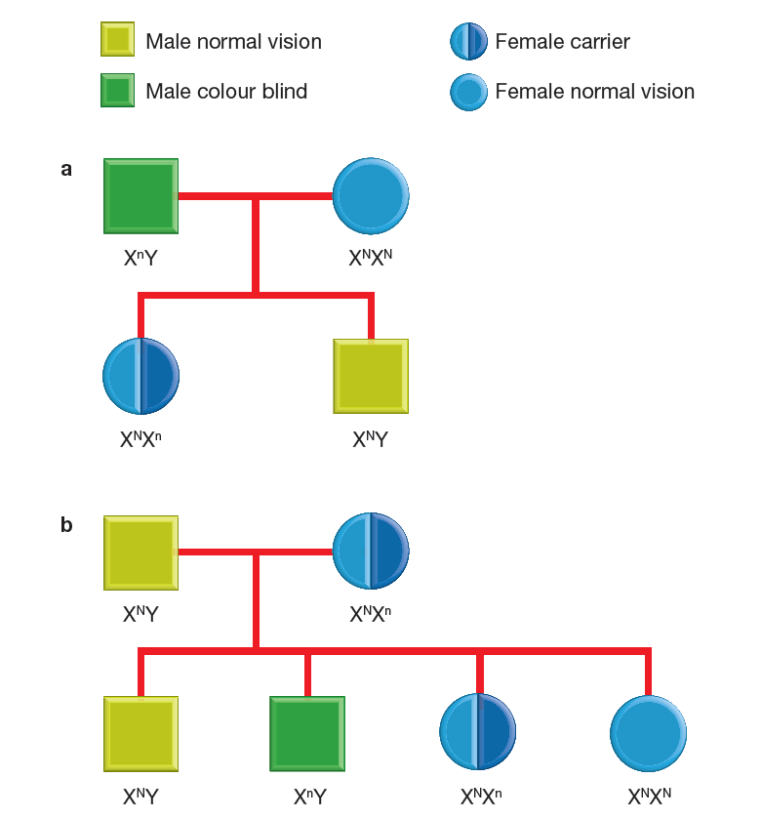
A pedigree chart can be used to show sex linked diseases
Subscripts are used to show which genes the chromosomes carry

Slide 23
Research Task
Your task is to research a sex linked disease. You may choose from: Colour blindness, Haemophilia or Duchene Muscular Dystrophy
You must find out:
How common is the disease?
What are the symptoms?
How is it managed?

Slide 24
Sex linked inheritance vs. Genetic Disorders
We have just learnt about how diseases can be sex linked and are inherited from ones parents.
Now we will learnt about genetic disorders and how they occur.....

Slide 25
Genetic Disorders
Genetic disorders occur when a mistake is make during the process of meiosis
We know that meiosis is the process of cell division that is necessary for the production of gametes (sperm and eggs).
Gametes have half the number of chromosomes as the original cell (haploid)

Slide 26
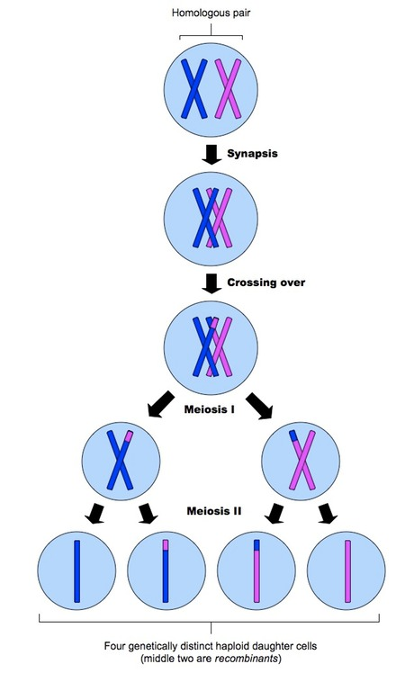
Meiosis (normal)
During the crossover genetic information is exchanged. This results in the daughter cells (gametes) having different sets of alleles and genes to their parents.

Slide 27
Meiosis Mistakes
Sometimes the process of meiosis does not go as smoothly as planned.
These mistakes cause the genetic information of the offspring to be changed, resulting in genetic disorders.
Offspring with genetic disorders have unique karotypes

Slide 29
How do genetic disorders come about?
There are 3 mistakes during the process of meiosis that can cause a genetic disorder...
1. Too many/few sex chromosomes
2. Too many body chromosomes
3. Gene mutation

Slide 30
Mistake 1: Too many sex chromosomes
If the chromatids fail to separate during meiosis a child may be born with an extra chromosome
An egg with too many X chromosomes is fertilised by a normal sperm
This is called Klinefelters Syndrome (KS)
KS only affects males
Men with KS receive and extra X chromosome
Also known as XXY syndrome

Slide 31
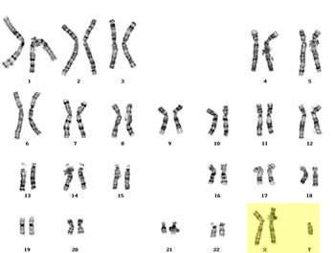
Karotype of Klinefelters syndrome

Slide 32
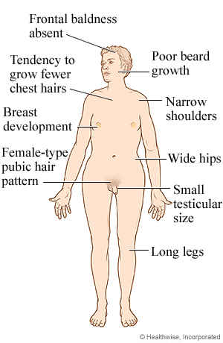
Klinefelters syndrome symptoms

Slide 33
Mistake 1: Too may chromosomes - Triple X syndrome
Whilst Klinefelters syndrome can only affect males (XXY), female offspring can be affected by Triple X syndrome (XXX)
Unlike most other chromosomal conditions there is usually no distinguishable difference to the naked eye between women with triple X and the rest of the female population

Slide 34
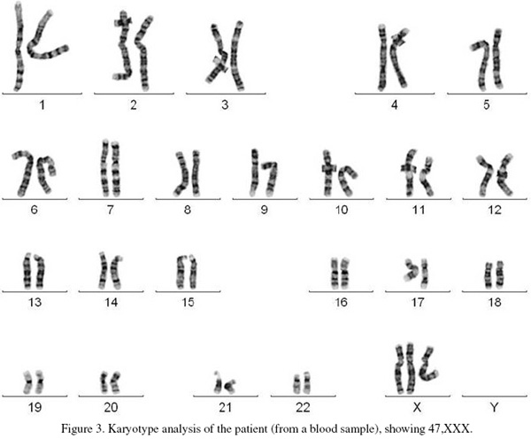
Triple X Karotype

Slide 35
Mistake 1: Too few sex chromosomes
Turners syndrome (TS) is the opposite of Klinefelters syndrome
It occurs in females only
Females with TS only receive one X chromosome

Slide 36
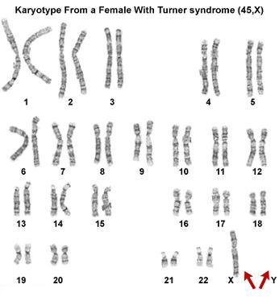
Karotype of Turners Syndrome

Slide 37
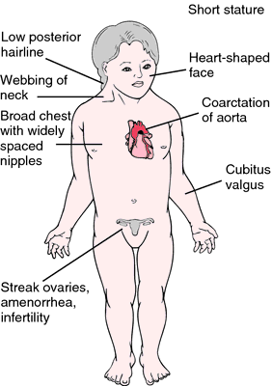
Turners Syndrome Symptoms

Slide 38
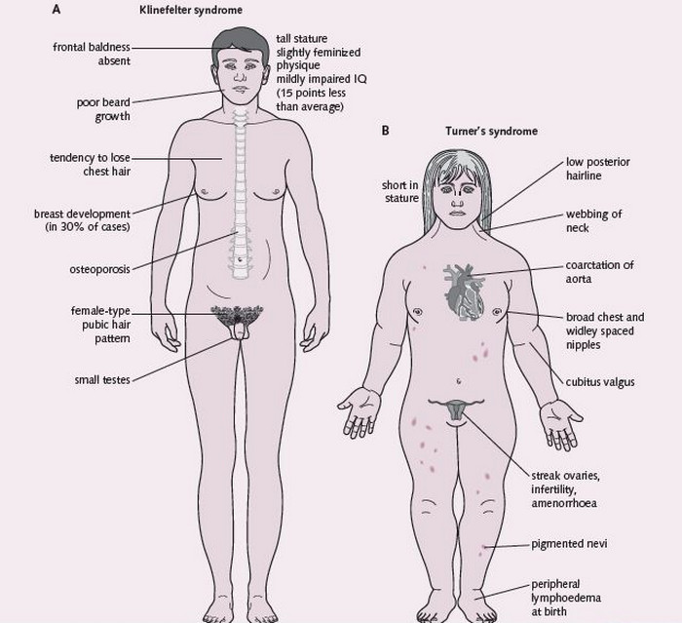
Comparison of Klinefelters syndrome and Turners syndrome

Slide 39
Mistake 2: Too many body chromosomes
Sometimes when gametes are formed during meiosis the chromosomes fail to separate. This results in the gamete receiving 24 chromosomes instead of 23
When the egg is fertilised by sperm) the child receives 47 chromosomes instead of the normal 46
Children with this disorder are known to have Down Syndrome
75% of the time the egg has extra chromosomes. 25% of the time it is the sperm

Slide 40
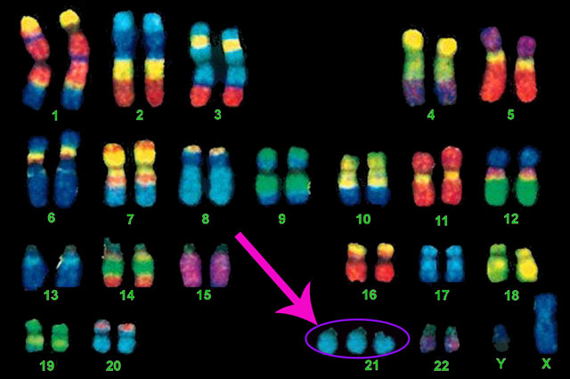
Down Syndrome Karotype
Down Syndrome is also referred to as Trisomy 21

Slide 41
Mistake 3: Gene Mutation
Mutations are changes in DNA or chromosomes
Mutations occur when the DNA is copied
Mutations can occur spontaneously or be as a result of damaged DNA.
Some examples of environmental causes of mutations are: UV radiation, nuclear radiation and certain chemicals such as nicotine or asbestos
Once a gene is changed, the change is permanent. This is then passed from parent to offspring as normal genes are

Slide 42
Gene Mutations
We know that DNA is a specific sequence of bases (A, C, T, G)
These bases work together in groups of 3
For example: ATG CTA GCT GAG CTA GTC GAC TGA CTA
We can also think of it as 3 letter words: the sun was hot but the old man did not get his hat
What happens if the sequence in changed by deleting one letter?
Hes unw ash otb utt heo ldm nad idn otg eth ish at
The sentence does not appear as it used to as it has been altered...

Slide 43
Common mutations
Some common mutations include:
Short legged sheep
Hornless cattle
Albinism
Seedless grapes and oranges
Haemophilia
Tail – less cats

Slide 44
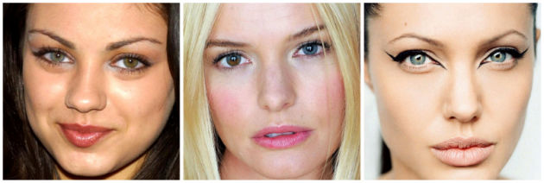
Mila Kunis, Kate Bosworth, Angelina Jolie - Heterochromia

Slide 45
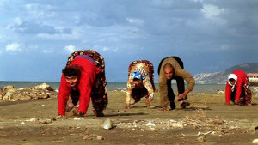
Uner Tan Syndrome

Slide 46
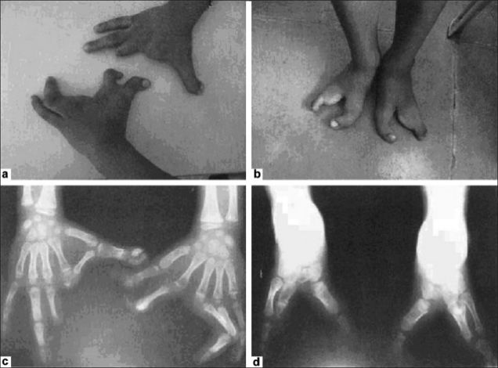
Ectrodactyly – lobster claw syndrome

Slide 47
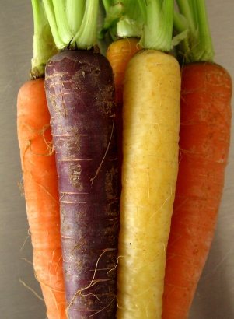
Purple carrots

Slide 48
Mutations – Good or Bad?
Some gene mutations can be good or bad
It depends on the gene that has been mutated
Can you think of any mutations that might be negative? (Write these in your notes)
Can you think of any mutations that might be positive?(Write these in your notes)

Slide 49
New Generations Booklet
Read through pages 50 – 51 to learn more about mutations and Agent Orange
Homework: Complete the questions on page 52 on Agent Orange

Slide 50
NATURAL SELECTION

Slide 51
What is natural selection?
Natural selection is the evolution of species due to beneficial alleles being passed to future generations. Environmental factors play an important role in natural selection.
Genetic variation describes the differences in alleles within a population
For example: different coat colours
Genetic variations allow natural selection to occur

Slide 52
Adaptations
Adaptations are changes in a species over a period of time which can help the organism to survive. Adaptations occur over generations due to mutations. There are 3 types of adaptations:
Structural – Physical features of the organism
Behavioural – How the organism acts
Physiological – How the internal systems of the body respond to stimulus

Slide 53
What type of adaptation?
Kangaroo has a long thick tail
Elephants dilate blood vessels in their ears when they are hot
Birds migrate at various times of the year
Snails retract into their shells
Spiders produce venom which is injected into their prey
Polar bears have white fur

Slide 54
Natural Selection and environmental factors
The environmental facts that acts on the population is called the ‘selective pressure’
Selective pressures select adaptations that help an organism survive in its environment
The selective pressure may be biotic (living) such as predation, bacterial infection or competition
Or it may be abiotic (physical) such as temperature, water, fire or soil nutrients
Those species which are not affected by this pressure breed and pass on their favourable genes to the future generations

Slide 55
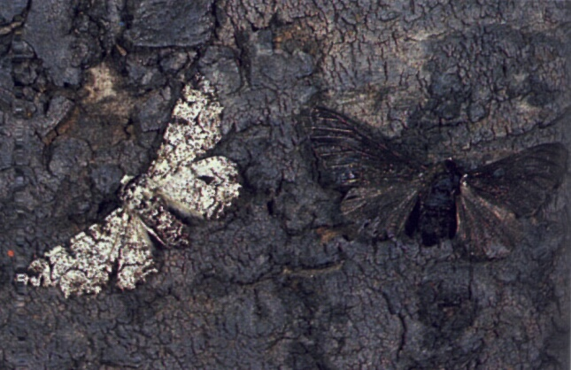
Peppered Moth
How many moths can you see here?
Which moth do you think would best survive predation and why?

Slide 56
Peppered moth
The peppered moth is a classic example of natural selection
The selective pressure in this case was predation
Light coloured pepper moths were abundant over 200 years ago. These moths camouflaged with the light coloured bark on the trees
During the industrial revolution the huge increase in pollution cause the bark of the trees to darken
The lighter coloured moths were no longer camouflaged and begin to become victims of predation
The darker coloured moths which were less abundant at the time began to increase their population as they were able to avoid predation
Light coloured pepper moths were abundant in the country side
Dark coloured pepper moths were abundant in the urban areas

Slide 57
Lets play a game...

Slide 58
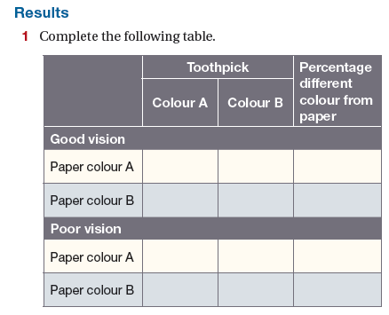

Slide 59
Natural Selection
Many selective agents act by killing individuals. These individuals are seen as ‘less fit’
For example: the slowest runner in a herd of sheep
However not all selective agents act by killing.
Charles Darwin called this ‘sexual selection’. This is because often females will select the brightest and most beautiful male to mate with. The offspring will therefore have similar genes and most likely have a higher chance of producing more offspring.

Slide 60
Variation
Darwin discovered that natural selection could only occur if their was genetic variation (natural differences) within a population
Variation is a difference in genes, which results in difference in characteristics
The difference in genes allows species carrying a particular trait to be more ‘fit’ in varying conditions

Slide 61
Focus Question
What would happen if all individuals in a population contained the same identical genetic makeup?
What would happen if a disease affected this population?

Slide 62
Selective Breeding Methods
Whilst we have learnt that for wild populations genetic diversity is important for species survival, there are some circumstances where selective breeding has been employed
Can we think of an example where this is the case?

Slide 63
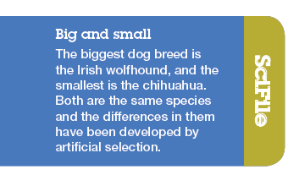
Selective Breeding Methods
Domestic dogs and cats are all one species...

Slide 64
Selective Breeding Methods
There are 2 main ways selective breeding can occur:
1. Cross breeding
The process of combining the desirable feature of two individuals
2. Inbreeding
The process of related individuals mating. This is not commonly done as it can result in genetic deformities and disease

Slide 65
Selective Breeding Methods

Slide 66
New Generations
Complete activity 25 in your New Generation booklet (page 54)

Slide 67
Resistance to disease
As we have seen from the ‘breeding like rabbits’ exercise species can become resistant to diseases
Can we think of any other examples of resistance?

Slide 68
Case study - Insects and insecticides
Insecticides have been used quite readily for the past century
At first these appeared to work well, however over time farmers and scientists found that the effectiveness of the insecticides was decreasing.
Farmers resulted to increasing the concentration of these insecticides
The found that some, but not all the insects died
Eventually the insecticides had no effect on the insect populations
How is this the case?

Slide 69
Case study - Insects and insecticides
This is a classic example of natural selection
Every time the farmers sprayed, there would be a larger portion of insects who survived. This meant they were able to pass on the desired gene which was resistant to the insecticide.

Slide 70
Bacteria and Antibiotics
Similar to the insect scenario, bacteria can become immune to antibiotics via natural selection
Bacteria reproduce asexually – by making an identical copy of itself
If we have an infection we often take antibiotics to kill the bacteria in our body that is making us sick
Often some of the bacteria will be resistant to the antibiotic. This bacteria will remain in your body and will reproduce. As the offspring are identical to the parent cell they will also be resistant to the medication

Slide 71
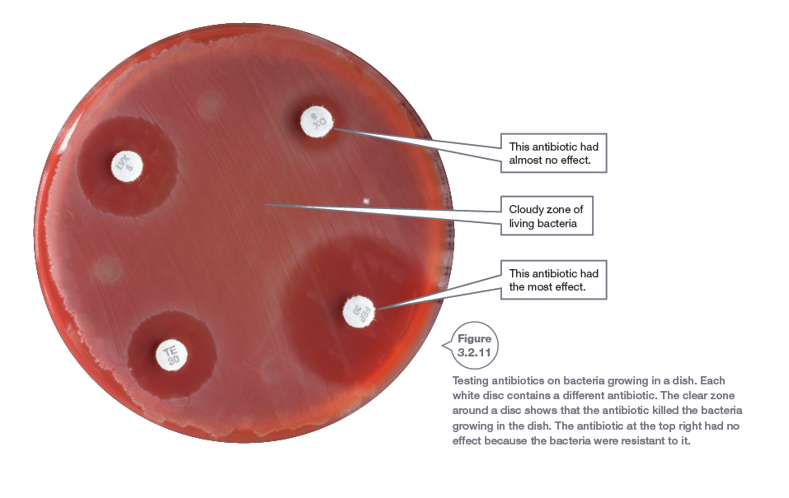
Bacteria and Antibiotics

Slide 72
Evolution
Charles Darwin proposed that new species could occur as a result of natural selection
The theory of evolution states that similar species must be closely related to each other. For example: Primates and humans
Darwin studied finches on the Galapagos Islands and found that the finches on different islands had different beaks…… how could this be???

Slide 73
Speciation
Speciation is the process where one species separates into two or more separate species
Speciation is responsible for the high biodiversity around the earth
Biodiversity is the number and range of different species that exist around the world
Did you know: the South West of Australia is the only biodiversity hotspot in Australia!!

Slide 74
Speciation
The are 3 main factors required for speciation (and therefore evolution) to occur:
1. Variation (Difference in genes)
2. Isolation
3. Selection

Slide 75
Isolation
Isolation as the name suggests is simply where a group of the same species are separated by one another
This causes a change in the genetic makeup of those species and new species evolve over time
The main causes of isolation are geographical (oceans, rivers, deserts, mountains) or climatic (Rainfall, temperature, salinity, sunlight)

Slide 76
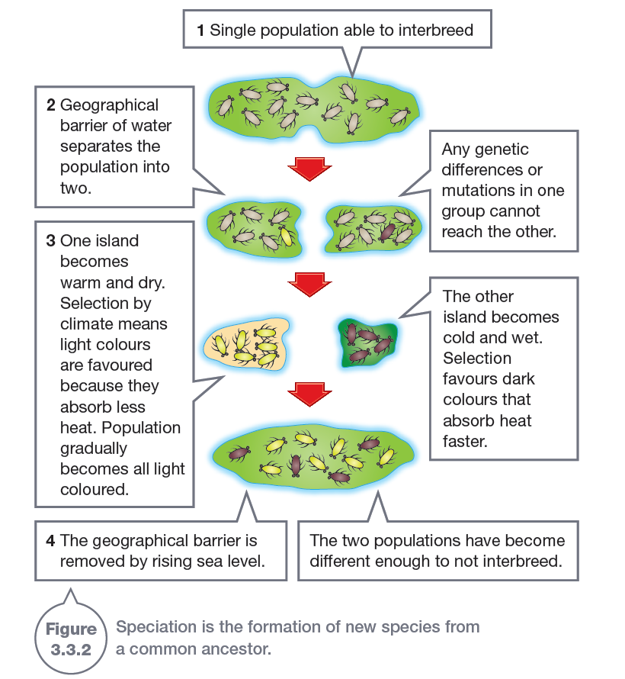
Isolation

Slide 77
Selection
Selection is all about mating
Once a species is separated by a barrier (geographical or climatic) changes in the selection processes can occur. Such as:
1. Courtship Behaviour
2. Breeding Seasons
3. Sterility (Mule)
4. Chemical Barriers (Sperm killed by chemical makeup of females)

Slide 78
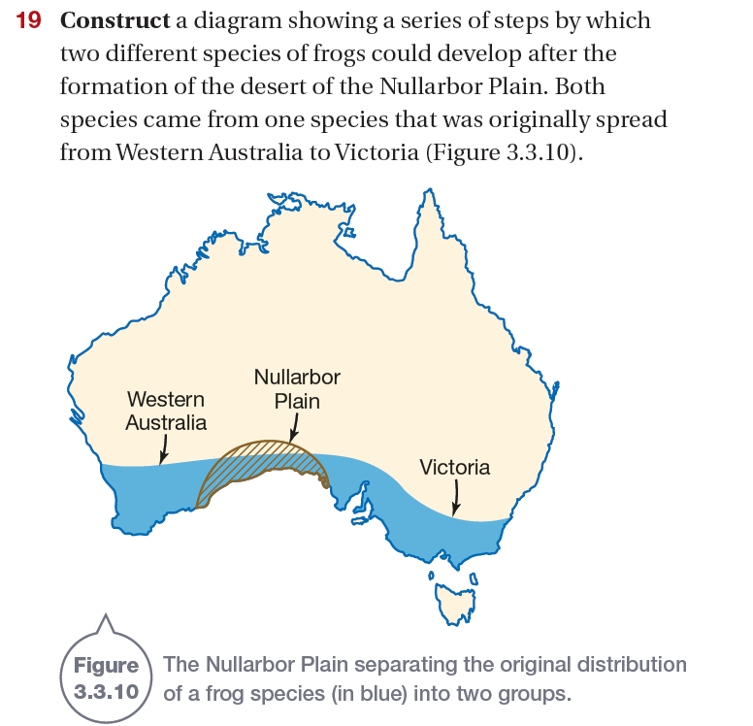
Worked example
The frogs within the original population had variation in there genes
The population was the divided into two isolated populations
Those frogs who best survived the conditions of those 2 populations (climate, predation, food etc.) then reproduced. This passed on favourable genes

Slide 79
Linking it together….
As the populations have isolated and there was variation within those populations, the fittest individuals are those which survive and are most successful at reproduction (passing on genes)
Both populations are faced with different environmental conditions and therefore often evolve to display varying traits
The finches on the Galapagos were isolated by geographical barriers. As each island has a slightly different biodiversity the finches evolved to grow different beaks based on the food supply available to them.

Slide 80
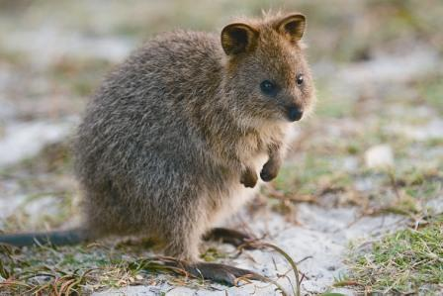
Examples
Can you think of an example of speciation right here in Perth?
Quokkas on Rottnest Island

Slide 81
Biodiversity
Biodiversity is the number and range of different species that exist around the world
Biodiversity impacts evolution as the biodiversity of an area affects the interactions and survival of the species
To ‘fittest’ individuals of a species survive the conditions and produce the most offspring

Slide 82
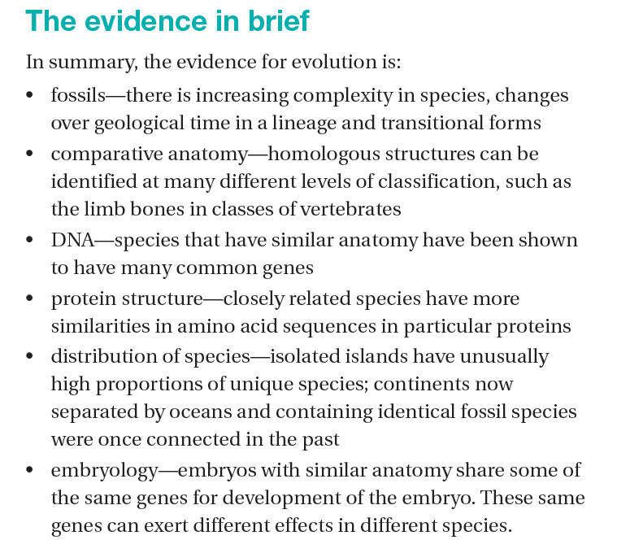
Evidence for Evolution

Slide 83
Biotechnology

