Slide 1
Topic 16: embryonic & foetal Development, stem cells & teratogens
R.Johansen 2021

Slide 2
Recap - fertilisation

Slide 3
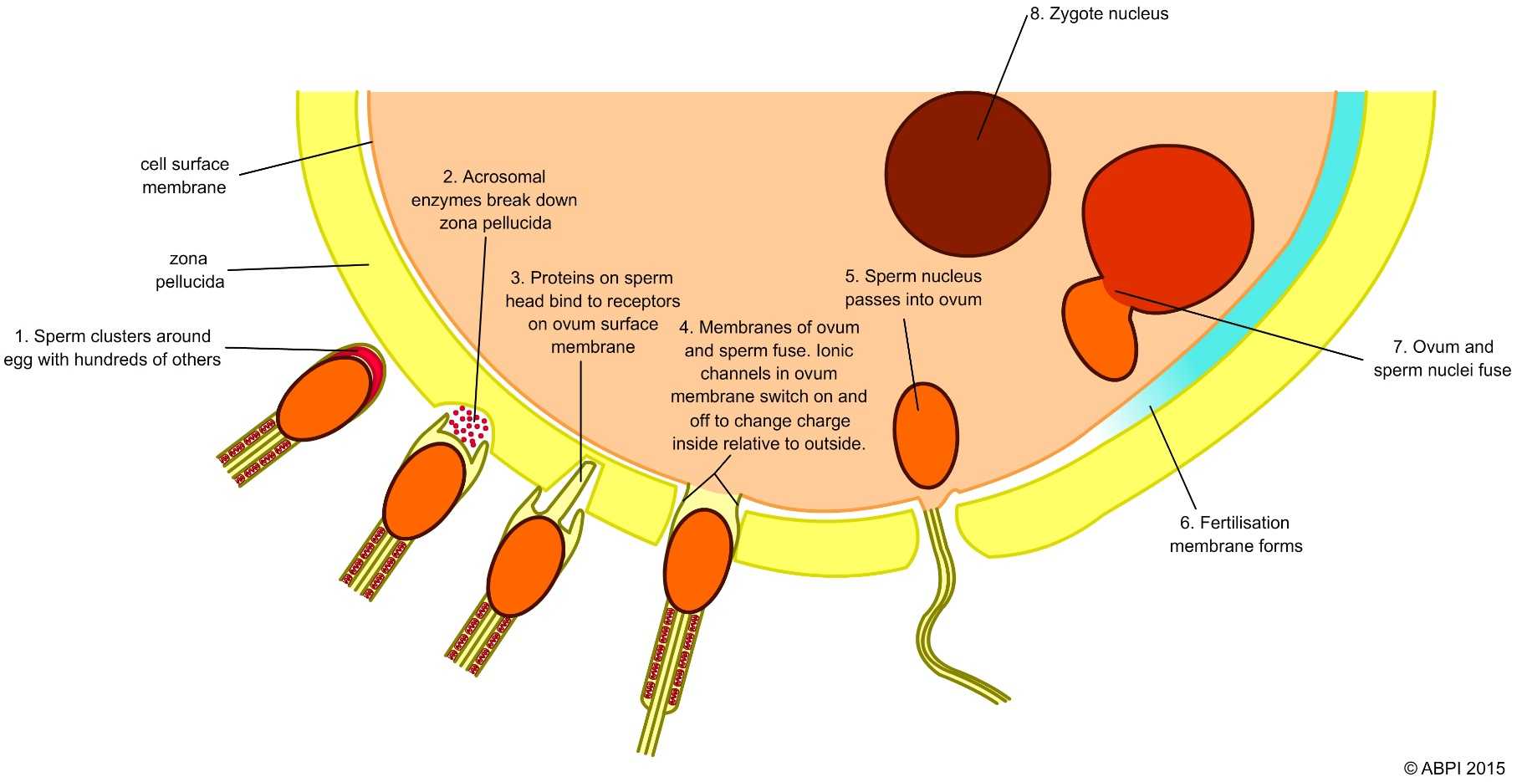
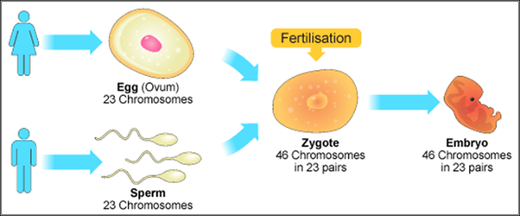

Slide 4
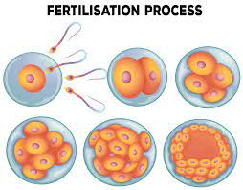
Watch:
https://www.youtube.com/watch?v=5bz8PWyZb0Q

Slide 5
Embryonic development
0 – 2 months

Slide 6
Early Embryonic development and implantation
Zygote: single cell that results from fertilisation of an egg by sperm- has potential to grow into human.
Process of mitosis begins to occur in uterine tube.
Blastocyst: hollow ball of cells surrounding a cavity filled with fluid. Occurs about 6 days after fertilisation. One side of cavity in group of 30 cells called inner cell mass (embryoblast).
Embryo: Inner cell mass becomes this, and cells composing it termed stem cells. Stem cells are able to produce any of different types of body cells.

Slide 7
Early Embryonic development and implantation
Implantation: Blastocyst remains free within uterus cavity for 2-3 days then sinks into soft endometrium & becomes firmly attached to wall.
Enables blastocyst to gain nourishment for growth and development.
IVF (In-vitro fertilisation): egg & sperm mixed in laboratory, resulting embryo implanted on uterus.

Slide 8
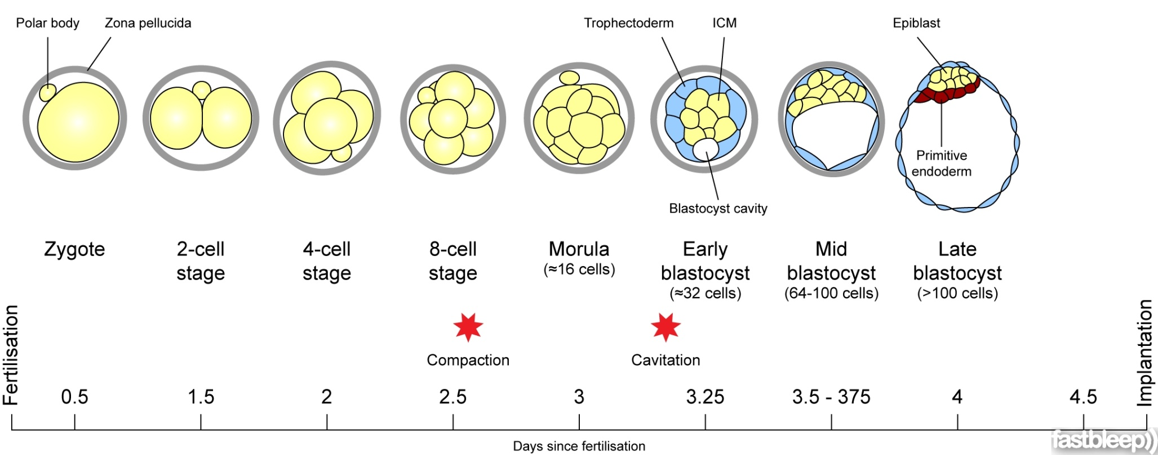
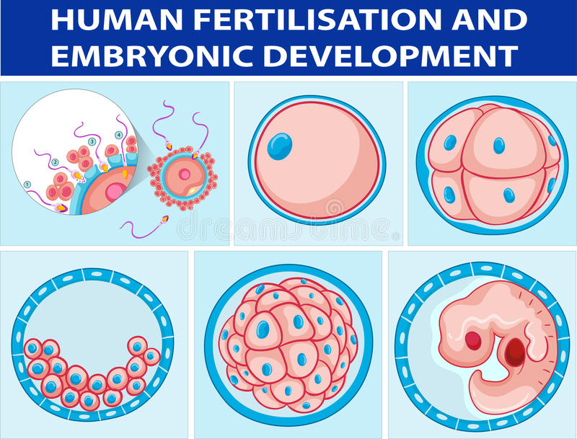

Slide 9
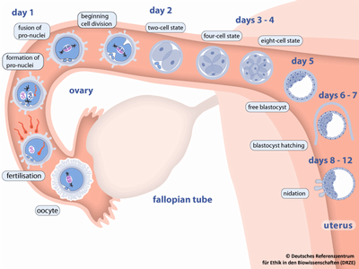

Slide 10
Stem cells introduction

Slide 11
Stem Cells & Differentiation
Stem Cells: Cells that make up the inner blastocyst are called stem cells.
These are different from other cells because :
They are not specialised for any particular role
They are capable of repeated divisions by mitosis (proliferation)
Proliferation: Cells replicating themselves many times over. Mitosis occurs in the stem cells contained within the blastocyst.
Differentiation: process by which unspecialised cells develop characteristics and functions of particular type of cell (eg. Muscle, skin, blood).
Tissue: group of cells that have similar structure and work together to perform common function.

Slide 12
Cell Differentiation
As stem cells proliferate different genes become activated. Resulting in differentiation into specialised cells.
Internal signals: controlled by genes that carry coded instructions for all structures and functions of cells.
External signals: chemicals secreted by other cells, physical contact with neighbour cells, molecules in immediate surroundings (microenvironment).

Slide 13
Types of stem cells
Totipotent: have the ability to form the embryo and membranes that surround, support and nourish it. An example is the early embryo before the formation of the inner cell mass.
Pluripotent: are capable of giving rise to most, but not all, tissues of an organism. An example is the inner cell mass.
Multipotent: are able to give rise to cells that have a specific function. An example is blood stem cells.

Slide 14
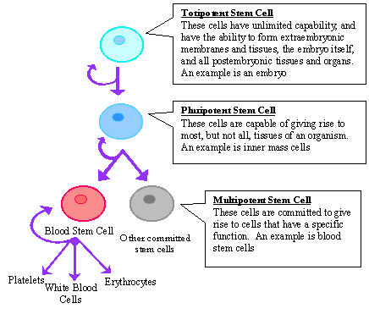

Slide 15
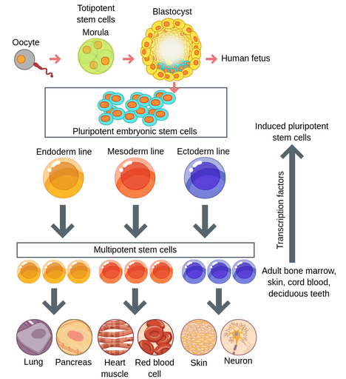

Slide 16
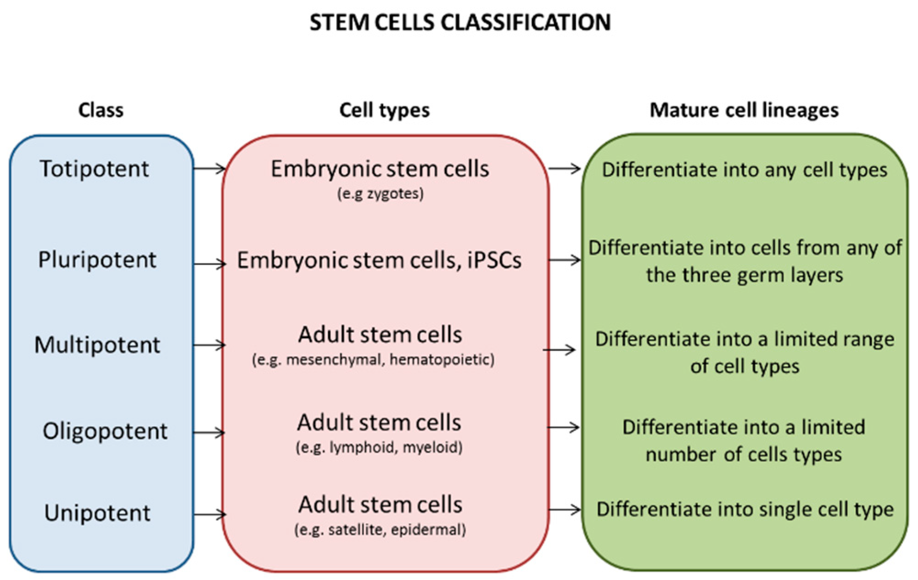

Slide 17
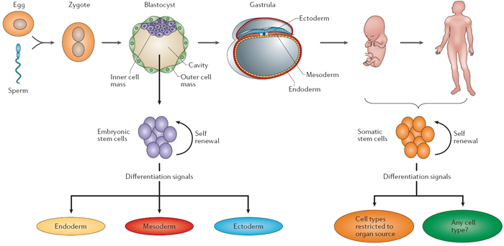

Slide 18
Totipotent stem cells:
Zygote formed by fertilised egg. At this point has potential to create any type of cell necessary for embryonic development, including embryo itself.
First few hours fertilised egg undergoes mitosis to form identical totipotent cells.
One cell can form entire human being.
Identical twins formed when 2 totipotent cells separate and develop into 2 genetically identical embryos.
5 days after fertilisation, begin to specialise and form a blastocyst. Outer layer eventually forms placenta and other tissues to support foetus.

Slide 19
Pluripotent stem cells:
Inner cell mass of blastocyst that will form all tissues of human body.
Able to give rise to many, but not all, cell types necessary for foetal development.
These cells are under investigation for medical use.

Slide 20
Multipotent stem cells:
Pluripotent undergoes further specialisaion into multipotent stem cell.
Give rise to cells that have a particular function
Eg. Blood stem cells give rise to WBCs, RBCs and platelets.
Exist in both embryo and adults.
Adults- Blood stem cells present in bone marrow, constantly replenishing RBCs, WBCs and platelets.

Slide 21
Primary germ layers

Slide 22
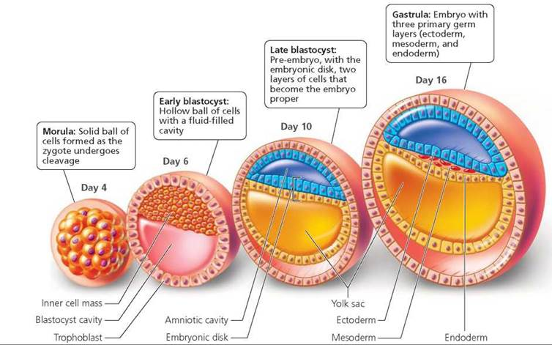
Primary Germ Layers

Slide 23
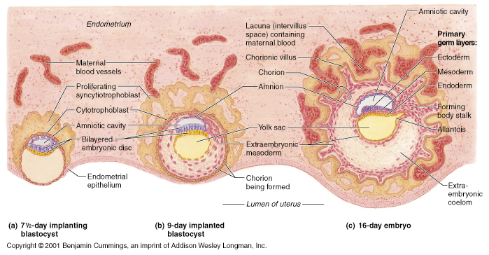
Blastocyst development after implatantation has occurred

Slide 24
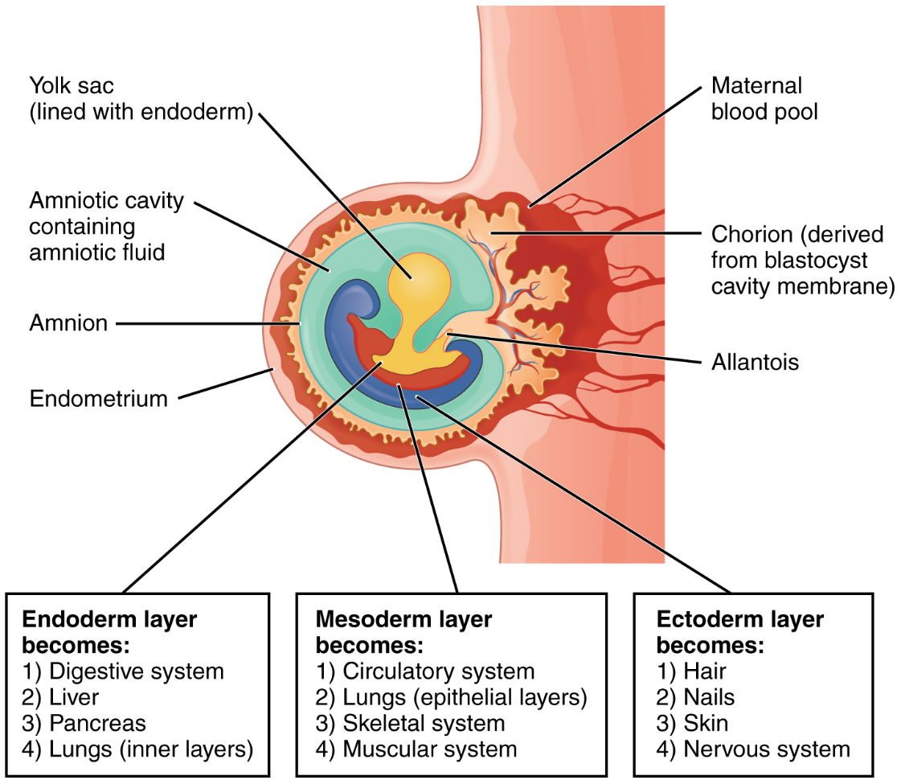
Primary Germ Layers
Ectoderm, mesoderm and endoderm: embryonic tissues that will differentiate into all the tissues and organs of the body.

Slide 25
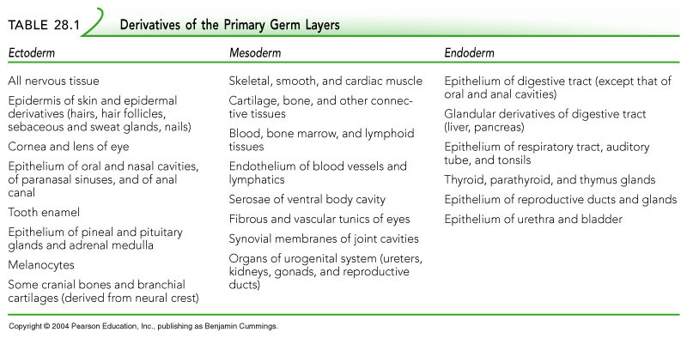

Slide 26
Watch:
https://www.youtube.com/watch?v=dgPCDXmcQjM

Slide 27
Embryonic membranes

Slide 28
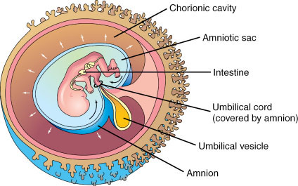
Embryonic Membranes
Early in embryonic period, 4 embryonic membranes develop (Amnion, Chorion, other two become part of umbilical cord as not as important in humans)
Lie outside embryo and serve to protect and nourish it as it develops

Slide 29
Embryonic Membranes - Amnion
1st membrane to develop, by eighth day surrounds embryo. Enclosing a cavity to which it secretes amniotic fluid.
Function: Protect, shock absorber, maintain constant temperature & allows movement of embryo/foetus.
Ruptures just before child birth “breaking of the waters”.

Slide 30
Embryonic Membranes - Chorion
Formed from outer cells of blastocyst together with a layer of mesodermal cells.
Surrounds embryo and other 3 embryonic membranes.
As amnion enlarges, it fuses with the inner layer of chorion.
Eventually becomes main part of foetal portion of placenta.

Slide 31
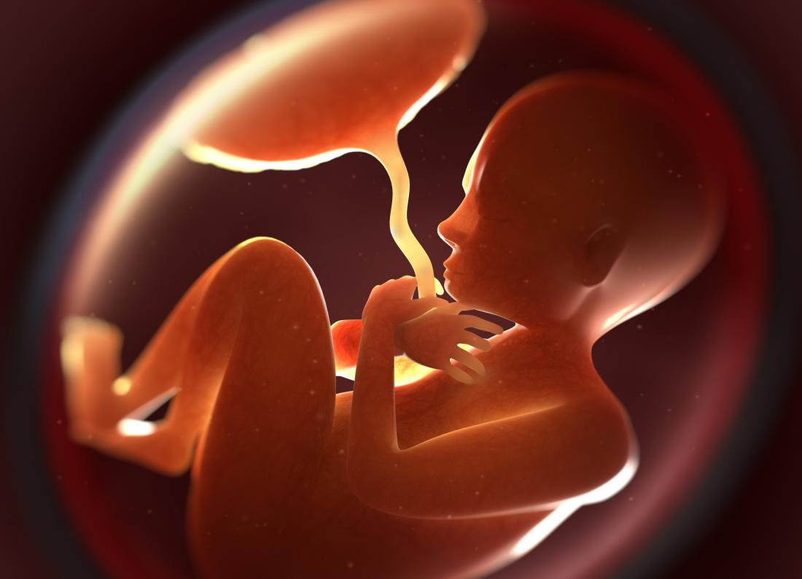
Development of the Placenta
Placenta: organ that supplies nutrients to, and removes waste from, the foetus.
Completely formed by end of 3rd month
Serves as an endocrine organ, producing number of hormones to maintain pregnancy.
Foetal part of placenta begins to develop as blastocyst is implanted in endometrium.

Slide 32
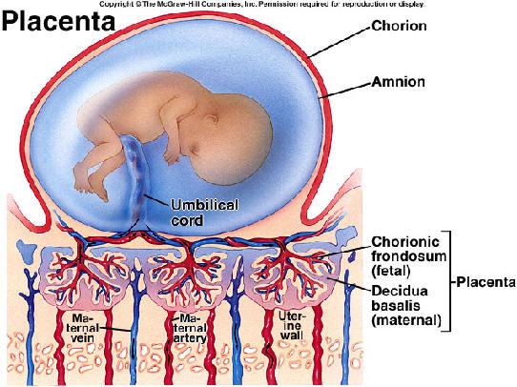

Slide 33
Development of the Placenta
Chorionic villi: small finger-like projections developing from outer layer of cells. Numerous blood vessels develop in these villi. Extensive surface area (16m²)
Grow into endometrium, like root of a tree into soil.
As villi penetrate endometrium, become surrounded by pools of mother’s blood, which has collected in spaces within endometrium.
Villi bathed in mother’s blood, foetal and maternal blood do not normally mix due to cell barrier.
Exchange of materials: diffusion and active transport. Oxygen and nutrients diffuse from mother to child. Waste products removed from foetus to mother.

Slide 34
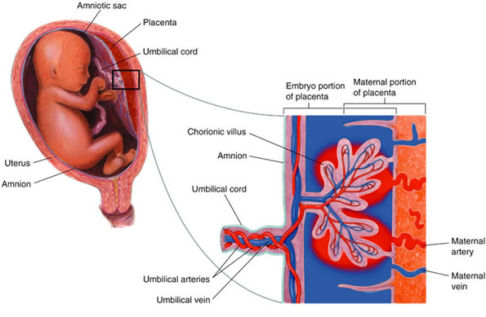

Slide 35
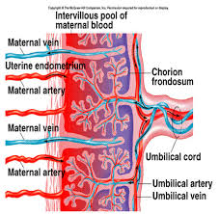
Development of the Placenta
Umbilical cord: attaches placenta to foetus.
Umbilical cord: Contains 2 umbilical arteries (carry blood to capillaries of chorionic villi) and single umbilical vein (carries blood from placenta, through cord, back to foetus).
From mother: blood enters placenta through uterine arteries, flows through blood spaces where exchange occur, and leaves through uterine veins.

Slide 36
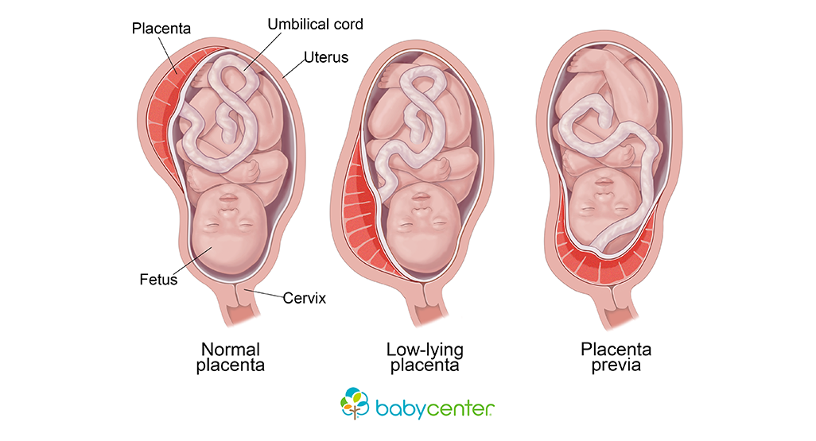

Slide 37
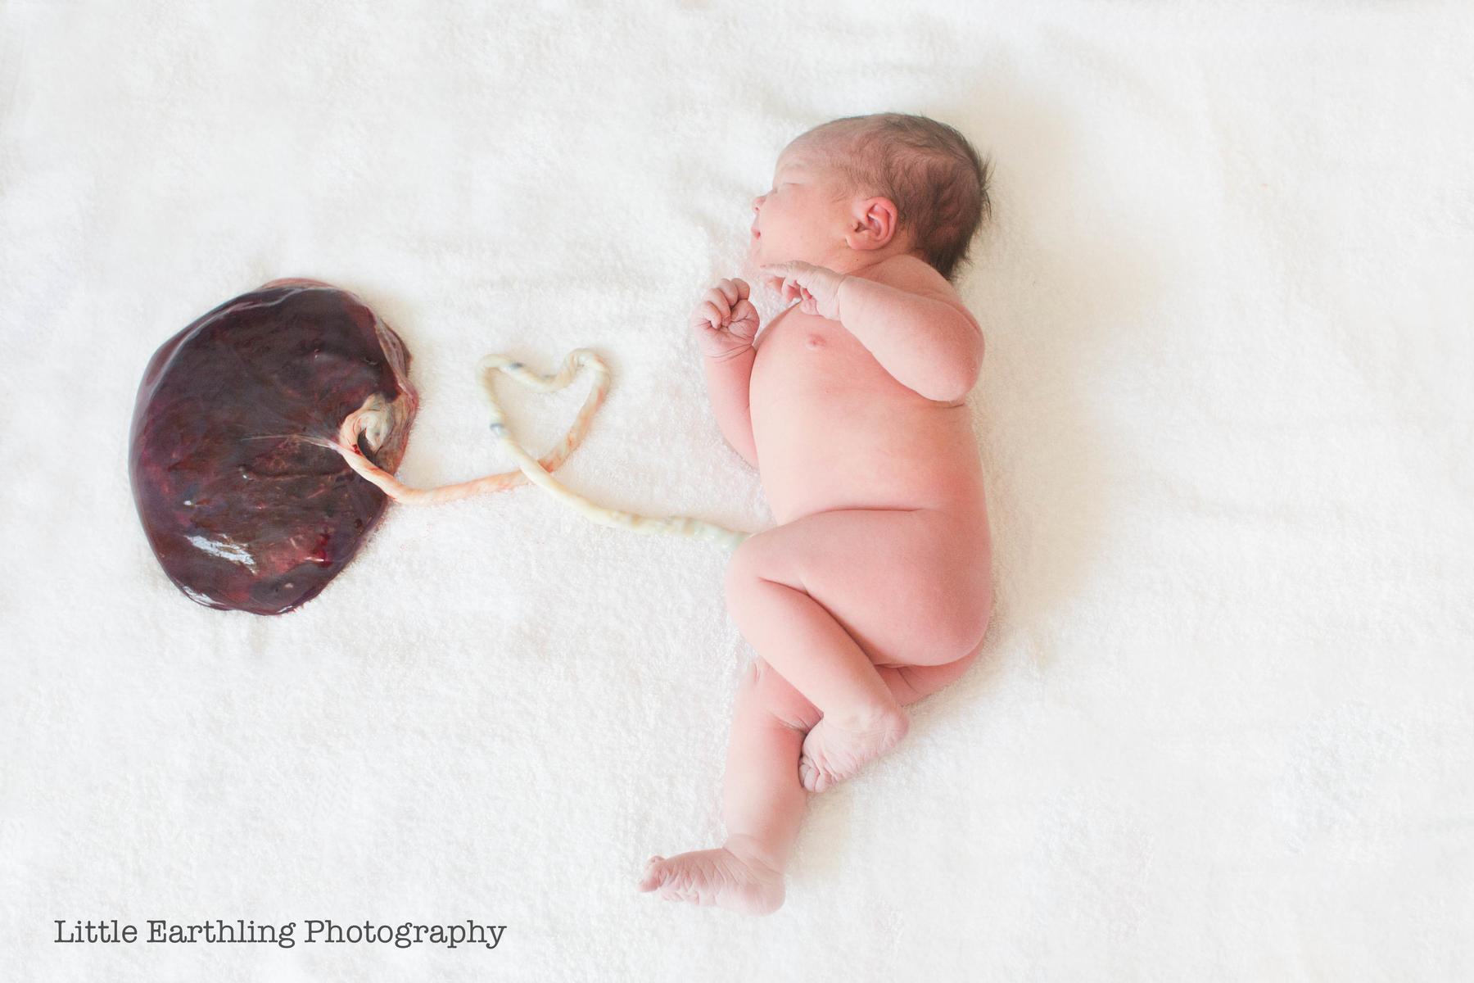

Slide 38
Embryonic Development
Endometrium needs to be maintained to continue development of blastocyst.
High levels of hormones in blood stop endometrium breaking down & menstrual cycle ceases. Hormones produced by Corpus Luteum, then Placenta.
Embryo: first 2 months
Foetus: after 2 months

Slide 39
stem cells continued
Research, uses & ethical considerations

Slide 40
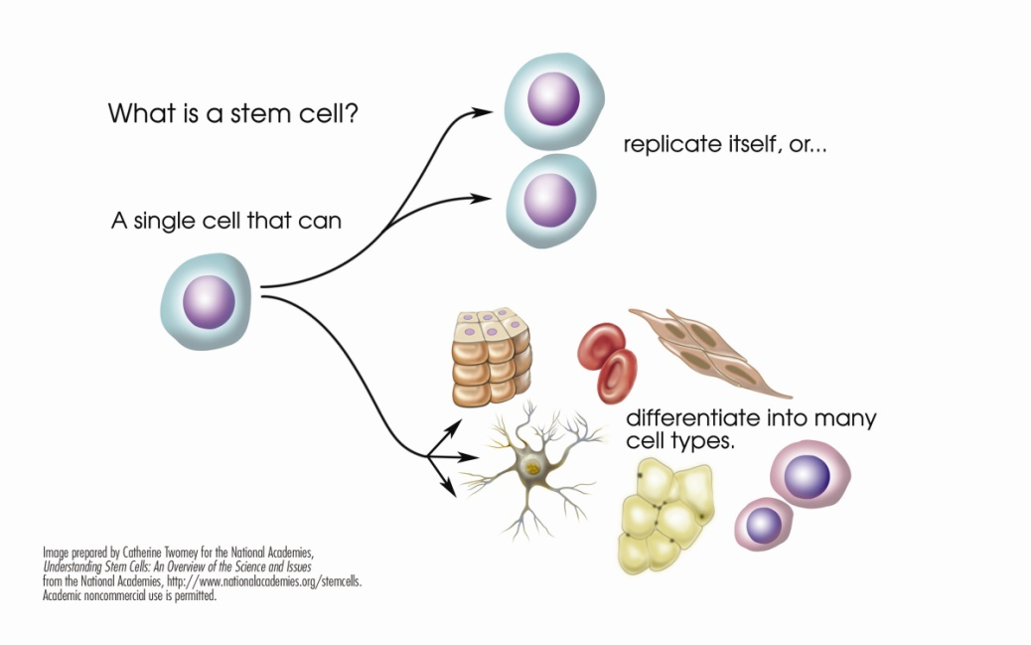
Sources of stem cells for research and therapy
Used to replace damaged or degenerated tissues
Three sources of stem cells:
Umbilical cord blood and placental stem cells
Embryonic stem cells
Adult stem cells

Slide 41
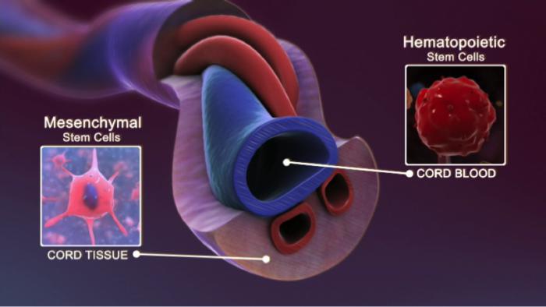
1. Umbilical cord blood and placental stem cells
Stem cells are present in the blood of umbilical cord & placenta
Multipotent cells
Once baby is born, these cells can be extracted
Used to help with bone marrow and blood diseases
No harm to baby or mother
Cord blood stored in blood
bank for any suitable donor

Slide 42
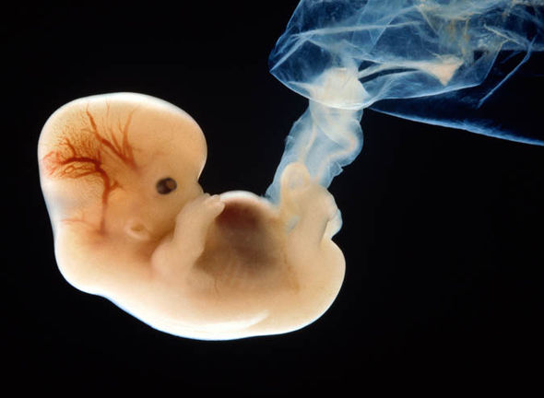
2. Embryonic stem cells
Cultured from frozen embryos
Obtained from In-vitro fertilisation clinics
Embryos unused and donated
Ethical issues as it is destruction of the embryo
Governments have strict regulations
Advantage: Pluripotent cells (can become any type of cell in the human body)
Disadvantage: Not derived from patient’s own cells and body can reject them

Slide 43
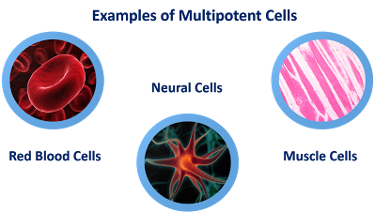
3. Adult stem cells
Multipotent (form many forms of tissue)
Advantage: Patient’s own cells, reduced risk of rejection
Disadvantage: Pre-specialised (eg. Blood stem cell makes blood cells)
Most organs of body have stem cells so they can replace dead or damaged cells

Slide 44
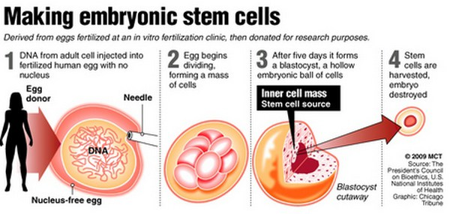
Stem Cell Research
Two types of stem cells: Embryonic & Adult
Embryonic: present in 3-5 day old embryos & through differentiation form specialised cells in the body

Slide 45
Stem Cell Research Adult Stem Cells
Occur in adult tissues such as bone marrow, muscles & brain. Produce new cells for replacement. Under right conditions, can differentiate into quite different tissues from the one in which they are located.
Source: Umbilical Cord & Placental blood (because they are not from embryos)
Cord Blood Stem Cells: differentiate into RBCs & cells of immune system.
Can treat Leukaemia, anaemia & immune system diseases.
Can treat own self later in life or other patient if a match

Slide 46
Stem Cell Research: Uses
Provide replacement tissues eg. Spinal cord injury
Testing new drugs or toxins, and understanding cause of birth defects
Teratogens (agent that may kill or harm a developing embryo)

Slide 47
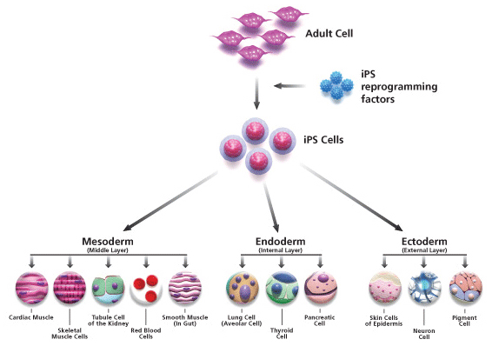
Stem Cell Research
Research aimed particularly at
Identifying how stem cells remain undifferentiated & self renewing for so long
Signals that stimulate stem cells to begin differentiation

Slide 48
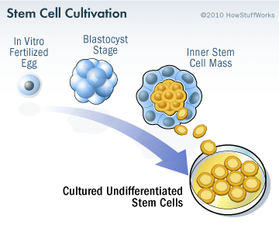
Embryonic Stem Cell Research
1981- Mouse embryo
1998- Human embryos
Inner cell mass from blastocyst
30 cells transferred to culture dish containing nutrient solution
Begin dividing and removed to fresh culture dishes: Subculturing
Stem Cell Line: repeating this process many times over
Original 30 cells Millions of cells

Slide 49
Embryonic Stem Cell Research
Therapeutic cloning: controversial method of obtaining embryonic stem cells
Clones are two or more cells, tissues or organs that are genetically identical
Nucleus from body cell inserted into donor egg (with nucleus removed). Develops into blastocyst & cells harvested
Big advantage:
No rejection of cells

Slide 50
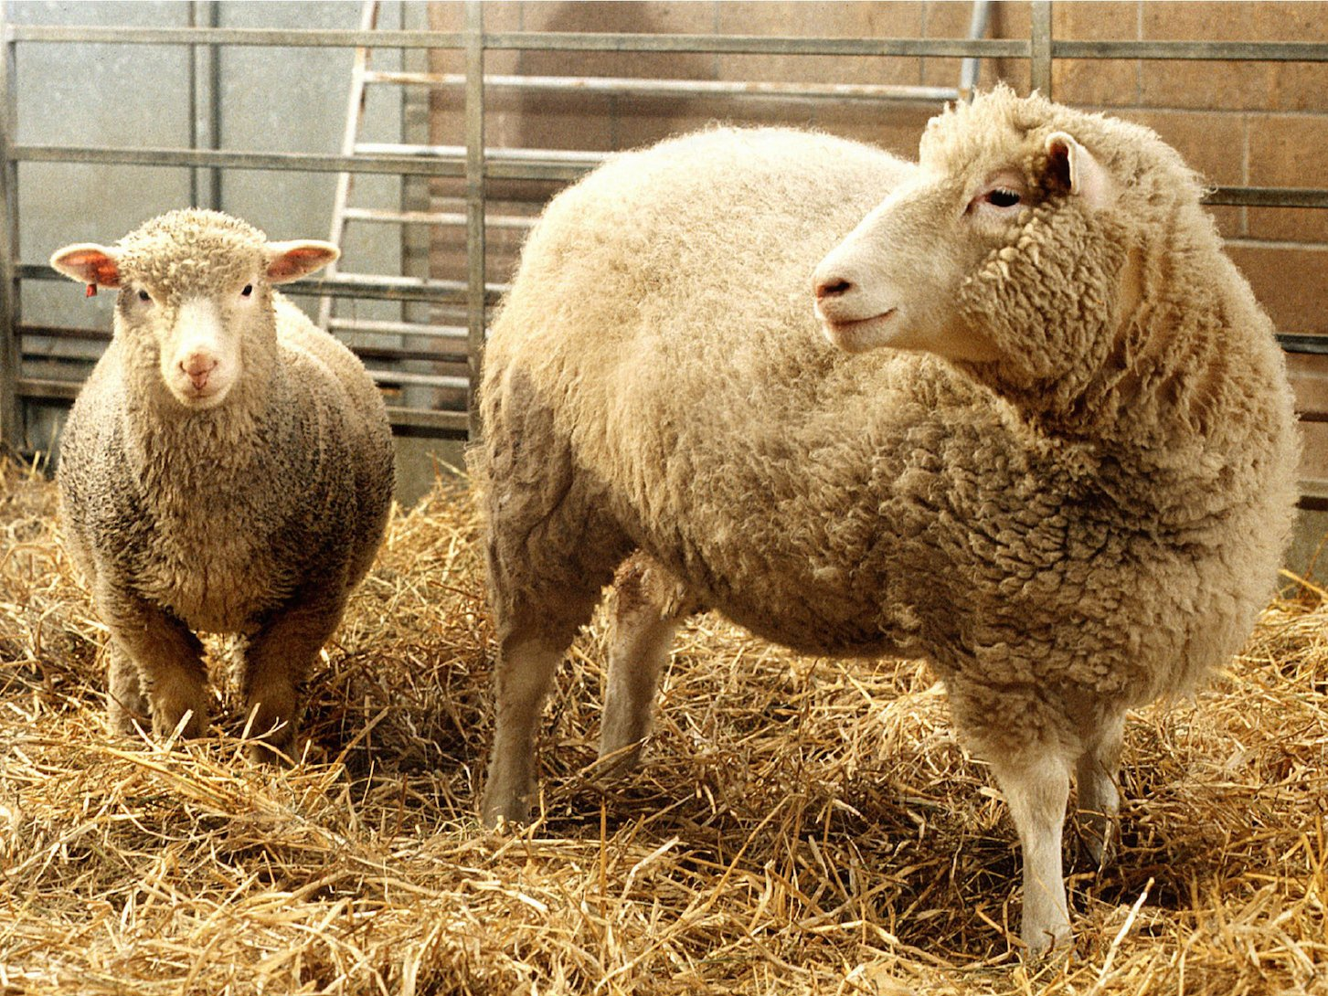
Embryonic Stem Cell Research
Dolly, sheep born in 1997, was first animal produced as clone of it’s mother

Slide 51
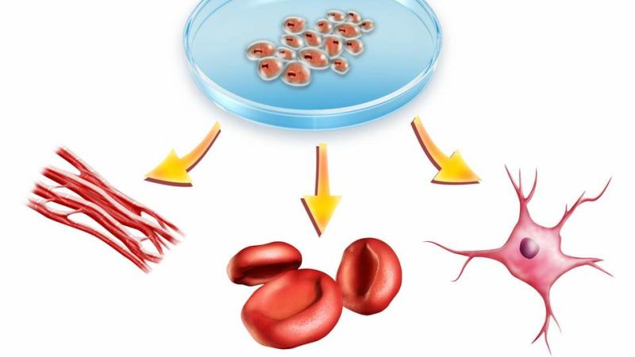
Adult Stem Cell Research
First began in 1960s
Bone marrow contains stem cells differentiate into :
Blood cells
Bone, cartilage and fat storage tissues
New developments:
Likely to exist in all body tissues
Cells may be able to differentiate in to different types of tissue depending on stimulation

Slide 52
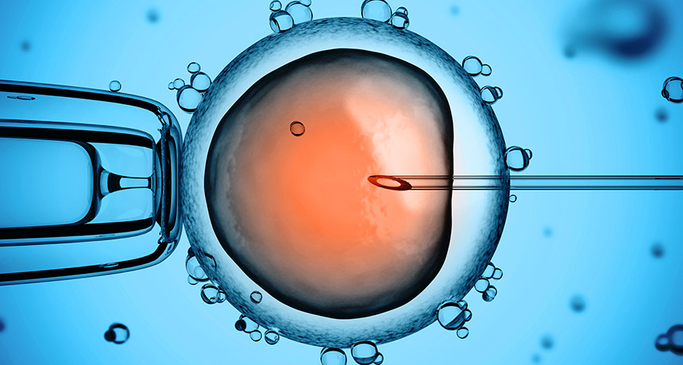
Ethical considerations
Conflict: Potential to alleviate human suffering vs Value of human life (ie. Destroy human embryos)

Slide 53
Ethical considerations For:
Organ transplant
Adult stem cells used for research, avoiding destruction of human embryos
Tissues developed from person’s own stem cells would not provoke immune response
At present, embryonic stem cell research uses surplus embryos from IVF programs that will be destroyed anyway
Embryos used in stem cell research are blastocysts and would not develop unless implanted into female uterus
No difference between prevention of implantation of embryo using IUD or morning after pill in terms of destruction of embryo

Slide 54
Ethical considerations Against:
Only potential benefits. Outcome of scientific research are unpredictable
Compared with embryonic stem cells, therapies from adult stem cells take many more years to develop as cannot be easily harvested & cultured
In future, embryos may be produced just for research purposes. Could ultimately lead to trade in human embryo
Allowing human embryos to be routinely destroyed may mean society will become desensitised to destruction of human life

Slide 55
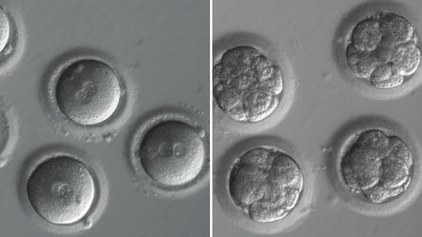
Stem Cell Research in Australia
Research Involving Human Embryos Act 2002 permits research on surplus embryos from IVF programs
Apply for licence
Embryo couple have to give permission
Prohibition of Human Cloning Act 2002 banned human cloning including for therapeutic purposes
2007 allowed cloning for therapeutic purposes.
Under review every 3 years.

Slide 56
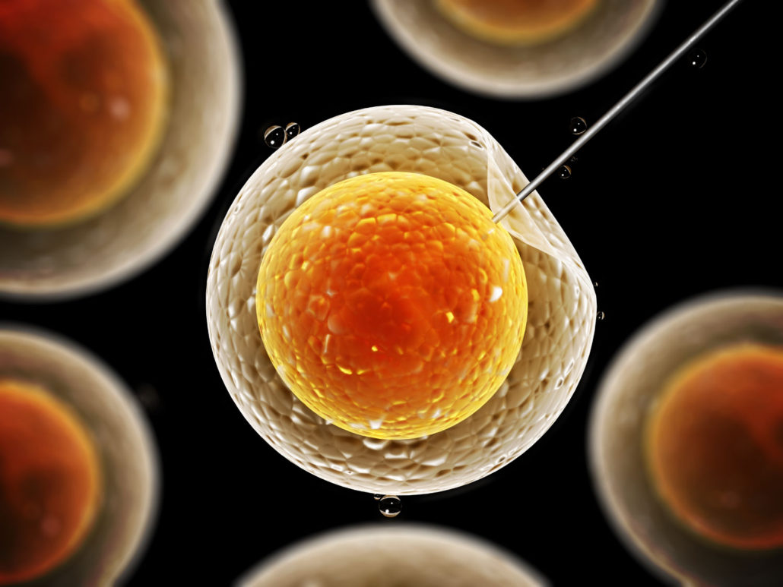
Big Question Regarding Stem Cell Research
When does human life begin????

Slide 57
Foetal Development
2 months - birth

Slide 58
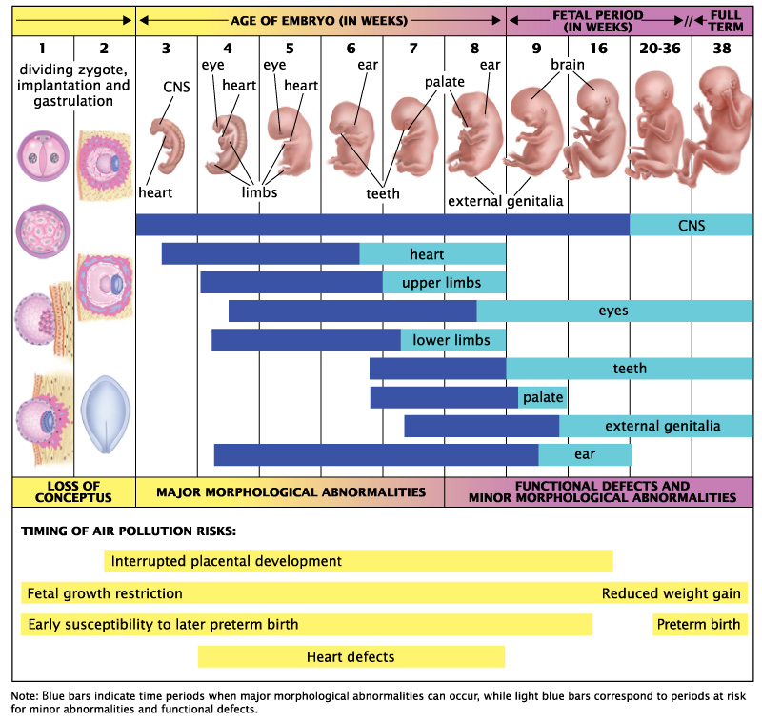

Slide 59
Development of Foetus
During embryo stage, general external features, body form of infant develop, basic plan of the organ systems is in place.
Foetus: Term used to describe developing individual from start of third month.
Foetal period: 9th week to birth. Characterised by great increase in size & maturation of organ systems.
Foetal length (head to buttocks): from 3cm to 50cm.
Foetal weight: 4g to 3400g.
Between week 9 & 12 foetus doubles in length.
Fingernails, toenails and hair appear.
Mother detects enlarging uterus at this stage.

Slide 60
Age (months) | Foetal Development
3 | Forelimbs well developed, eyelids closed, outer ear completed, bone marrow formed, blood cells formed in bone marrow, sex distinguishable
4 | Arms and hands fully shaped, skeleton completed, exercising of muscles evident, ears stand out from head
5 | Fine hair covers body, gripping reflexes are developed, increased growth
6 | Respiratory movements, digestive glands begin to function, tooth buds evident, eyebrows and eyelashes
7 | Period of greatest growth, all systems functional except respiratory system
8 | Accumulation of fat beneath skin, growth slowed
9 | Eyes open, nose well formed, sucking and grasping reflexes apparent, fine body hair is shed

Slide 61
During fourth month (week 12-16)
Uterus expands and woman’s abdomen begins to bulge
Foetus grow rapidly this month
18cm long, 100g in weight
Posture mostly erect, fingerprints appear
Foetus moves, stretching arms and legs
Heartbeats 120-160 bpm, twice rate of mother

Slide 62
End of fifth month (week 20)
25cm long, weighs 300g
Foetal movement
END OF THE SIXTH MONTH (WEEK 24)
27- 35cm long, weighs 565-680g
END OF THE SEVENTH MONTH (WEEK 28)
38 cm long, weighs over 1000g
Moves vigorously within uterus
Brain enlarged considerably

Slide 63
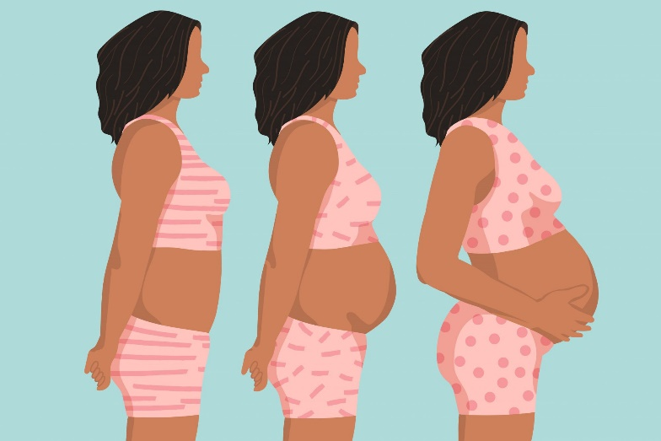
End of eighth month (week 32)
41-45 cm length, 1800- 2200g weight
WEEK 40
Pregnancy is full term
50cm length, weighs 3400g
Diminished foetal activity as foetus occupies all available space within uterus
Boys usually 100g heavier

Slide 64
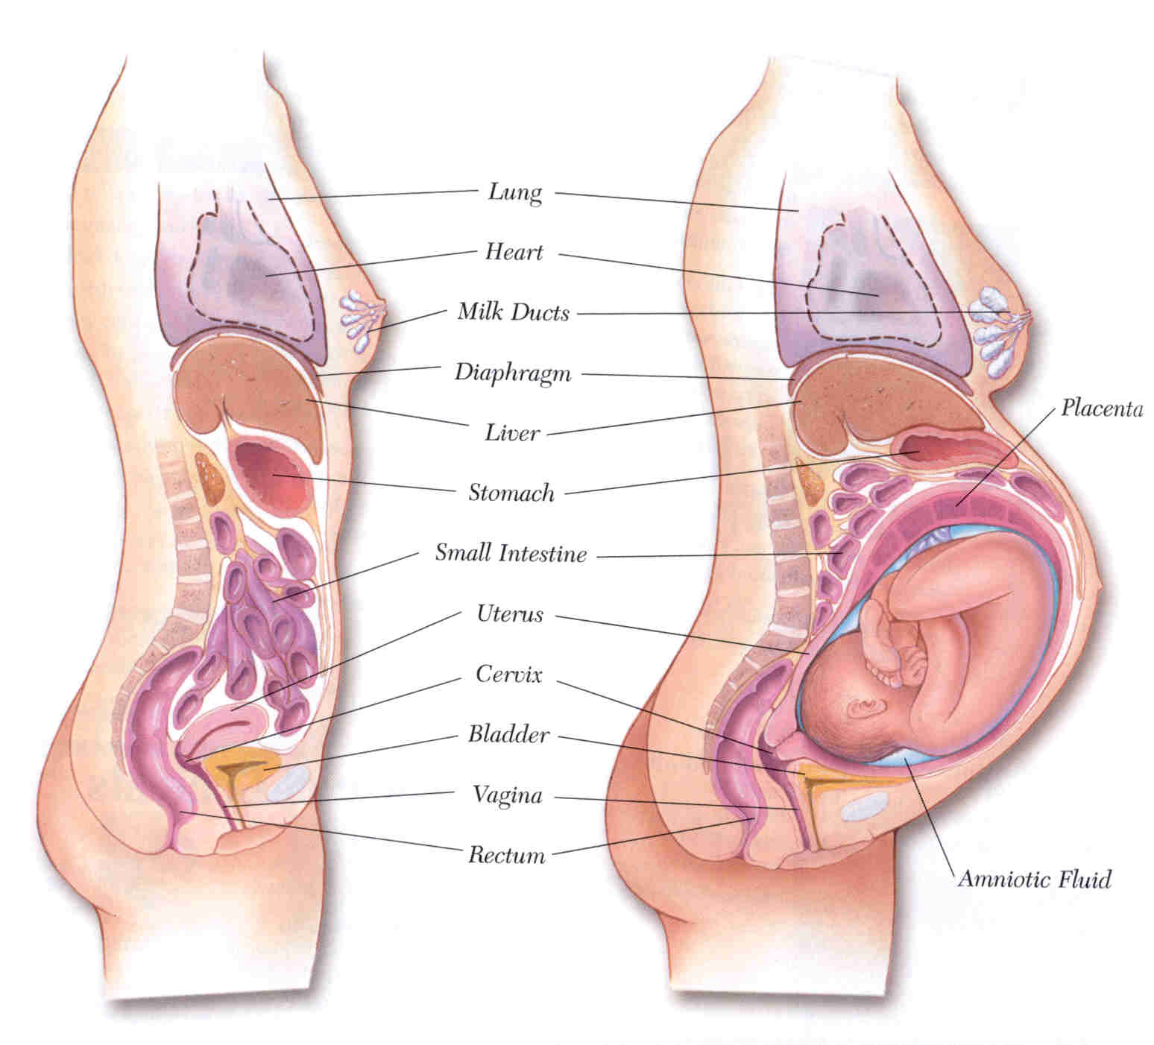

Slide 65
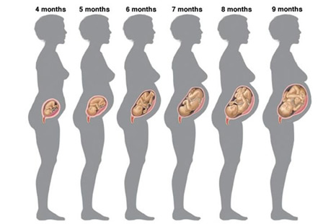

Slide 66
Shortly before birth
Birth weight can vary 2500- 4500g
Shortly before birth foetus changes position, head resting on curved pelvis
Foetus growth very slowly
Placenta begins to fail, becomes fibrous
During later pregnancy, Antibodies from mother diffuse across placenta into baby’s blood: temporary. Six months- child develops own immune responses

Slide 67
Maintaining a healthy pregnancy

Slide 68
The Pregnant Mother
Mother supplies foetus with oxygen & nutrients and needs to remove carbon dioxide & waste.
After birth, continued nourishment required.
Changes in mother during this time accommodate all these requirements.
Not all increase of abdomen size is due to uterus. Internal organs (stomach, liver, intestines) forced up and outward.
Enlarged breasts: Development of milk secreting tissues lead to increase in size and change due to hormones.

Slide 69
The Pregnant Mother
Increase size of heart and increase in blood volume.
Increased blood flow to kidneys, increase urine production.
Uterus (later stages foetus) presses on bladder, feels as if it is filled with urine.
Emotional state: Change in mood due to hormones, fear, stress etc.

Slide 70
Maintaining Healthy Pregnancy
Women’s own functions slow, allowing nutrients to stay in blood for longer, easily diffuse across placenta.
Constipation: Alimentary canal less active, stomach empties more slowly.
More urination: Due to increase of wastes to get rid of.
Blood volume increase by 40%
Increase dietary intake to provide balance diet and nutrients to foetus.
Average pregnant woman, increases her energy intake by 850kJ per day, especially in second half of pregnancy. Including increase in protein.

Slide 71
Maintaining Healthy Pregnancy
Increase calcium, iron, folic acid (folate).
Hormonal changes promote conversion of energy to fat & the retention of water in body.
Best for mother to keep weight gain to about 0.5 kg a week during second half of pregnancy.
Average total weight gain is around 13- 14kg.

Slide 72
Maintaining Healthy Pregnancy
If a woman is used to regular exercise she should maintain her exercise program. Women who are not used to exercise should not suddenly start.
Walking regularly is a good habit to establish
Studies have shown that women who have a good exercise program:
Are more likely to carry their babies to full term
Are better able to maintain stamina during labour
Regain their pregnancy body health and fitness more quickly after birth
For more information read pages 323 – 324 of your text

Slide 73
Exposure to teratogens

Slide 74
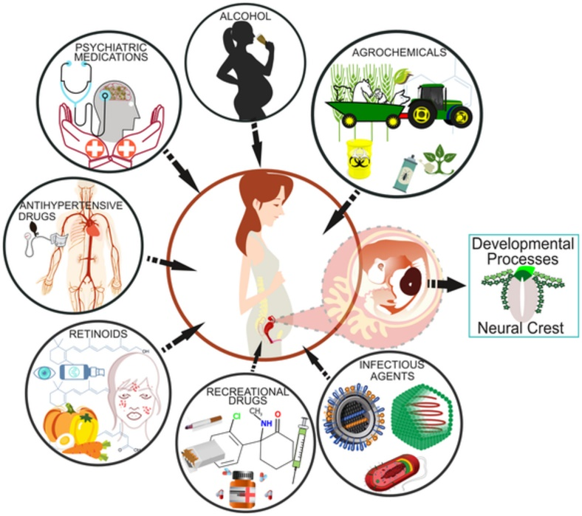
Exposure to teratogens
A teratogenic agent (or teratogen) is one that causes physical defects in the developing embryo.
Some potential teratogens include:
Hormones
Antibiotics
Oral anticoagulants
Anticonvulsants
Anti-tumor drugs
Thyroid drugs
LSD
Marijuana
Alcohol
Thalidomide (found in some sleeping pills)

Slide 75
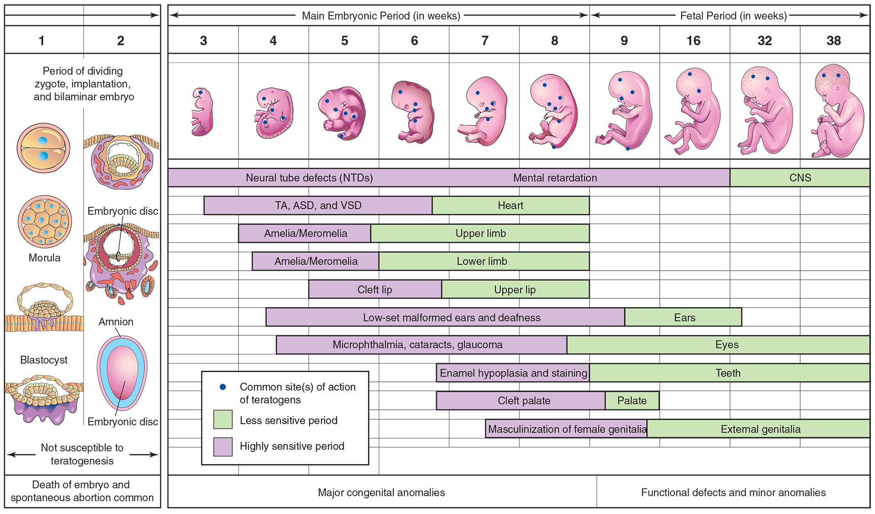
Exposure to teratogens
For more information read pages 325 – 327 of your text

