Slide 1
Roman Religion
Wednesday 25th May

Slide 2
Roman Religion
Before Christianity, the Romans believed in many different Gods and Goddesses.
They adopted many of the Greek Gods and Goddesses, and based their beliefs on a series of myths and superstitions.
What is a myth?
What is a superstition?

Slide 3
Jupiter
Juno
Neptune
Minerva
Mars
Venus
Apollo
Diana
Vesta
Mercury

Slide 4
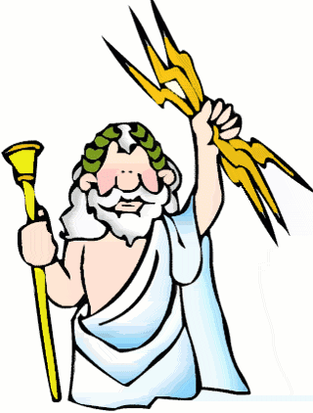
Roman God: Jupiter Greek name : Zeus
King of all the Gods
Brother of Neptune
Wife; Juno
Lots of children
Short temper
Sense of humour
Lots of girlfriends
Not afraid of anything – except his wife!

Slide 5
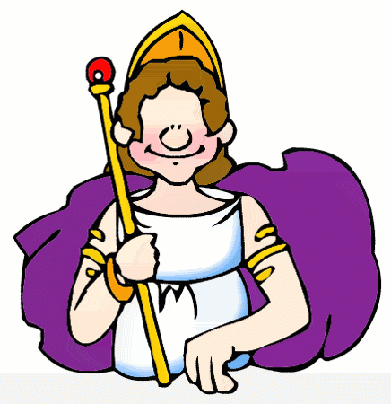
Roman Goddess: Juno Greek name : Hera
Queen of all the Gods
Goddess of marriage
Husband; Jupiter
Jealous of her husband
Did not like children Jupiter had with other women
Many stories of jealousy, anger and revenge

Slide 6
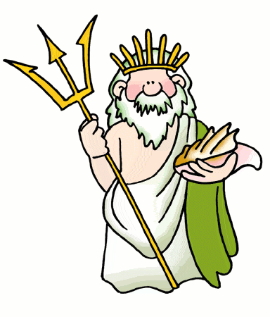
Roman God: Neptune Greek name : Poseidon
Lord of the Sea
Good looking
Always on the move
Very powerful
Many wives
Sailors and people who lived near the sea were terrified of Poseidon

Slide 7
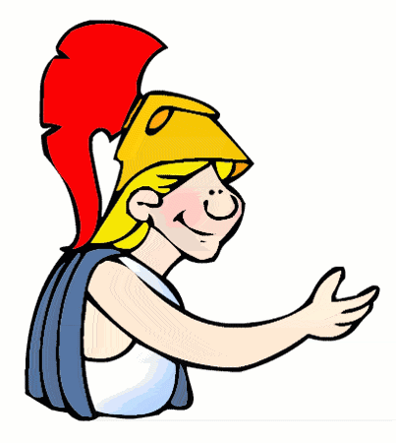
Roman Goddess: Minerva Greek name : Athena
Goddess of Wisdom
Daughter of Jupiter
No mother
Born out of Jupiter’s brain
Jupiter’s favourite child
Always on the move
Very powerful

Slide 8
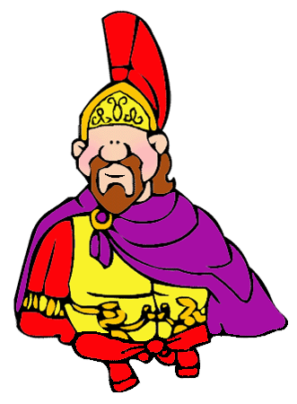
Roman God: Mars Greek name : Aries
God of War
Son of Jupiter and Juno
Tall, handsome, mean and self centred
Did not care who won a battle, just liked bloodshed
Other gods and goddesses avoided him
Only caused trouble

Slide 9
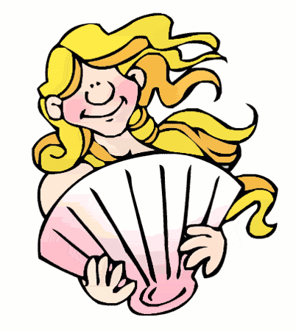
Roman Goddess; Venus Greek name : Aphrodite
Goddess of Love and Beauty
Daughter of Jupiter
Could be kind and harsh
Only ever caused havoc accidentally or if you truly angered her
Vain

Slide 10
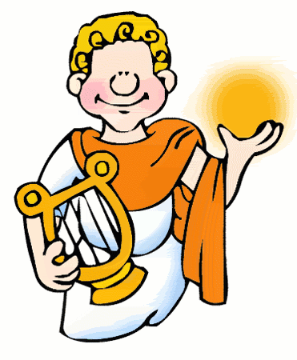
Roman God; Apollo Greek name : Apollo
God of Sun, Music and Light
Son of Jupiter and Latona
Twin sister – Diana
Very protective of his mother Latona
Gentle and full of warmth

Slide 11
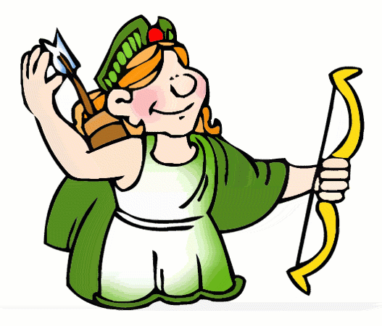
Roman Goddess; Diana Greek name : Artemis
God of Hunting and the Moon
Daughter of Jupiter and Leto
Twin brother; Apollo
Cold and pitiless
Loved floppy-eared dogs

Slide 12
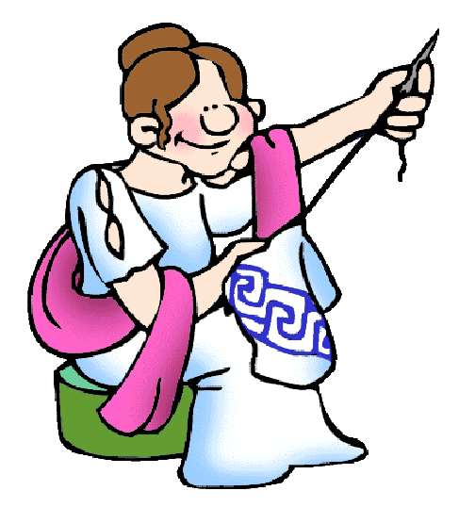
Roman Goddess; Vesta Greek name : Hestia
Goddess of the Home
Jupiter’s sister
Important to women
Watched over women sewing and cooking
Guardian of women

Slide 13
Roman Goddess; Mercury Greek name : Hermes
Messenger of the Gods
Son of Jupiter
Mischievous and lots of fun
Fast on his feet and very clever
Trustworthy and loyal
Good negotiator
Helping others out of trouble

Slide 14
Family Tree
Vesta
Neptune
Jupiter
m.
Juno
Minerva
Mercury
Apollo
Diana
Venus
Mars

