Slide 1
Homeostasis

Slide 2
If you are cold, what do you do? What does your body do?
If you are hot, what do you do? What does your body do?
If you are hungry, what do you do? What does your body do?

Slide 3
What is homeostasis?
Homeostasis is the process of maintaining a constant internal environment within the body, regardless of the changes to the external environment.

Slide 4
The body works in the best way when the internal environment is kept reasonably constant.
What does this mean?

Slide 5
This means factors such as your body temperature, water content, available energy (glucose), available oxygen and concentration of waste in the blood are controlled in the body.

Slide 6
How does the body maintain homeostasis?
The body maintains homeostasis through what is called a negative feedback loop system.
A negative feedback loop is a process that responds to changes (e.g. temperature, blood glucose levels), to maintain a constant internal environment.
https://www.youtube.com/watch?v=quQr6X1Q58I
https://www.youtube.com/watch?v=62e8IV-WT8c

Slide 7
How does a negative feedback work?
It begins with a stimulus (e.g. temperature change)
A sensor/receptor detects the stimulus or change
A control responds to the change (e.g. the brain)

Slide 8
There is an effector, the effect of the response. This is how your body responds to the stimulus/change (e.g. vasoconstriction, releasing insulin when blood sugar (glucose) levels are high.)
Once the constant, ideal internal environment has been achieved, a feedback is sent back to the sensor/receptor to stop or inhibit the response.

Slide 9
Negative Feedback Loops in the Body
Osmoregulation (excretions):
water balance in the body, salt and urea expelled from the body
Chemical regulation:
Blood glucose regulation, breathing rate in response to increased levels of CO2, red blood cell formation.
Thermoregulation:
regulation of internal body temperature in response to the external environment.

Slide 10
Thermoregulation
Thermoregulation is the way an organism (human, mammal, lizard etc.) regulates internal heat
Endothermic: Organisms are warmed from within, by internal sources e.g. metabolism and other function.
Mammals
Birds
Ectothermic: Organisms are warmed by external sources, e.g. the sun
Amphibians
Lizards
Snakes
Fish

Slide 11
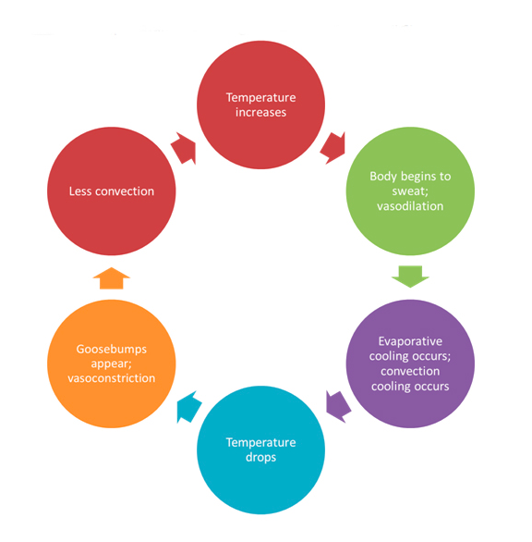
Heat regulation (thermoregulation)
Ideal internal body temperature is 37 degrees. Any changes (e.g. increase or decrease in body temperature) will initiate a negative feedback to maintain and regulate a constant internal body temperature
https://www.youtube.com/watch?v=vJhsyS4lTW0

Slide 12
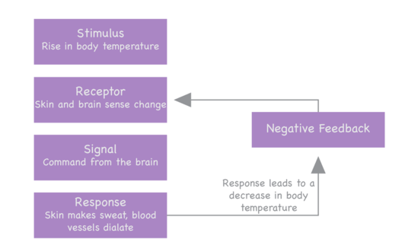
Thermoregulation

Slide 13
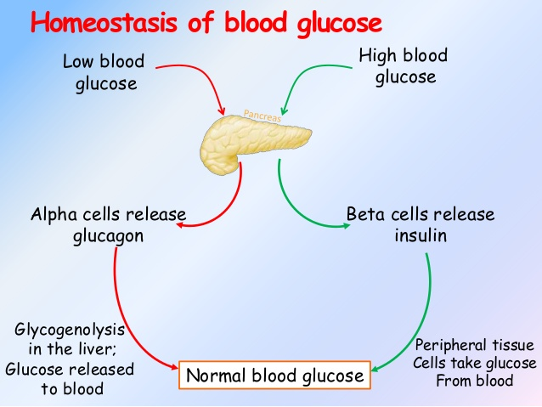
Blood glucose regulation
The pancreas is involved in helping to maintain the bodies blood glucose level by release hormones, glucagon when blood glucose is low and releasing insulin when blood glucose is high.

Slide 14
Read pages 56-57 from the textbook (Oxford textbook)
Complete worksheets about homeostasis
When worksheets are finished, write your own personal notes in your note books

Slide 15
Positive Feedback Loops

Slide 16
Recap of homeostasis
https://www.youtube.com/watch?v=tN78hYn3ehc

Slide 17
Positive Feedback Loops
Positive feedback loops also occur, along with negative feedback loops in animals and plants
While negative feedback loops respond to changes in the environment to achieve homeostasis, Positive feedback loops enhance and intensify changes.

Slide 18
Positive Feedback Loops
Positive feedback loops moves a system further away from equilibrium
It does so by amplifying the effects of a product or event and occurs when something needs to happen quickly.

Slide 19
Examples of positive feedback loops
Wound clotting in the body
Fruit ripening on a tree

Slide 20
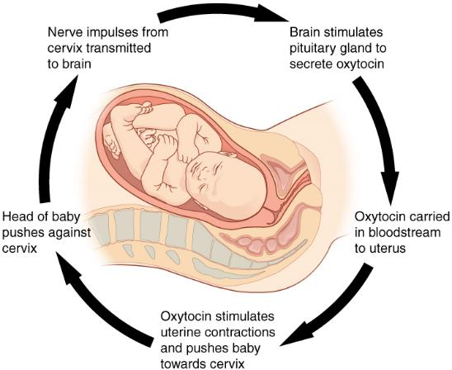
Child birth is also an example of positive feedback in homeostasis

Slide 21
How do negative and positive feedback loops differ from each other?

Slide 22
Negative Feedback Vs. Positive Feedback
Negative feedback loops work to reduce changes (i.e. changes in body temperature from the constant 37 degrees), working towards equilibrium (constant internal environment)
Positive feedback loops work to amplify changes. This means that you will get more product (i.e. more contractions in child birth, more platelets used in wound clotting to prevent bleeding), moving away from equilibrium (the constant internal environment)

Slide 23
Why is it important to learn about homeostasis and feedback loop systems?

Slide 24
What happens if there is a problem in a feedback system?
https://www.youtube.com/watch?v=Iz0Q9nTZCw4

