Slide 1
Respiratory System
R. Johansen 2021

Slide 2
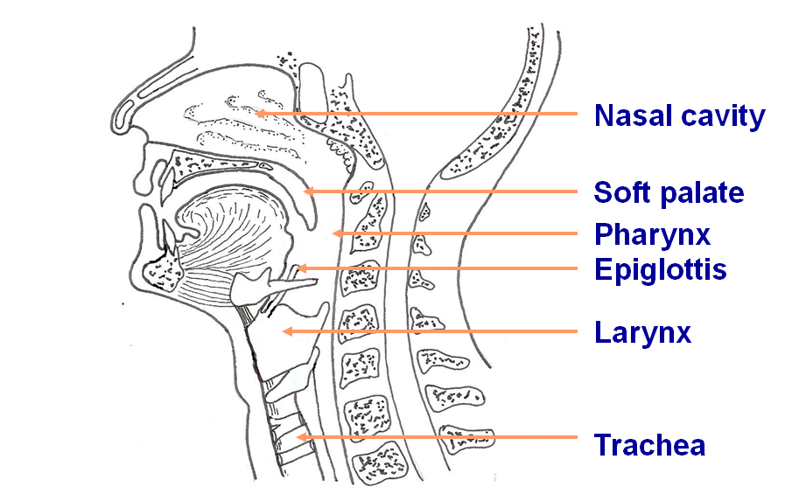
Respiratory Structures

Slide 3
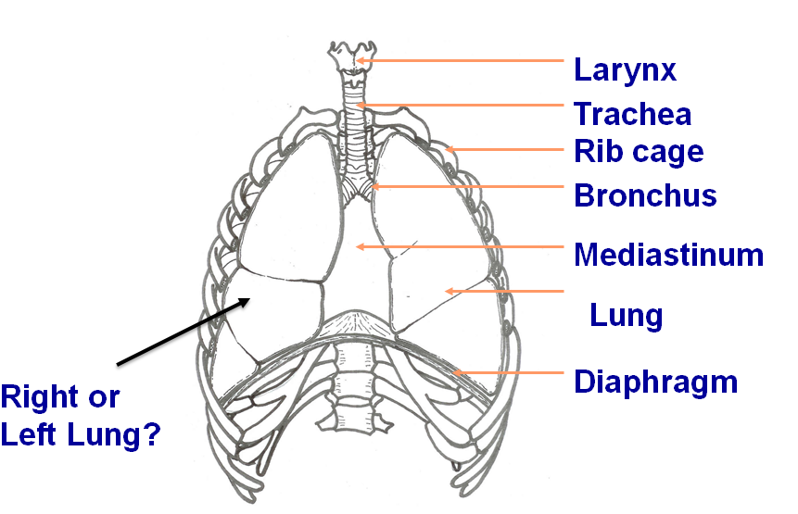
Respiratory Structures

Slide 4
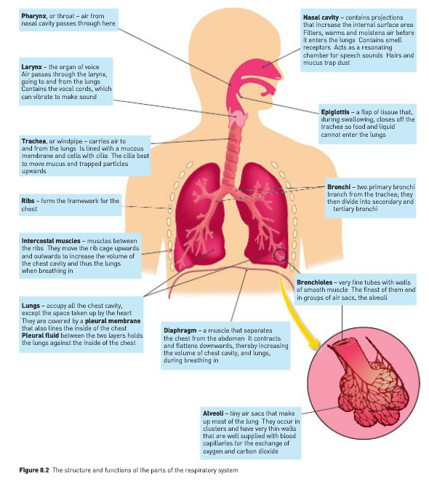
Structure and Function

Slide 5
Nasal Cavity and Upper Airways

Slide 6
Nasal Cavity Function
Air enters and leaves the body through the nose
Here it is cleaned (filtered), warmed and moistened before entering the body
The nasal secretions contain an anti-bacterial enzyme - lysozyme

Slide 7
Nasal Cavity and Upper Airways Structure
The nasal cavity and upper airways have a mucous lining
The epithelial lining contains goblet cells which secrete a clear, sticky mucus
The function of mucus is to trap dirt particles and microbes before they enter the lungs
Cilia – microscopic hair-like structures that beat back and forth to help move mucus along and trap the particles. The cilia sweep the dirty mucus up the trachea and into the throat

Slide 8
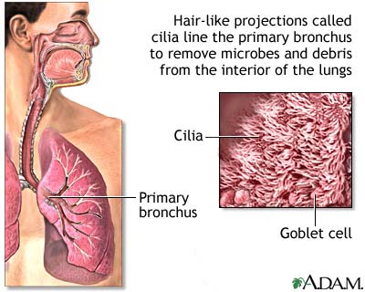

Slide 9
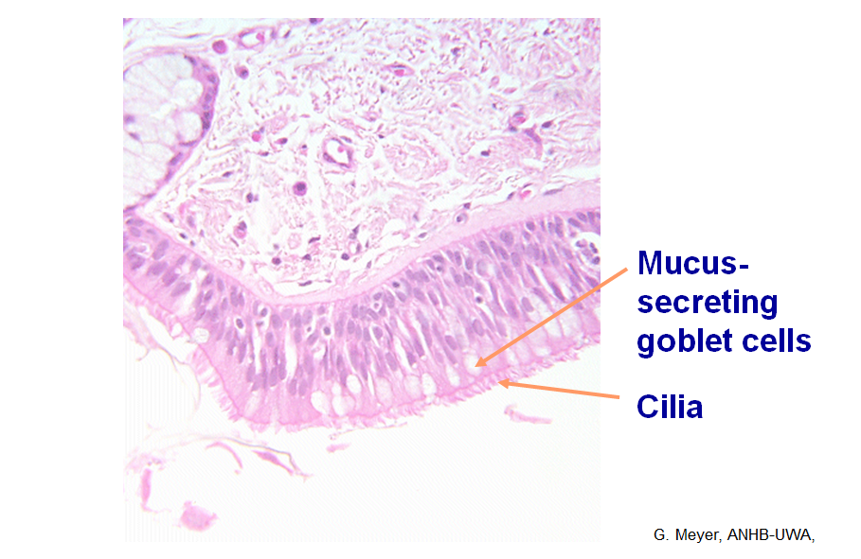

Slide 10
Upper Airways Function
Epiglottis - Flap of tissue which, when swallowing, closes off the trachea to prevent food and liquid from entering the lungs
Larynx – the organ of voice. Air going to and from the lungs passes through the larynx. It contains vocal cords which vibrate to make sound. Vocal cords can change the pitch and volume.

Slide 11
Bronchial Tree

Slide 12
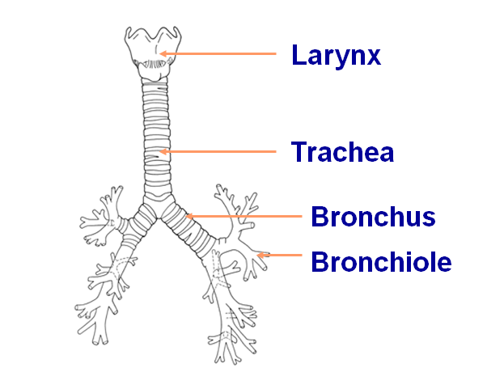
Bronchial Tree Structures

Slide 13
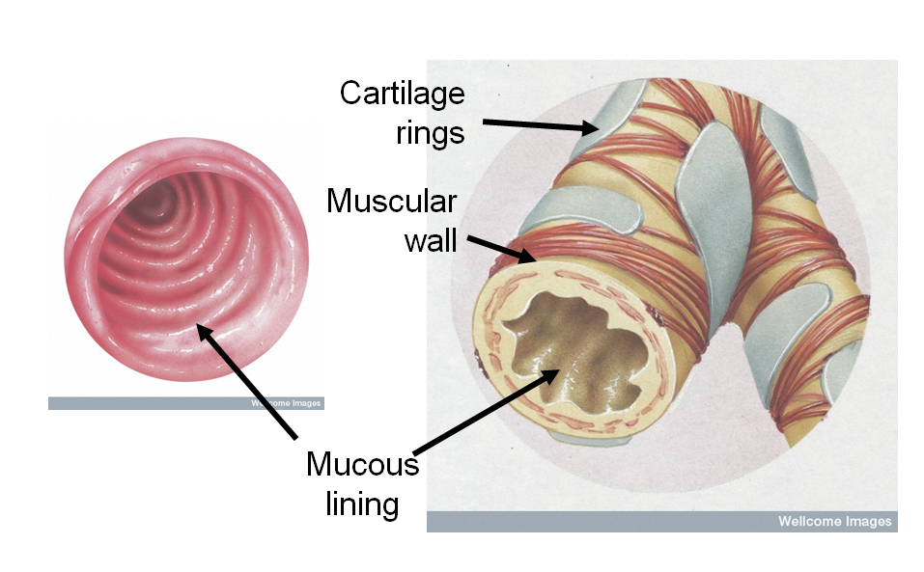
Bronchial Tree Structure
The trachea & bronchi are reinforced with C-shaped rings of cartilage. These prevent the tubes collapsing during inhalation.

Slide 14
Lungs

Slide 15
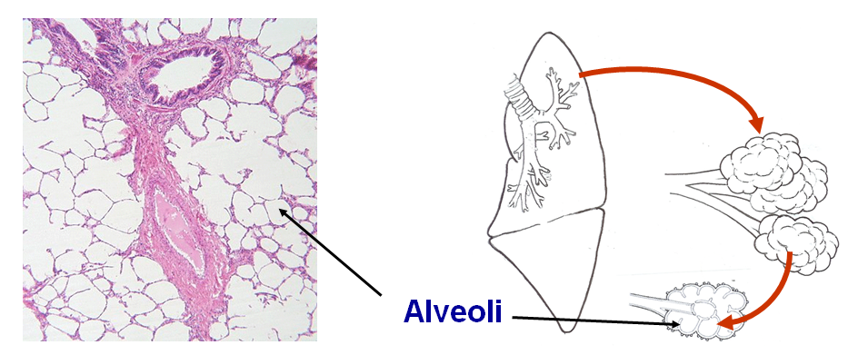
Alveoli Structure and Function
The bronchioles terminate in microscopic clusters of air sacs called the alveoli. These make up most of the lung
Gas exchange takes place in the alveoli

Slide 16
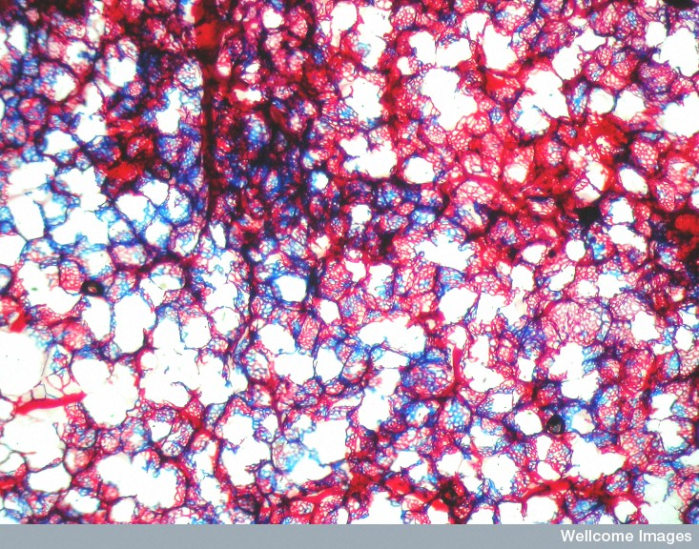
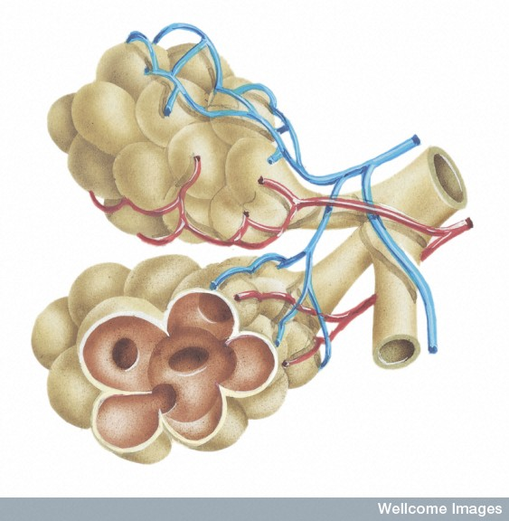
Alveoli Structure and Function
Alveoli are well supplied with blood capillaries = increasing efficiency of Gas exchange (taking in O₂ around the body, and removing CO₂)

Slide 17
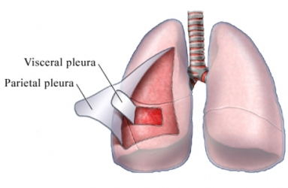
Pleural Membranes (Pleura) Structure and Function
Double layered – 2 layers: Visceral and Parietal
These linings lubricate chest movements, and help to keep lungs in position. Contains a pleural cavity between layers filled of pleural fluid which lubricates the surfaces and allows the layers to slide against each other easily during respiration.

Slide 18
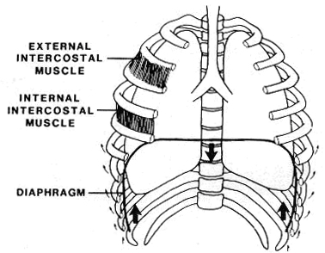
Diaphragm and Intercostal Muscles Structure and Function
Diaphragm and Intercostal Muscles (rib muscles)
These muscles are involved in contracting and relaxing during inspiration and expiration to change the volume of the thoracic cavity, and therefore changing the volume of lungs.

Slide 19
Gas Exchange
The primary role of the respiratory system is to perform gas exchange.

Slide 20
Respiratory surfaces and the exchange of gases (page 92)
The lungs are well suited to their function of gas exchange because:
Alveoli and lungs have a large internal surface (millions of alveoli in the lungs) = more area for gas exchange to occur
Each alveoli is well supplied with blood vessels
Bloody continuously moved through blood vessels = maintain gradient for diffusion
Membrane of the alveoli are thin (1 cell thick) = easy diffusion
Alveoli are covered in a thin layer of moisture as gases must be dissolved to diffuse
Lungs are positioned deep in the body to prevent excess evaporation
Lung volume can be changed by movements of respirator muscles. Causing constant movement of air into and out of the lungs = maintain gradient for diffusion

Slide 21
Concentration Gradients and Gas Exchange
Concentration gradients are required for gas exchange to occur.
The blood in the capillaries around the alveoli has a low oxygen concentration (as it has already delivered all the oxygen to the cells and returning to the lungs)
the air outside (in the alveoli) is high in oxygen concentration.
Oxygen will move from high to low concentration = from the alveoli to the blood capillaries.

Slide 22
Concentration Gradients and Gas Exchange
Oxygen dissolves in the moisture on the inside of the alveolus and diffuses through the membrane, through the walls of the capillaries and into the blood.
The blood in capillaries around the alveoli are high in Carbon Dioxide (has come from the cells and picked up the wastes)
Carbon dioxide diffuses out of the blood and into the air in the alveolus
Thus the expired air contains less oxygen, and more carbon dioxide, than inspired air.

Slide 23
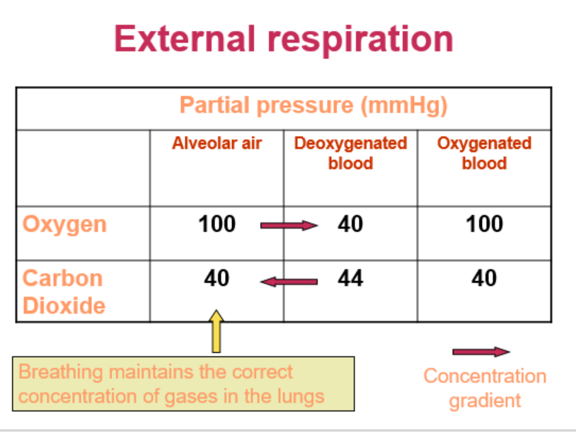

Slide 24
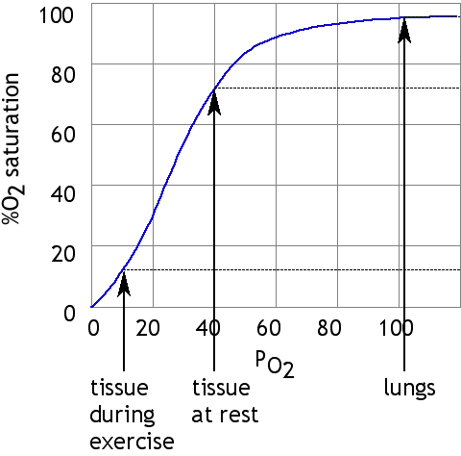
Oxygen Saturation

Slide 25
Breathing and Respiration

Slide 26
Breathing and Respiration
Breathing | Respiration
Breathing (sometimes referred to as ventilation) is the process of moving air into and out of the lungs. The purpose of breathing is to exchange oxygen and carbon dioxide between the lungs and the air . | Respiration is the transport of oxygen from the air to the tissues and the transport of carbon dioxide in the opposite direction. [not to be confused with the process of cellular respiration discussed earlier]

Slide 27
Internal and External Respiration
External respiration is the movement of O₂ and CO₂ between the lungs and the bloodstream.
Internal respiration is the exchange of O₂ and CO₂ between the blood and the tissues that need it.

Slide 29
Inspiration and Expiration - ventilation
Air flows from areas of higher pressure to areas of lower pressure.
INSPIRATION – taking air into the lungs
EXPIRATION – removing air from lungs

Slide 30
Thoracic Volume
Volume and pressure changes are important in allowing ventilation to occur.
Changing the thoracic volume changes the pressure inside the lungs
Increase thoracic volume = decrease pressure inside lungs
Decrease thoracic volume = increase pressure inside lungs

Slide 31
Thoracic Volume

Slide 32
Inspiration
Pressure of air in the lungs is less than outside.
Low pressure inside is achieved by increasing the volume of the lungs.
Diaphragm and external intercostal muscles contract – becomes flatter
Rib cage moves outwards and upwards and diaphragm moves downwards
Air flows in until the pressure becomes equal.
During normal breathing mainly diaphragm involved. Heavier inspiration, movements of the rib cage become more important.

Slide 33
Expiration
Pressure of air in the lungs is greater than outside.
High pressure inside is achieved by decreasing the volume of the lungs.
Diaphragm and external intercostal muscles relax.
Diaphragm moves back upwards into the chest cavity and rib cage moves downwards and inwards.
Lung volume reduces and air is greater inside = thus air flows out until pressures are equal.
At rest, expiration is a passive process. During forceful expiration, the intercostal muscles contract to actively lower the rib cage

Slide 34
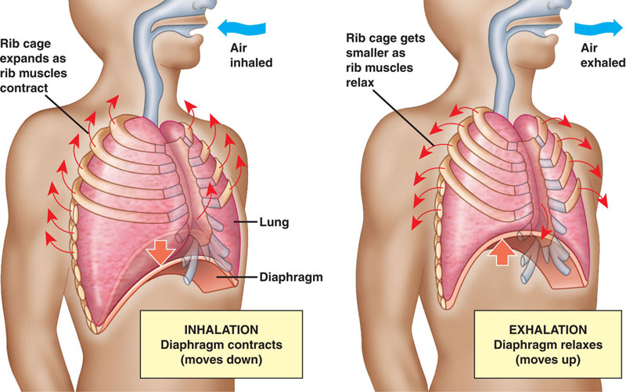

Slide 35
EFFECTS OF LIFESTYLE ON the gas exchange page 93-95
Emphysema
Lung Cancer
Lung Infections
Asthma

Slide 36
DO: Questions in the text
Complete a glossary using the key words from chapter 4 (Page 198)
Complete all Chapter 4 Review Questions (Page 99-100)
Prepare your own notes

