Slide 1
Year 9 Chemistry
R. Johansen 2017

Slide 2
What can you remember???
In 5 minutes record down as many names of elements and their appropriate symbols as possible.
For example:
Oxygen - O

Slide 3
Watch!
https://www.youtube.com/watch?v=_lNF3_30lUE
https://www.youtube.com/watch?v=yQP4UJhNn0I

Slide 4
What is an atom?
All of matter is made up of atoms
Atoms themselves are made up of sub-atomic particles
These sub-atomic particles are:
Protons
Neutrons
Electrons

Slide 5
What does an atom look like?
We don’t know for certain (as they are very tiny), however there have been many proposed models
What we do know is that a vast part of the atom is empty space. This is the area surrounding the nucleus. The electrons orbit around the nucleus in this empty space.
The nucleus is very dense (contains lots of mass). This is where we will find protons and neutrons.

Slide 7
Sub-atomic particles and atomic structure
An atom has a neutral charge
The sub-atomic particles in an atom have different charges. When these charges are combined they should be neutral.
Protons = Positively charged
Neutrons = Neutrally charged
Electrons = Negatively charged
Therefor in a neutral atom the number of protons should equal the number of electrons

Slide 8
Atoms and elements?
Elements are substances made up of one type of atom. For example carbon
So what makes atoms different from one another?
Different atoms have a different number of subatomic particles (protons, neutrons and electrons) from one another.
For example:
Type of Atom | Number of Protons | Number of Neutrons | Number of Electrons
Sodium | 11 | 12 | 11
Fluorine | 9 | 10 | 9

Slide 10
aTOMS HAVE MASS
The sub-atomic particles that make up the atom all have mass.
On the relative atoms scale the mass of these particles are as follows:
Proton = 1
Neutron = 1
Electron = 1/100
Because protons and neutrons are much heavier than electrons, these particles make up the majority of the mass of an atom.
This explains why the nucleus is so dense (as protons and neutrons are found in the nucleus)
Therefore the total number of protons and neutrons is known as the mass of the atom. We call this the atomic mass.
Atomic mass is represented by the mass number of each atom.

Slide 11
Atomic mass
If we refer back to the table below, we can add in the atomic mass of the following types of atoms:
Can you predict the atomic mass of sodium and fluorine?
Type of Atom | Number of Protons | Number of Neutrons | Number of Electrons | Atomic Mass (Mass Number)
Sodium | 11 | 12 | 11
Fluorine | 9 | 10 | 9

Slide 12
Atomic mass
Type of Atom | Number of Protons | Number of Neutrons | Number of Electrons | Atomic Mass (Mass Number)
Sodium | 11 | 12 | 11 | 23
Fluorine | 9 | 10 | 9 | 19
Use the following method to calculate atomic mass (mass number):
Number of Protons + Number of Neutrons = Mass Number

Slide 13
Give it a try
Complete the following table using the information you have just learnt:
Remember:
Atoms are neutral (number of protons = number of electrons)
The mass of an atoms comes from the nucleus. Protons and Neutrons have a relative mass of 1
Type of Atom | Mass Number (to the whole number) | Number of Protons | Number of Neutrons | Number of Electrons
Barium (Ba) | 137 | 56 |  | 56
Carbon (C) |  | 12 | 12
Oxygen (O) | 16 |  | 8
Potassium (K) |  |  | 20 | 19
Helium (He) |  | 2 | 2

Slide 14
Representing atoms
When we look at the periodic table elements (represented by the type of atom they are made up of) are displayed using symbols and a series of numbers.
What do these represent?

Slide 15
General rule for representing atoms

Slide 16
Do!
Complete CYLQ 7.3 on page 139 Oxford

Slide 17
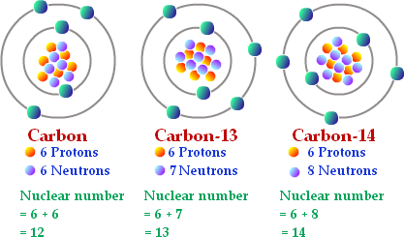
Isotopes
Isotopes of an element have the same number of protons and electrons as an atom, however they have a different number of neutrons.
This changes the mass number making the isotope heavier of lighter than the atom

Slide 18
Electron Configuration
As we know, electrons orbit around the nucleus in the empty space of an atom
Whilst these electrons are always moving, there is a pattern to their locations
Electrons are organised into ‘shells’. This means that only a certain number of electrons follows the same orbit path
The number of electrons which can be located in each shell follows the 2, 8, 8, 2 rule
Nucleus
Max 2 electrons
Max 8 electrons
Max 8 electrons

Slide 19
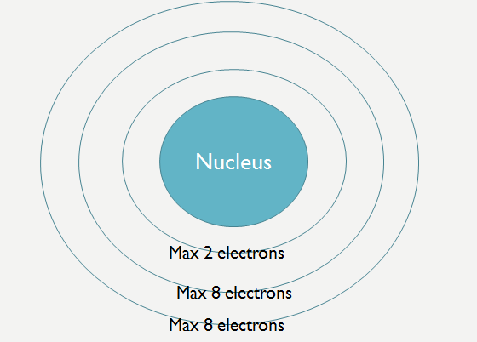
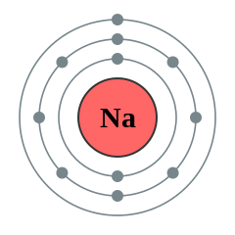
Electron configuration rules
Work out how many electrons in your atom
For example:
Sodium has 11 electrons
Fill up the shells until all electrons are represented. The last shell does not need to be full.
For example:
Shell 1 has 2 electrons (11 – 2 = 9 electrons left)
Shell 2 has 8 electrons (9 – 8 = 1 electrons left)
Shell 3 has 1 electron

Slide 20
Do!
Have a try at showing the electron configuration for the atoms on the handout provided…

Slide 21
Reminder!
Don’t forget to practice your elements symbols!!

Slide 22
Recall - Periodic table and metals and non metals
On your blank periodic table in your booklet - Colour in all the metals, non metals and metalloids.

Slide 23
Valencies – Ions - Ionic Compounds
Note: It is very important you know this concept before moving on. You must also practice everyday to learn your valencies!
Remember we have just learnt about how an atom is neutral meaning it has the same amount of protons (+ve) and electrons (-ve).
Atoms (neutral) can turn into IONS which are charged atoms
The way they do this is by losing or gaining electrons in their valence shell (the outer shell of electrons).
Ions occur so that ionic compounds (2 or more ions join together) can be formed. Ionic compounds are neutral like atoms.

Slide 24
Atoms to ions
Atoms (neutral) become ions (charged) by gaining or losing electron in their valance (outer) shell.
This causes the ion to either have more or less electrons than protons
Ions that have lost electrons become positively changed (more protons than electrons)
Ions that have gained electrons become negatively charged (more electrons than protons)
An atom will lose or gain as many electrons are in their valence (outer) shell
Therefore the possible charges for an ion include:
Number of electrons lost | 1 | 2 | 3 | 4
Charge | +1 | +2 | +3 | +4
Number of electrons gained | 1 | 2 | 3
Charge | -1 | -2 | -3

Slide 25
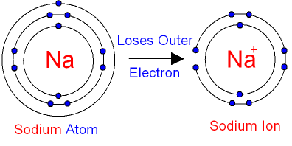

Slide 26
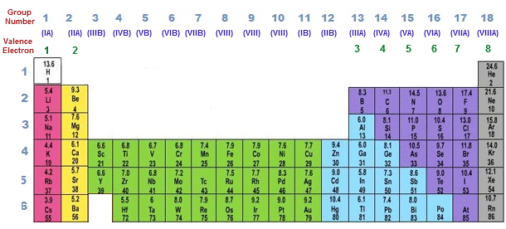
How do we know which atoms lose and gain electrons?
If we look at the periodic table we can see patterns that tell us how many electrons in the valence shell of each atom:
Add this annotation to your periodic table in your booklet

Slide 27
Why do atoms gain or lose electrons
Electrons gain or lose electrons to have a full outer shell of electrons
Electrons are easier to lose than gain. This is why atoms with 4 electrons on the outer shell will chose to lose 4 electrons rather than gain 4.
Once the atom has lost/gained electrons it is no longer neutral = now called an ion and is charged

Slide 28
Groups
The groups tell us how many valance electrons (electrons in the outer shell) each atom has.
These groups help to tell us whether atoms will gain or lose electrons.
Electrons will only be gained or lost from the outer shell
All of these atoms have 1 electron in their outer shell = Group 1

Slide 29
Groups – electron exchange - ion formation
Group Number | Valence Electrons (electrons on outer shell) | Gain or lose electrons? | Charge of Ion
1 | 1 | Lose 1 | 1+
2 | 2 | Lose 2 | 2+
3 | 3 | Lose 3 | 3+
4 | 4 | Lose 4 | 4+
5 | 5 | Gain 3 | 3-
6 | 6 | Gain 2 | 2-
7 | 7 | Gain 1 | 1-
8 | 8 | Do not gain or lose | 0

Slide 30
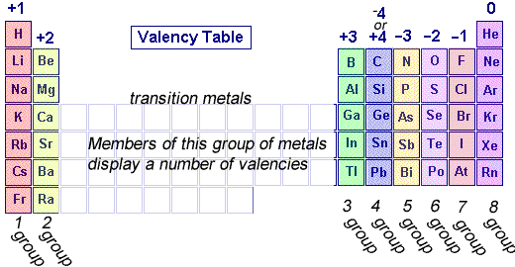
valency
The charge of the ion is known as the ions valency
This is important as it helps us to from ionic compounds
You will need to be able to identify the valency of ions using the periodic table!

Slide 31
Valency and the period table
Copy the valencies for each group on to your blank periodic table

Slide 32
watch
https://www.youtube.com/watch?v=utLoRJootfY
https://www.youtube.com/watch?v=900dXBWgx3Y

Slide 33
Valencies of ions you will need to know….
1+ Lose 1 electron Group 1 | 2+ Lose 2 electrons Group 2 | 1- Gain 1 electron Group 11 | 2- Gain 2 electrons Group 12
H⁺ | Mg²⁺ | F⁻ | O²⁻
Na⁺ | Ca²⁺ | Cl⁻ | S²⁻
K⁺ | Cu²⁺ | Br⁻
Ag⁺ | Zn²⁺ | I⁻
 | Pb²⁺
 | Al²⁺

Slide 34
Valencies of polyatomic ions you will need to know
Polyatomic ions are ions that are formed by joining one or more atoms (2 non – metals). You will need to memorize the name, symbol and valency of the following:
Atoms that are combined | Symbol for polyatomic ion | Name of polyatomic ion | Valency
Nitrogen (N) and Hydrogen (H) | NH₄ | Ammonium | NH₄⁺
Oxygen (O) and Hydrogen (H) | OH | Hydroxide | OH⁻
Nitrogen (N) and Oxygen (O) | NO₃ | Nitrate | NO₃⁻
Carbon (C) and Oxygen (O) | CO₃ | Carbonate | CO₃²⁻
Sulfur (S) and Oxygen (O) | SO₄ | Sulfate | SO₄²⁻

Slide 35
Ions and ionic structure
Remember the table that we used for atomic structure (neutral atoms):
Type of Atom | Number of Protons | Number of Neutrons | Number of Electrons | Atomic Mass (Mass Number)
Sodium (Na) | 11 | 12 | 11 | 23
Fluorine (F) | 9 | 10 | 9 | 19
Let’s now compare the structure of a Sodium and Fluorine atom with that of their ions…..
Atom / Ion | Number of Protons | Number of Neutrons | Number of Electrons | Atomic Mass (Mass Number)
Na | 11 | 12 | 11 | 23
Na⁺ | 11 | 12 | 10 | 23
F | 9 | 10 | 9 | 19
F⁻ | 9 | 10 | 10 | 19

Slide 36
Ions - cations and anions
Cation is a name given to an ion that loses electrons to become positively charged
These are all metals
Anion is a name given to an ion that gain electrons to become negatively changed
These are non-metals

Slide 37
Ions – cations and anions
You will notice that the anions take a name different to the element.
Anions end in ‘ide’
For example:
Hydrogen = Hydride
Oxygen = oxide
Cations are named the same as the original element.
(no change is made)
For example:
Sodium = Sodium

Slide 38
Ionic compounds
Ionic compounds are formed when cations (metals) and anions (non – metals) are combined.
The cation and anion will join together at the valence (outer) shell of electrons. They will form a neutral ion (with no charge)
This means that the valency of each ion is important to determine the ratio of how many cation and ions are needed to combine to make a neutral ionic compound.

Slide 39
Rules for ionic compounds
A cation (metal – positive charge) must be combined with a anion (non-metal – negative charge)
The cation is always named first. The name does not change
The anion is always named second. The name ends in ‘ide’
If more than one of either ion is required (based on valencies) the number is always written as a subscript after the symbol.
If more than once polyatomic ion is required brackets must be put around the polyatomic ion first and then the subscript can be used

Slide 40
Watch!
https://www.youtube.com/watch?v=mKo72RnN37E (watch the first 2 minutes)
https://www.youtube.com/watch?v=ptAw20kem90

Slide 41
Radiation - radioisotopes
If we break the word down… Radioisotopes are radioactive isotopes
We should recall than and isotope is an element that has the same number of protons and electrons as an atom, however they have a different number of neutrons.

Slide 42
Radioisotopes
Some isotopes are unstable due to their mismatched number of neutrons and protons.
Eventually they will undergo spontaneous “radioactive decay”.
This means that the nucleus will emit either a particle, or energy, or both.
There are three possible radio-decay reactions: alpha, beta and gamma.

Slide 43
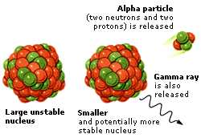
Alpha radiation
An alpha particle is the same as a He-4 nucleus: 2 protons and 2 neutrons.
They are “large”, slow moving and have a double positive charge.
These characteristics make them highly reactive and restrict the distance they travel.

Slide 44
Alpha decay equation
The new atom created by alpha decay has an atomic number that decreases by two, and a mass number that decreases by 4:

Slide 45
Alpha decay equation
Using your periodic table, write alpha decay equations for the following isotopes:
U – 238
Ra – 222
Po - 214

Slide 46
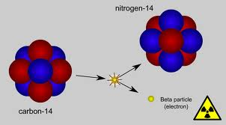
Beta radiation
This is the emission of an electron from a nucleus.
This occurs when a neutron spontaneously turns itself into a proton and an electron.
This means the new atom has one more proton than the original, but the same mass number.
Beta particles are light, fast and have a single negative charge.
This makes them more penetrating than alpha particles, so they travel further.

Slide 47
Beta decay equation

Slide 48
Beta decay equation
Using your periodic table, write beta decay equations for the following isotopes:
Th – 234
I – 131
Sr - 90

Slide 49
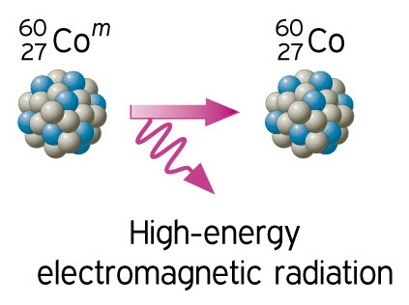
Gamma radiation
Gamma radiation (rays) is a very powerful and energetic form of light.
All nuclear decay reactions release gamma rays.
Some isotopes can release gamma rays without emitting a particle.
Protons and neutrons rearrange themselves into a more stable configuration.
Energy, in the form of gamma rays is emitted.
This loss of energy helps make the nucleus more stable.

Slide 50
Gamma decay equation

Slide 51
watch
https://www.youtube.com/watch?v=5oUagoF_viQ
https://www.youtube.com/watch?v=KWAsz59F8gA

Slide 52
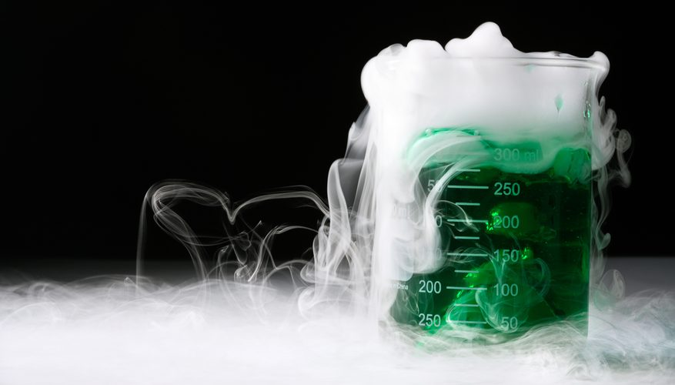
What is a chemical reaction?
We can observe the following when a chemical reaction has occurred:
Change in temperature
Change in colour
Change in smell
Change in state
Sounds may be heard
Light my be emitted

Slide 53
Representing chemical reactions
Reactants = the substances that have been combined together. These will ‘react’ with one another
Products = the new substances ‘produced’ after the chemical reaction has occurred
Reactants → Products
Vinegar (acetic acid) + sodium bicarbonate → sodium acetate +carbon dioxide + water

Slide 54
Conservation of mass
The total mass of the reactants before the chemical reaction = the total mass of the products after the chemical reaction
Even though the products formed are different to the reactants at the start, the total amount of matter (and therefore mass) is the same before and after the change.
Reactants → Products
(mass 1 = mass 2)

Slide 55
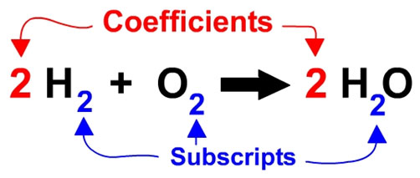
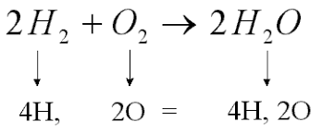
Balancing equations
When given chemical equations, to account for the conservation of mass, the number of elements in the reactants must be the same as the total number of elements in the products.
To do this, big numbers (coefficients) are put at the front of each product and reactant as required.

Slide 56
Do!
Complete CYLQ 1-5 on page 157 of Oxford
Complete CYLQ 1-5 on page 159 of Oxford

Slide 57
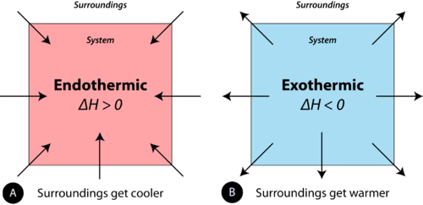
Exothermic and Endothermic reactions
Remember: Chemical reactions can cause a change in temperature (Thermal Energy)
Chemical reactions can either be:
Exothermic or Endothermic
Exothermic Reaction | Endothermic Reactions
Heat exits the reaction to the surroundings Heat is released to the external environment | Heat enters the reaction from the surroundings Heat is taken in to the internal environment
Match Burning (Combustion) Respiration Neutralisation Reactions | Process of Melting (Ice → water) Photosynthesis

Slide 58
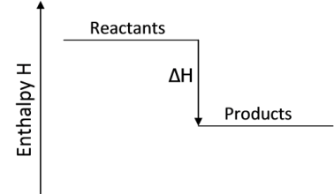
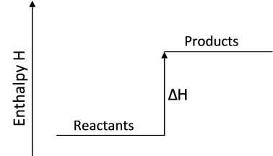
Exothermic and Endothermic Reactions

Slide 59
Do!
Complete CYLQ 1 – 6 on page 161 of Oxford

Slide 60
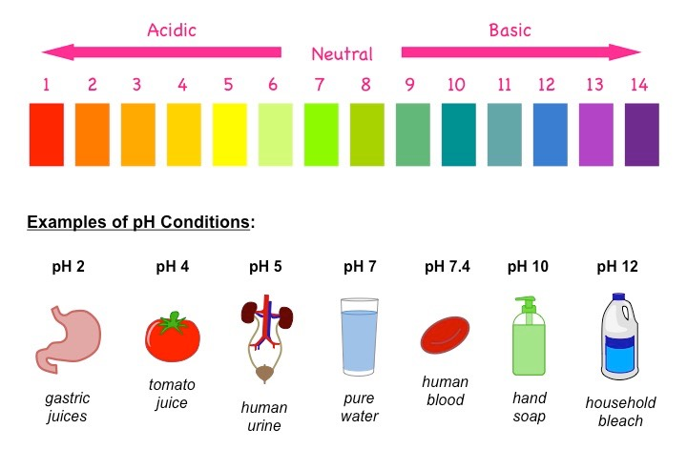
Acids and Bases
Acids and bases have different properties and are measured using the pH scale.
Very acidic substances = pH 1
Weak acidic substance = pH 6
Neutral substance = pH 7
Weak basic substance = pH 8
Very basic substances = pH 14

Slide 61
Watch
https://www.youtube.com/watch?v=gRZ-2IbLd34

Slide 62
Characteristics of acids and bases
 | Acids | Bases
React with metals? | Yes | No
Turns litmus paper | Red | Blue
Tastes | Sour | Bitter
Produces the following when combined with water: | H⁺ | OH⁻

Slide 63
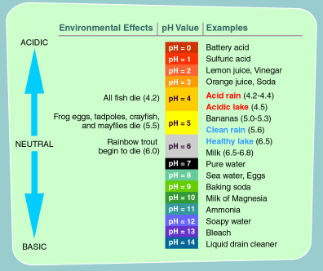
Ph scale
pH – ‘Possible Hydrogen’
Measured using a Universal Indicator

Slide 64
Do!
Complete the practical activity ‘Identifying acids and bases’
Complete CYLC 1-6 on page 163 of Oxford

Slide 65
Acid and Metal Reactions
When acids and metals react they create hydrogen and a salt
Metal + acid → salt + hydrogen
Magnesium + hydrochloric acid → magnesium chloride + hydrogen
Mg + 2HCl → MgCl₂ + H₂

Slide 66
Oxidation reactions
Occurs when an element reacts with oxygen
Metal + oxygen → metal oxide
Magnesium + oxygen → magnesium oxide
Non metal + oxygen → molecular compound
Hydrogen + oxygen → water

Slide 67
Hydrocarbons
Hydrocarbons contain the elements hydrogen and carbon
Hydrocarbons are one of the most common fuels used to produce energy n generators, engines and motors.
When hydrocarbons burn they produce carbon dioxide and water. This is called a combustion reaction.
Fuel + oxygen → carbon dioxide + water
Hydrocarbon + oxygen → carbon dioxide + water
Methane + oxygen → carbon dioxide + water
CH₄ + 2O₂ → CO₂ +2H₂O

