Slide 1
Work done
STARTER – remember W = F x D

Slide 2
Why is there a difference between the two cranes? What do you think will happen?
Notes:
Teacher notes
This animation could be used to introduce the concept of power as the rate at which work can be done (or energy transferred).

Slide 3
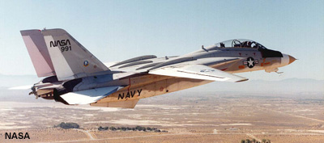
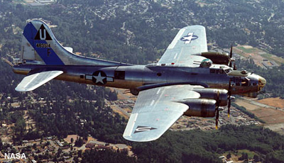
Which is most powerful?
Power is the rate at which work is done/energy transformed.
A more powerful engine therefore does work (i.e. transfers energy) faster than a less powerful engine.
Both these planes are about the same mass but the jet has more powerful engines.
This means that chemical energy in the fuel can be transferred to kinetic energy faster so it will have greater acceleration and a higher top speed.
Notes:
Photo credit (top): NASA Dryden Flight Research Centre
F-14 Tomcat
Photo credit (bottom): NASA
B-17 Flying Fortress

Slide 4
Power!
Power is the amount of energy transformed (changed) per second.
It is measured in Watts (1 Watt = 1 J/s)
Power = Energy transformed (work done)
time

Slide 5
How is power calculated?
The power exerted by an object can be calculated using this equation:
power =
work done
time taken
Work done is measured in joules (J).
Time is measured in seconds (s).
Power is measured in watts (W).
Remember that work done = energy transferred.
Notes:
Teacher notes
Students could be informed that 1W = 1J/s.

Slide 6
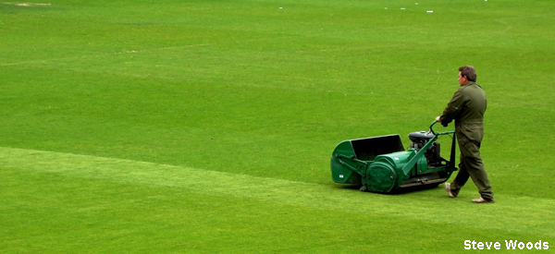
Calculating power question 1
A lawnmower engine does 10 kJ of work in 10 seconds. What is the power of the engine?
power =
work done
time
= 10,000 / 10
= 1,000 W = 1 kW
Notes:
Photo credit: Steve Woods

Slide 7
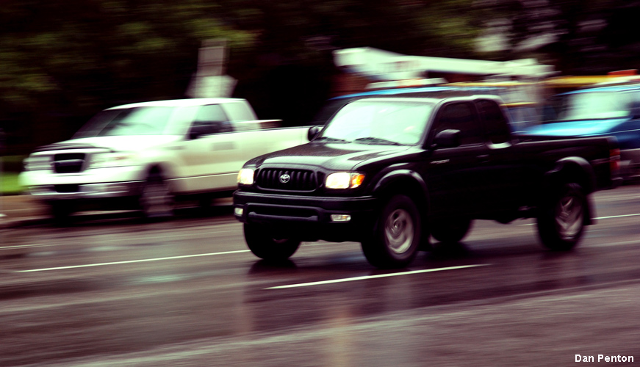
Calculating power question 2
A car transfers 12 MJ of energy in 2 minutes. What is the power of the car?
power =
work done
time
=
energy transfer
time
= 12,000,000 / 120
= 100,000 W = 100 kW
Notes:
Photo credit: Dan Penton

Slide 8
Power, work and time calculations

Slide 9
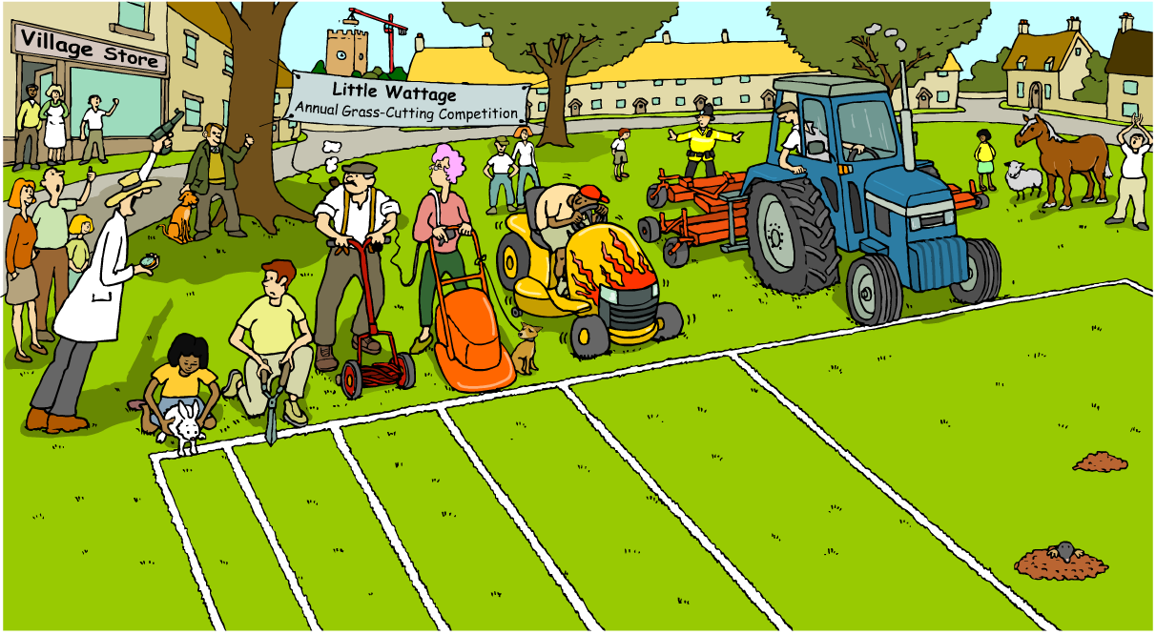
More power!
What advantages and disadvantages are there in using a more powerful machine?

Slide 10
How is power related to fuel consumption?
Which plane will consume fuel the fastest?
The jet plane will have a higher fuel consumption than the propeller plane because its engines are more powerful.
A higher-powered engine will consume fuel more quickly than a lower-powered engine because it transfers energy at a faster rate. However, more work will be done in the same time.
Notes:
Photo credit (top): NASA Dryden Flight Research Centre
F-14 Tomcat
Photo credit (bottom): NASA
B-17 Flying Fortress

Slide 11
Let’s prove it for ourselves! We can calculate our power output because we are machines!

Slide 12
Extension
1. Anuar runs up a 2.91-meter high flight of stairs at a constant speed in 2.15 seconds. If Anuar’s mass is 55.9 kg, determine the work which he did and his power rating.
2. On a recent adventure trip, Lucia went rock-climbing. Lucia was able to steadily lift her 45.0-kg body 20.0 meters in 100 seconds. Determine Lucia's power rating during this portion of the
climb.
3. Hina owns a family of squirrels. The squirrels have been trained to do push-ups in
repetitive fashion. Being connected to an electrical generator, their ongoing exercise is used to help power the home.
There are 23 squirrels in the family and their average mass is 1.1 kg.
They do work on the "up" part of the push-up, raising their body an average distance of 5.0 cm.
If the squirrels averages 71 push-ups per minute, then determine the total amount of work done in one minute and the power generated by their activity
4. An elevator motor lifts 715 kg of mass to the height of the fourth floor of an office building (11.0
meters above ground level) at a constant speed in 9.35 seconds. Determine the power rating of the
motor.

