Slide 1
British Empire 1750’s

Slide 2
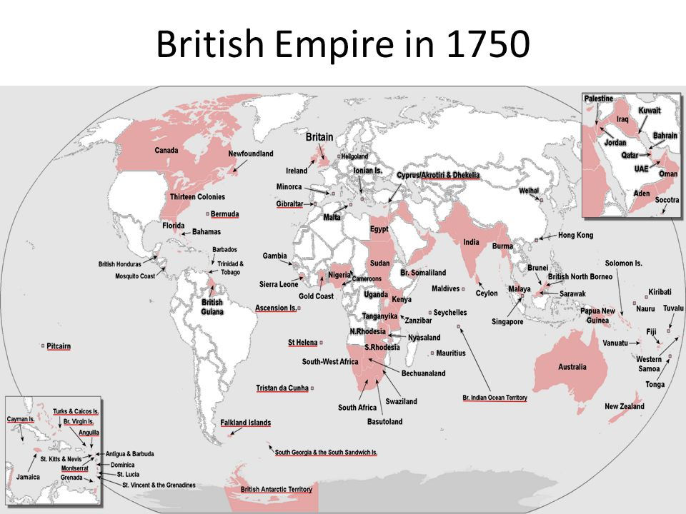

Slide 3
Canada
Newfoundland
13 colonies
Florida
Bahamas
Bermuda
Barbados
British Gulana
Falkland Islands
British Antarctic
Ireland
Britain
Cyprus
Minorca
Egypt
Sudan
Gambia
Sierra Leone
Gold Coast
Jordan
Malaya
Singapore
Australia
New Zealand
Tonga
Western Samoa
Nigeria
Cameroons
Uganda
Kenya
Tanganyika
Zanzibar
South-West Africa
N. & S. Rhodesia
South Africa
Basutoland
Swaziland
Maldives
India
Burma
Palestine
Iraq
Kuwait
Bahrain
Qatar
UAE
Oman
Aden
Hong Kong
Papua New Guinea
Fiji
Nauru
Solomon Islands

