Slide 1
Nervous System 2023
Topic 2: Transmission of a Nerve Impulse

Slide 2
What are Nerve Impulses?
Nerve impulses are the electro chemical messages that travel along the nerve fibre.
Nerve impulses occur quickly to allow the body to respond to change rapidly, however the rate of different impulses may vary (myelinated v unmyelinated neurons)
Nerve impulses are electrochemical changes that travels along the nerve fibres.
Electrochemical changes = change in electrical voltage brought about by the change in concentration of ions inside and outside of the cell membrane

Slide 3
How do electrochemical changes occur?
Recall some electrical concepts:
There are two electrical charges:
Positive
Negative
Like charges repel and opposite charges attract
The potential difference of two places can be measured (voltage) in volts
When chemical substances dissolve in water they break into ions. Ions are charged particles.
The environment inside the cell (intracellular) and outside the cell (extracellular)contains charged ions that can move across the membrane with the help of membrane proteins

Slide 4
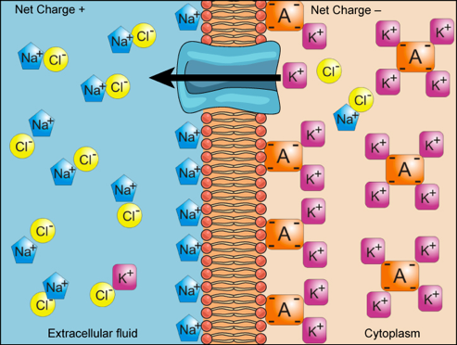
Potential difference across the nerve cell membrane
Some common ions found inside/outside of cells include:
Sodium (Na⁺)
Potassium (K⁺)
Chloride (Cl⁻)

Slide 5
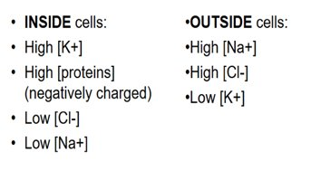
Resting Membrane Potential (RMP) -70mV

Slide 6
Resting Membrane Potential (RMP) -70mV
The difference in concentrations of ions means that there is a potential difference between the inside and outside of the cell across the cell membrane = membrane potential.
Resting membrane potential occurs when the neuron is unstimulated.
RMP is –70mV meaning that the inside is 70 mV less than the outside of the cell.

Slide 7
Resting Membrane Potential (RMP) -70mV
At rest ions are still being moved across the cell membrane. The net movement of ions at rest maintains the RMP of –70mV.
Ions move though protein channels in the plasma membrane. Some of these are called leakage channels which are open all the time.
Voltage gated channels only open when a nerve is stimulated.

Slide 8
Resting Membrane Potential (RMP) -70mV
The RMP of neurons is mainly due to the movement of sodium and potassium ions.
Concentration of sodium ions (+) is approx. 10x higher outside than inside the cell. Due to limited number of sodium leakage channels which limits facilitated diffusion of sodium ions into the cell.
Concentration of potassium ions (+) is approx. 30x higher inside than outside the cell. Due to large number of potassium leakage channels which means more potassium ions are able to diffuse than sodium ions.
Concentration of chloride ions (2+) is higher outside than inside the cell due to the membrane being highly permeable to chloride ions.
Concentration of large negatively charged organic ions is higher inside the cell than outside. The membrane is impermeable to these ions so they are unable to leave the cell.

Slide 9
Resting Membrane Potential (RMP) The Sodium-Potassium Pump
In addition to sodium and potassium ion leakage channels these ions are moved across the membrane through a carrier protein (active transport) called the sodium-potassium pump.
The pump moves 2 potassium into the cell for every 3 sodium it moves out of the cell.
This results in a net reduction of positive ions inside the cell hence RMP = -70mV
At RMP the membrane is described as POLARISED

Slide 10
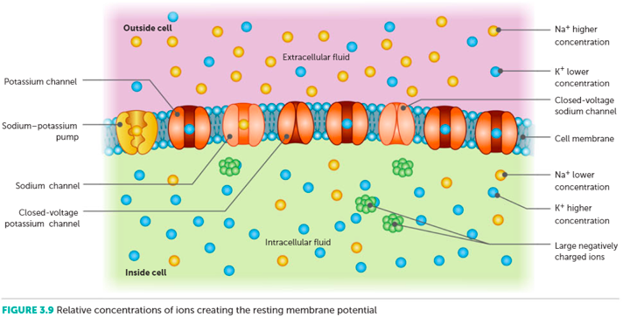
Nelson Net Human Perspectives

Slide 11
Still confused? Watch this at home!
https://www.youtube.com/watch?v=hk09AkV5_Kc

Slide 12
From RMP to an generation of an Action Potential
Key terminology
RMP = the membrane potential of an unstimulated nerve cell (-70mV = polarised).
Action potential = the rapid depolarisation and repolarisation of the entire length of the axon
Depolarisation = the process of increasing the membrane potential
Repolarisation = the process of decreasing the membrane potential back to RMP (polarised state)
Nerve impulse = the electrochemical change (action potential) that travels along the membrane of a nerve cell; the message carried by a nerve

Slide 13
Watch! How to generate an Action Potential
https://www.youtube.com/watch?v=BbUcWbtVjT4

Slide 14
Depolarisation
A stimulus is received by the dendrites and the ligand gated channels on the pre-synaptic neuron are stimulated to open.
This causes sodium ions to move into the cell and the membrane potential to rise (less negative) = slow depolarisation occurs
If the stimulus is strong enough, causing the membrane potential to rise more than 15mV (to –55mV) the threshold has been met and an all-or-none response will occur.
This means that the movement of sodium ions moves into the cell proceeds independently of the stimulus. The size of the response is not related to the strength of the stimulus.
The sodium voltage gated channels are stimulated to open and sodium ions rush into the cell = rapid depolarisation occurs
The membrane potential rises rapidly due to the influx of positive sodium ions
When the membrane potential reaches +40mV the membrane is said to be depolarised and the sodium voltage gated channels are stimulated to become inactive and close.
At max depolarisation the number of sodium ions entering the cell = the number of potassium ions leaving the cell = no net movement of ions.

Slide 15
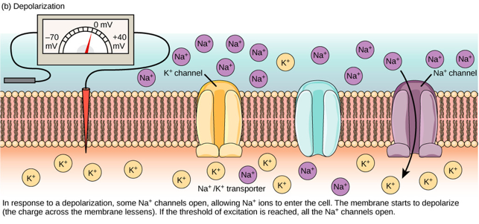

Slide 16
Repolarisation
Sodium voltage gated channels are stimulated to close at +40mV. These channels have an inactive state so the rapid movement of sodium ions into the cell stops immediately.
Potassium voltage gated channels are stimulated to open. Potassium ions rushes out of the cell. Sodium-potassium pump is also active.
Causing the inside of the cell to become more negative than the outside decreasing membrane potential = repolarisation occurs
When the membrane is repolarised to –70mV the potassium voltage gates channels are stimulated to close. Potassium voltage gated channels do not have an inactive state so some potassium ions continues to leave the cell for a short period of time until the gates are closed.
This results in the membrane potential to drop below its resting state. An undershoot occurs whereby the membrane potential is now greater than –70mV (approx –90mV). The membrane is now said to be hyperpolarised. This increases the refractory period.

Slide 17
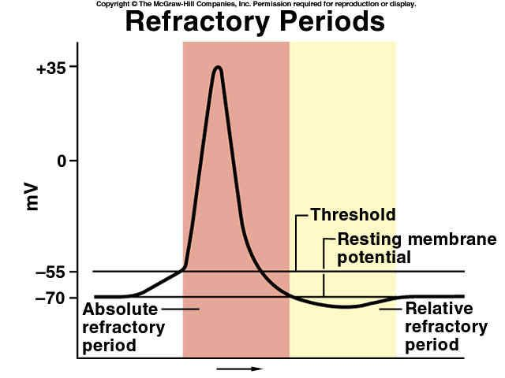
Refractory Period
During action potential and very briefly afterwards, that part of the nerve cannot be stimulated to respond again. This is called the refractory period.
Resting potential must be restored before the next impulse can be carried out.
This causes the impulse to only travel in one direction.
Therefore the refractory period effectively sets the limit of frequency of impulses along the neuron
The refractory period lasts from when the membrane reaches the threshold (-55mV) until it returns to RMP (-70mV).
https://eprojects.isucomm.iastate.edu/314-4-kbcm/2016/11/16/relative-refractory-period/

Slide 18
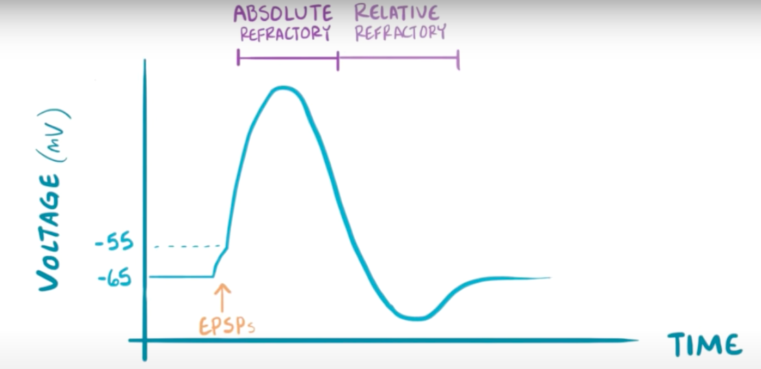
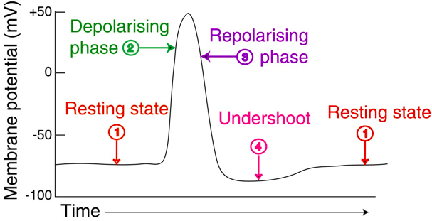
Tomorrow..... Action Potential Graph Annotation

