Slide 1
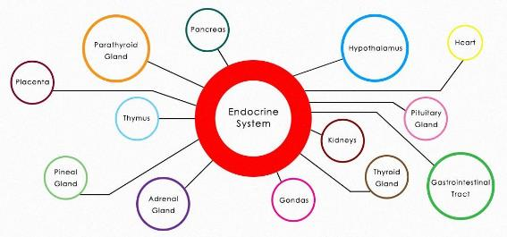
The Endocrine System
Hormonal Control

Slide 2
What changes happen in your body when you are surprised or frightened?

Slide 3
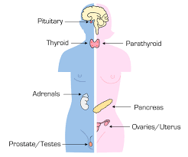
What is the endocrine system?
The endocrine system is a collection of glands, in the body, the secrete (release) hormones, which maintain control and regulate growth.
Pancreas
Pituitary gland
Thyroid gland
Parathyroid glands
Adrenal glands
Ovaries
Testes

Slide 4
What is a hormone?
Think-pair-share activity

Slide 5
What is a hormone?
A hormone is a chemical substance, produced in an endocrine gland, which acts as a messenger in the body
Each hormone acts on specific target cells

Slide 6
Can you think of any hormones that circulate in the body?

Slide 7
The endocrine system
Hormones are secreted directly into the bloodstream and travel around the body through the blood
Hormones do not effect all cells in the body, hormones are specific
Hormones only act on particular cells in the body. These are known as target cells
Different hormones have different chemical structures, meaning their shape varies, making it specific

Slide 8
The endocrine system
Target cells have receptors and a hormone only become active in cells that have receptors that fit the shape of the hormone
Once target cell receptors detects the correct hormone, the hormone tells the cell what to do
E.g. tell the cell to stop growing, change its shape or activity
https://www.youtube.com/watch?v=HXPCQBD_WGI

Slide 9
Plants have hormones too!
The endocrine system in the human body and other mammals is sensitive to changes to the internal environment
Plants are also sensitive to changes in their internal and external environments, and produce hormones
Auxin is an example of a hormone in plants
Auxin is involved in plant growth and growth responses
Other plant hormones include gibberellins, cytokinins and ethene

Slide 10
Nervous system Vs. Endocrine System
 | Nervous System | Endocrine System
Type of message | Electrochemical Messages | Chemical Messages
Method of transport | Neurons/nerve cells | Blood
Speed of reaction | Very quick | Slower than the nervous system
Duration of reaction | Short | Longer than the nervous system
Examples | Sensory response to touching a hot surface | Insulin to lower blood glucose levels

Slide 11
What now?
Read pg. 54-55 of the oxford text book
Complete the worksheet
If you complete the worksheet early, you can move on to making your own private notes in your notebooks

