Slide 1
YEAR 10 SCIENCE
Chemical Sciences
METALLIC BONDING

Slide 2
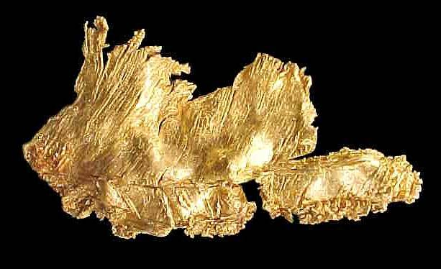
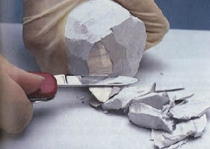
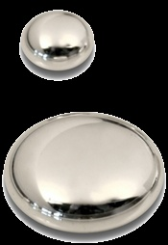
Examples of metals
Gold
Sodium
Mercury

Slide 3
Properties of metals
TRY: List all the common properties that metals have
Good conductors of electricity in solid and liquid form – as temperature increases electrical conductivity of solid metals decreases
Good conductors of heat in solid and liquid form – this is why metals feel cold to the touch
Malleable – can be hammered, pressed or bent into different shapes
Ductile – can be drawn into thin wires without breaking
Hard, dense solids at room temperature (Mercury is the only exception)

Slide 4
Bonding in metals
The diagram below shows metallic bonding
Positive metal ions
M⁺
M⁺
M⁺
M⁺
M⁺
M⁺
M⁺
M⁺
M⁺
M⁺
M⁺
M⁺
‘Sea’ of delocalised electrons from valence shell
M⁺
M⁺
M⁺
M⁺
M⁺
M⁺

Slide 5
Metallic Bonding and Properties
Using the ‘electron sea’ model for metallic bonding, it is possible to explain the common properties of metals.
These are shown in diagrams and in text

Slide 6
Conduction of heat and electricity
Conduction of both heat and electricity is good because of the mobility of the delocalised electrons.
M⁺
M⁺
M⁺
M⁺
M⁺
M⁺
M⁺
M⁺
M⁺
M⁺
M⁺
M⁺
M⁺
M⁺
M⁺
M⁺
M⁺
M⁺

Slide 7
Malleability and ductility
The attractive forces between the delocalised electrons and the metal ions keep the lattice together even when it is pushed or pulled out of shape
M⁺
M⁺
M⁺
M⁺
M⁺
M⁺
M⁺
M⁺
M⁺
M⁺
M⁺
M⁺
M⁺
M⁺
M⁺
M⁺
M⁺
M⁺

Slide 8
Malleability and ductility
The attractive forces between the delocalised electrons and the metal ions keep the lattice together even when it is pushed or pulled out of shape
M⁺
M⁺
M⁺
M⁺
M⁺
M⁺
M⁺
M⁺
M⁺
M⁺
M⁺
M⁺
M⁺
M⁺
M⁺
M⁺
M⁺
M⁺

Slide 9
Hardness and Density EXT
Electrostatic bonds or forces are extremely strong and metal ions are held together tightly. The bigger the metal ion, the softer the metal.
Boiling points are high (and most melting points) because it takes a large amount of energy to overcome the electrostatic bonds

