Slide 1
Topic 1: Microscopes and Investigating
R. Johansen 2021
Chapter 1

Slide 2
Investigating

Slide 3
Key concepts in investigations
Variables
Aim vs. Hypothesis
Role of a placebo
Control vs. Experimental Group
Methodology
Presenting Data
Conclusion / Results that support or refute
Validity
Reliability
Others:
Things that impact results
Ethical considerations – Animal ethics
Type of study
Many of these concepts are the same as you have experienced in lower school. The bold concepts may be new to you.
Make sure you are completing the activities in your investigating booklet throughout the term.

Slide 4
Variables
Independent Variable:
The variable that is changing/manipulated……… (the cause)
Dependent Variable:
The variable that is measured……. (the effect)
Controlled Variables:
Variables that must be kept the same throughout the experiment. If two groups are used in an experiment – these variables must be the same for both groups.
Helps to make a fair test = improving validity
Uncontrolled Variable:
Variables that are not kept the same for the control and experimental groups

Slide 5
Hypothesis vs. Aim
Hypothesis:
A scientific statement based on the available information that can be tested by experimentation. When appropriate, the statement expresses an expected relationship between the independent and dependent variables for observed phenomena.
Examples:
If the room temperature increases, the urine production decreases
The synthetic hormone, Levothyroxine, increases BMR in individuals with Hypothyroidism
Aim:
Outlines the purpose of the experiment.
e.g. to test the effectiveness of the synthetic hormone…….

Slide 6
Placebo
A placebo is an inactive substance (does not contain any active ingredients) used to test the effectiveness of medical treatments & eliminate psychological effects.
A placebo should look exactly the same, and be given the same way, as the real drug being tests. It is important that the subject does not know if it is the real treatment or the placebo. He/She needs to believe they are receiving the same treatment as everyone else in the trial.
It could be a tablet, injection, skin patch, nasal spray, a special diet, a physical therapy or even mock surgery.

Slide 7
Placebo Effect
If patients who are given a placebo show an improvement in their condition – this is known as the placebo effect.
This is because the patient believes it to be the ‘real’ therapy.
To reduce this effect – blind experiments are conducted.
Watch - https://www.youtube.com/watch?v=z03FQGlGgo0

Slide 8
Groups
Experimental Group:
The group receiving the independent variable
e.g. if testing the effectiveness of a vitamin on rats. The experimental group would receive the vitamin
Control Group:
A group that is used for comparison (to test the effectiveness of the IV). Receives either the placebo or no treatment/drug
e.g. rat experiment – receives a placebo vitamin or no vitamin at all.
Apart from the IV – group dynamics/characteristics should be the same
Watch - https://www.youtube.com/watch?v=GMqrOdCx4Yg

Slide 9
Controlling variables in groups
Some variables to consider:
Age groups
Gender
Ethnicity
Fitness levels
Diet / fluid intake
Previous medical history
No other medications
No. of subjects per group
Same dosage / administration
Controlling increases validity

Slide 10
Methodology
Numbered steps / logical sequence
Outline:
Equipment used
How variables have been controlled (important!)
How results have been specifically measured
Number of trails/repetition
Should be detailed
Include a diagram if possible

Slide 11
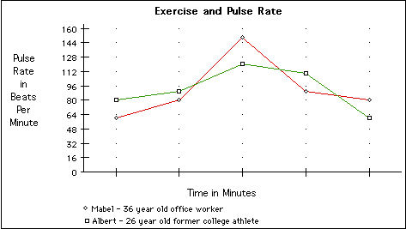
Presenting Data
Tables:
Must have a title
Data presented in columns (usually IV on left, DV on right)
Headings for each column, with units
Trials & Averages
Graphs:
Discrete Data (BAR) vs. Continuous (LINE)
Title
does it include axis information (independent/dependent) (avoid vs.)
Does it include groups
Is it over time?
Labelled axes, with units
Even scales
If multiple trials – use the average
Correct plotting + ruled lines
Key / identification of groups
What improvements could be made to this graph?
Read page 11 of your text for more information on graphs.

Slide 12
Validity and Reliability
Validity – does the experiment test what it is supposed to test? Did other things affect the results?
Improved by:
Controlling all variables between groups
Using a placebo / control group
Randomising subjects
Reliability – how consistent are the results?
Improved by:
Repetition (same experiment many times)
Replication (number of identical experiments running at same time or on a larger number of subjects)
Increased sample size

Slide 13
Analysis and Conclusion
Express the results in words:
Is there a noticeable relationship/trend in results
What happens to the DV as the IV increases or decreases?
Give evidence / data to support
Reasons for outliers
Do not forget to compare between experimental and control group.
e.g., the experimental group showed an increase in BMR, in comparison to the controlled group who had no change to BMR / or a decrease in BMR
Do results support or refute hypothesis?

Slide 14
Experimental Error
Experiments always contain errors. Hence why it never really ‘proves’ a hypothesis, rather the results ‘support’.
Human Error:
A mistake has occurred, e.g., incorrectly reading a scale, spilling of liquid before measuring volume. These are not part of experimental error, and can be avoided by taking care and regular checking.
Random Error:
Unpredictable errors that occur. They are present in all experiments, because no measurements can be made with absolute precision, e.g., stopping a stop watch at the ‘right’ time.
Reduced be taking several measurements and averaging
Systematic Error:
Occur because of the way the experiment was designed. As a result, the measurements will all be too low or too high.
Only fixed by changing the procedure.

Slide 15
Bias and Blind Experiments
Experimental Bias
Research bias is a process where the scientists performing the research influence the results, in order to portray a certain outcome.
Can arise from experimental error and failure to take into account all possible variables
Other bias arises when researches select subject that are more likely to generate the desired results, a reversal of the normal processes governing science
= reduced by using double blind studies
Blind studies
Blind: the subject is unaware if taking active drug or placebo
Double Blind: both the subject and the administrator is unaware
Blind studies reduce bias therefore improve validity

Slide 16
Type of Data and Study
Type of Data
Quantitative data: measured in numbers and usually involving measurement
Qualitative data: observations that do not involve numbers or measurement
Types of Studies
Case Study: an in-depth investigation of one particular person or situation, e.g., documenting a particular disease on one person.
Longitudinal: conducted over a long period of time

Slide 17
Ethical Principles to Consider
Voluntary Participation – people should not be pressured into taking part in the research
Informed Consent – the participants should be fully informed about the objectives, procedures, possible risks and potential benefits
Consent in writing is sought after all information has been given
Risk of Harm – the possibility of harm should be minimised and the relationship between the risks and the benefit should be carefully assessed.
Confidentiality – identities of the participants is not to be revealed, only to the people directly involved in the study
Anonymity – participants remain anonymous, even to the researchers.

Slide 18
Clinical Trails
Process:
Laboratory studies and/or animal testing
Test the drug on a small group of patients (15-30)
Test a larger group (under 100)
Test an even larger group
Approval by medical authorities
Ongoing testing / made available to the public
Watch –
https://www.youtube.com/watch?v=5zXuON7Rueo
https://www.youtube.com/watch?v=dsfPOpE-GEs
Whilst completing ongoing assessment of side effects and risks.

Slide 19
Example
Plan an experiment to test the following aim:
Aim: to test the effectiveness of penicillin (an antibiotic) in treating bacterial infections.

Slide 20
Microscopes

Slide 21
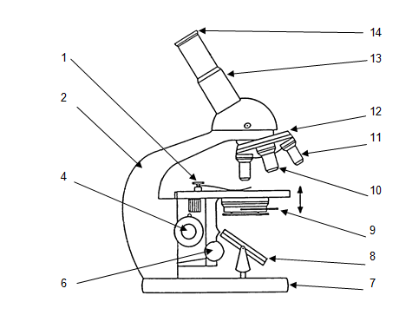
Microscopes - Parts
Can you name the parts on the microscope?

Slide 22
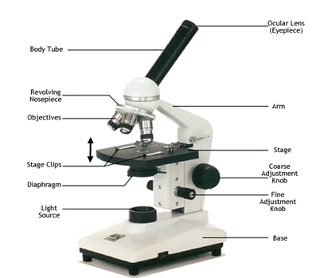
Microscopes – Parts and Function
What is the function of each of the parts?

Slide 23
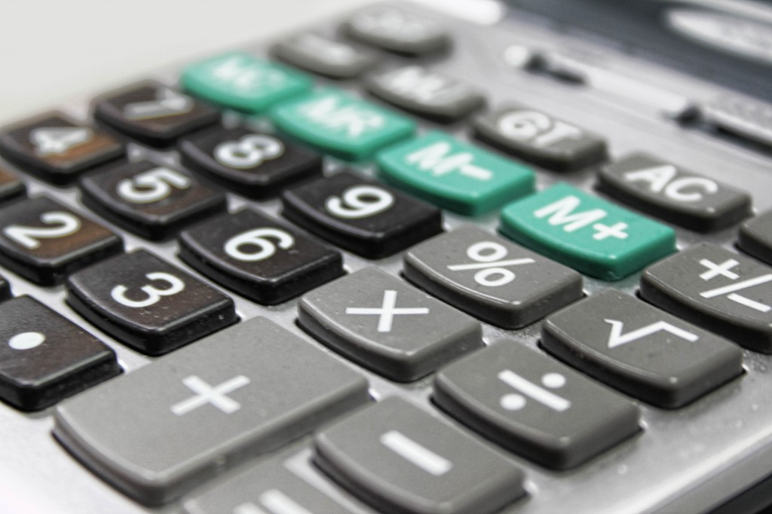
Calculations
Once we have looked at something through the microscope it is important for us to know how big it actually is.
There are three calculations we need to make:
Magnification
Field of View
Estimated Cell Size

Slide 24
Magnification
Magnification tells us how much we have increased the size of an object!
There are 2 lenses on the our microscope:
Ocular lens
Objective lens
Each of these lenses have a different magnification:
Ocular lens = x10
Objective lens = x4, x10, x40
How would we work out the magnification?
Multiply the magnification of the ocular lens by the magnification of the objective lens
OCULAR X OBJECTIVE = MAGNIFICATION

Slide 25
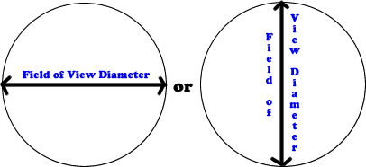
Field of View (FOV)
Microscopists call the circle of light you see when you look through your microscope the field of view. It is important to know the diameter of the field of view so you can estimate the size of structures you are examining.
You can calculate the FOV by looking through the microscope on low power using a slide with a 1mm grid, or even just using a ruler.
Obviously, a millimeter is too large a unit of measurement to be useful in microscopy. We therefore use a much smaller unit called a micrometer which is one thousandth of a millimeter. 1 mm = 1 000 µm

Slide 26
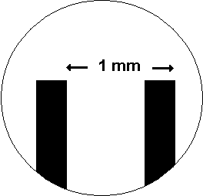
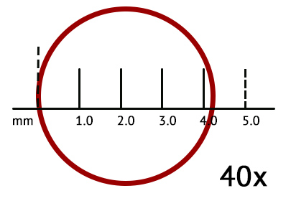
Field of View (FOV)
If you increase the magnification you will decrease the FOV
If you decrease the magnification you will increase the FOV
These values are proportional:
If you double your magnification you half the FOV
e.g. magnification is 50x and FOV is 2000um. Then at 100x, the FOV is 1000um

Slide 27
Field of View (FOV)
How do we work out the FOV on high power?
In order to calculate FOV in high power, you must find FOV in low power first…
HP MAG x HP FOV = LP MAG x LP FOV
HP FOV = LP MAG x LP FOV / HP MAG

Slide 28
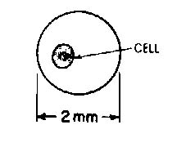
Estimating Cell Size
If we know the field of view then we can estimate the actual size of the objects in the microscope.
We count how many cells we can see in the given FOV (high power or low power)
We the divide the FOV diameter by the number of cells we can see within that FOV
FOV/# CELLS = ESTIMATED SIZE OF CELL(µm)

Slide 29
DO: Questions in the text
Complete a glossary using the key words from chapter 1 (Page 22)
Complete all Chapter 1 Review Questions (Page 23-24)
Prepare your own notes

