Slide 1
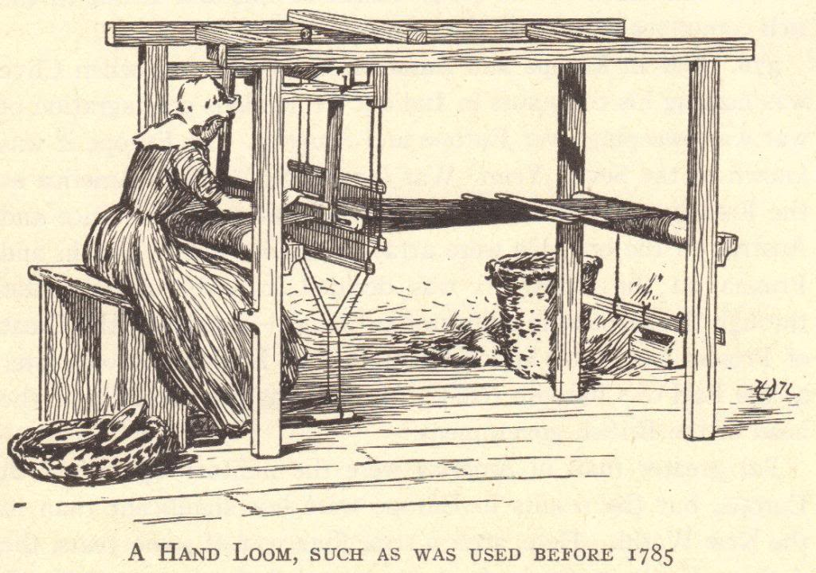
The Technology Revolution
© Student Handouts, Inc.

Slide 2
The textile or cottage industry
How was Britain’s industrialisation sparked by changed in various industries?

Slide 3
Development of the Domestic System of Production
Domestic system developed in England
Late 1600s-late 1800s
Domestic system of production – “putting out” system
Businesspeople delivered raw materials to workers’ homes
Workers manufactured goods from these raw materials in their homes (typically articles of clothing)
Businesspeople picked up finished goods and paid workers wages based on number of items
Domestic system could not keep up with demand

Slide 4
Factory System
Developed to replace the domestic system of production
Faster method of production
Workers concentrated in a set location
Production anticipated demand
For example: Under the domestic system, a woman might select fabric and have a businessperson give it to a home-based worker to make into a dress. Under the factory system, the factory owner bought large lots of popular fabrics and had workers create multiple dresses in common sizes, anticipating that women would buy them.

Slide 5
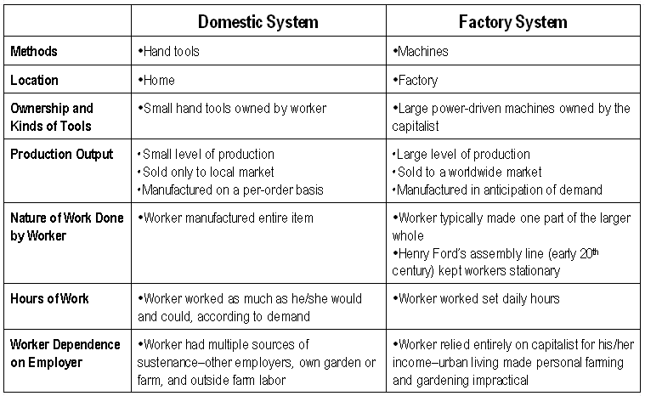

Slide 6
England’s Resources: Capital
The Commercial Revolution made many English merchants very wealthy
These merchants had the capital to invest in the factory system – money to buy buildings, machinery, and raw materials

Slide 7
England’s Resources: Workers
Serfdom and guilds ended earlier in England than other countries
English people could freely travel from the countryside to the cities
Enclosure Acts – caused many small farmers to lose their lands, and these former farmers increased the labor supply

Slide 8
“Necessity Is the Mother of Invention”
Spinning machine
Need to speed up weaving
Power loom created

Slide 9
“Necessity Is the Mother of Invention”
Power loom
Increased demand for raw cotton
Invention of the cotton gin

Slide 10
“Necessity Is the Mother of Invention”
Cotton gin
Demands for stronger iron
Improvements in iron smelting and the development of steel (Bessemer process)

Slide 11
“Necessity Is the Mother of Invention”
As more steam-powered machines were built, factories needed more coal to create this steam
Mining methods improved to meet the demand for more coal
The process of inventing never ends
One invention inevitably leads to improvements upon it and to more inventions
Notes:
Notes: An excellent example of this phenomenon is the personal computer or cell phone. Cell phones were initially used by professionals who needed fast communications for business. The everyday usefulness of cell phones was quickly apparent, increasing demand. Cell phone towers were built around the globe, and cell phone technology continues to grow more complex. Have students compare the original “brick” cell phone to the iPhone.

Slide 12
The Textile Industry
Textiles – cloths or fabrics
First industry to be industrialized
Great Britain learned a lot about textiles from India and China

Slide 13
The Birth and Growth of the Textile Industry
John Kay (English)
Flying shuttle, 1733
Hand-operated machine which increased the speed of weaving
James Hargreaves (English)
Spinning jenny, 1765
Home-based machine that spun thread 8 times faster than when spun by hand
Richard Arkwright (English)
Water frame, 1769
Water-powered spinning machine that was too large for use in a home – led to the creation of factories

Slide 14
The Birth and Growth of the Textile Industry
Samuel Crompton (English)
Spinning mule, 1779
Combined the spinning jenny and the water frame into a single device, increasing the production of fine thread
Edward Cartwright (English)
Power loom, 1785
Water-powered device that automatically and quickly wove thread into cloth
Eli Whitney (American)
Cotton gin, 1793
Device separated raw cotton from cotton seeds, increasing the cotton supply while lowering the cost of raw cotton
Elias Howe (American)
Sewing machine, 1846
Speed of sewing greatly increased

