Slide 1
Starter
Think about a specific product from a specific company.
Think about the target audience (customers) for the brand.

Slide 2
What do you think the following words
Product,
Price,
Place and,
Promotion
mean in relation to your product?

Slide 3
The 4 P’s of Marketing

Slide 4
Objectives
Students should be able to:
Explain what marketing is
Understand and explain the 4 P’s of marketing

Slide 5
What is Marketing?
The means by which an organisation communicates to, connects with, and engages its target audience to convey the value of and ultimately sell its products and services.

Slide 6
The 4 P’s
Referred to as the Marketing Mix - combination of variables that a business uses to carry out its marketing strategy and meet customer needs
4 P’s stand for
Product
Price
Place
Promotion
Mix of all four is necessary to sell a product

Slide 7
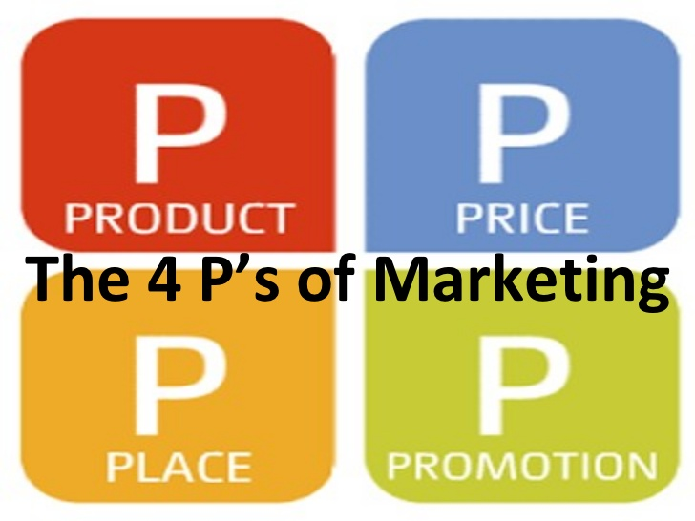

Slide 8
Product
Refers to the benefit of buying a product
What need does the product/service fulfil?
Elements to consider:
Product quality
Product features
Product design
Packaging
Range of products

Slide 9
Price
Must consider costs of all inputs
Mark-up price – How much profit do you want to make on each product/customer?
Different price strategies:
Competition
Penetration
Bundle

Slide 10
Place
Refers to how and where you are going to sell
Direct distribution – sell product directly to customer
Indirect distribution – sold through a 3rd party
Where are you going to locate to best reach your target market (customers) ?

Slide 11
Promotion
Communication of your product/service to your target market
There are many ways to get the word out…

