Slide 1
Topic 3: Cellular Metabolism
R. Johansen 2021

Slide 2
What is metabolism?
Metabolism is the total of all the chemical processes that take place in the body.
These chemical processes convert the food you eat into the energy and materials needed for all life processes.

Slide 3
Anabolic and Catabolic Reactions
Metabolic processes can be regarded as either anabolic or catabolic.

Slide 4
Catabolic reactions

Slide 5
Catabolic reactions
Catabolic reactions are destructive metabolic processes during which complex substances are broken down into simpler ones.
Catabolic processes release energy.

Slide 6
Example of a catabolic reaction – Cellular respiration
Cellular respiration is a good example of a catabolic process.
Equation:
glucose + oxygen —> water + carbon dioxide + energy C₆H₁₂O₆ + 6O₂ —> 6H₂O + 6CO₂ + energy
Glucose is formed from the breakdown of complex carbohydrates. Main food material used in respiration.

Slide 7
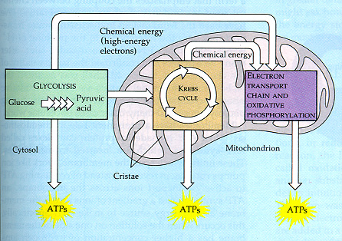
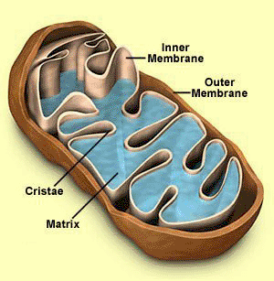
Cellular respiration – where does it occur?
The first stage of cellular respiration (the anaerobic stage) takes place in the cytoplasm
The aerobic stages takes place in the mitochondria.
Aerobic: Process requires Oxygen
Anaerobic: No oxygen required

Slide 8
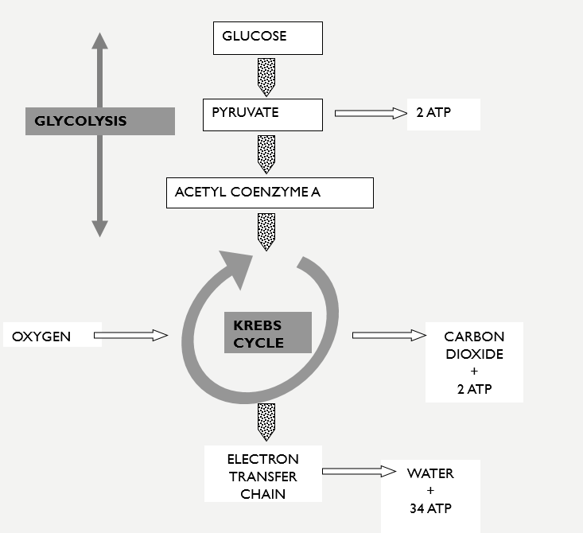
Cellular Respiration – the process

Slide 9
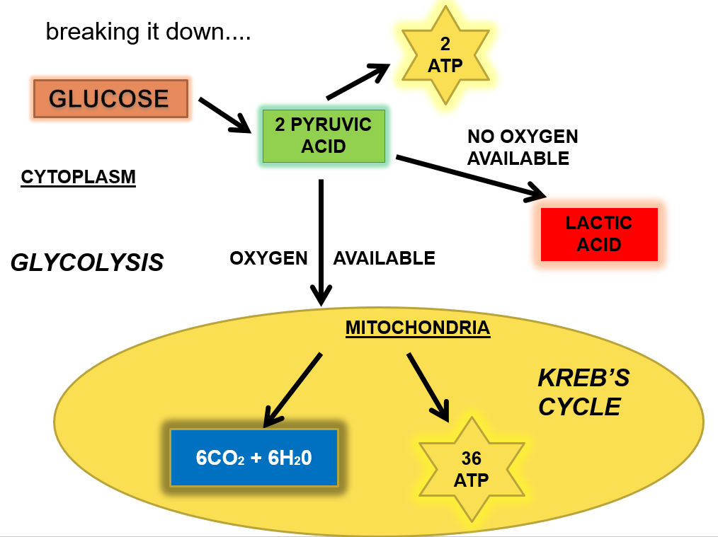
Cellular respiration – the process
& Electron Transport Chain

Slide 10
Cellular respiration - glycolysis
Breaks down one molecule of glucose (C₆H₁₂O₆) to produce two molecules of pyruvate (pyruvic acid - C₃H₄O₃).
Yields two molecules of ATP.
Takes place in the cytoplasm.
Requires no oxygen (anaerobic)

Slide 11
Cellular Respiration – Krebs cycle & Electron transport chain
The series of reactions during which pyruvate (via acetyl coenzyme A) is completely broken down to C0₂ (after glycolysis)
Yields 36 molecules of ATP.
Takes place in the mitochondria.
Requires oxygen (aerobic).

Slide 12
Anaerobic vs aerobic respiration
Comparison | Anaerobic | Aerobic
Oxygen required? | No | Yes
Where it occurs | Cytoplasm | Mitochondria*
Name of processes involved | Glycolysis | Krebs Cycle and Electron Transfer/Transport Chain
Molecule broken down (Reactant) | Glucose | Pyruvate (product of glycolysis)
By-products produced (other than ATP) | Lactic acid | Carbon Dioxide and Water
Number of ATP molecules produced | 2 | 36*
Rate at which the process occurs | Fast | Slow
Example of when it occurs | During short periods of intense exercise | At rest or during long periods of low intensity exercise

Slide 13
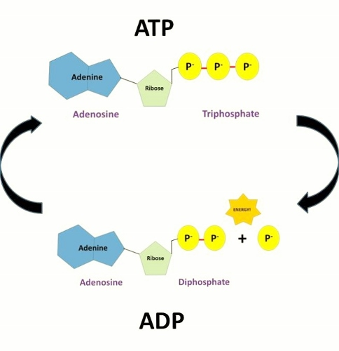
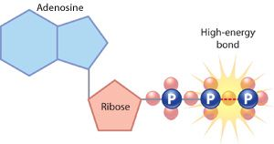
ATP
ATP = adenosine triphosphate
Energy from the Krebs cycle is used to convert adenosine diphosphate (ADP) to the energy-rich compound, ATP.
Energy is stored in cells as ATP.
When a phosphate molecule is stripped from ATP energy is released and ATP becomes ADP again.
Energy released by this process is available to do biological work (e.g. muscle contraction).

Slide 14
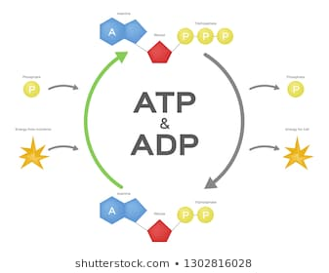
Atp/adp cycle

Slide 15
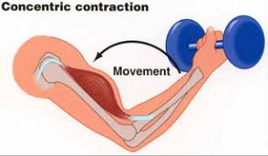
Uses of energy
60-80% of the energy produced by the breakdown of ATP is heat energy, which maintains of our body temperature.
The remaining energy is used for important biological processes such as:
• muscle contraction
active transport across cell membranes
• synthesis of large molecules needed for growth and repair
• transmission of nerve impulses
• cell division
• cellular activities such as the movement of substances in the cell

Slide 16
Anabolic reactions

Slide 17
Anabolic reactions
Anabolic reactions construct complex substances from simpler ones.
Anabolic processes use energy.

Slide 18
Example of an anabolic reaction – protein synthesis
Protein synthesis is an example of an anabolic process.
Proteins are long chains of amino acids
There are 20 common amino acids
Instruction for the assembly of proteins (the number and sequence of the amino acids) is carried by DNA in the cell nucleus (see chapter 18).
Ribosomes are protein construction sites.
Glu
M
Cys
A
Pro
Cys
Glu
His
Met
Phe
His

Slide 19
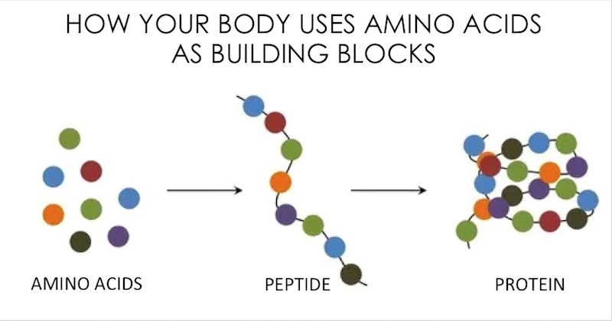
Amino acids make up proteins

Slide 20
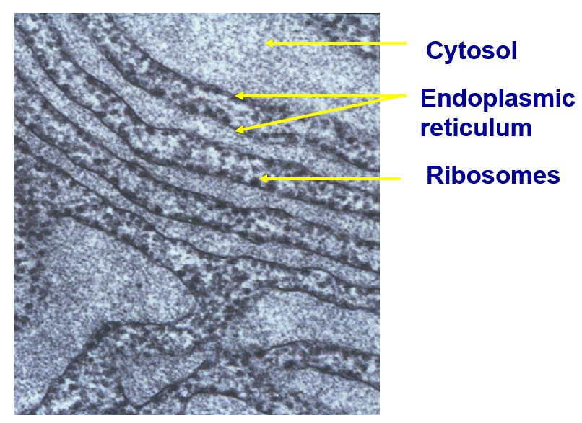
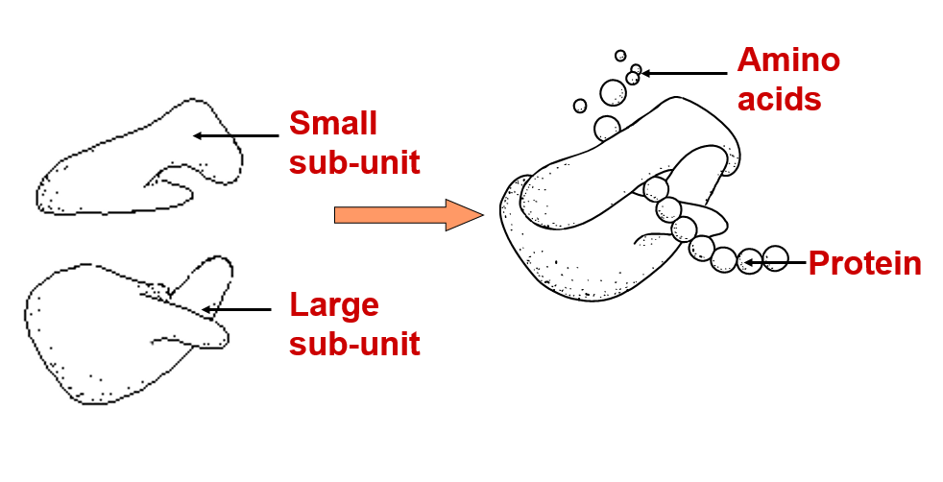
Ribosomes construct proteins
Most ribosomes line the endoplasmic reticulum (some float free in the cytosol).
Ribosomes are made of RNA and consist of a large sub-unit and small sub-unit.

Slide 21
Basal metabolic rate

Slide 22
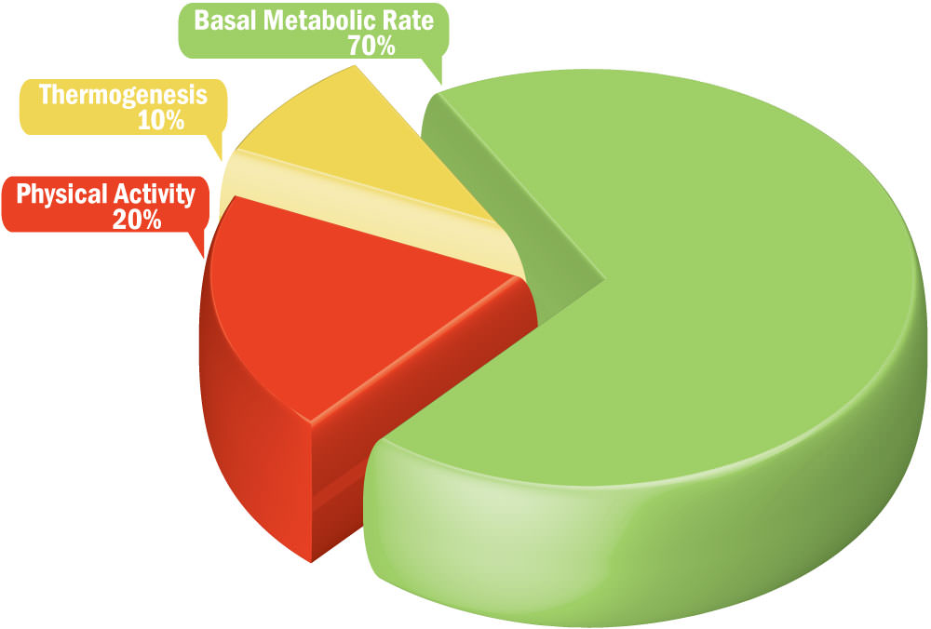
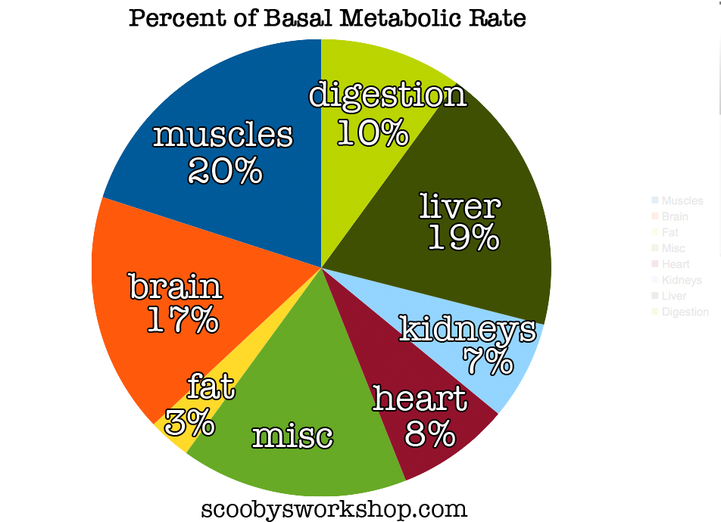
What is your basal metabolic rate?
The smallest amount of energy that can sustain life (i.e. of amount of energy needed to keep the body functioning at rest)

Slide 23
DO: Questions in the text
Complete a glossary using the key words from chapter 3 (Page 81)
Complete all relevant Chapter 3 Review Questions (Page 83-84)
Prepare your own notes

