Slide 1
Divisions of Peripheral The Nervous System
A. Williams

Slide 2
Purpose of Nervous System
Receive and process information from sense organs, and to bring about responses to the information received.
Along with the endocrine system, it coordinates all our voluntary and involuntary actions.
https://www.snoezelen.info/the-senses/

Slide 3
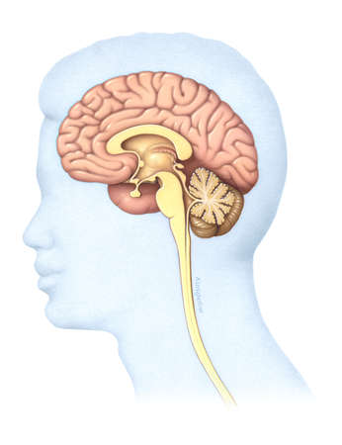
Divisions of the Nervous System
Nervous System:
Brain
Spinal cord
All nerves
2 Main Divisions:
Central Nervous System (CNS): control centre consists of brain and spinal cord
Peripheral Nervous System (PNS): nerves that connect CNS with receptors, muscles & glands

Slide 4
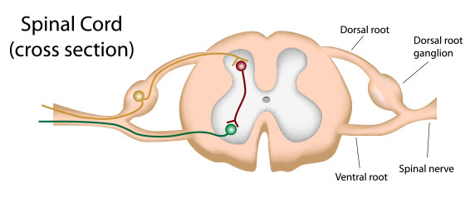
Peripheral Nervous System
Consists of nerve fibres, which carry information to and from the CNS, and groups of cell nerve bodies (ganglia), which lie outside the brain & spinal cord.
https://socratic.org/questions/what-are-ganglia-in-the-nervous-system

Slide 5
Peripheral Nervous System
Nerve fibres arranged into nerves, which arise from the brain & spinal cord
Cranial Nerves (12 pairs)
Spinal Nerves (31 pairs)

Slide 6
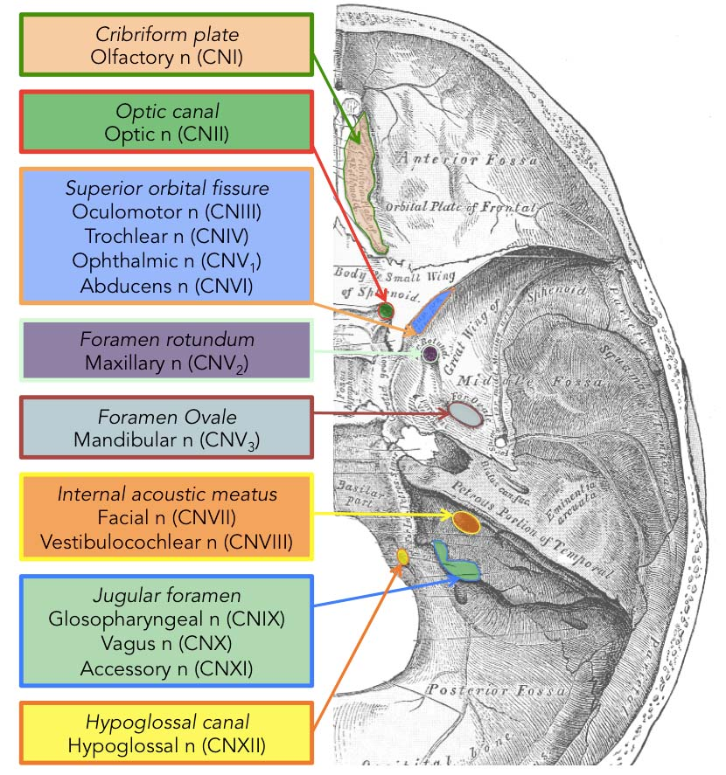
Cranial Nerves
12 pairs of nerves arising from the brain
Most are mixed nerves: contain fibres that carry information to brain (sensory) & fibres that carry information away from brain (motor)
Few carry only sensory
or only motor
http://teachmeanatomy.info/head/cranial-nerves/summary/

Slide 7
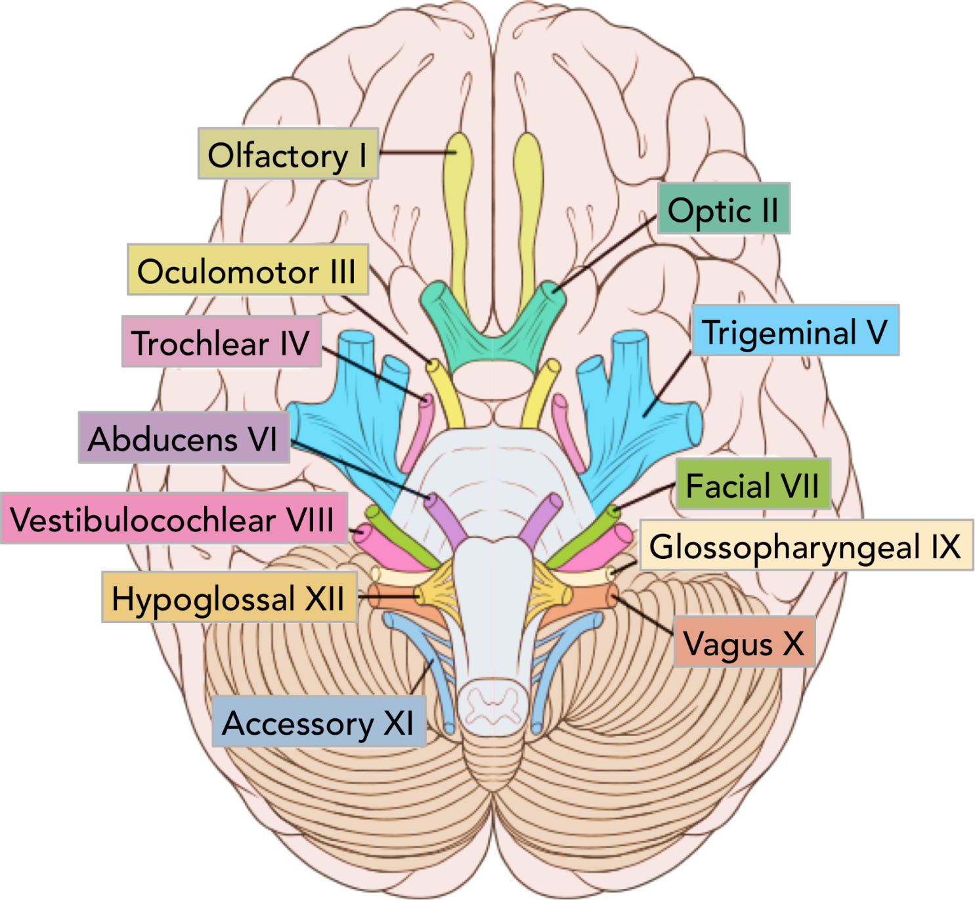
http://teachmeanatomy.info/head/cranial-nerves/summary/

Slide 8
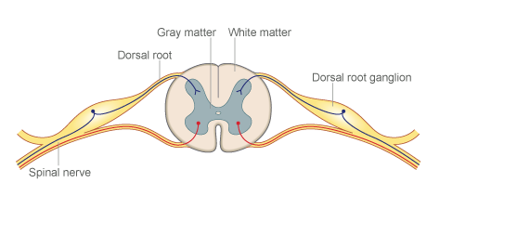
Spinal Nerves
31 pairs arising from the spinal cord
All mixed nerves & each joined to spinal cord by 2 roots
Ventral root: contains axons of motor neurons that have their cell bodies in grey matter of spinal cord
Dorsal root: contains axons of sensory neurons that have cell body in small swelling known as dorsal root ganglion

Slide 9
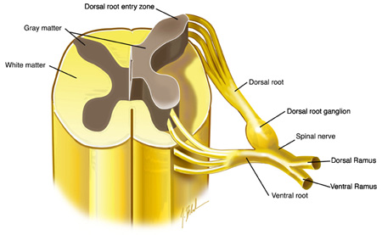

Slide 10
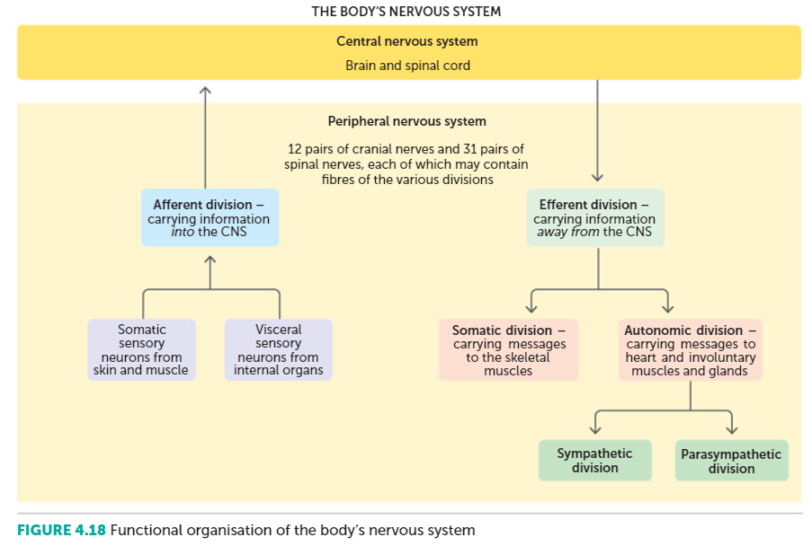

Slide 11
Afferent Nervous System
Sensory division
Fibres that carry impulses into the CNS
Somatic sensory neurons: Carried by sensory nerve cells from receptors in skin & around muscles & joints
Visceral sensory neurons: Sensory nerve cells that take impulses from internal organs

Slide 12
Efferent Nervous System
Motor Division
Fibres that carry impulses away from CNS
Somatic division (Somatic Nervous System): Takes impulses from the CNS to skeletal muscles
Autonomic division (Autonomic Nervous System): Carries impulses from the CNS to heart muscle, involuntary muscle & glands
Sympathetic division
Parasympathetic division

Slide 13
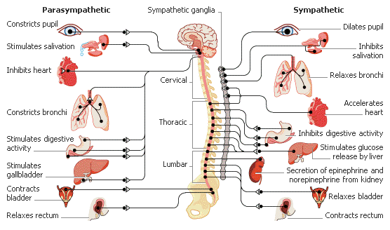
Autonomic Nervous System
http://medicalterms.info/anatomy/Autonomic-Nervous-System/

Slide 14
Autonomic Nervous System
Part of the PNS
Responsible for control of the body’s internal environment & is involved in many mechanisms to keep internal environment constant
Usually operates without conscious control
Regulated by group of nerve cells in Medulla Oblongata, Hypothalamus & Cerebral Cortex
Auto means ‘self’, nomo means ‘govern’
Autonomic System is self governing

Slide 15
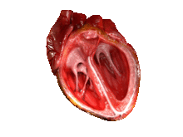
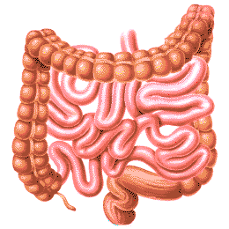
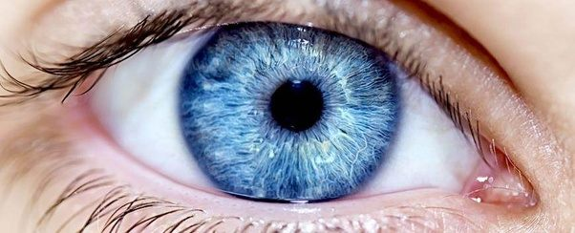
Autonomic Nervous System
Body functions under this control:
Heart rate
Blood pressure
Body temperature
Digestion
Release of energy
Pupil diameter
Air flow to lungs
Defecation
Urination

Slide 16
Autonomic Nervous System
Nerve fibres of ANS make up part of spinal nerves & part of some of cranial nerves
Carry impulses to heart muscle, internal organ muscles & glands
2 motor neurons involved in Autonomic pathway, only one motor neuron in somatic pathway

Slide 17
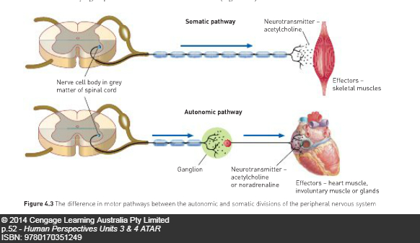
Autonomic Nervous System

Slide 18
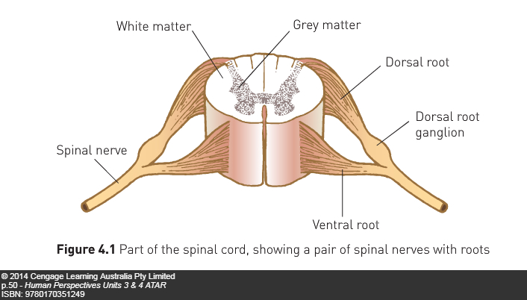
Autonomic Nervous System
Each pathway consists of a preganglionic neuron & a post ganglionic neuron
Ganglia- group of cell bodies located outside CNS
2 nerve fibres in ANS with a synapse between them
1 nerve fibre has cell body
in CNS, cell body of other
is in a ganglion

Slide 19
Differences between Autonomic & Somatic Nervous System
Organs under ANS control receive 2 sets of nerve fibres
Sympathetic
Parasympathetic
Neurotransmitter carrying messages from neuron to the effector (eg. Skeletal muscle) is acetylcholine (parasympathetic) or noradrenaline (sympathetic)
In somatic division, it is only acetylcholine

Slide 20
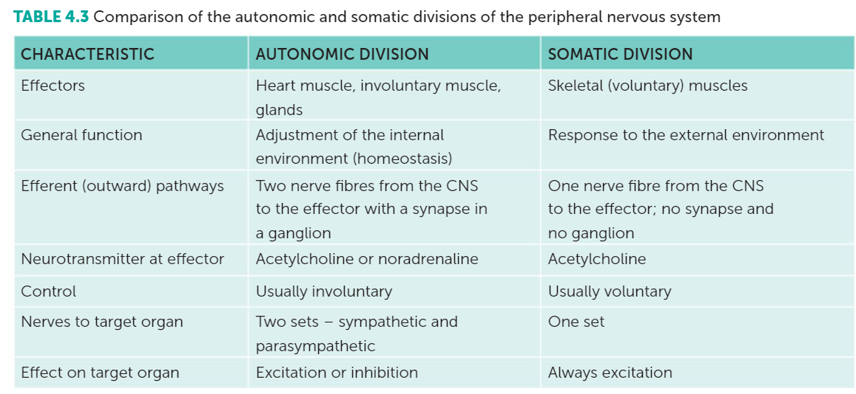
Differences between Autonomic & Somatic Nervous System

Slide 21
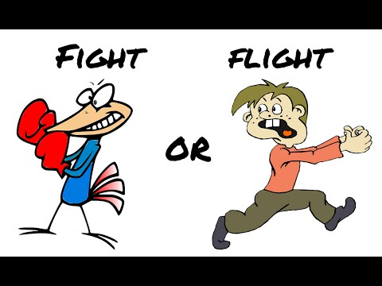
Autonomic Nervous System
Parasympathetic: generally produces responses that maintain body during relatively quiet conditions. Nerve endings release acetylcholine
Sympathetic: produce responses that prepare body for strenuous physical activity. Fight-or-flight response. Nerve endings release noradrenaline
https://www.youtube.com/watch?v=mtRrxNTnyh8

Slide 22
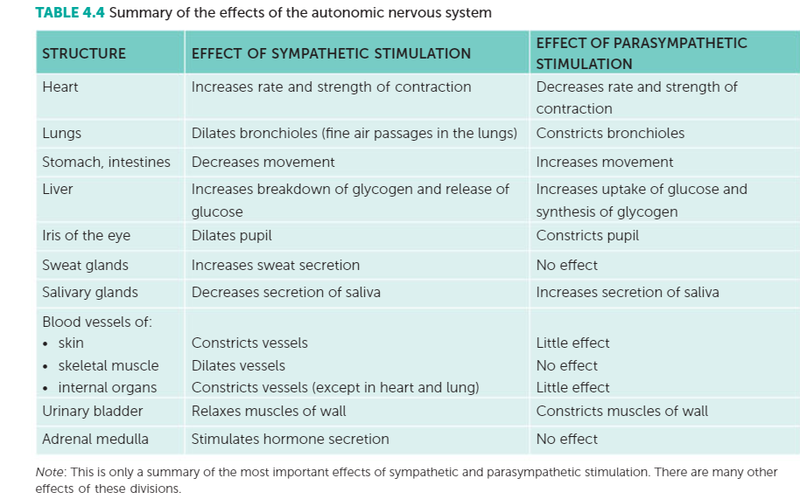
Autonomic Nervous System

Slide 23
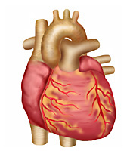
Autonomic Nervous System:
Under normal circumstances we are
not aware of the activities of ANS
Right now your sympathetic & parasympathetic nerves are sending out impulses to the internal organs to maintain stability of body’s functions
Eg. Heart has inbuilt rate of 100 beats per minute, parasympathetic stimulation keeps it down to around 70 to 80 beats per minute

Slide 24
Autonomic Nervous System:
In threatening situation, balance between sympathetic & parasympathetic stimulation is changed, sympathetic becomes dominant
Fear, stress, anger, danger, competition all evoke fight or flight response or alarm reaction
Prepares body for increased activity

Slide 25
Autonomic Nervous System: Sympathetic division
Rate & force of contraction of heart blood pressure
Blood vessels in skeletal muscles, heart & liver dilate ready for strenuous activity
Blood vessels in kidney, stomach, intestines & skin constrict as they are not involved in activity
Airways dilate, rate & depth of breathing
Blood glucose level (glycogen glucose in liver)
Secretion from sweat glands
Adrenal medullae secrete adrenaline and noradrenaline to intensify & prolong above responses

Slide 26
Watch
https://www.youtube.com/watch?v=NGGU-fGGycA
https://www.youtube.com/watch?v=q3OITaAZLNc

Slide 27
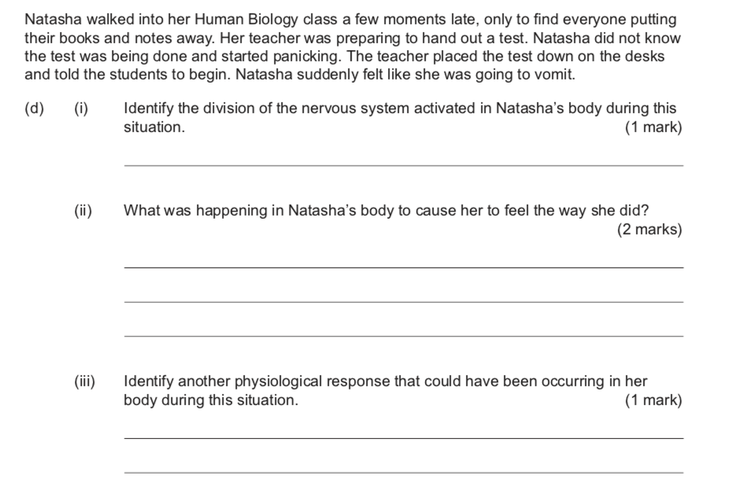
Past Exam Question

Slide 28
