Slide 1
Title: Analysing Media: Film Posters
Date:
L/O: To examine features of Media texts; to revise for text
Look closely at the following film posters. Select one and answer the following questions:
Is the film title prominently featured? What does the font and style suggest about the film?
Are the main actors shown? If so, which ones? What do their appearances and expressions convey about the movie?
What is the genre of the film and how is this shown? What feeling and emotions are communicated?
What other images are included? What do you notice about the framing of the images?
Is there a catchy tagline? If so, what does it tell you about the movie’s story?

Slide 2
Is the film title prominently featured? What does the font and style suggest about the film?
Are the main actors shown? If so, which ones? What do their appearances and expressions convey about the movie?

Slide 3
What is the genre of the film and how is this shown? What feeling and emotions are communicated?
What other images are included? What do you notice about the framing of the images?
Is there a catchy slogan? If so, what does it tell you about the movie’s story?

Slide 4
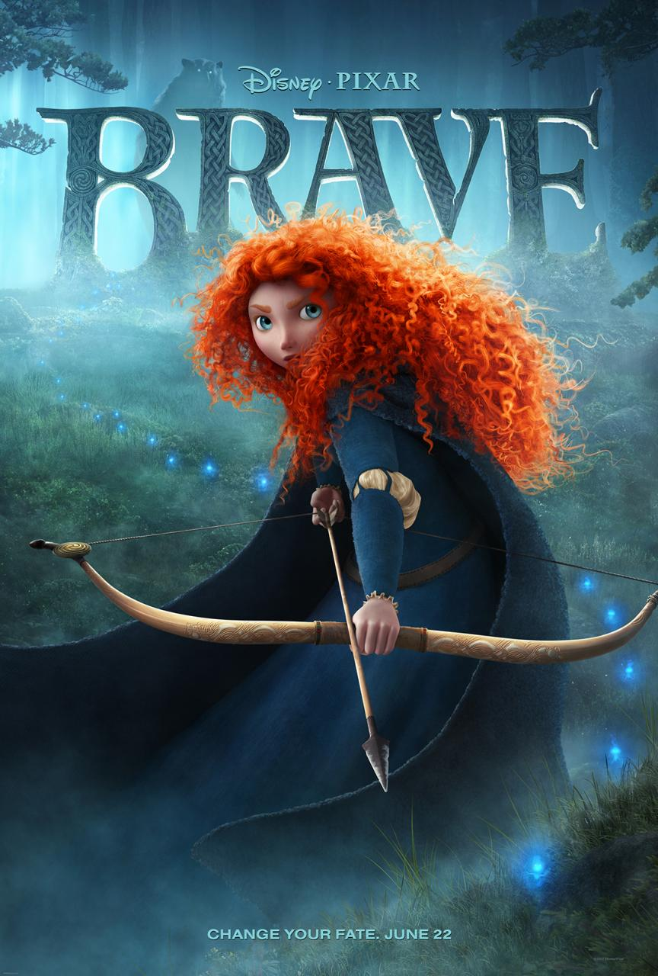

Slide 6
Find one of your own film posters and analyse it. Be ready to explain it to the class.

