Slide 1
Topic 6: Excretory system
A. Williams and R.Johansen 2021

Slide 2
what IS excretion?
There are many chemical reactions taking place in the body that produce by-products, some of which are able to be used by the body, while others are wastes.
Most wastes are toxic and would be harmful if allowed to accumulate .
Excretion: The removal of metabolic wastes from the body
Removing wastes also allows the body to maintain equilibrium within the body (this is called Homeostasis)

Slide 3
structures of excretion
Kidneys:
Filter blood to maintain a constant concentration of materials in the body fluids
Excrete/remove nitrogenous wastes like urea, uric acid & creatinine
Liver: Deamination & synthesis of urea
Lungs: Removal of CO₂
Skin: Sweat glands secrete sweat (contains salts, urea & lactic acid)
Alimentary canal: Passes out bile pigments

Slide 4
Organs of excretion

Slide 5
Liver

Slide 6
Organs of excretion: the liver

Slide 7
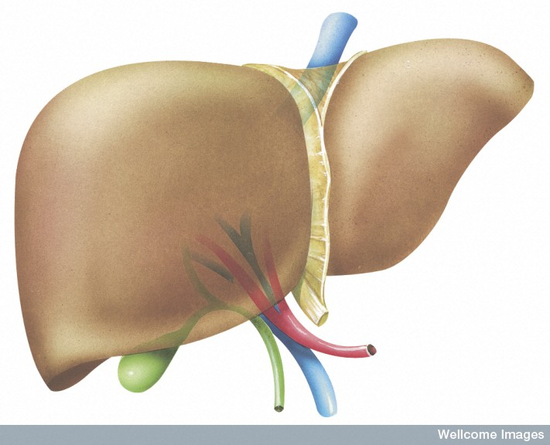
Functions of the liver
Deamination
Blood glucose regulation
Fat conversion
Bile formation
Plasma protein production
Production of blood-clotting factors
Storage
Toxin and hormone breakdown
Heat production

Slide 8
Functions of the liver
Deamination: stripping of nitrogen from amino acids and nitrogen bases (with aid of enzymes)
Some of the amino acids absorbed during digestion are taken in by cells and used to make proteins
Excess amino acids cannot be stored, they are converted in the liver into carbohydrates

Slide 9
deamination
The conversion first involves the removal of the amino group (-NH2) from the amino acid
The amino group is converted to Ammonia (NH3)
As ammonia is toxic to the body, so is quickly converted to urea
Urea is removed from the blood by the kidneys and excreted as urine

Slide 10
Process of deamination
Amino acid → ammonia + organic compounds (used for respiration)
Ammonia (very toxic) + CO₂ → urea (H₂NCONH₂)
The amino group

Slide 11
Summary of process: deamination
Amino acid + oxygen carbohydrate + ammonia
Ammonia is highly toxic & therefore needs to be removed quickly
Energy + CO2 + ammonia urea + water
Refer to page 171 of your Human Perspectives text ☺
enzymes

Slide 12
skin

Slide 13
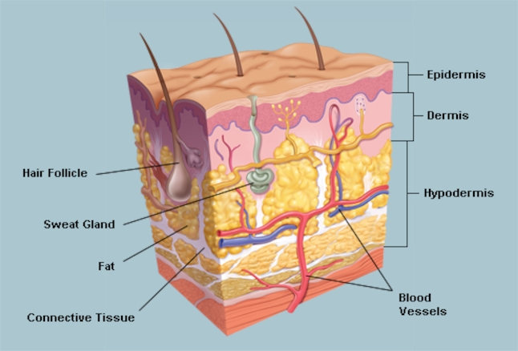
Organs of excretion: skin

Slide 14
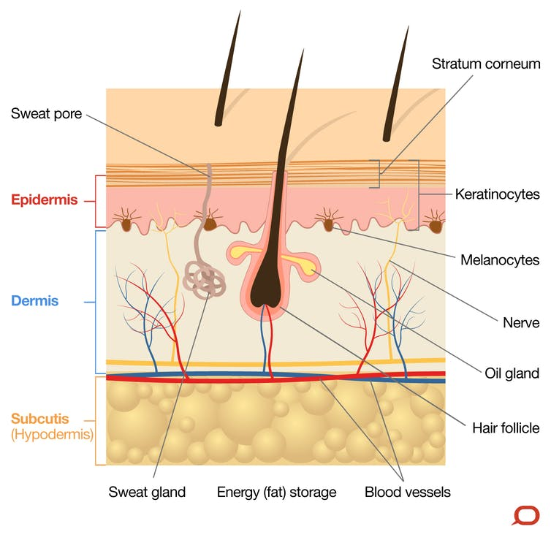
skin
Protective covering over surface of the body
Regulate body temperature
Excretion
Sweat glands secrete 500mL of water per day
Sodium chloride, lactic acid & urea are dissolved in the water
See diagram on page 171 of text. Make sure you can label this!

Slide 15
kidney

Slide 16
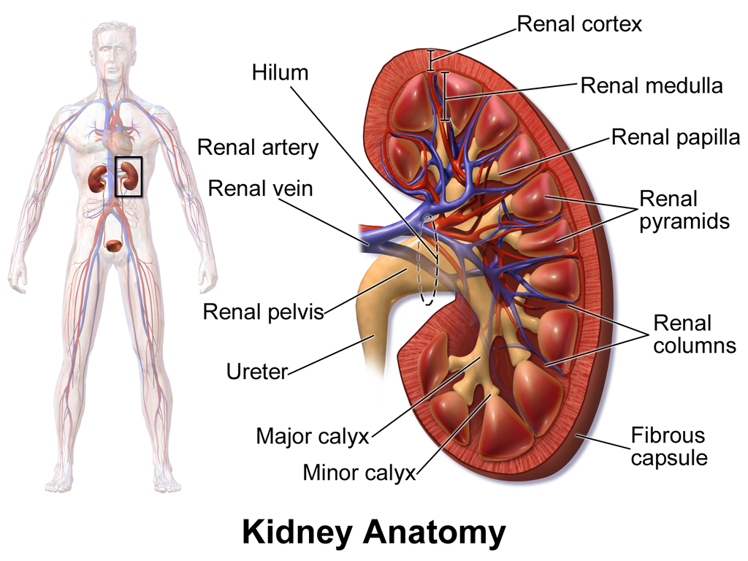
Organs of excretion: kidneys

Slide 17
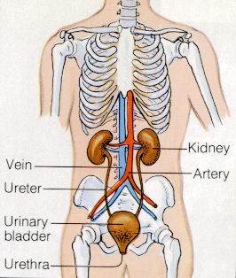
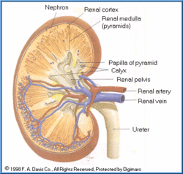

Slide 18
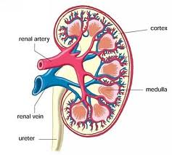
structure OF THE kidneys
Structure suited to its function of filtering the blood
Renal Cortex (outside) and Renal Medulla (inner).

Slide 19
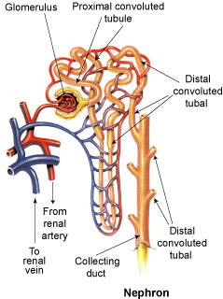
nephron
Functional unit of the kidney, where the urine is formed
1.2 million nephrons in each human kidney
Surrounded by complex network of blood capillaries: maintain a constant concentration of materials in the body fluids & remove wastes

Slide 20
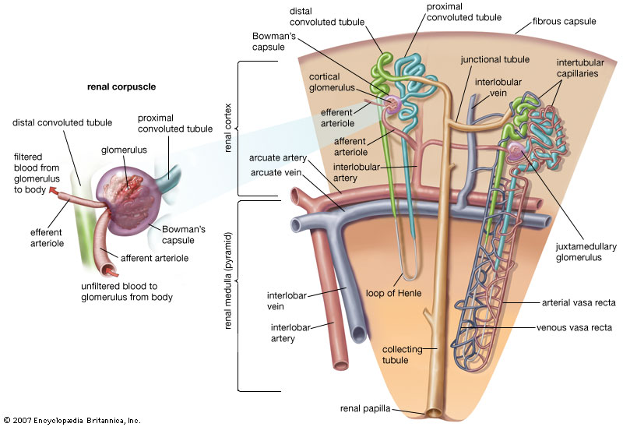

Slide 21
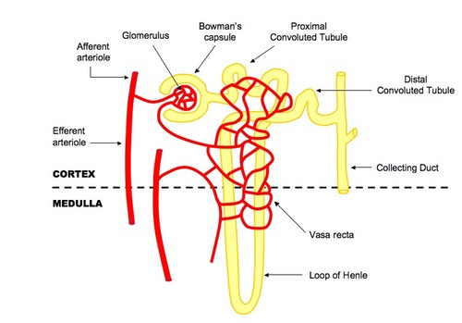
Structure of the nephron

Slide 22
Structures of the nephron
Structure | Function
Renal Corpuscle
Glomerulus | A knot of arterial capillaries
Glomerular capsule | Double walled cup that surrounds the glomerulus
Renal Tubule
Proximal Convoluted Tubule | Winding convoluted section leading away from the glomerulus
Descending Limb | Straight portion leading to Loop of Henle
Loop of Henle | Hairpin bend at bottom of nephron
Ascending Limb | Straight portion leading from Loop of Henle
Distal Convoluted Tubule | Winding convoluted section leading to the Collecting Duct
Collecting Duct | Several convoluted tubules from different nephrons join here. This opens into a chamber called renal pelvis

Slide 23
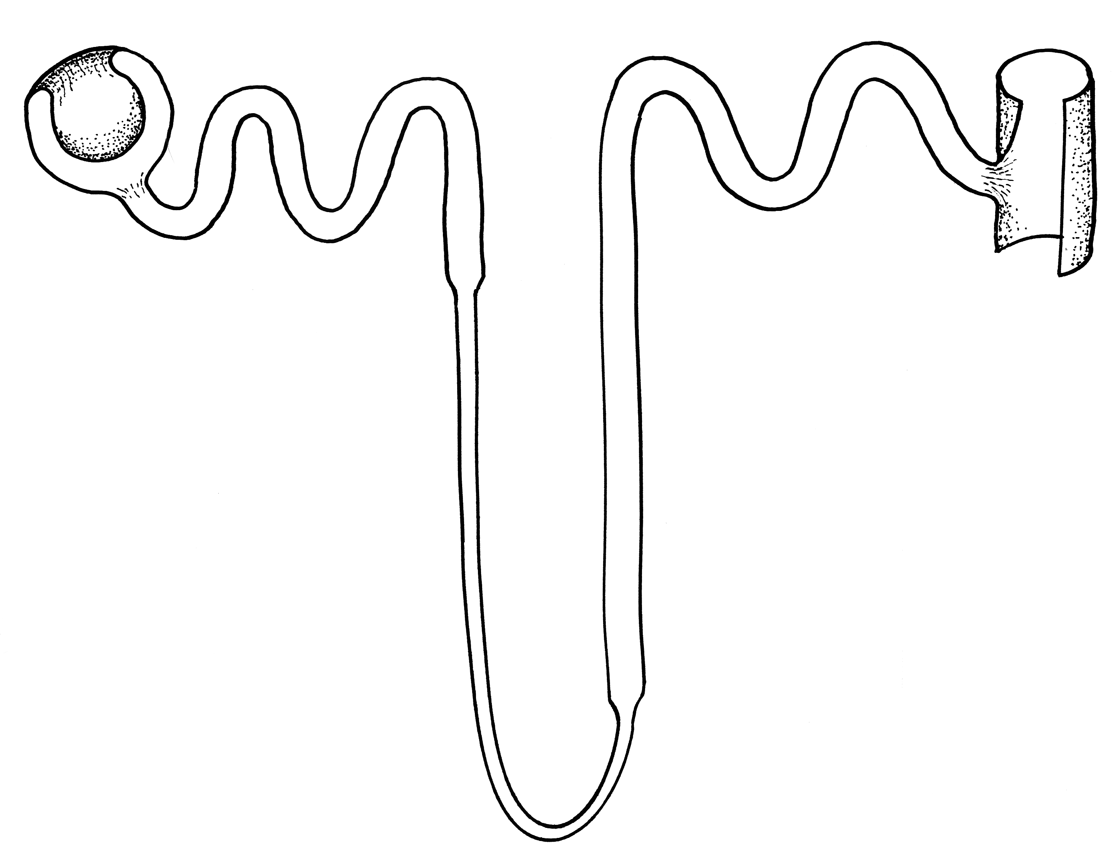
Distal convolute tubule (DCT)
Common collecting duct
Glomerular capsule
Proximal convolute tubule
(PCT)
Loop of Henle
See diagrams on page 173/4 of Human Perspective text for more detail.

Slide 24
Blood supply
Renal arteries: blood entering the kidneys through these arteries
Large arteries
Together 2 kidneys receive about a quarter of blood from left (oxygenated) side of the heart
1.2 Litres of blood pass through 2 kidneys every minute
After entering the kidneys, renal arteries divide into small arteries and arterioles

Slide 25
Blood supply
Afferent Arteriole: Each renal corpuscle is supplied by this arteriole, which then forms the glomerulus
Efferent Arteriole: Glomerular capillaries unite to form this, which then passes out the renal corpuscle
Peritubular Capillaries: After leaving the corpuscle, efferent arteriole breaks into second capillary network. These capillaries surround the nephron
Venous blood drains away from this network and leaves kidney via Renal Vein.

Slide 26
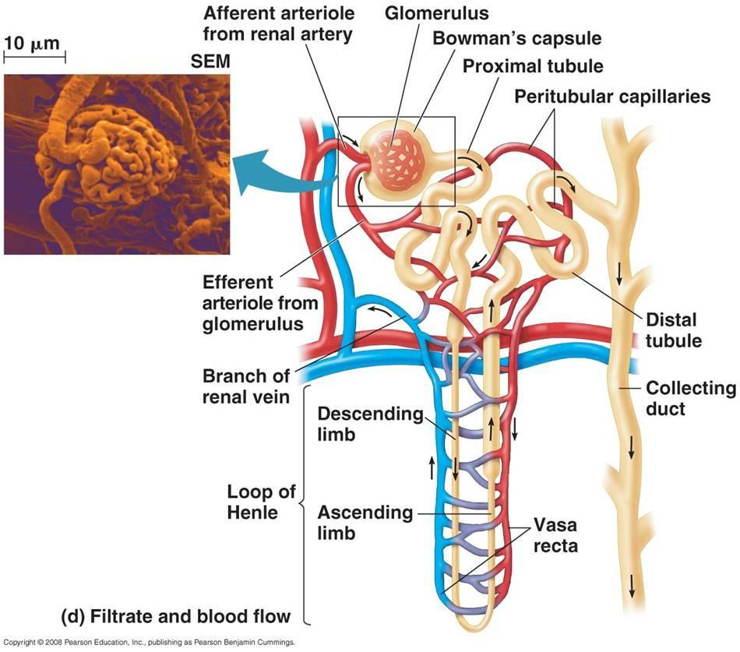

Slide 27
Urine formation
Involves 3 major processes:
Glomerular Filtration
Selective Reabsorption
Tubular Secretion

Slide 28
Glomerular filtration
Process takes place in the renal corpuscle when fluid is forced out of blood and collected in glomerular capsule
High pressure in glomerulus forces substances into the blood
Pressure created by afferent arteriole having a wide diameter than the efferent arteriole leaving the glomerulus
Narrowing of efferent arteriole increases resistance to flow of blood and produces high pressure in glomerulus

Slide 29
GLOMERULAR FILTRATION
Water
Glucose
Amino acids
Fatty Acids
Urea
Uric Acid
Creatanine
Hormones
Toxins Salts
Ions

Slide 30
Glomerular Filtration
20% plasma is filtered through capillary walls into glomerular capsule
Filtrate: consists of all materials present in blood except red blood cells, white blood cells and plasma proteins
Normal adult: 125mL of filtrate per minute or 180 Litres per day
Only about 1% of filtrate leaves body as urine, the rest is reabsorbed as it’s travelling through the nephron

Slide 31
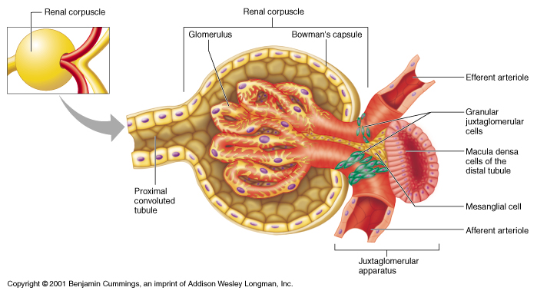

Slide 32
Selective reabsorption
Selective reabsorption: Movement of substances from the nephron back into the capillaries. Transport can be passive or active.
Many components of plasma filtered from capillaries of glomerulus are of use to the body
Carried out by cells that line the renal tubule
Water, glucose and amino acids
Ions- Sodium, potassium, calcium, chloride, bicarbonate
Urea (waste product of deamination) – partially reabsorbed

Slide 34
Structure of tubules improves reabsorption
Long length of tubule = Large surface area (due to convolutions)
Proximal Convoluted Tubule (PCT), Distal Convoluted Tubule (DCT) and Loop of Henle achieve this large surface area
Well supplied with blood vessels
Many (millions) nephrons within each of the 2 kidneys

Slide 35
Facultative resbsorption
Facultative Reabsorption: Active reabsorption under hormonal control.
Hormones change permeability of nephron depending on body’s water requirements

Slide 36
reabsorption
Water
Water, Glucose,
Amino acids,
Vitamins, Salts (mainly sodium & chlorine)
Urine
- Water
- Urea
- Salts
Salts (mainly sodium & chlorine)

Slide 38
Tubular secretion
Adds materials from blood to the filtrate (body wants to get rid of these materials)
Potassium & Hydrogen Ions, Creatinine, Drugs eg. Penicillin
Can be active or passive
Controls pH of blood- blood pH is 7.4-7.5, our diet usually lowers pH. To raise this pH of blood, tubules secrete hydrogen and ammonium ions into filtrate
Urine is slightly acidic, pH 6

Slide 39
Tubular secretions
H+
K+
NH4+ (ammonium)
Creatinine
Toxins
Drugs

Slide 40
summary OF KIDNEY PROCESSES

Slide 41
Summary of kidney processes
Region of nephron | Activities taking place
Renal Corpuscle | Filtration of blood from capillaries of glomerulus Formation of filtrate in glomerular capsule
Proximal convoluted tubule and loop of Henle | Reabsorption of sodium, potassium, chloride and bicarbonate ions Reabsorption of glucose Passive reabsorption of water by diffusion
Distal convoluted tubule | Active reabsorbtion of sodium ions Active reabsorption of water depending on body’s water needs Secretion of hydrogen and potassium ions, creatinine and certain drugs like penicillin
Collecting duct | Active reabsorption of water, depending on body’s water needs

Slide 42
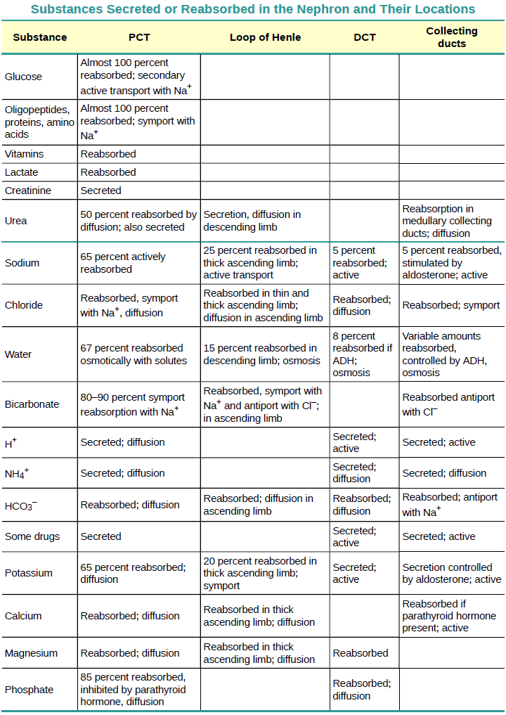
ACTIVE + PASSIVE PROCESSES

Slide 43
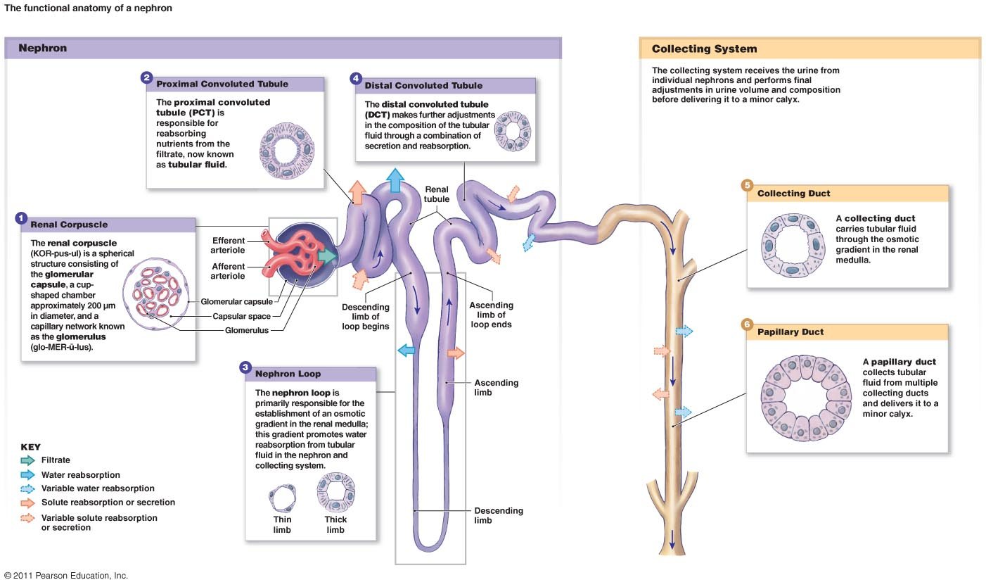

Slide 44
How is structure of kidney suited to its function
Glomerular capsule surrounds whole glomerulus to collect fluid filtered out of blood capillaries
Afferent arteriole has larger diameter than Efferent arteriole, raising blood pressure resulting in more fluid being filtered out of blood into glomerular capsule
Each tubule has 2 sets of convolutions (PCT & DCT) and long loop (loop of Henle), giving a large S.A. for reabsorption & secretion
Each kidney has over 1 million nephrons so total S.A. area is very large

Slide 45
FORMATION OF URINE

Slide 46
Formation of urine
Water and other substances not reabsorbed drain into the collecting duct and into renal pelvis
From renal pelvis, urine drains into the ureters and is pushed by muscular contractions to urinary bladder where it is stored
Bladder is a hollow muscular organ from which urethra carries urine to exterior of body

Slide 47
Urine composition
Chemical Component | Filtrate | Reabsorbed Substances | Urine
Water | 180 L | 178- 179 L | 1-2 L
Sodium, chloride and other ions | 1500g | 1485g | 15g
Proteins | 2g | 1.9g | 0.1g
Glucose | 180g | 180g | 0g
Urea | 53g | 28g | 25g
Uric Acid | 8.5g | 7.5g | 1g
Creatinine | 1.6g | 0g | 1.6g

Slide 48
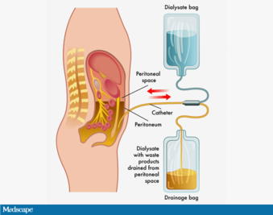
EFFECTS OF LIFESTYLE ON EXCRETION page 180- 182
Kidney stones
Kidney failure
Dialysis
Peritoneal dialysis
Haemodialysis
Liver disease
https://www.medscape.com/viewarticle/887404

Slide 49
DO: Questions in the text
Complete a glossary using the key words from chapter 7 (Page 189-190)
Complete all Chapter 7 Review Questions (Page 191-192)
Prepare your own notes

