Slide 1
Foreign Exchange

Slide 2
What is Foreign Exchange?
Different countries use different money.
When we exchange one currency into different currencies, we get different amounts.
This depends on the rate of exchange.

Slide 3
Rate of Exchange
The rate of exchange is the price one currency can be exchanged for another.
To change Australian Dollars to another currency we multiply by the exchange rate.

Slide 4
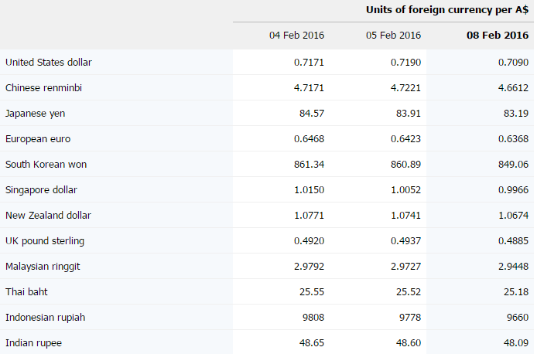

Slide 5
Example
Sue is going to France. She wants to take $1,000 AUD spending money. How many Euro’s will she get if the rate of exchange is 0.6368 Euro?
$1,000 = 1,000 x 0.6368 = 636.80 Euro

Slide 6
Activity 1
Per Australian Dollar $
New Zealand Dollar | 1.05
Pound | 0.45
Convert AUD$250 into NZ Dollar and Pound.

Slide 7
Changing Back
When we convert our money back into $AUD, we get a different rate of exchange.
To convert back into $AUD, we divide by the exchange rate.
A good way to remember is:
Multiply when you go away ×
Divide when you come back ÷

Slide 8
Example
When Sue returned from France, she had 100 Euro left over. How much would she get?
100 / 0.6368 = $157

Slide 9
Activity 2
Per Australian Dollar $
New Zealand Dollar | 1.05
Pound | 0.45
Convert $500 NZ Dollar and 500 Pound to AUD.

