Slide 1
International Government
Civics and Citizenship

Slide 2
Human History
Of the past 3,400 years of recorded history humans have been entirely at peace for 268 years
This is just 8 percent of recorded history.
Humans have occasionally sought ways to improve peace
One of these ways is the United Nations

Slide 3
Australia & the UN
The United Nations (UN) was born out of the pain and suffering of World War II
The overall aim of the UN is to establish global peace
Australia was a founding member of the UN
Dr Herbert ‘Doc’ Evatt was an influential Australian who helped make the UN, and also assisted in making the Universal Declaration of Human Rights

Slide 4
Australia Supporting the UN
Australia has provided a small but significant role to the UN since 1945
We do this by:
Involvement in peacekeeping missions
Participation in policy development
Donations to the UN budget
Australia has also been a member of the non-permanent Security Council 5 times
Notes:
The Security Council consists of five permanent members — the United States, the United Kingdom, France, Russia and China
There are 10 non-permanent members who serve for 2 years each over a staggered period of time

Slide 5
International Peace Keeping
Sometimes the best way to ensure peace is to enforce it
The role of United Nations peacekeepers is exactly that — to develop and maintain peaceful interactions between social, ethnic or political groups.
Since 1948 there have been 71 UN peacekeeping missions, and as of 2016 there are 16 current right now

Slide 7
Australian Peacekeeping
Australian peacekeepers have served in several key conflicts around the world including:
Indonesian War of Independence
Korean War
Israel & the Middle East
Iraq
Rwanda
East Timor

Slide 8
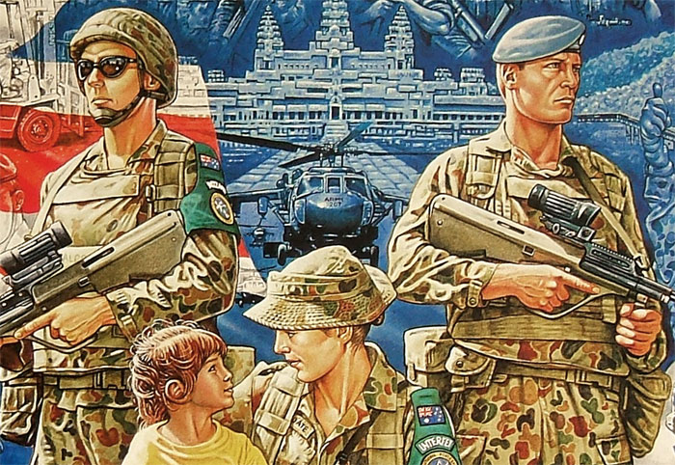

Slide 9
Good Global Citizen
In addition to peacekeeping there is a modern idea that nations ought to be ‘good global citizens’ in order to assist peace
This means that where possible countries help our ‘neighbours’ and try to all get along well
One method of being a good global citizen is through foreign aid

Slide 10
Foreign Aid
Foreign aid is provided with the aim of improving the living standards of people in less developed countries.
It can also be cost effective: stabilising a population, thereby preventing refugees or war, can be cheaper then accepting refugees or sending a military response

Slide 12
Foreign Aid
Foreign aid may be provided by governments or by independent bodies, such as NGOs.
Australian aid from both sources has been critical in helping the Asian region.
Aid can be divided into two categories:
development aid — for long-term programs to support the general development of a country
emergency aid — for natural disasters and other crises.

Slide 13
Development Aid
Is focused on alleviating poverty in the long term
Many of these programs focus on the provision of medical care, such as vaccinations
By organising mass immunisations, the Australian government has sought to improve the health and wellbeing of disadvantaged nations.

Slide 14
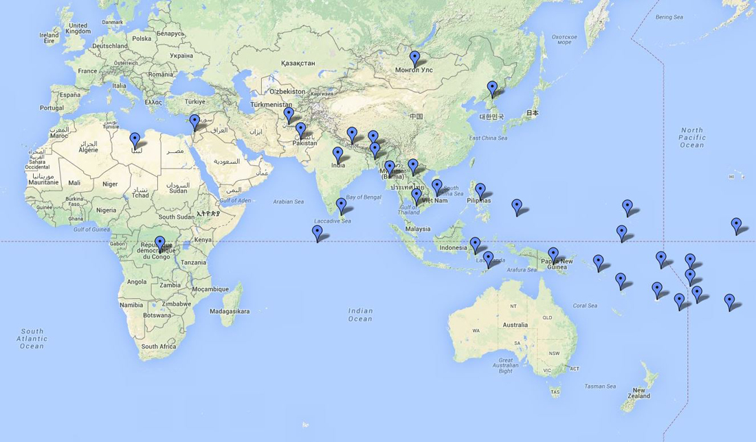
AusAID Programs

Slide 15
Development Aid
The UN has called for developed nations to provide 0.7% of their GDP to Foreign Aid
As of the 2016 Australian budget Australia is providing 0.22% of its budget to Foreign Aid.
This is a trend:
2016 Budget $224 million cut
2015 Budget $1 billion cut

Slide 16
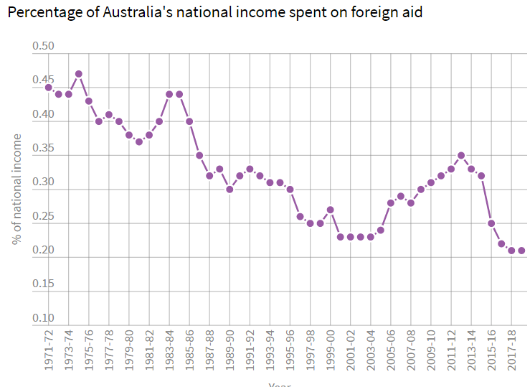

Slide 17
Emergency Aid
Is provided for humanitarian purposes in response to unexpected events such as natural disasters and other crises
In 2004, the Boxing Day tsunami ravaged much of western Indonesia as well as many countries in the surrounding area.
Members of Australian aid and military departments were immediately sent to the affected areas of Indonesia to organise and staff temporary hospitals and emergency response centres
The Australian Government pledged $1 billion, and is a good example of how re respond to disasters.

Slide 18
NGO & Foreign Aid
A non-government organisation (NGO) is one that runs independently of any government control.
NGO’s may be partly funded by governments, but are free to develop their own policies and programs
Free from government and politics, NGOs often have the opportunity to reach and assist a broader range of people
An example of this is the Fred Hollows Foundation

Slide 19
The United Nations – In more detail

Slide 20
The UN has 4 main purposes:
To keep peace throughout the world;
To develop friendly relations among nations;
To help nations work together to improve the lives of poor people, to conquer hunger, disease and illiteracy, and to encourage respect for each other’s rights and freedoms;
To be a centre for harmonizing the actions of nations to achieve these goals.

Slide 22
General Assembly
The General Assembly is the main, policymaking and representative organ of the United Nations
Comprising all 193 Members of the United Nations, it provides the only place on Earth where so many nations come together to discuss issues

Slide 23
Security Council
The Security Council has primary responsibility for the maintenance of international peace and security.
The Council is composed of five permanent members — China, France, Russian Federation, the United Kingdom and the United States
And ten non-permanent members elected by the General Assembly

