Slide 1
ASX Sharemarket Game 1
The best performing sectors were:
telecommunications up over 10%
health care up by 9.8%
materials and IT both up over 8%
The worst performing sector was financials up only 0.76% and consumer staples up just over 2%
The top stocks were:
The best performing stocks were:
ORE ­ Orocobre Limited up 44%;
EVN ­ Evolution Mining up over 40% and;
ZEL ­ Z Energy up over 28%.
The worst performing stocks were:
CDD ­ Cardno Limited down 33%;
MSB ­ Mesoblast and;
ILU ­ Iluka Resources both down over 21%

Slide 2
ASX Sharemarket Tips
Look at two fundamental indicators.
Return of Equity (ROE) – assets minus liabilities.
Payout Ratio (PR) - percentage of earnings paid to shareholders in dividends.

Slide 3
ASX Sharemarket Tips
For ROE, an ROE of 10% or greater, preferably with a history of having a high and stable ROE or a recent trend of increasing ROE. The higher the ROE the better.
For PR make sure that there is enough money left over after paying a dividend to grow a company (i.e a PR of less than 100%). A PR of around 70% seems to work quite well, an upper cut-off being around 90%.

Slide 4
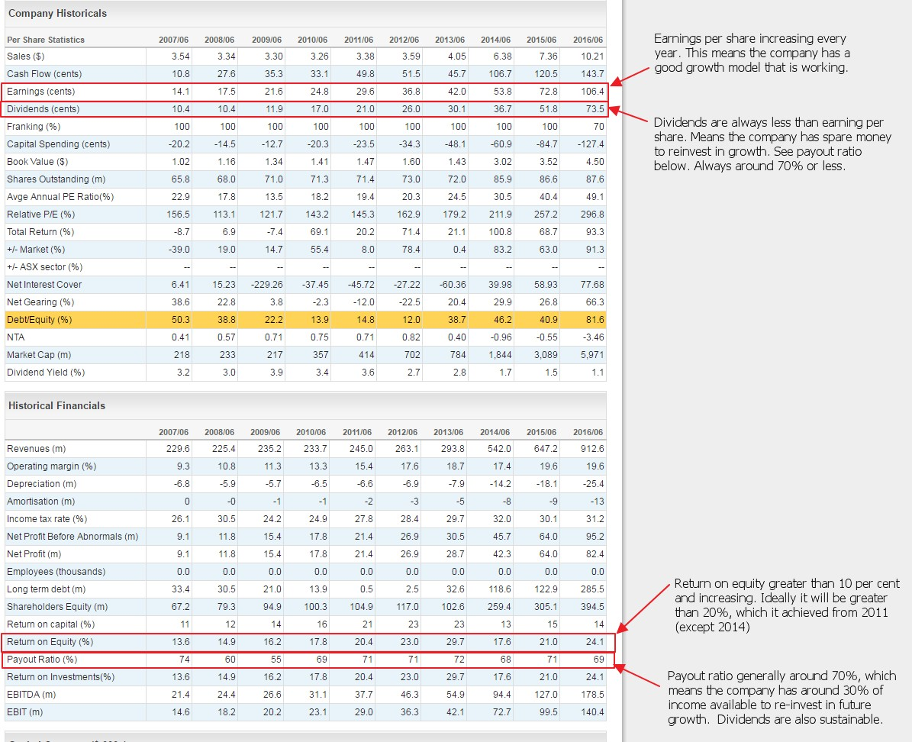

Slide 5
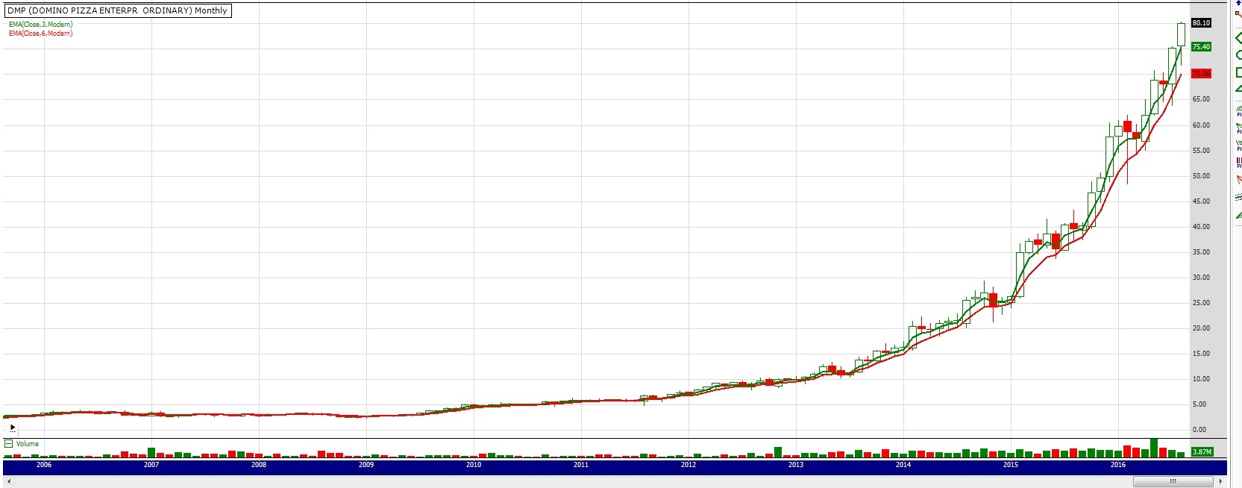
Dominos Pizza
Steep increases in price as the earnings and ROE increase. PR has remained stable during the entire chart period.

Slide 6
ASX Sharemarket Game Tips
Energy sector seems to be starting to fire (Code: XEJ).
If oil prices remain high it may be worth having a look at stocks from this sector, and suppliers for this sector (for example drilling supply companies).
The Materials (XTR, XMJ) and Consumer Discretionary (XDJ) sectors also seem to be starting to gain some short-term momentum.

Slide 7
ASX Sharemarket Game Tips
Spread your risk by not putting all of your eggs in the one basket. A good rule of thumb is no more than 5% of the portfolio in any given stock.

