Slide 1
Diagnosis of Foetal Health
R.Johansen 2021

Slide 2
Ultrasound

Slide 3
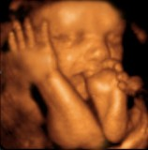
Ultrasound
Uses inaudible high frequency sound waves to produce an image of the foetus.
Probe placed on abdomen & sound waves reflected by foetal tissues producing visual ‘echo’
Uses:
Confirming pregnancy
Estimating the stage of pregnancy
Determining the number of foetuses
Identifying abnormalities in the cervix/uterus
Monitoring growth and development of the foetus
Determining gender and evaluating anatomy of foetus
Genetic screening
Studying the placenta and amniotic fluid
Identifying birth defects
Determining the position of the foetus

Slide 4
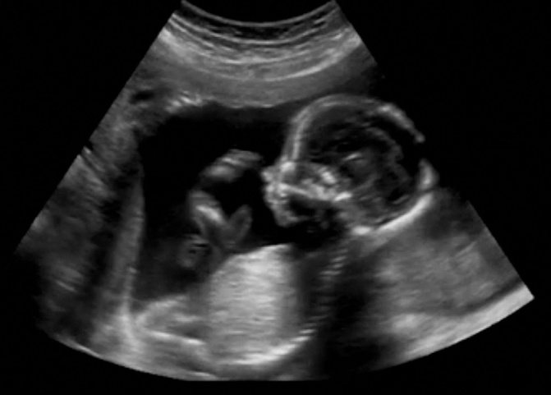
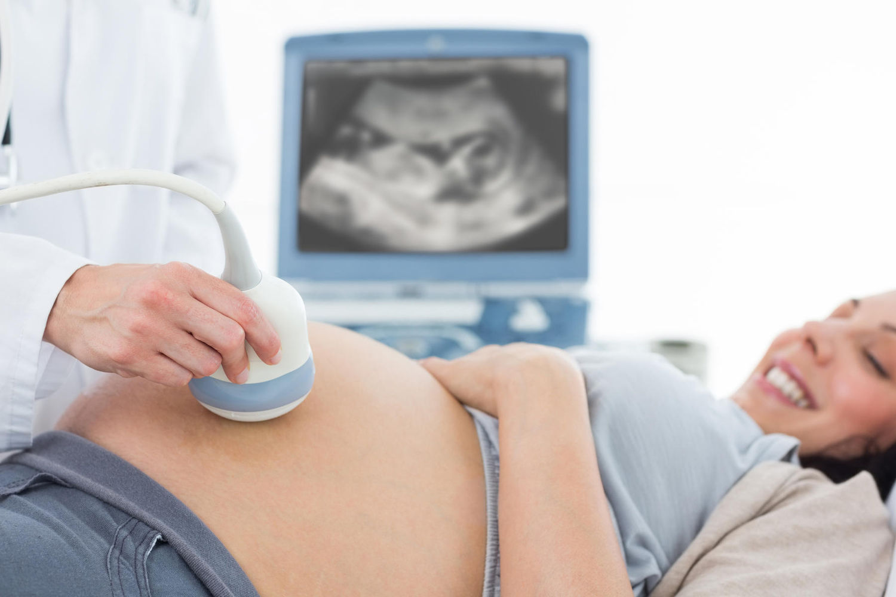
Ultrasound

Slide 5
Genetic analysis

Slide 6
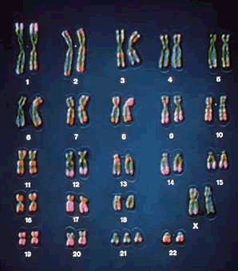
Chromosome Analysis
Chromosomes in cells from foetus can be examined to detect defective, missing or additional chromosomes.
Photograph of chromosomes displayed in order is called a karyotype.
Can be obtained from amniocentesis or chorionic villus sampling

Slide 7
Chromosome Analysis: Amniocentesis
16-20 weeks while foetus is floating in 130mL amniotic fluid.
Living cells from foetus floating in the fluid
Can be examined for biochemical defects & abnormalities in number of chromosomes or structure of chromosome.
Does involve a small risk of infection, miscarriage or damage to baby. Therefore only preformed on women who are high risk.
Down syndrome, cystic fibrosis, neural tube defects eg spina bifida, PKU, Tay-Sachs disease, Duchenne muscular dystrophy, sickle cell disease

Slide 8
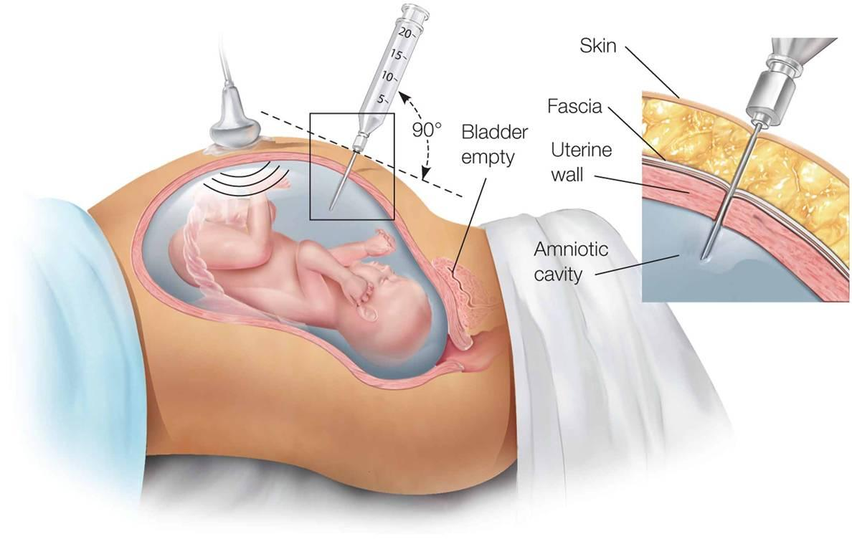
Chromosome Analysis: Amniocentesis

Slide 9
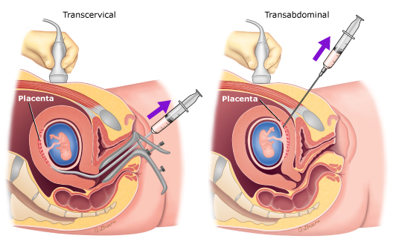
Chromosome Analysis: Chorionic villus sampling (CVS)
Specimen of foetal cells from the chorion
Cells examined in same say as amniocentesis
Advantage: can take place 9-19 weeks & be tested more quickly
Disadvantage: risk of miscarriage is 2%
Cannot diagnose spina bifida

Slide 10
Chromosome Analysis: Blood Test
Mother’s blood can also be used to detect genetic disorders
6 weeks after conception
Simpler as only take blood from arm of mother
Sample treated with special antibodies that adhere to the few foetal cells within mother’s blood: cultured & examined

Slide 11
FETOSCOPY

Slide 12
Fetoscopy
Looking directly at the foetus through a small, telescope-like instrument called fetoscope
Introduced to uterus through abdominal wall
Cleft lip & palate, missing or abnormal ears, deformed or absent limbs, spinal abnormalities
See page 377 of text for more information

Slide 13
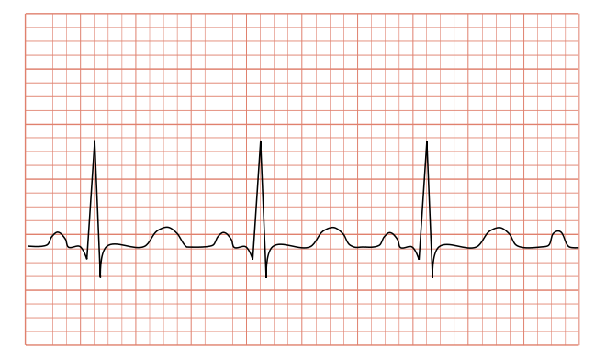
Foetal monitoring
Regular recording of baby’s heart rate in order to detect indicators of stress
During labour & birth
Uses ultrasound & electrocardiography (records electrical changes in heart)
Aim is to identify any risk of injury to foetus, oxygen deficiency

Slide 14
BIOCHEMICAL ANALYSIS

Slide 15
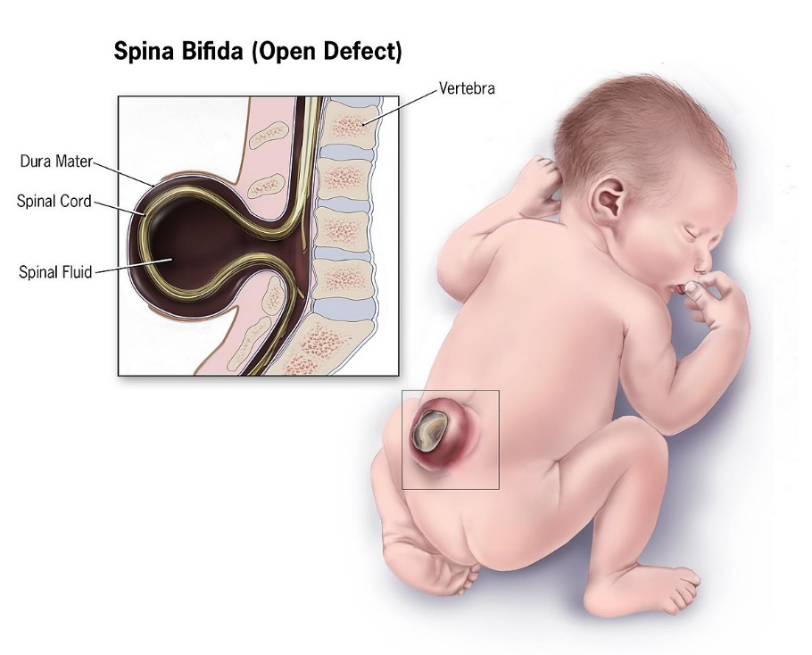
Biochemical Analysis
Marker protein assessment occurs with all newborns in Australia.
High concentrations of the marker protein can indicate a malformation.
Used to detect PKU, spina bifida
Blood or amniotic fluid

Slide 16
DNA PROBES

Slide 17
DNA probes
More recent innovation enabling detection of a range of genetic disorders including Duchenne muscular dystrophy & Thalassaemia
Uses DNA segments, labelled & can be used to detect abnormal genes
Probes are based on recombinant DNA technology.
See page 378 of text for more information

