Slide 1
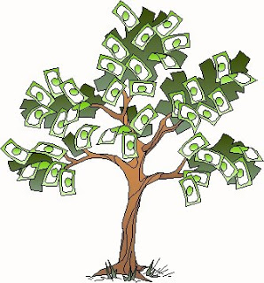
Investment: Does Money Grow?

Slide 2
What do think the saying ‘Be an early bird’ means when it comes to investing?
The more time you have to invest, the more likely you are to reach your financial goals – compound your returns.

Slide 3
Objectives
Students should be able to:
Understand the impact of time on investment.
Understand the risk vs reward trade-off.
Understand and explain the different asset classes.

Slide 4
Activity – Chris and Linda
Lively Linda is a keen investor. From 25 years of age, she invests $2,000 p.a. earning an average of 8% p.a.
Chris doesn’t start investing until he turns 40 years of age at which point he invests $5,000 p.a. for the next 20 years, also earning 8% p.a. Both Linda and Chris retire at 60 years of age.

Slide 5
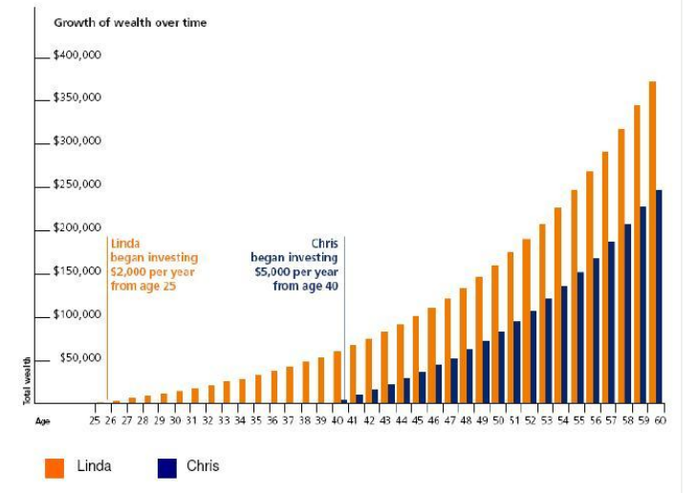
Despite putting aside less total savings, Linda has created more wealth than Chris. This is simply because Linda chose to invest earlier.

Slide 6
Rule of 72
Divide 72 by the interest rate you expect to earn. This will tell you how long it will take to double your money.
72 / 6% interest = 12 years to double your money
Divide 72 by the number of years in which you expect to double your money.
72 / 12 = 6% interest to double your money

Slide 7
Risk vs Reward
Risk is intrinsically linked to investing and, historically, greater risks have reaped greater rewards but have also been subjected to greater losses.
Diversify (spread investments) to lower risk.

Slide 8
Asset Classes
Two types of asset classes.
Income-producing assets – for short-term investors or people wanting more safer, secure investments with more consistent returns.
Higher risk, higher-return assets – for long-term investors.

Slide 9
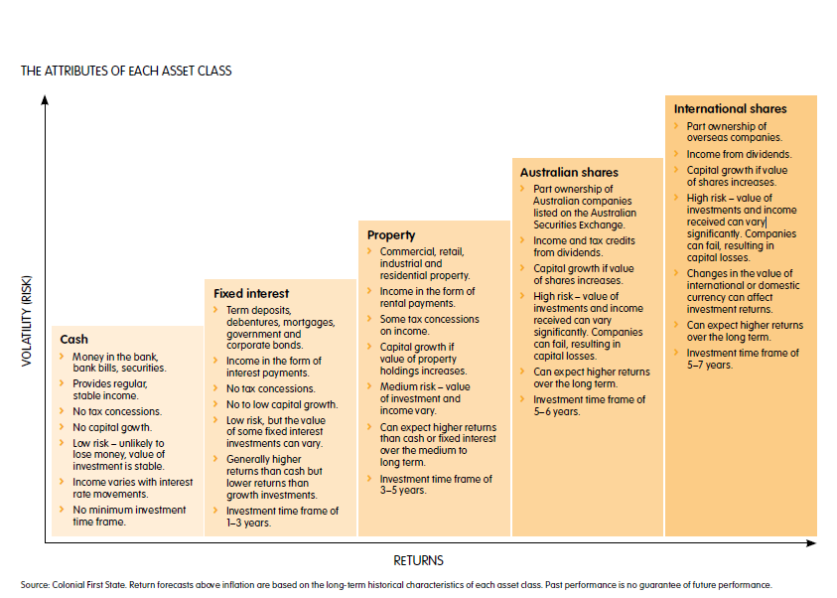

Slide 10
Income v Growth Assets
Type of investment depends on requirement for capital growth, income or both.
Income assets – provide stable and regular returns. Eg. Cash
Growth assets - increase capital with moderate levels of income over time. Eg. Shares.

