Slide 1
Politics and Law: Taster Lesson

Slide 2
Without government the natural state of ‘man’ is “solitary, poor, nasty, brutish and short”
- Thomas Hobbes (1651)
Notes:
In such a state, people fear death, and lack both the things necessary to commodious living, and the hope of being able to toil to obtain them. So in order to avoid it people accede to a social contract and establish a civil society. According to Hobbes, society is a population beneath a sovereign authority, to whom all individuals in that society cede some rights for the sake of protection. Any abuses of power by this authority are to be accepted as the price of peace. There is no doctrine of separation of powers in Hobbes's discussion. According to Hobbes, the sovereign must control civil, military, judicial, and ecclesiastical powers.

Slide 3
Why?
Is your life improved by having laws?
If so, then can we legalise too much? How much autonomy should citizens have...
What makes a ‘good law’
What makes a ‘bad law’

Slide 4
What is a Law?
Laws are rules enforceable by the courts
This means that a law has been determined by Parliament (statute law) or through the courts (common law)
Not all rules are laws
Laws are formal rules consciously determined by society

Slide 5
Sources of law
Statute law: Laws passed through parliaments (Federal and State. Can be delegated.)
Common law: Laws developed over time by the judgements of the courts

Slide 6
Development of Law
One of the basic features which defines a civilization is organised government.
Laws to regulate these societies have a long history:
Sumerian Code of Ur-Nammu (2050 BC)
Hammurabi’s Code (1750 BC)
The 10 Commandments
Sharia Law
Notes:
1. CITIES- man decides to stay in one place. 2. CENTRAL GOVERNMENT- President, King, etc to coordinate societies efforts. 3. COMPLEX RELIGION- belief system. Usually has holy text. 4. JOB SPECIALISATION- everyone has their own job. 5. SOCIAL CLASS- whether we admit it or not, there are wealthy people, and poor people. 6. ART AND ARCHITECTURE- we like to create things. 7. PUBLIC WORKS-what can the government do for you? 8. WRITING- every civilization as developed a form of writing.

Slide 7
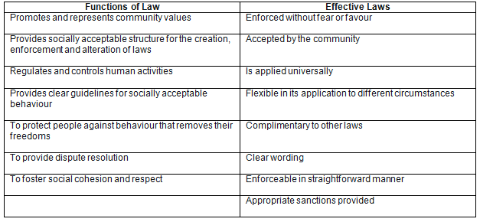
Hammurabi’s Code
http://www.commonlaw.com/Hammurabi.html

Slide 8
Development of Law
In a modern context nations either have one of three basic systems of law, or a combination:
Civil Law
Common Law
Religious Law

Slide 9
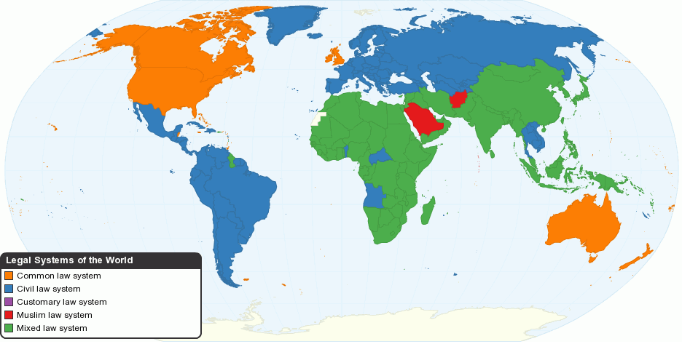

Slide 10
Religious Law
The ethical and moral codes taught by religion
Generally: obey and laws and you will receive positive spiritual reward; disobey and be punished
Canon Law, Judaic Law, Hindu Law, Sharia Law
Notes:
Discuss

Slide 11
Civil Law
Influenced by Roman Law and Napoleonic Codification
Emphasises that law is codified (written)
These codes are continually updated
Specify all matters capable of being brought before a court, the applicable procedure, and the appropriate punishment for each offence
Judges investigate and establish the facts as well as decide the case (inquisitorial system).
This is done through the framework of the legal code
Notes:
Roman Law = Justinian Code
This can be contrasted with common law systems whose intellectual framework comes from judge-made decisional law which gives precedential authority to prior court decisions on the principle that it is unfair to treat similar facts differently on different occasions (doctrine of judicial precedent)
Discuss

Slide 12
Common Law
Developed in the middle ages
Is generally uncodified
While common law utilises statutes, it is largely based on precedent
Precedent: Judge’s decisions in pending cases are informed by decisions in similar previously settled cases
Precedents are maintained over time through court records
Judges have a significant role in shaping law

Slide 13
Common Law
Adversarial system: two opposing parties compete in court before a judge (who moderates)
A jury of people decide on the facts of the case
The judge determines the sentence based on the jury’s verdict
Notes:
Discuss
13

Slide 14
Development of Common Law
In 1066, King William of England introduced a feudal system.
Under this system, the king owned all of the land and divided most of it among his lords or noblemen.
The Lords had their own servants, or vassals.
If a vassal broke the law, their Lord could punish them however they saw fit.
Punishments were inconsistent and unfair.

Slide 15
Development of Common Law
King William appointed judges to travel throughout England and decide cases.
Cases with similar facts were decided in the same way.
If a judge issued a verdict in a new case, that decision became the standard for similar future cases - precedent.
The system of law based on past legal decisions is known as common law or case law.

Slide 16
Development of Common Law
By the 1100’s BC this travelling circuit of tax collectors and judges became known as the curia regis
The local and county laws progressively declined as these judges selected the ‘best’ traditions to base uniform decisions on
These decisions reflected ‘common custom’
Notes:
Before the Norman conquest in 1066, justice was administered primarily by what is today known as the county courts (the modern "counties" were referred to as "Shires" in pre-Norman times), presided by the diocesan bishop and the sheriff, exercising both ecclesiastical and civil jurisdiction

Slide 17
Development of Common Law
The Rule of Law was recognized in the signing of the Magna Carta of 1215.
The rule of law states that the law applies equally to all persons.
The Magna Carta also introduced the writ of habeas corpus – a document that is used to determine whether or not someone is being legally detained.
Notes:
habeas corpus – A person being arrested must be brought before the courts

Slide 18
Functions of Laws
It is important to note that laws can be one of two things:
Written codes requiring behaviour by the people.
The legal system, practices and culture that is created by observing the law.

Slide 19
Functions of Laws
Promotes and represents community values
Provides socially acceptable structure for the creation, enforcement and alteration of laws
Regulates and controls human activities
Provides clear guidelines for socially acceptable behaviour

Slide 20
Functions of Laws
To protect people against behaviour that removes their freedoms
To provide dispute resolution
To foster social cohesion and respect

Slide 21
Functions/Effective Law

Slide 22
The home is no place to give birth
There is no place for births outside a hospital obstetric facility in our society. People who advocate home or similar delivery, while perhaps well-meaning, are at best misguided.
Babies do not care where they are delivered: a birthing suite, Bourke Street mall, or on national television. They need safe, loving care. As a GP obstetrician for 35 years, I have delivered ''low-risk'' pregnancies where the mother would have died if they had delivered outside a hospital, with its instant access to skilled medical emergency care.
We all want a safe delivery with a healthy mother and baby. Why should we accept anything less than an environment that allows the best chance for this to happen? It is unthinkable how seemingly ''normal'' people can advocate something which, while most often safe, occasionally leads to horrific and unnecessary outcomes.
Dr Paul Kelly, Benalla
Notes:
Review understanding of functions of law in this letter

Slide 23
Criminal Code
Internet search: State Law Publisher –WA (http://www.slp.wa.gov.au/Index.html)
Go to ‘Online Legislation Database’
‘Acts in force’
‘C’
Criminal Code
Look at 72
Look at 557 (G)
Look at 557 (I)

