Slide 1
Topic/Objective:
Ancient Rome Social Hierarchy

Slide 2
Essential Question:
How was society organised in ancient rome?

Slide 3
What was the social hierarchy of Ancient Rome?

Slide 4
Who was a citizen in Ancient Rome?
Under Roman law, a boy was born a citizen if his father was a citizen and his parents were legally married
Citizens were divided into two groups based on birth and property
Patricians and plebians

Slide 5
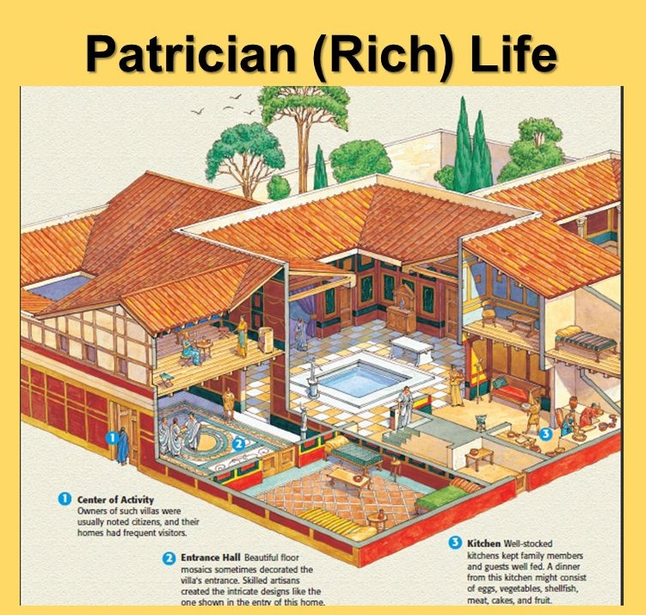
Who was a patrician?
Usually people who could trace their family back to the heads of influential families that made up the original Senate of Rome.
Wealthy & typically owned huge estates
At one point held ALL positions of political importance
Only they could interpret laws
Beneath them to be involved in commerce and trade

Slide 6
Who was a plebian?
Ordinary citizens of Rome
Made up the majority of the population and army
Had some say in how they were ruled by the Citizen’s Assembly
The poorest owned no property at all

Slide 7
Who were the rulers of Ancient Rome?
During the Roman Republic (509-27 BCE) two elected consuls ruled and were advised by the Senate.
New consuls were elected every 2 years
Julius Caesar was one of the most famous and powerful consuls.
Rome transitioned from a republic to an empire in 27 BCE when Julius Caesar’s heir Octavian assumed total power.

Slide 8
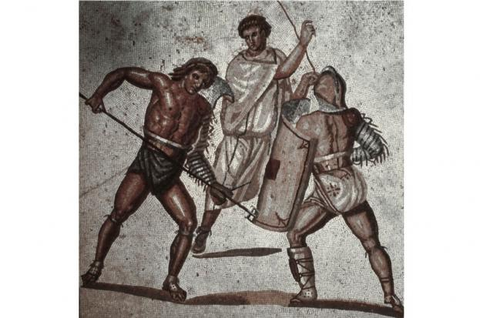
What was the role of non-citizens in society?
Foreigners and slaves could not vote and had very few rights
If slaves were freed they were given a form of Roman citizenship and their sons could become citizens
Most slaves were prisoners of war
Less fortunate slaves might be forced to fight to the death as a gladiator

Slide 9
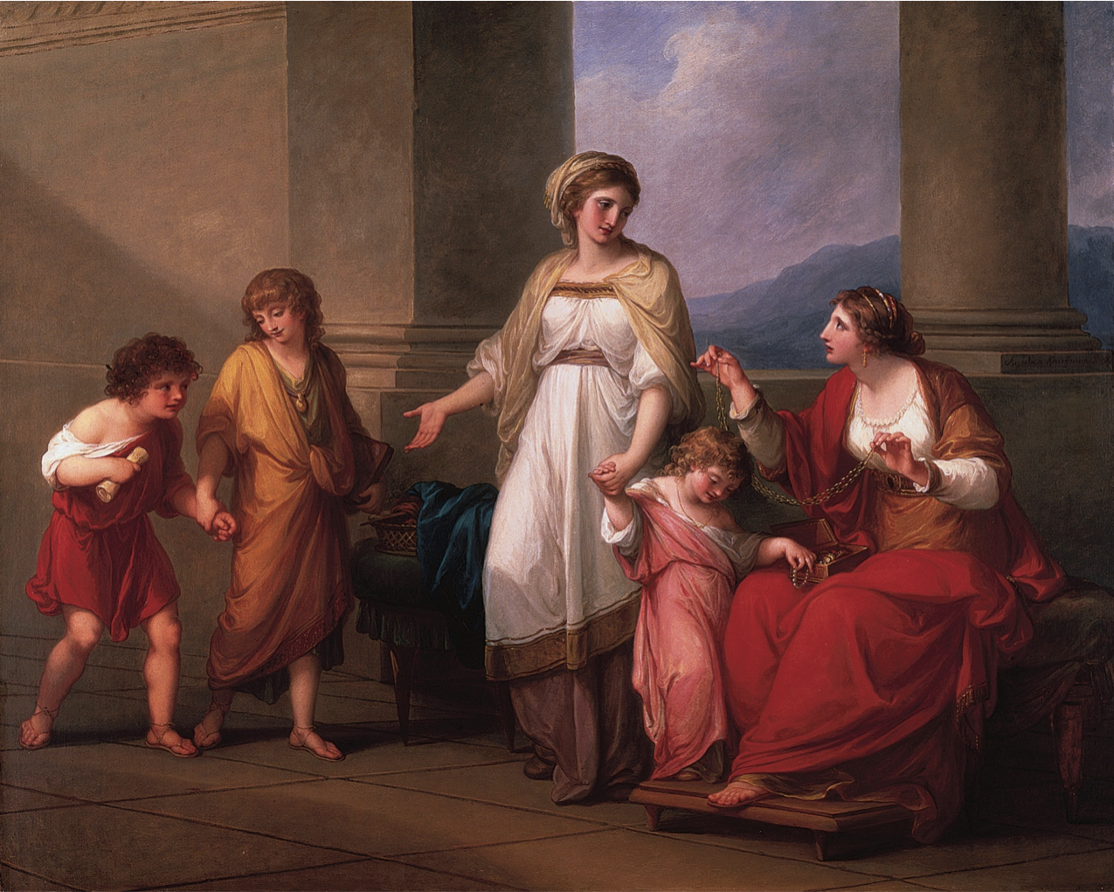
What was the role of women in society?
Women were technically considered citizens, but had very few right compared to men
Main role is to raise children and run the household
Had to obey their husbands in every aspect of life
Any property or money brought into the marriage automatically belonged to the husbands

Slide 10
Summary:
Write 3-5 complete sentences summarizing Ancient roman social hierarchy

Slide 11
Complete the following bookwork in your notebooks:
10.4: page 292 (q. 1-3)
10.6: page 296 (q. 1-4)

