Slide 1
Credit: Friend or Foe?

Slide 2
Rally Robin
List products or services that you, friends or family members have bought on credit.

Slide 3
Objectives
Students will be able to explain credit terms and the factors impacting on receiving credit.

Slide 4
Key Questions
1. What are the Three C’s of Credit?
2. What are the requirements for credit?

Slide 5
Credit Terms
Debtors - people who borrow.
Creditors - people who loan money.
Finance charges - the amount that is paid over the original loan amount (interest + other charges).
Annual Percentage Rate (APR) - rate of interest that is paid every year on a loan.
Secured Credit - credit for which the consumer must put up some property of value (collateral) to the loan.
Unsecured Credit - money that is loaned on nothing but the promise to repay in the future.

Slide 6
The Three C’s of Credit
Character - will you repay the debt?
From your credit history, does it look like you possess the honesty and reliability to pay credit debts?
Capital - what if you don’t repay the debt?
Do you have any valuable assets that could be used to repay credit debts if income is unavailable?
Capacity - can you repay the debt?
Have you been working regularly in an occupation that is likely to provide enough income to support your credit use?

Slide 7
Which ‘C’ does the following relate to?
Do you have a savings account?
Have you used credit before?
How long have you lived at your present address?
Do you have a steady job?
Do you pay your bills on time?
What are your current debts and your current living expenses?

Slide 8
Your responsibilities
Borrow only what you can repay.
Read and understand the credit contract.
Pay debts promptly.
Notify creditor if you cannot meet payments.

Slide 9
Building a Credit History
A credit report providers users information about your credit history to help work out whether you can afford a loan and whether you are likely to repay it.
Tips for a good credit report:
Establish a steady work record.
Pay all bills promptly.
Open a savings account and make regular deposits.

Slide 10
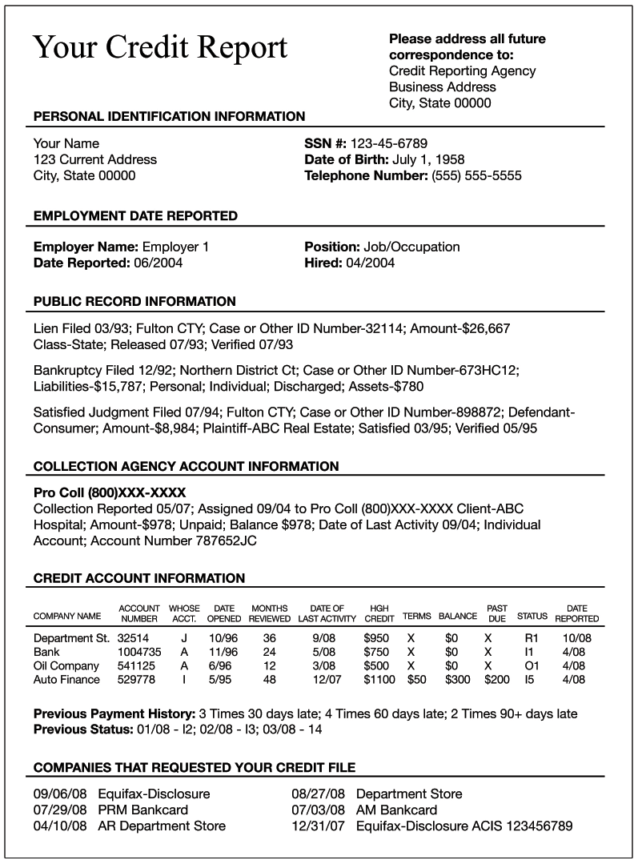

Slide 11
Activity
List five things you can do to build a credit history.

