Slide 1
Ancient Civilisations:
Locations and timeline

Slide 2
On which continents did the most important ancient civilisations develop?
Africa, Europe and Asia
They included ancient Egypt, Greece and Rome in the Mediterranean region
Ancient India and China were located in Asia

Slide 3
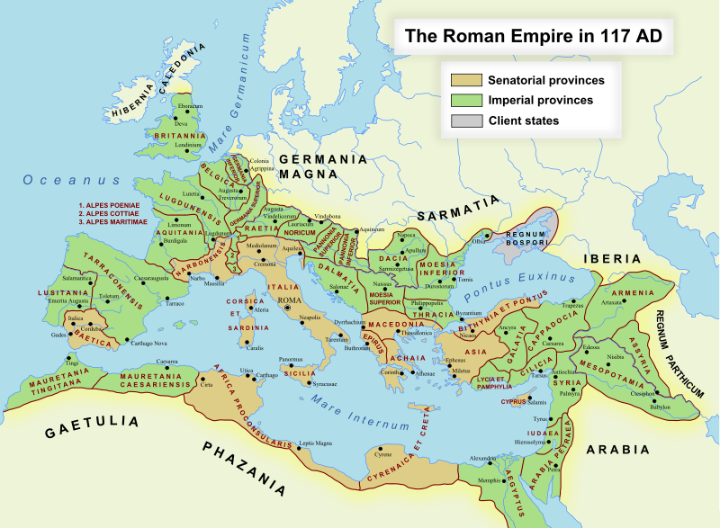
Did these ancient civilisations exist at the same time?
No. Some flourished and then disappeared and later become apart of another civilisation
Ancient Egypt and ancient Greece became apart of the Roman empire

Slide 4
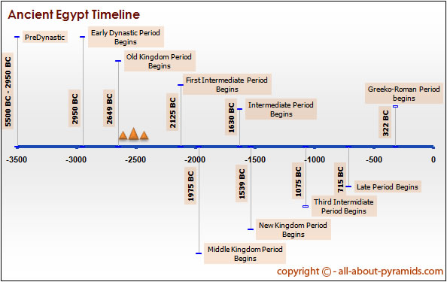
Ancient Egypt
Based around the Nile River in northern Africa
One of the world’s first civilisations
Ruled by one government from 3100 BCE-30 BCE
There were 31 dynasties and 70 pharoahs.

Slide 5
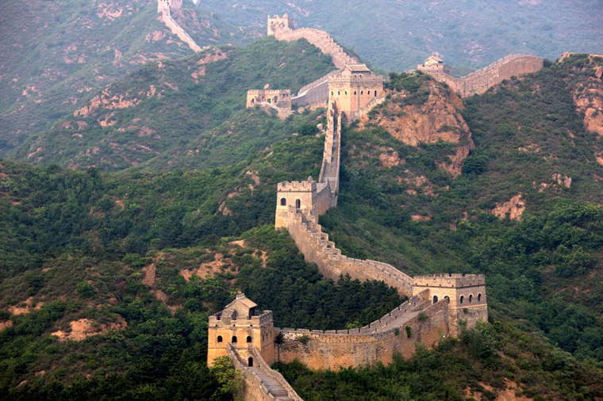
Ancient China
Ruled for 3600 years by dynasties (families)
The last dynasty ended in 1912
One of the earliest in the world to establish towns and cities
Important technological developments
Gunpowder and printing

Slide 6
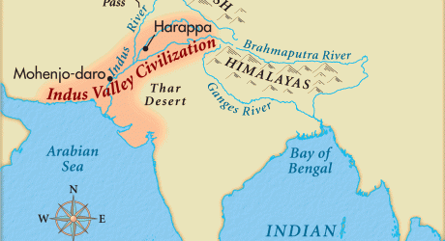
Ancient India
Began in the Indus Valley in 3500 BCE
Collection of separate regions and kingdoms

Slide 7
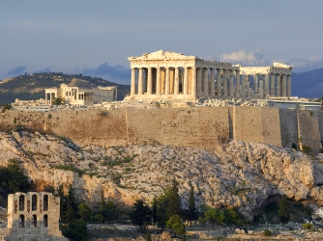
Ancient Greece
Formed from 3 existing cultures
Only lasted 400 years
But its legacy (including democracy) influences the Western world today

Slide 8
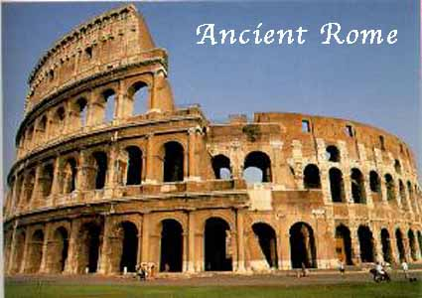
Ancient Rome
Lasted 1300 years
Centered around Rome in modern-day Italy.
Conquered the ancient Egyptians and Greeks
Ruled as a monarchy, republic and empire
Strong military and advanced culture

