Slide 1
Topic/Objective: Long term impacts of the Industrial Revolution

Slide 2
Essential Question:
What were the long term effects of the industrial revolution?

Slide 3
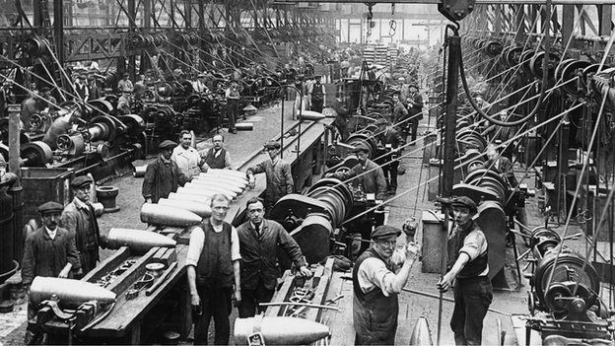
When did the Industrial Revolution end?
The beginning of WWI in 1914

Slide 4
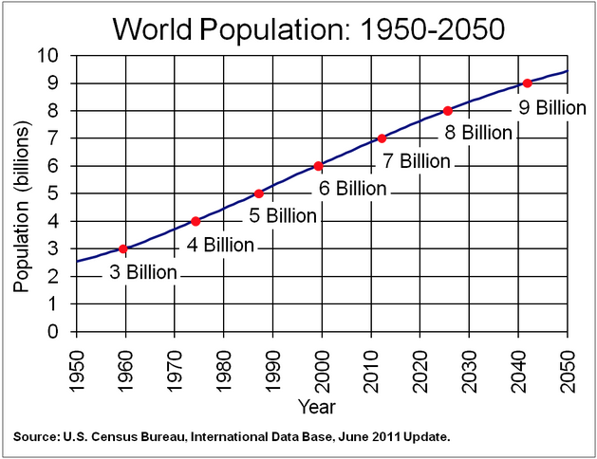
How did the world population change?
In the 100 years since the end of the Industrial Revolution the world population has continued to rise.
Growth has slowed in industrialised nations
Population is increasing rapidly in the developing world
1801: world population = 1 billion people
2027: world population estimated to exceed 8 billion people
Many academics argue this number is unsustainable & placing the resources of the world at risk from overuse

Slide 5
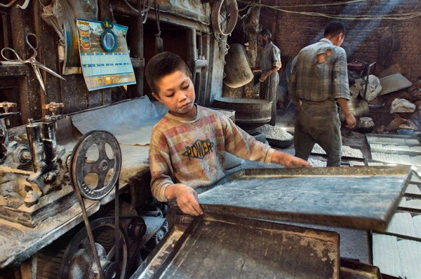
How did the Industrial Revolution effect global inequality?
The colonies of Europe and other parts of the world did not benefit from industrialisation.
They were left behind & exploited for their natural resources
Increased global trade has caused developing countries to experience many of the problems of the Industrial Revolution
Long hours, poor working conditions, child labour, etc.

Slide 6
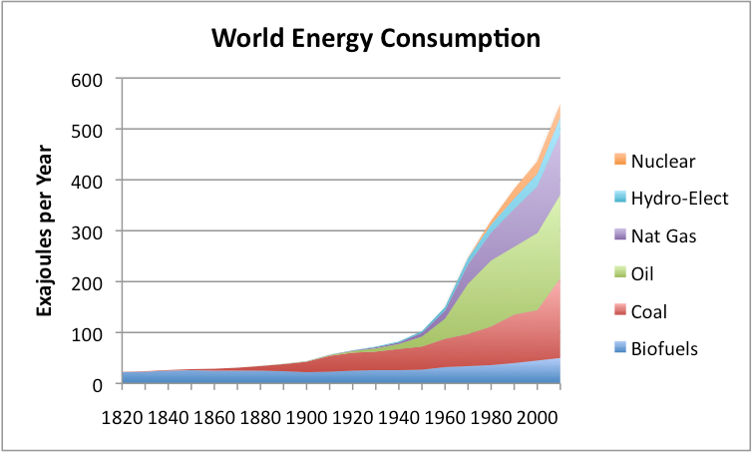
How did the Industrial Revolution effect the environment?
New sources of air & water pollution were introduced that we are only now beginning to link to industrialisation.
The modern world heavily depends on fossil fuels
Eg. Coal and oil
These fuels are running out

Slide 7
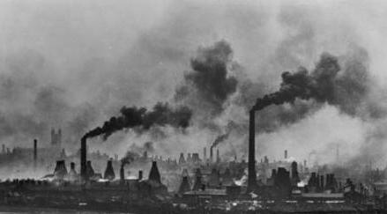
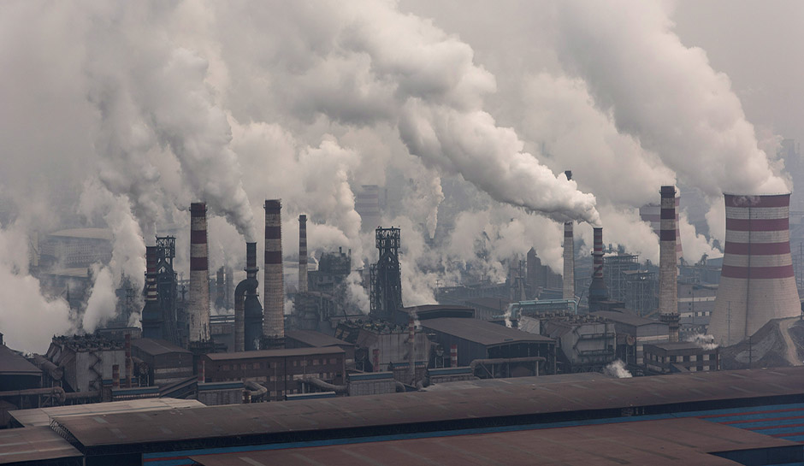
How did the Industrial Revolution effect the environment?
Air pollution created during the Industrial Revolution has long-term effects on the entire planet.
Caused humans to become dependent on carbon fuels (petrol & gas)
Governments worldwide are trying to find greener sources of energy
China, India & the rest of the developing world have copied industrialised nations and are now HUGE producers of pollution
It is now widely accepted that pollution has changed Earth’s climate
Pollution in Britain 1850’s
Pollution in China 2015

Slide 8
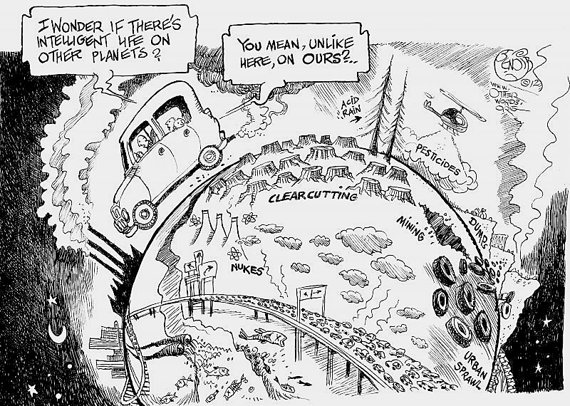
How did the Industrial Revolution effect the environment?
Factories, tanneries, and industrial building were often built along the banks of rivers.
Waste from these buildings & sewers was dumped into rivers, badly polluting the water.
By 1833 salmon could no longer be found upstream from the London Bridge
Rivers were still used to provide drinking water
This led to 4 serious cholera outbreaks
Starting in the 1960’s, people began to realize the problems caused by water pollution
Large areas of land were poisoned, run-off from chemicals entered the water supply, lead entered the food chain, etc.

Slide 9
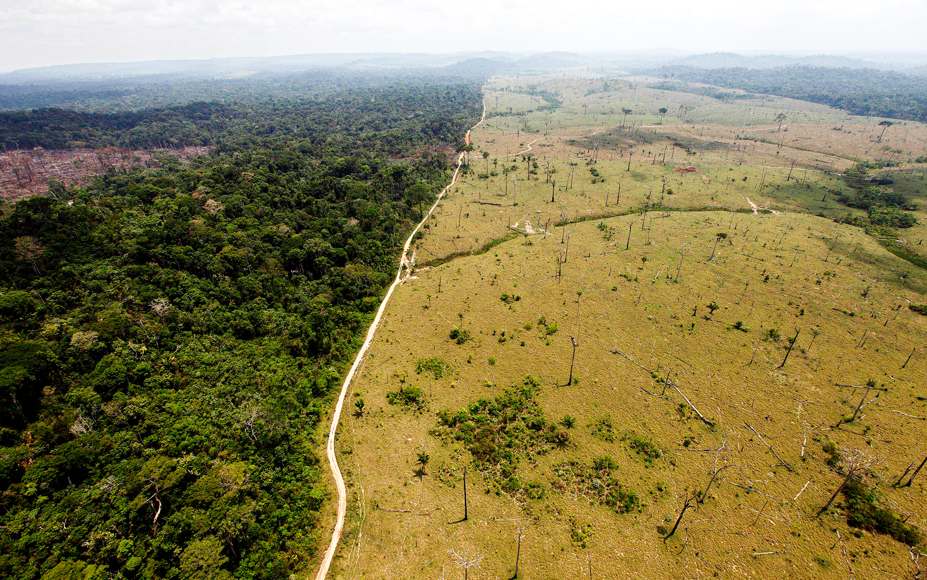
How did the Industrial Revolution effect the environment?
Forests were cleared to the greatest extent for fuel, building materials, and farmland.
Rising population needed more buildings & railways
Land was needed for new factories, mills, and housing.
The forests lost contained old-growth trees that had stood for decades
These trees held together soil or soaked up rain water
The loss of these trees led to landslides and flooding

Slide 10
Now complete the summary section in your Cornell style notes
Make sure you address the essential question and use main ideas we identified in our notes.

Slide 11
Grab a book and read pages 278-285
Answer the following questions in your notebook:
Questions 1-6 page 281
Questions 1-7 page 285

