Slide 1
Topic/Objective:
Accessing water in world

Slide 2
Essential Question:
How do people in the world access fresh water?

Slide 3
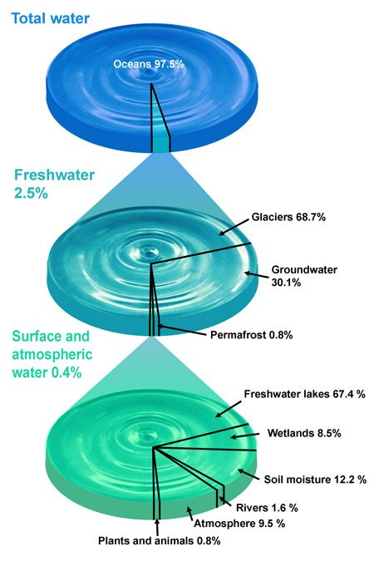
How do we access fresh water?
Only 2.5% of the water on Earth is fresh water
Usually found in lakes & rivers
As populations grow, people are using groundwater locked away in aquifers.
Water is the most precious resource
Available fresh water is not spread across the planet evenly
Brazil, Indonesia, Papua New Guinea = water rich
Australia = water poor

Slide 4
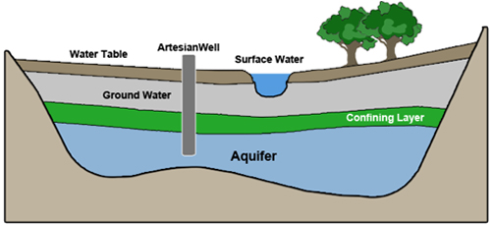
How do we access fresh water?
When it rains, water passes through the space between soil & rock it becomes groundwater
Groundwater naturally comes to the surface at springs or oases
Most of Perth’s water is drawn from an underground aquifer
A layer of permeable rock that stores water

Slide 5
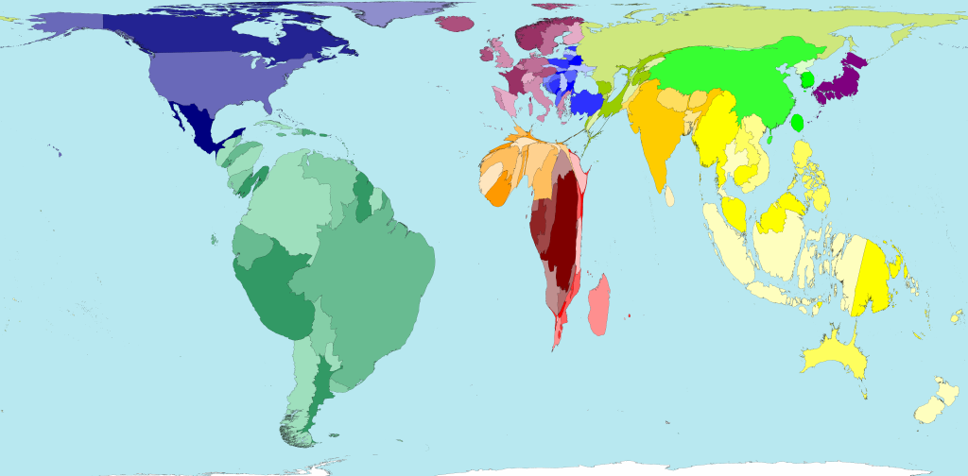
How do we access fresh water?
Each country is shown in its correct location, its size shows the proportion of the world’s freshwater resources found there.
Countries that appear fat are water rich
Countries that appear thin are water poor

Slide 6
How much fresh water does Australia have?
Australia has the lowest volume of water in rivers & smallest number of permanent wetlands of any country except Antarctica.
Australia’s water is not evenly distributed
Northern Australia is water rich.
Inner Australia receives very little rain
All of Australia’s large cities and towns are on the coast
Reliable rainfall on the coast makes these areas more livable than inner Australia
Large # of water users has put strain on water resources

Slide 7
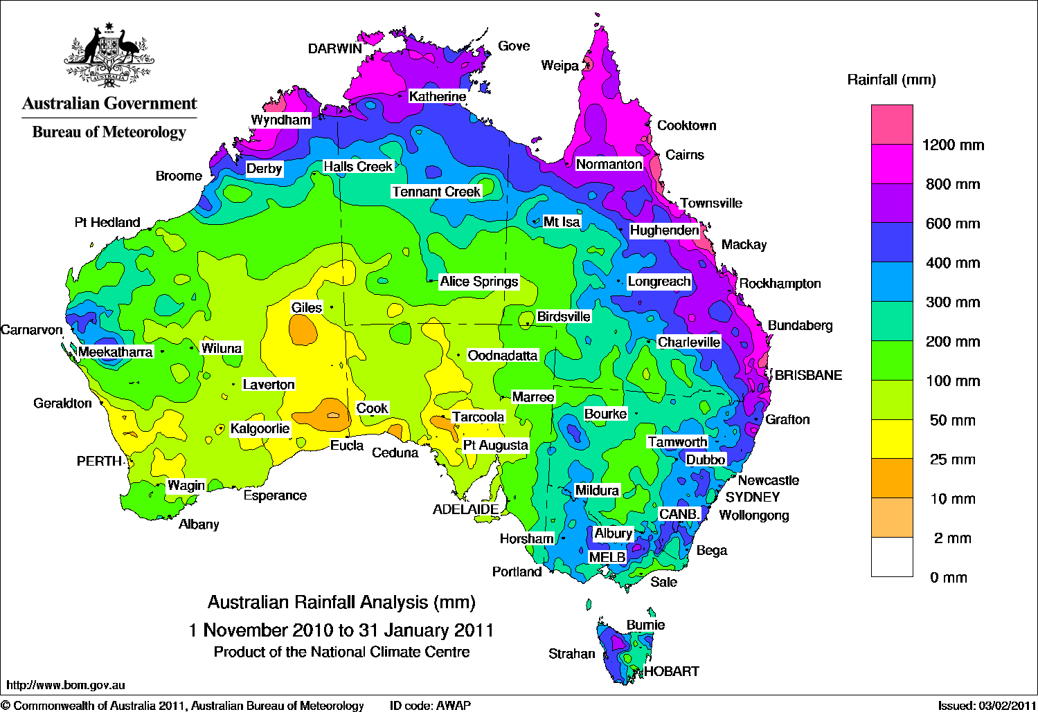
How much rain falls in Australia?
Only the northern, eastern and south-western coasts receive good annual rainfall
The climate of east coast is influenced by the Great Dividing Range
Australia has a large variation in rainfall
It is common for one part of the country to flood while the other has a long drought

Slide 8
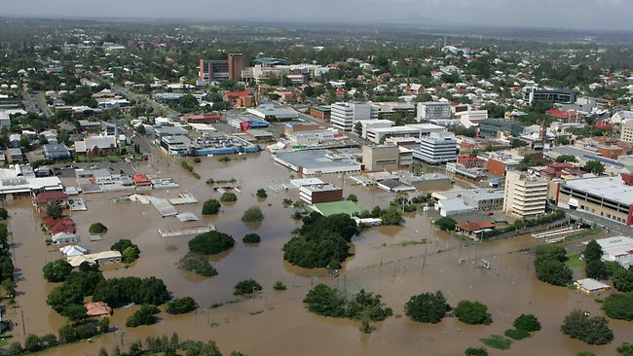
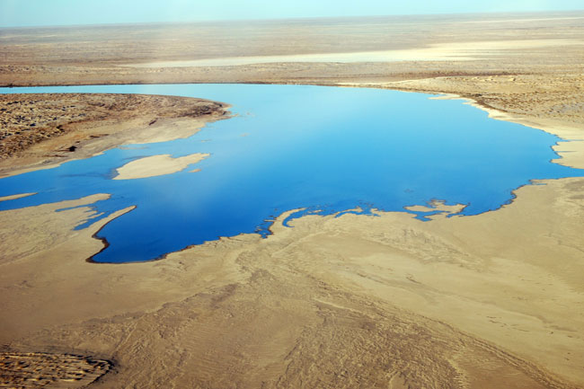
How much rain falls in Australia?
The wettest place in Australia: Tully, Queensland
4204 mm rainfall per year
Receives so much rain because of location
Within the tropics & north-east slopes of Great Dividing Range
The driest place in Australia: Lake Eyre, South Australia
100 mm rainfall per year
Lies far from any supply of moisture
Tully, Queensland
Lake Eyre, South Australia

Slide 9
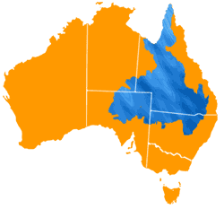
How much rain falls in Australia?
Many communities rely on underground water
Beneath eastern Australia is the world’s largest underground water supply
Great Artesian Basin is over 1.7 million square kilometers & covers 22% of Australia.
This water is accessed by drilling a well & pumping water to the surface with a windmill.

Slide 10
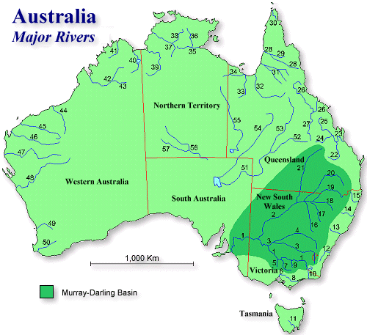
How do rivers in Australia provide fresh water?
Australia has the lowest volume of water in rivers of any inhibited continent on Earth.
12% of rainfall is collected in rivers
88% used by plants, held in natural water storages or evaporated
The Darling River loses enough water every year through evaporation to fill Sydney Harbour 4 times.

