Slide 1
Taxation

Slide 2
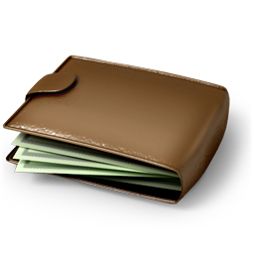
Taxes
‘The only sure thing in life are death and taxes’

Slide 3
What is Tax?
Money governments collect to pay for services they provide to the community.
The Australian Taxation Office (ATO) is responsible for the administration of the tax system in Australia.

Slide 4
WHAT IS TAX?
Collected from individuals and businesses.
Must complete an income tax return each financial year.
Financial year is from 1 July to 30 June.

Slide 5
Types of Taxes
The Australian Government collects a number of taxes including the following:
Income Tax – money paid by individuals on how much they earn.
Goods and Services Tax (GST) – 10% on processed goods and services.
Company Tax – 30% flat rate of tax paid by companies on the income they earn.
Capital Gains Tax – paid on profits from the sale of property or an investment.
Fringe Benefits Tax – paid on non-cash benefits that an employer provides “in respect of employment”.

Slide 6
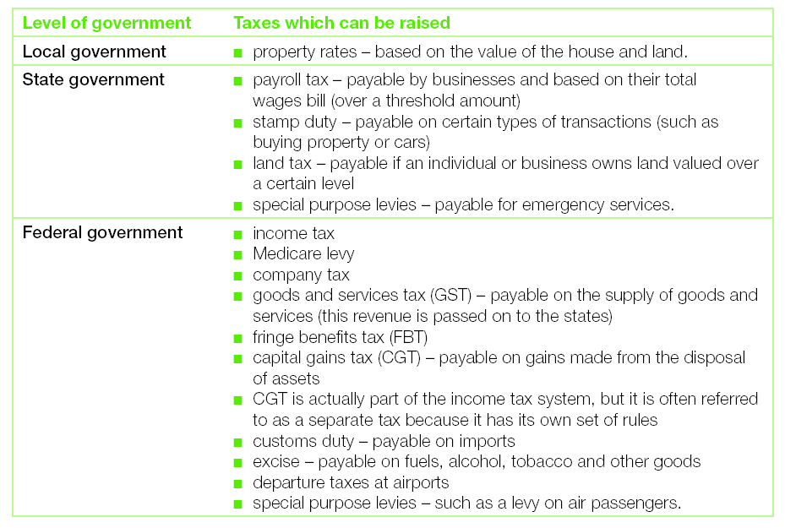

Slide 7
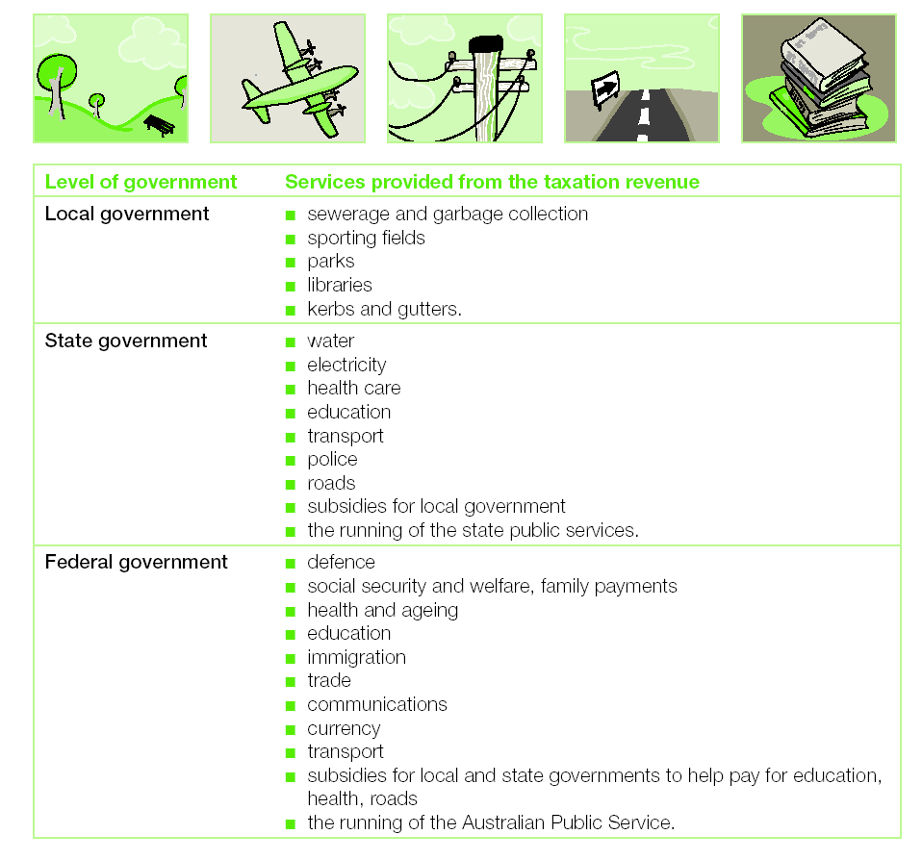
How do governments use the revenue they collect?

Slide 8
TAX CLASSIFICATION
Progressive taxes – the higher the income, the higher the percentage of tax paid. Eg. Income tax.
Proportional taxes – the same percentage is levied, regardless of the level of income. Eg. Company tax.
Regressive taxes – the same dollar amount of tax is paid, regardless of the level of income. Eg. The levy on passengers at airports is a regressive tax.

Slide 9
INCOME
Income is generally defined as the regular receipt of money.
Gross income - income before taxes and deductions.

Slide 10
ASSESSABLE INCOME
Income on which tax must be paid is called assessable income. Not all money received by an individual is considered to be assessable income. Examples of money that is not assessable income and therefore no tax is paid (exempt income):
gifts
pocket money
inheritances
lottery or prize winnings (or windfall gains).

Slide 11
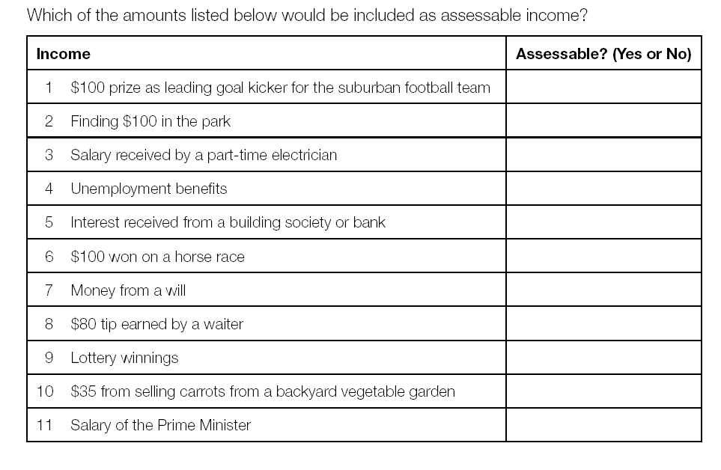

Slide 12
Taxable income
The amount of your income on which tax is payable is called taxable income.
Taxable Income = Assessable Income – Allowable Deductions

Slide 13
EXERCISE
Pretend you are the ‘government’ of Rossmoyne SHS. Discuss and decide on a new project or service for the school. What is it and how much will it cost?
You need to raise money for this project by taxing the members of the school. Suggest a form of taxation that could be imposed. How could this be enforced?

Slide 14
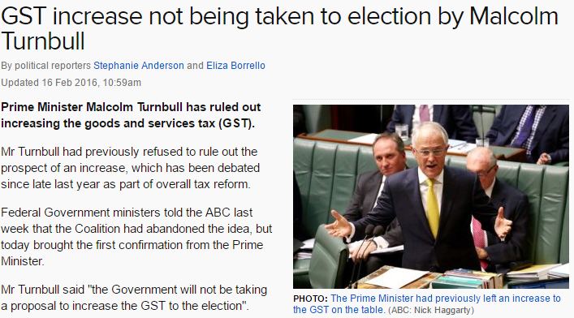

Slide 15
BRAINSTORM
Possible advantages and disadvantages of reducing tax on income and increasing tax on goods and services.

Slide 16
Deductions
Allowable deductions are expenses that you may incur in the course of earning income and can be used to reduce your assessable income.
Must be a legitimate link between the expense and your work. Eg. cost of tools and equipment used at work for a builder.
There are also a few allowable deductions not related to income-earning activities. Some examples are:
the costs of preparing a tax return
gifts or donations, of $2 and over, paid to an approved charity.

Slide 17
Income tax rates
Income tax rates determine the proportion of taxable income which is paid as tax.
Expressed as a percentage or in cents per dollar.
Does not include the Medicare Levy which is payable by most taxpayers to cover the cost of the public health system. Normally, the Medicare levy is calculated at 2% of your taxable income.
Without a Tax File Number (TFN) you get taxed at the top marginal tax rate.

Slide 18
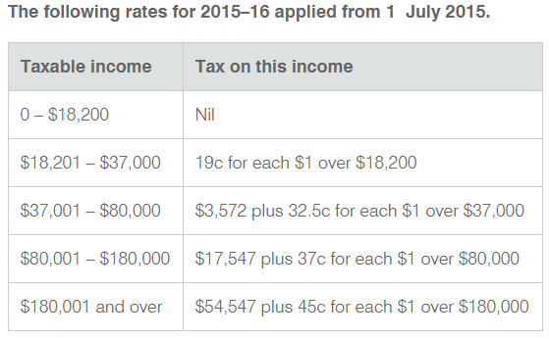

Slide 19
Example
If your taxable income is $30 000 per year, the tax is $2,242. This is calculated as follows:
Taxable income | Tax payable
$0 - $18 200 | Nil
$18 201 - $37 000 | $30 000 - $18 201= $11 799 x 0.19
Total | $2 242

Slide 20
Calculate THE tax on the following taxable incomes.
$35,700 | $60,000
$82,400 | $120,00

Slide 21
TAX EXEMPTIONS
People who earn less than $18 200 per year do not need to pay any tax - tax-free threshold.
People who receive certain pensions, such as the disability pension, do not need to pay any tax.
Religious, charitable, scientific and educational organisations are also exempt from paying tax.

Slide 22
OFFSETS
Offsets directly reduce the amount of tax payable on your taxable income.

Slide 23
PROCESS OF paying income tax
Employer deducts tax from employee and sends it to ATO. Known as PAYG (Pay As You Go).
End of financial year employee receives group certificate detailing gross earnings and tax paid.
Employee completes tax return including all income and deductions.
If not enough tax paid employee must pay extra or if too much has been paid employee receives a refund.

