Slide 1
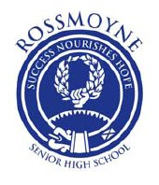
Origins of Democracy

Slide 2
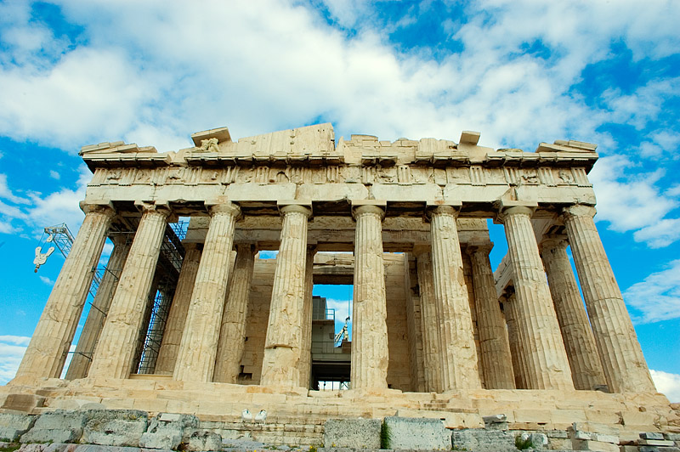

Slide 3
Greece
Democracy and many other ruling systems originated in Ancient Greece
Greece occupies a small, mountainous peninsula
Greek communities were separated by mountains and water – this isolation resulted in different ruling systems developing
Greek communities were separated into city states – Polis
Politics means: the things of the polis

Slide 4
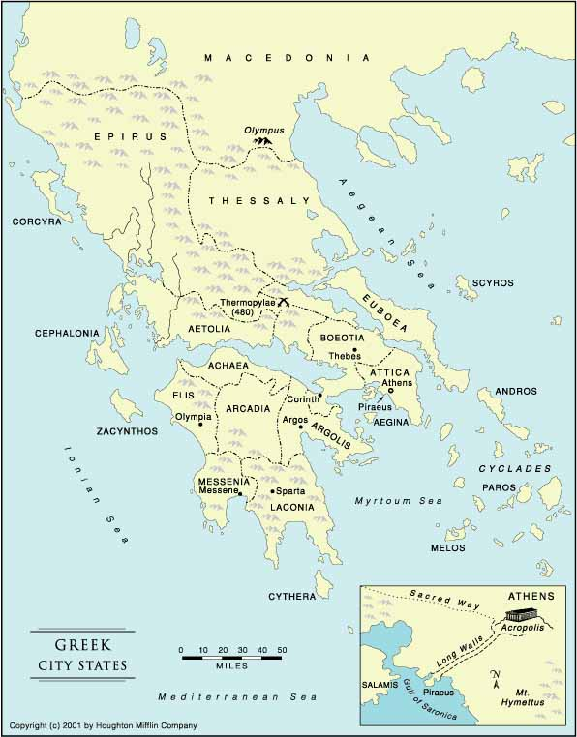

Slide 5
Polis
All political, social and religious activities took place in the polis
Words derived from polis:
Politics
Metropolis
Cosmopolitan
Police
The running of the polis was done in a variety of ways, such as:
Oligarchy
Tyranny
Democracy was another:
Demos – People
Cracy - rule
Rule of the people

Slide 7
Democracy
The people who were allowed to rule were Athenian adult male citizens
About 10 – 20% of the population
Children, women, slaves, foreigners had no political voice
These citizens met about 40 times a year to debate and decide public issues
Declared war, signed treaties, spent taxes

Slide 8
