Slide 1
Year 9 Financial Management
SWOT ANALYSIS

Slide 2
Learning Objectives
Students will be able to:
Know the purpose of a SWOT analysis
Identify the four basic elements of a SWOT analysis
Analyse a business using a SWOT

Slide 3
SWOT ANALYSIS
What is it?
A planning tool
Assesses for potential risks and rewards
Considers effectiveness/ success in relation to the business environment
Evaluate and adjust strategies
Helps a company to operate in a competitive environment.

Slide 4
SWOT ANALYSIS
What does it SWOT actually mean?
S
W
O
T
Strengths
Weaknesses
Opportunities
Threats

Slide 5
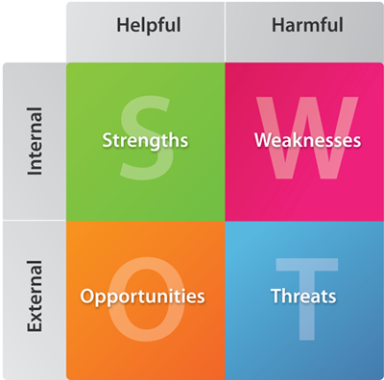
Strengths (Internal)
What the business is good at that may help
You have control over INTERNAL factors
Weaknesses (Internal)
What the business is bad at that may harm
SWOT ANALYSIS

Slide 6
SWOT ANALYSIS
Opportunities (External)
Factors outside the business that may help
Threats
(External)
Factors outside the business that may harm
You have NO control over EXTERNAL factors

Slide 7
TASK: Discuss in Pairs
Can you work out where you would put the following factors on the SWOT analysis: 2 minutes GO!
Competitor has gone bankrupt
Experienced workforce
High production costs
New competitor
Growth in demand for your product
Poor location
Increased income tax
Loyal customers
How many did you get right?

