Slide 1
Geography: Biomes

Slide 2
But first:
What is scale?
What is a classification, and why are they useful?
Notes:
Scale: The concept of scale is about the way that geographical phenomena can be examined at different spatial levels
Classify – to arrange into groups. Easier to identify, study and explore effectively.

Slide 4
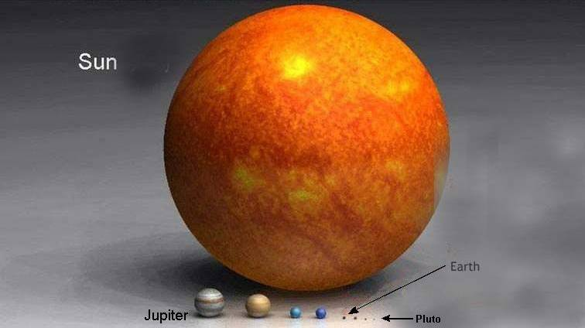

Slide 5
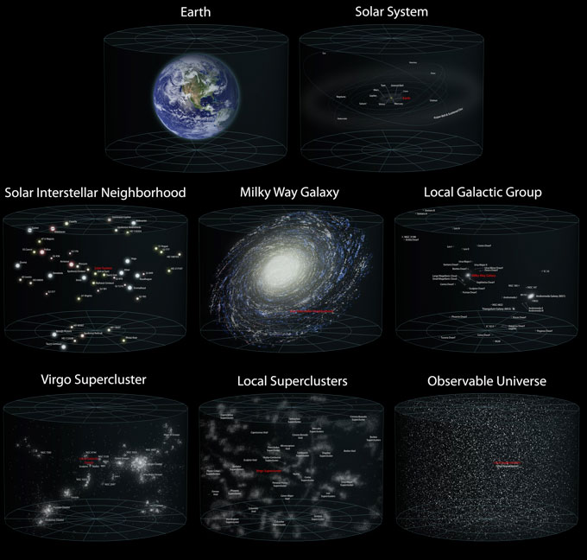

Slide 6
Classifications
Just as scientists classify the space and systems outside of our planet, the space and systems within our planet are classified

Slide 7
Earth – The 4 Spheres
All elements of Earth belong to one of four unique, but interdependent ‘spheres’:
Atmosphere
Biosphere
Lithosphere
Hydrosphere

Slide 8
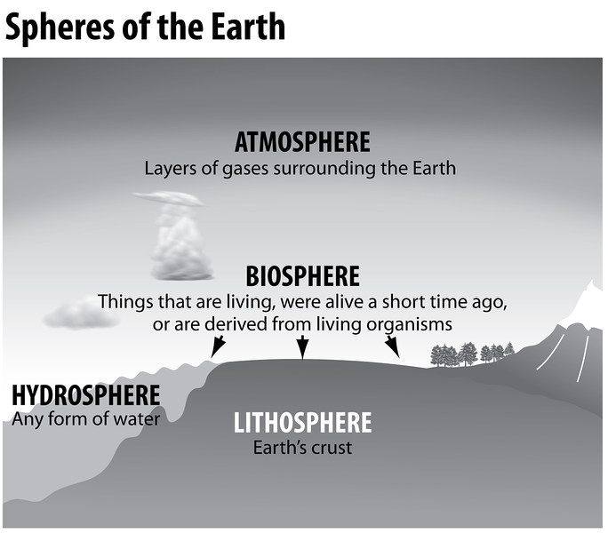

Slide 9
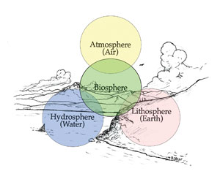

Slide 10
Pre
The Biosphere
Biosphere – All Biomes combined
Biome – is a set of ecosystems sharing similar characteristics with their abiotic factors adapted to their environments, classified by the predominant plant or climate type
Ecosystem - An ecosystem includes all of the living things (plants, animals and organisms) in a given area, interacting with each other, and also with their non-living environments (weather, earth, sun, soil, climate, atmosphere)
Community – all the populations in a specific area at a given time. A community includes populations of organisms of different species
Population - A group of individuals of a given species that live in a specific geographic area at a given time.
Individual Species and Organisms
Notes:
Biotic – Living
Abiotic – Non Living

Slide 11
Biomes
A biome is a set of ecosystems spread over a wide geographic area
Characterised by certain types of flora and fauna, as determined by climate.
Climate and soil determine the flora, which, in turn, largely determine what type of other organisms live in that biome.

Slide 12
Biome Categorisation
Can be categorised into a variety of ways
Generally 5 main types:
Aquatic
Deserts
Forests
Grasslands
Tundra
Each of these biomes can be further divided into separate categories
Notes:
What impact do you think latitude has on this?

Slide 13
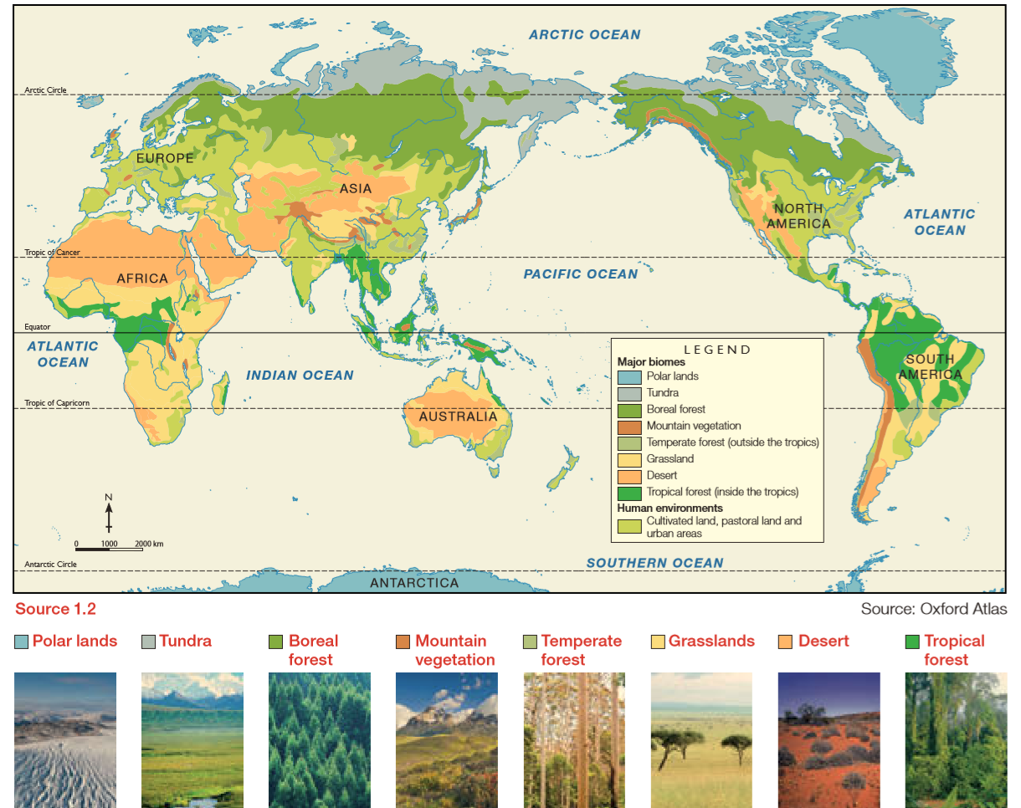

Slide 14
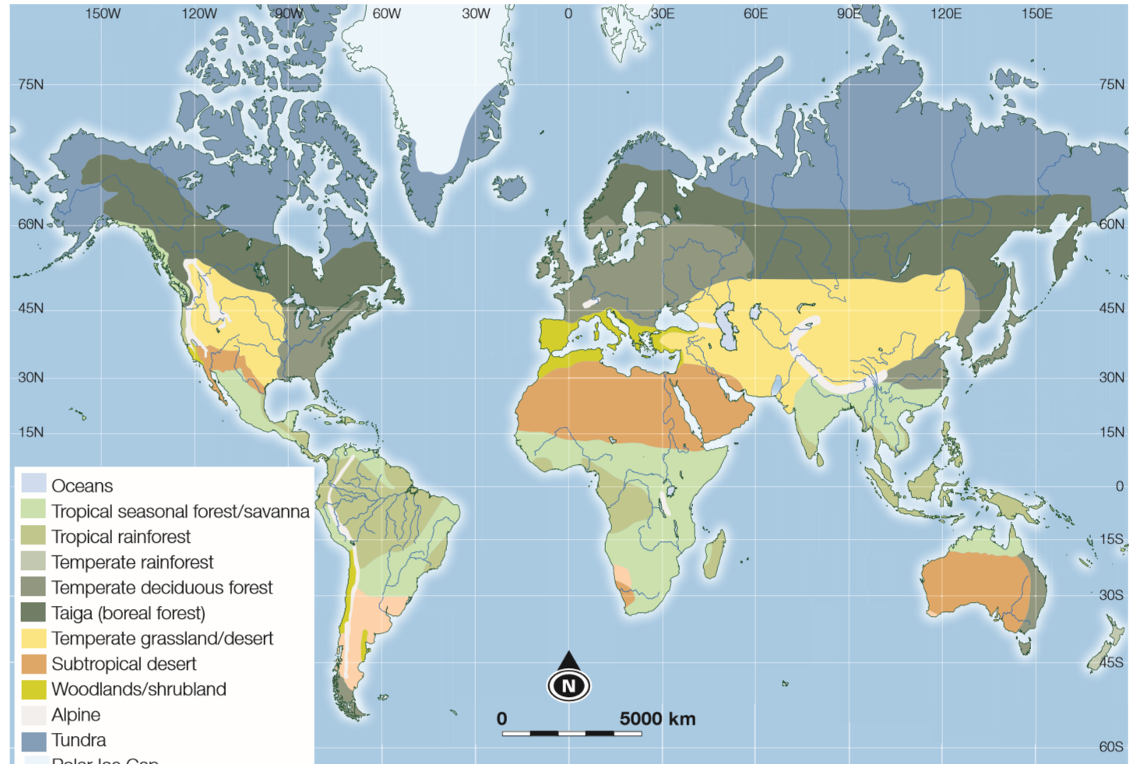
Notes:
Graphic Organiser activity.

