Slide 1
MARKETING
What is it, why is it important?

Slide 2
Objectives
Understand the importance of marketing to a business.
Understand and detail target market and the components associated.
Describe and explain the role of the marketing mix.

Slide 3
Marketing
“the science and art of exploring, creating, and delivering value to satisfy the needs of a target market at a profit. Marketing identifies unfulfilled needs and desires. It pinpoints which segments the company is capable of serving best and it designs and promotes the appropriate products and services.”
Dr Philip Kotler

Slide 4
What does that mean?
Your goal in marketing?
The coordination of key activities so that you are able to attract and retain customer satisfaction
This includes:
Market research
Brand
Marketing mix (product, placement, promotion, price)
Communication / image
Success?
Is dependent on these concepts being embedded in all aspects of your business including your people

Slide 5
Market Research – Competitor Analysis
It is important to understand your competitors so you know what their strengths and weaknesses are
These can become your threats and opportunities
They also help you work out your competitive advantage

Slide 6
Target Market
The people you will sell to distinguished by:
Geography – where your customers live
Demographic – gender, age, income, occupation, education, stage of life
Psychographic – attitudes, values, lifestyles
Behavioural – what are their motivational drivers

Slide 7
Target Market Task
Complete the worksheet provided – it should give you your target market to add to section 8 “Target Market” of your workbook

Slide 8
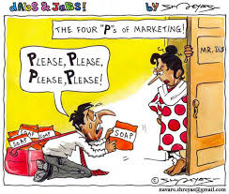
Marketing Mix (4 P’s)
Product
Price
Place
Promotion

