Slide 1
Birth, Changes and Development
R.JOHANSEN 2021

Slide 2
Birth – Stages of Labour

Slide 3
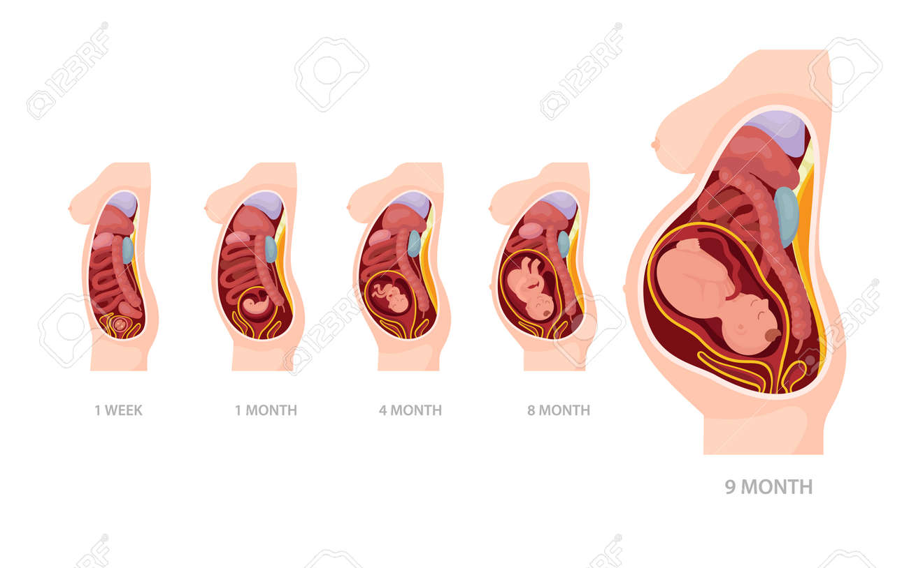
Gestation
Time that an embryo or foetus is carried in the uterus
Average growth and development period is 280 days
During this period the child grows to a length of approx. 50cm and a weight of approx. 3400g.
Predicted due date is calculated from the beginning of the last menstrual period. This is because this date is known, whereas the date of fertilization is not.

Slide 4
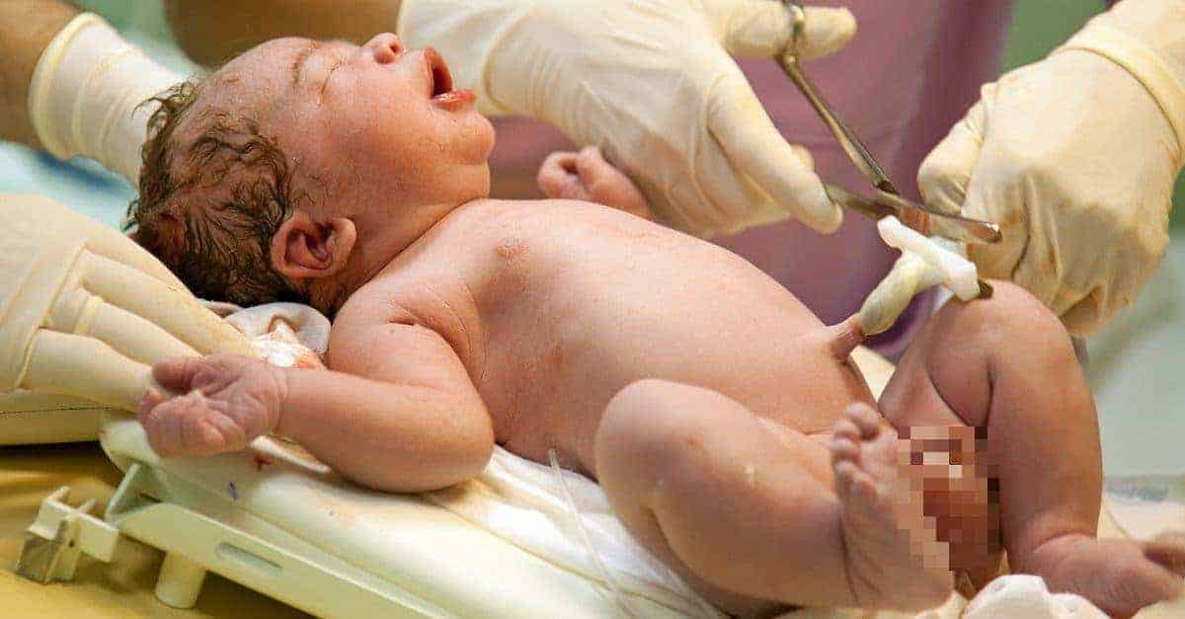
Parturition- Giving birth
Process in which foetus is expelled from the mother’s body
This is proceeded by the stages of labour

Slide 5
Labour
Has 3 major stages
Several hormonal changes occur to soften the ligaments of the pelvis – makes the pelvic region more pliable so that childbirth is easier
Hormones also act on the uterus – increase response to stimuli and strengthen contractions of it’s muscles

Slide 6
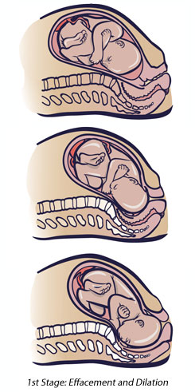
Before Labour
Before the process begins, the foetus has probably settled with its head in mothers pelvis
Cervix has softened, shortened in length and is likely to begin to open a little
Foetus is usually facing right or left hip bone of mother with knees tucked into abdomen with legs crossed. This position takes up as little room as possible.
One side of the head is pressed against the mother’s bladder, the other against the bowel

Slide 7
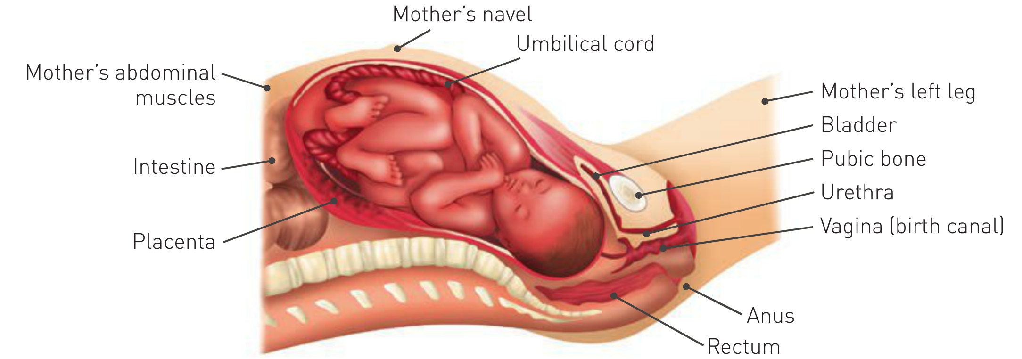
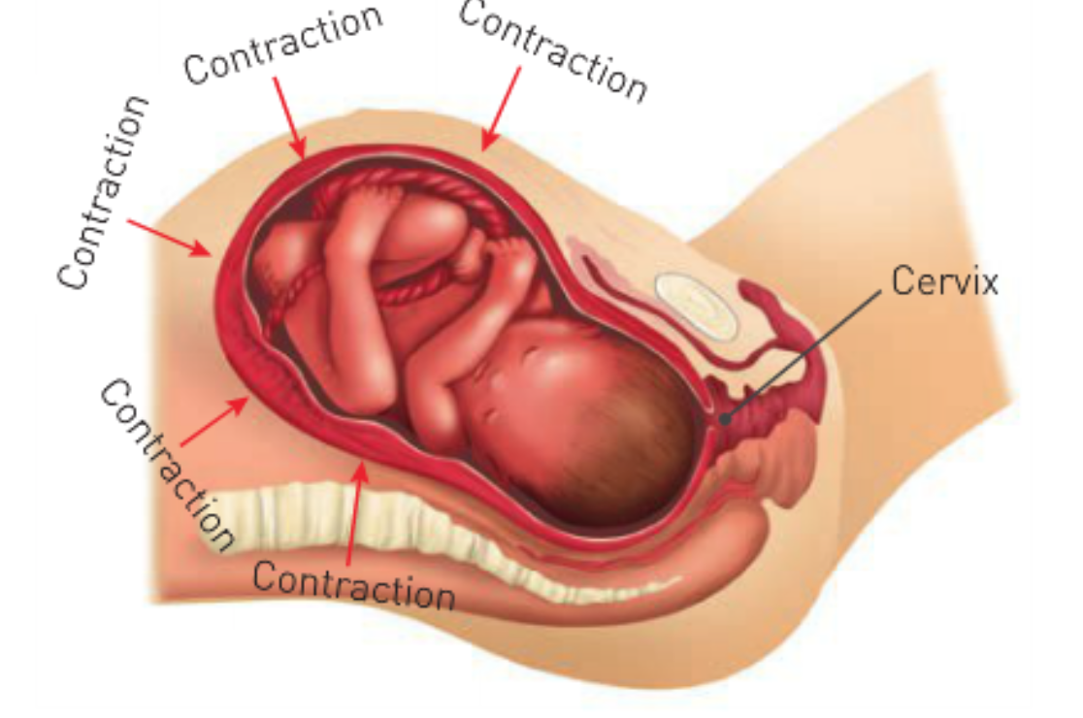
Labour Stage 1
In the last 3 months of gestation, uterus undergoes weak, irregular contractions that increase in intensity towards the end of pregnancy
Contractions will become stong and frequent, occurring every 30 mins
These are known as labour pains.
Dilation of the cervix – time from onset of labour to full dilation
Lasts an average of 8-9 hours in the first birth and 4 hours in subsequent births – this number can greatly vary
Waves of contractions travel from the upper part of the uterus downward towards cervix
With each contraction, the muscle fibers shorten, pulling on the cervix, shortening it so it no longer projects into the vagina
At the same time the cervix opened. This dilation allows the foetus to move into pelvis

Slide 8
Labour Stage 1
As the contractions become more frequent, the head of the foetus is pushed more forcefully against the slowly dilating cervix.
Cervix is dilated totally at approx. 10cm (marks the end of 1st stage of labour)
Uterus, cervix and vagina form a single curved passage The Birth Canal

Slide 9
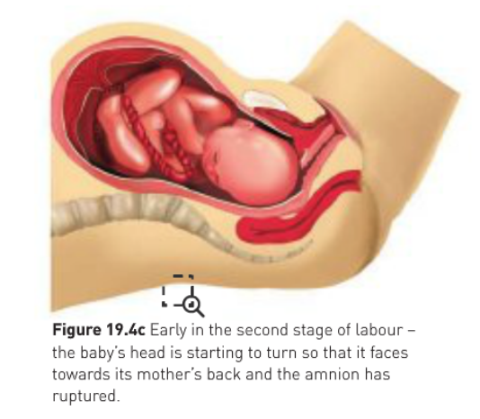
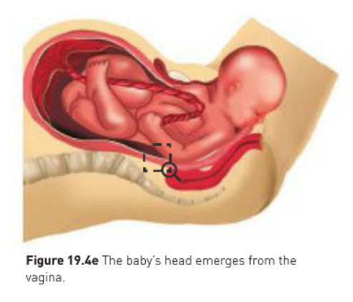
Labour Stage 2 - expulsion
Usually begins with the rupture of the membrane surrounding the foetus and gush of fluid from the vagina.
This rupture may occur earlier in labour (stage 1) or occasionally my not occur until the foetus is ready to be born.
Usually last anywhere from 20 minutes to 2 hours (from time of full dilation until birth)
As the foetus moves through the fully dilated cervix, it’s head stretches the vagina
This cause mother to contract abdominal muscles
Contractions of abdominal muscles together with uterus contractions help to push foetus through the vagina
As this happens the babies head turns to face the mothers back

Slide 10
Labour Stage 2 - expulsion
With each contraction the head advances a small amount
Between contractions causes a slight retreat but the push is greater and head is pushed towards opening of vagina
As this occurs the head will become visible
Mothers pulse rate increases and she usually begins to sweat from the effort required.
Mother rests between contractions to regain strength for the next contraction
Eventually the head stretches the vagina opening and tissues between it and the anus
This tissue is tightly stretched over the head as it is forced out of the canal
Once head emerges it turns sideways to face mothers hips
This rotation allows the shoulders and rest of the body to move more easily through the birth canal
As the foetus passes through the birth canal, the pressure of it’s head my force it to be pushed out of shape. This produces no damage to the brain, as the bones of the skull are pliable and separated by joints that allow some degree of overlap. The head resumes it’s normal shape a few days after birth

Slide 11
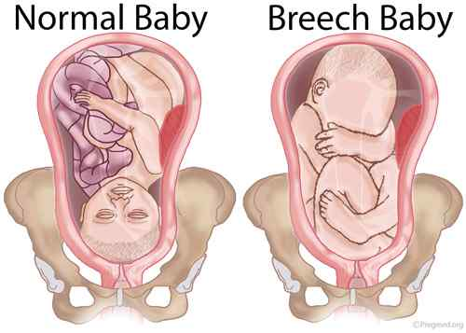
Labour Stage 2 - expulsion
The head of the foetus is downward in over 90% of births
This position allows the head to be delivered first and to act as a wedge to force open the cervix and the vagina
The head down position also allows the foetus to begin breathing even before it’s completely free of the birth canal

Slide 12
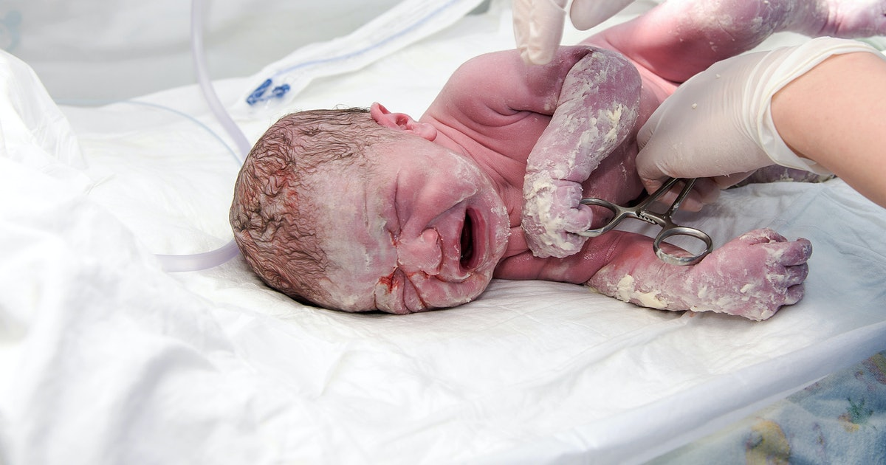
Labour Stage 3 - expulsion
Baby will begin to breathe even though it is still connected to the placenta via umbilical cord
The amnion, chorion and placenta remain in the uterus
The umbilical cord is clamped, tied in two places and cut between the ties
The artery and vein within the cord contract either before or straight after they are cut
After a few days the stump of the cord dries up and falls away. The navel (umbilicus) is all that remains
After baby is born, it is covered in a waxy material called vernix
This is washed off in first bath mostly…
Since it has a protective function from infections, it is common place now to use a cleaning agent that leaves a thin layer of vernix
Since this practice has been adopted, the incidence of skin infections in babies has been greatly reduced

Slide 13
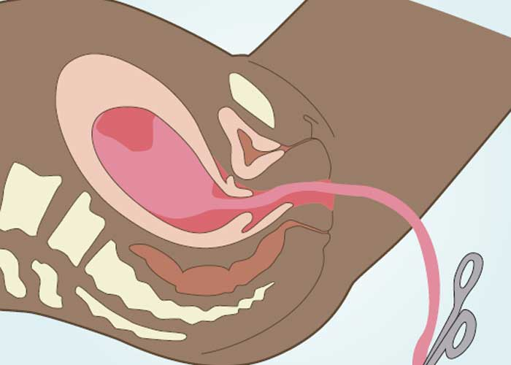
Labour Stage 3 - expulsion
Uterus contracts after the baby is born and after about 5 mins, the placenta, other membranes and remains of umbilical cord are expelled – together called afterbirth
Little blood is lost during this stage as the placental blood vessels constrict and contractions of the uterus squeeze shut the uterine vessels that supply blood to the placenta. Blood clots then form to stop all leakage of blood
With such a large area of exposed tissue, infection can occur. In this past this was quite common and made childbirth hazardous, with many women dying from infection in the uterus
Today there are strict standards of cleanliness and a vast availability of antibiotics which has greatly reduced the number of women who die from infection following childbirth

Slide 14
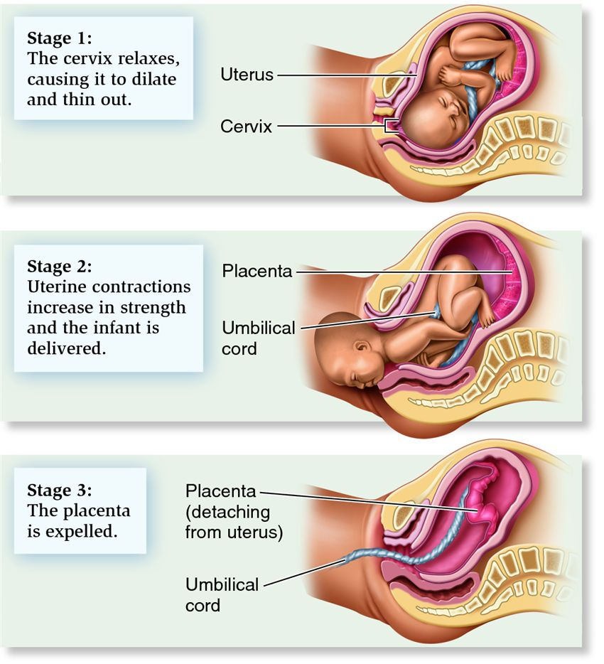

Slide 15
Changes after birth

Slide 16
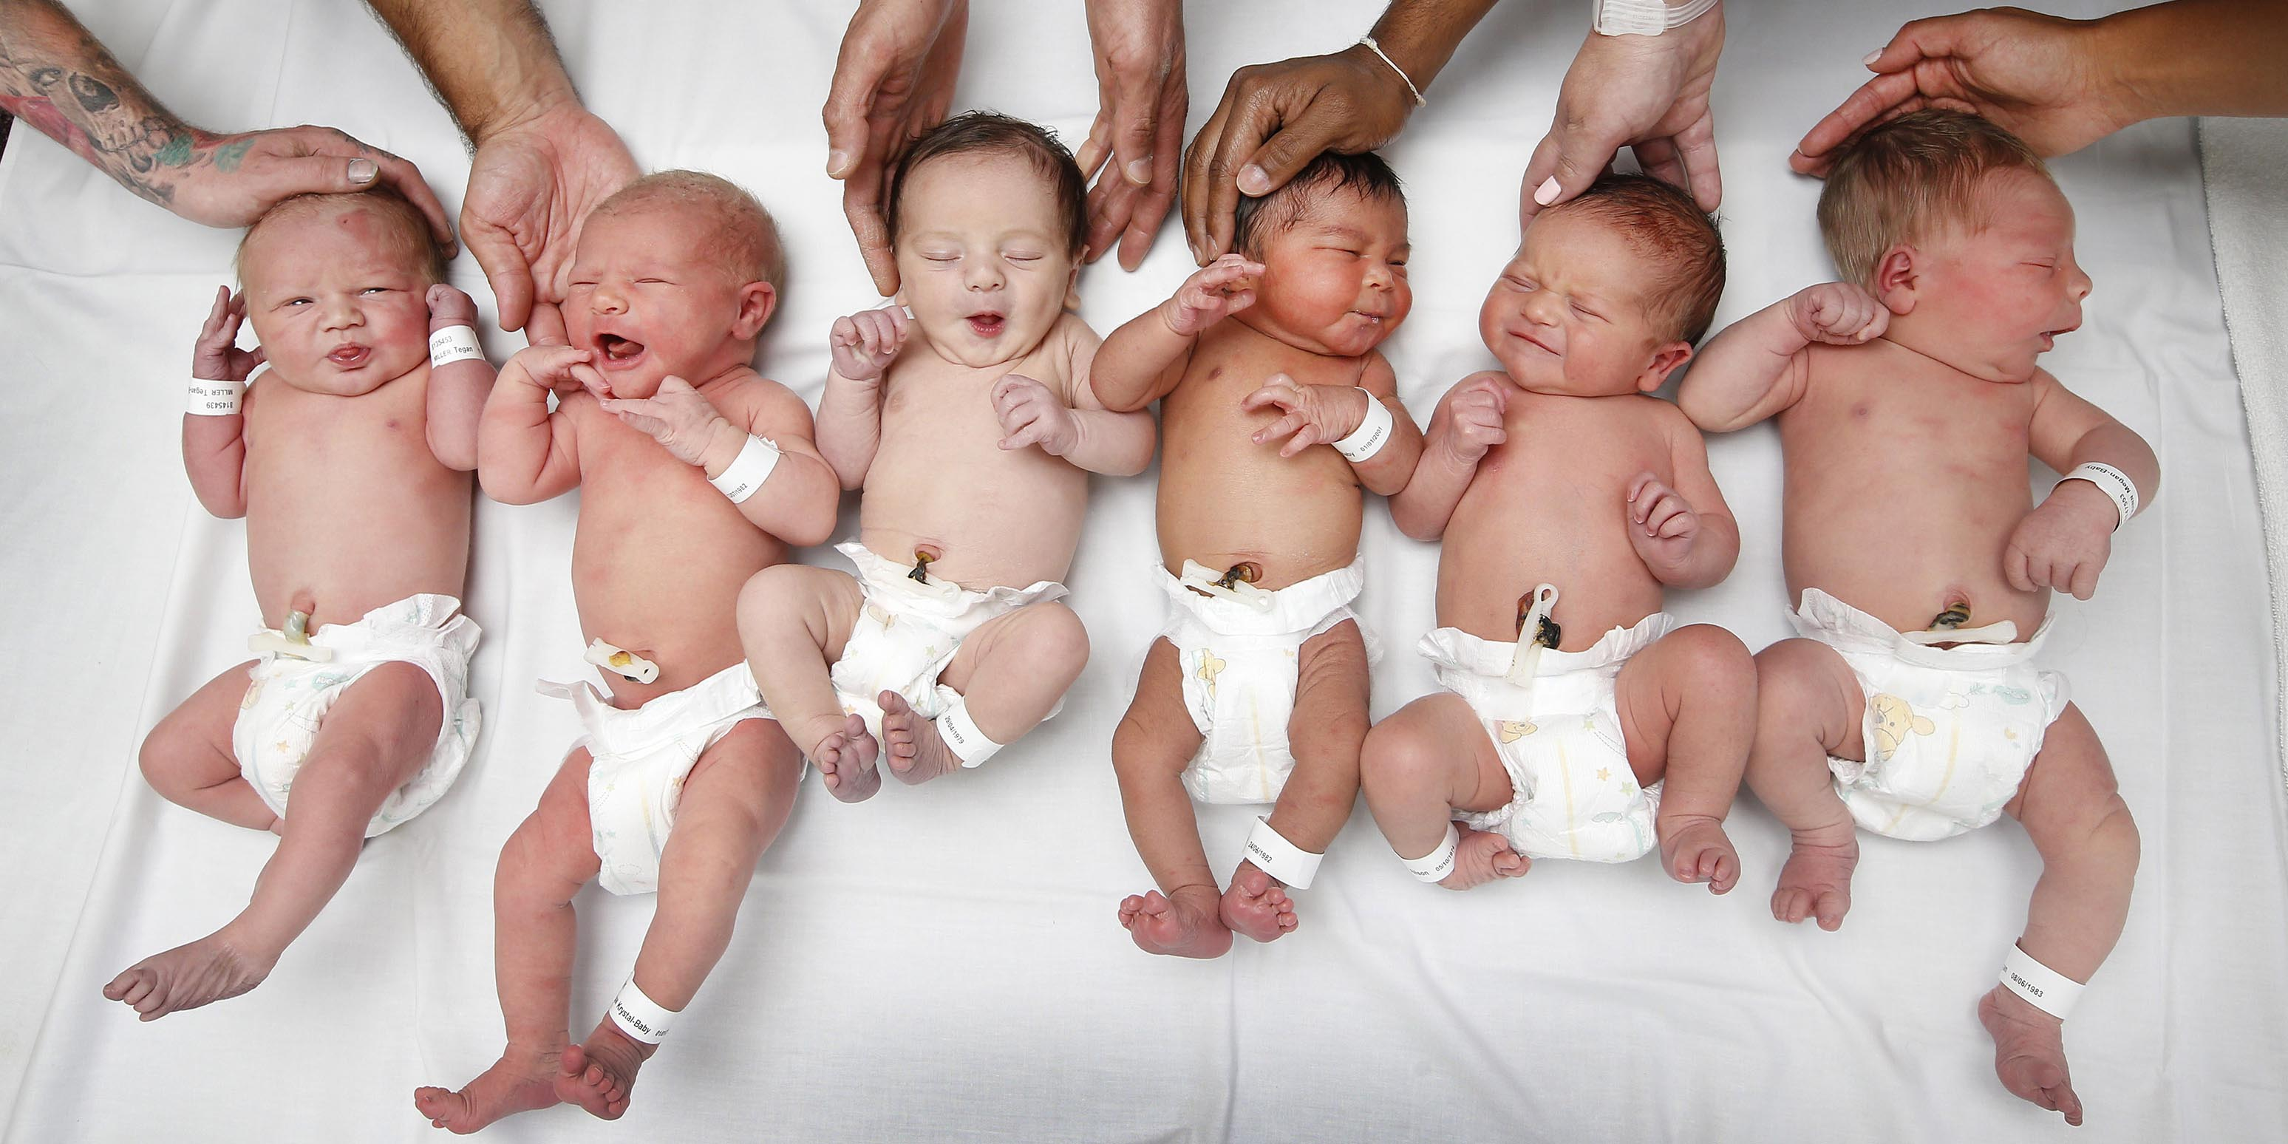
Terminology
Foetus = name of baby in womb / before birth
Neonate = New Born Baby
Pre-natal / Ante-natal = time before birth
Post-natal / Neo - natal = time after birth

Slide 17
 | FOETUS | NEONATE / NEW BORN
Digestion | System not functioning Rely on Placenta (and maternal diet) for nutrients | System now functioning. Breast milk is source of all nutrients
Gas Exchange | Lungs not functioning Diffusion via placenta | Lungs functioning
Excretion | Excretion via placenta | Via Liver, Lungs, kidneys, skin
Temperature Control | Heat exchange through placenta | Heat exchange through skin, resp system
Protection | Protected in the womb | Rely on parents for warmth, comfort

Slide 18
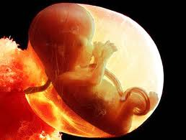
Before Birth
Foetus is totally dependent on mother for all needs
Supply of oxygen and nutrients
Removal of carbon dioxide and other wastes
Protection from shocks, temperature changes and diseases
Foetus has lungs – but are not functioning
Lungs are collapsed during this time
Oxygen supplied by placenta
Does not use digestive system
Nutrients supplied by placenta
Circulatory System is functioning
But blood does not flow exactly the same way
Foetal blood is carried to and from placenta via the umbilical cord

Slide 19
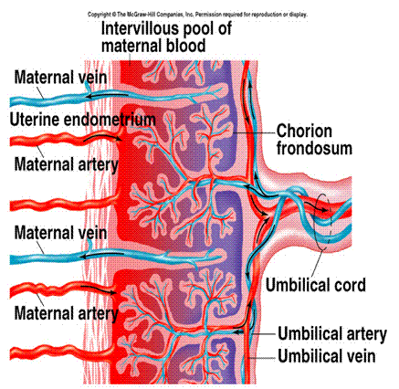

Slide 20
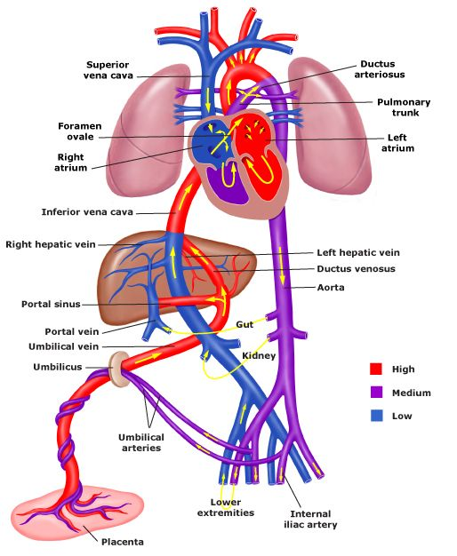
Foetal Circulation
Ductus Venosus: Blood from umbilical vein (bypasses liver) to Inferior Vena Cava to Right Atrium.
Foramen Ovale: Opening between both atria. Blood flows from Right Atrium to Left Atrium.
Ductus Arteriosus: Right Ventricle to pulmonary artery (bypass lungs) and directly into Aorta.

Slide 21
CV system BEFORE birth
Blood from placenta goes to foetus via the UMBILICAL VEIN (high oxygen). Blood from foetus to the placenta goes via the UMBILICAL ARTERY (low oxygen).
Most blood goes directly to the inferior vena cava (bypassing the liver). Bypass is called the DUCTUS VENOSUS
Liver not required at this stage, as needs served by the mother’s liver

Slide 22
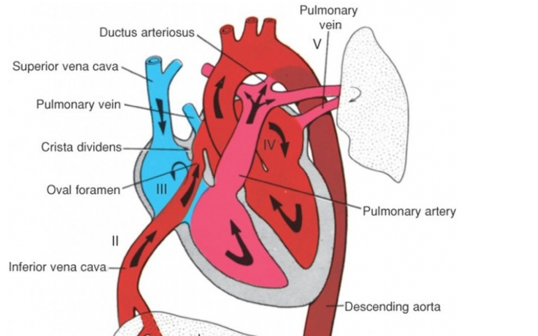
Foetal circulation through the heart
Blood enters the foetal heart (at the Right Atrium) and flow through the heart in several ways:
Blood may go the normal way = into RV and then to lungs (not usually – as lungs are not functioning, collapsed = offer high resistance)
May go to right ventricle = bypass the lungs via the DUCTUS ARTERIOSIS → then straight into the aorta. (most common way)
Blood goes from RA → directly into the LA, through an opening between the two chambers (FORAMEN OVALE). Some blood flows this way = has an advantage because blood coming from the placenta is highly oxygenated and can flow to the foetal tissues very quickly.

Slide 23
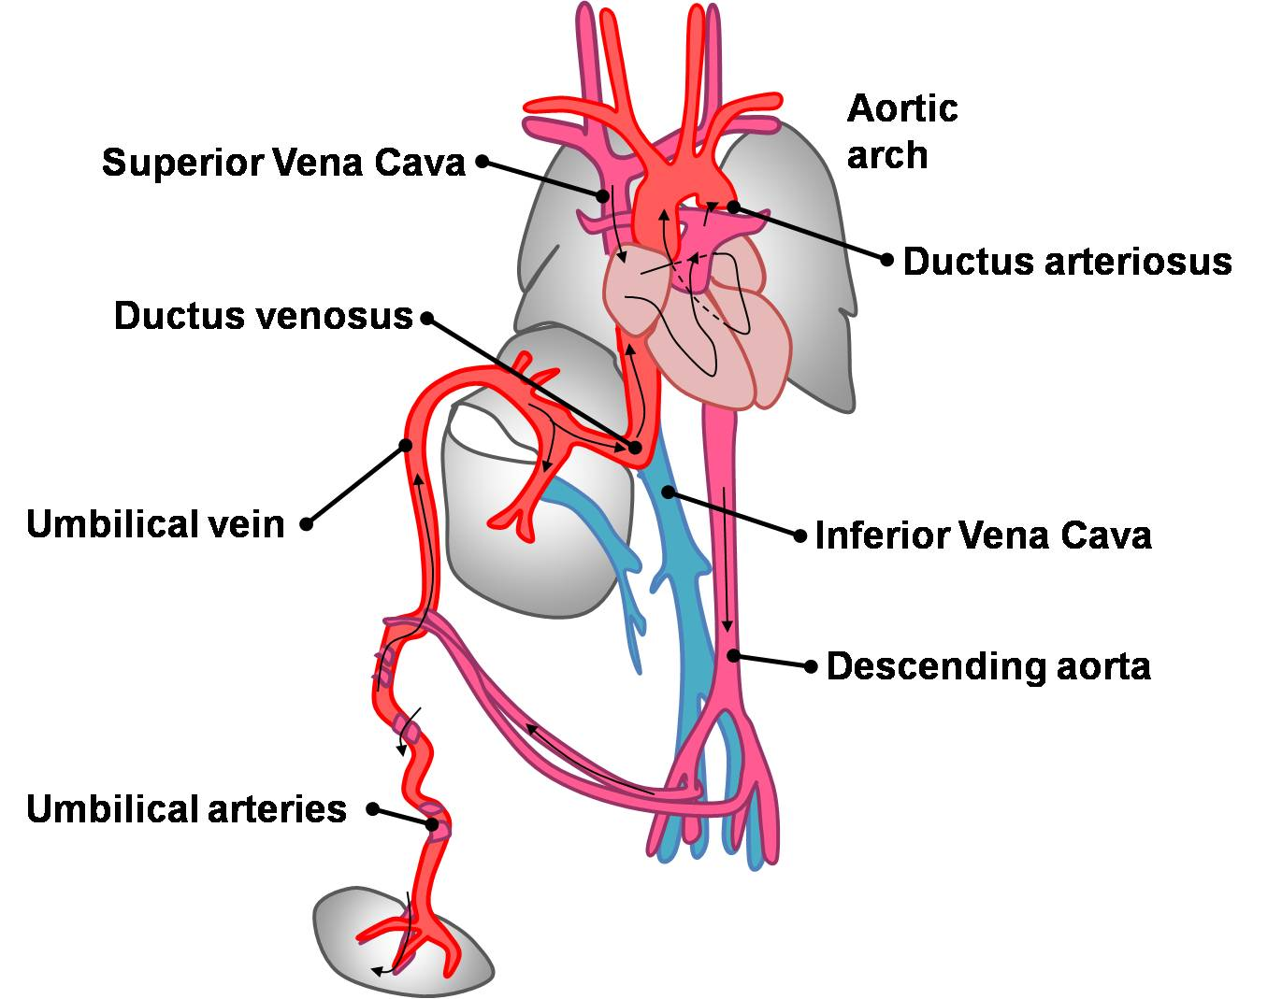

Slide 25
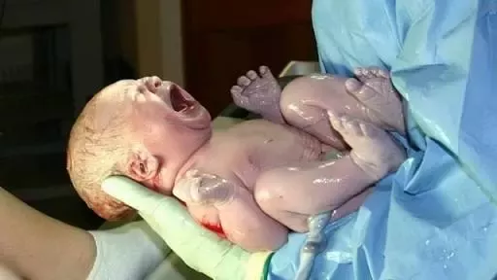
After Birth
First breath of life is usually triggered by the shock by birth (if not the traditional slap on the bottom can provide enough stimulus or the clamping of the umbilical cord can)
Foetus - no longer dependent on mother for food and oxygen
Lungs and liver now functional (blood now flows through them)

Slide 26
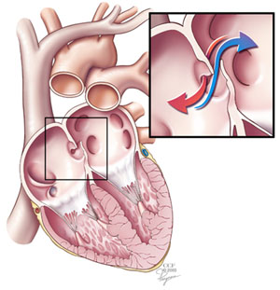
CV changes AFTER birth
Now lungs and liver now working – they no longer offer resistance to blood flow
blood now flows through lungs – therefore blood through ductus arteriosus decreases
Eventually closes over after a few weeks
More blood flowing to lungs = more blood is returning to the heart at the left atrium.
Pressure at L.A. increases = forcing the flap of the foramen ovale against the wall of the atrium, closing the ovale (which eventually becomes permanently closed)
If foramen ovale fails to close, the baby is born with a ‘hole in the heart’
From cutting the umbilical cord, blood no longer flows through ductus venosus
Ductus venosus gradually constricts and closes off.
* Liver bypass is lost, and therefore all blood from the hepatic portal vein must pass through the liver.

Slide 27
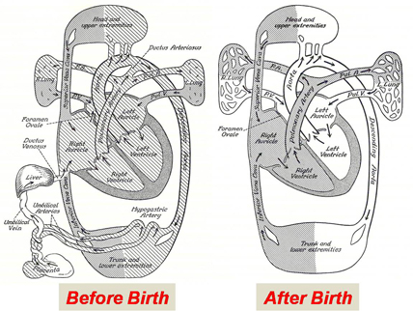

Slide 28
Other Changes
After birth – breathes rapidly ~45 breathes/pm
After 2 weeks slows to a more normal rate
Heart Rate – 125-130 beats/pm (high because more oxygen is needed for increased muscular activity. Therefore high RBC number as well)
HR decreases normal level over time

Slide 29
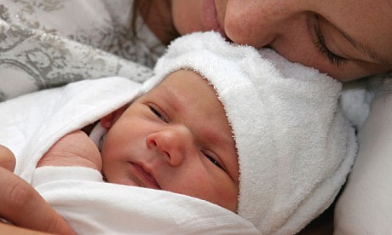
Post natal Principles
Meeting the baby’s (babies) needs for:
Food & water (breast milk is ideal – contains all necessary nutrients for the baby’s development)
Warmth (Newborns, being very small, have a large S.A compared to their mass)
Cleanliness
Protection
Intellectual bonding
Emotional bonding

Slide 30
Bonding
The unconditional love (or affection) that parents give their baby
The time immediately following birth is important for long-term effect in the relationship between parents and child
Children deprived of love and affection tend to suffer poor emotional development
Quiet, sad, frightened, mistrust, insecurity, lack of confidence
or could be opposite – attention seekers

Slide 31
Changes to mother after birth & breast feeding

Slide 32
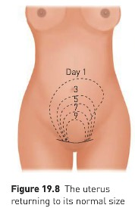
Changes to mother after childbirth
Puerperium: Uterus & other reproductive organs slowly return to non-pregnant state. This usually lasts about 8 weeks
After delivery, uterus continues to contract
Uterus eventually shrinks, flattening the abdomen
Fluid (blood & breakdown of tissues) discharge from the uterus during this time

Slide 33
Changes to mother after childbirth
Blood volume gradually returns to normal
Pulse slower
Body temp slightly high
Return of menstruation shows reproductive system back to normal after pregnancy
Breastfeeding can delay menstruation for about 6 months or more

Slide 34
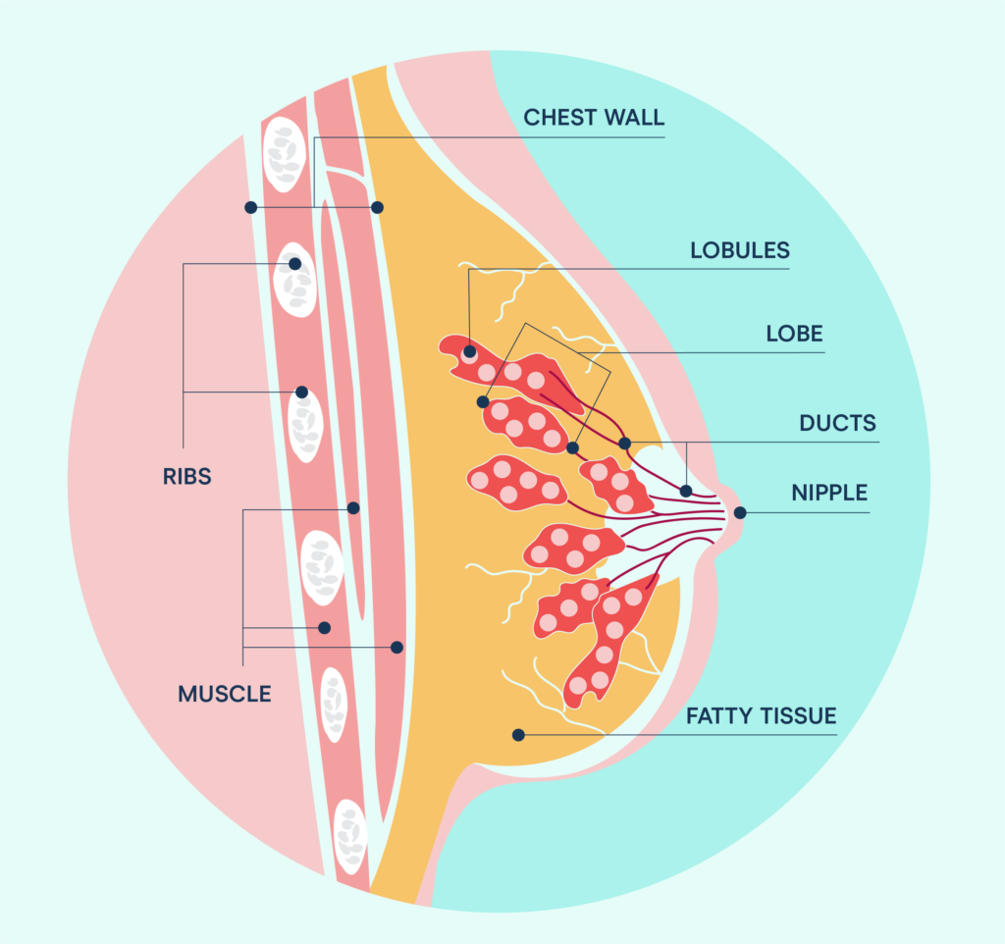
Structure of breast
Around age 10 in females, nipples start to bulge & nipple projects from centre
Caused by influence of hormones secreted by ovaries (oestrogen)
16-25 lobes contained in each lobule
Alveoli: milk-secreting glandular regions that make up the wall of each lobule
Fatty connective tissue surrounds lobules & gives breast rounded contour

Slide 35
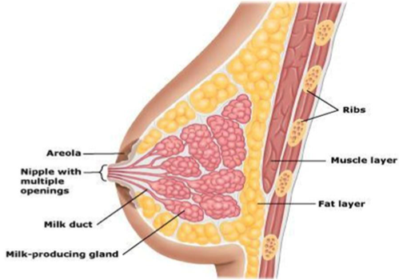
Structure of breast
From lobules, ducts open into wide spaces
Milk spaces serve as reservoirs for milk produced by alveoli, straight duct leads to nipple
Each lobe has own milk space
15-25 openings on nipple for secretion of milk

Slide 36
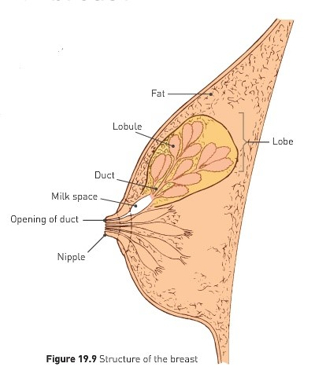
Lactation
Lactation: initiation & maintenance of milk secretion
Early in pregnancy, increase in levels of circulating hormones causes changes in breasts
Lobes become more complex & larger in size, oil-secreting glands around nipple enlarge

Slide 37
Lactation
Milk secretion begins a day or two after birth (some begin earlier than this)
Colostrum: first secretion from the breast: watery, yellowish white fluid
Similar composition to milk but contains little fat & high content of mother’s antibodies
Antibodies absorbed through infants intestine to give temporary immunity
Milk remains stored in breast until suckling begins

Slide 38
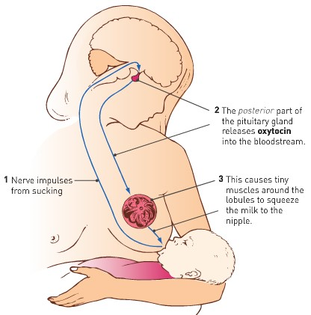
Milk let-down reflex
Milk let-down reflex: automatic response where milk begins to flow once nipples are suckled

Slide 39
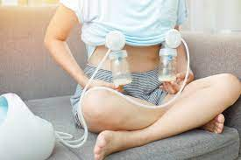
Lactation
Up to 1.5L milk may be formed each day at height of lactation
Mother’s diet is important during lactation
Calcium, phosphate, Vitamin D
Otherwise calcium may be withdrawn from own bones & teeth

Slide 40
Breast feeding vs Bottle feeding
Breast Feeding | Bottle (formula)
Advantages | Advantages
Colostrum provides antibodies Easier to digest Does not require preparation Baby unlikely to be overfed Free (no cost) | Can tell how much milk is delivered to baby (mL) Mothers wellbeing won’t affect supply Can be prepared in advance & given by others
Disadvantages | Disadvantages
Can’t determine exact feed amount No-one else can feed baby Some women don’t like to expose breast | No colostrum (or equivalent) Can be difficult to digest Needs to be sterilised & prepared Can lead to overfeeding Expensive & have to source formula

