Slide 1
Treatment of Infertility
r. Johansen 2021

Slide 2
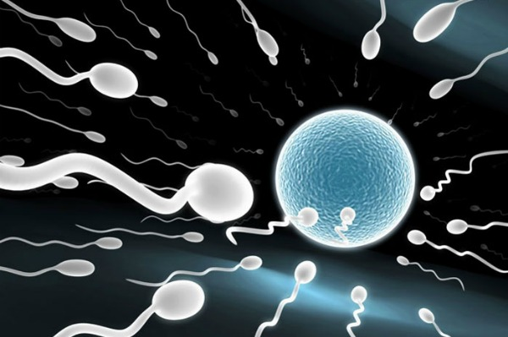
Couples are unable to get pregnant due to many reasons including:
Physical defects preventing sperm & egg from uniting
Few too sperm to fertilise the egg
Blocked uterine tubes or sperm ducts
Cervical mucus hostile to sperm
Problems with ovulation
See page 365 – 367 for more information

Slide 3
Treatments that allow unassisted fertilisation

Slide 4
surgery
Microsurgery can repair blocked uterine tubes and sperm ducts.
Fibroids and endometriosis can be removed

Slide 5
Ovulation tracking
Identifying when a female is most fertile through blood analysis
There is a surge of luteinising hormone prior to ovulation
Sperm can survive in uterine tubes for two to three days (egg only survived 24 hours)
Therefore insemination prior to ovulation provides the highest chance of conceiving
Tracking may occur over a number of cycles

Slide 6
Ovulation induction
Medication may be taken to increase previously low levels of ovulation inducing hormones
There are two types of drugs which use FSH to induce the development of follicles
Clomiphene stimulates the body to make more FSH
Hormone injections of FSH increase blood levels of the hormone
Human chorionic gonadotrophin (HCG) hormone may be used to trigger ovulation once the follicle has matured.
Females affected by hyperprolactinemia will need to lower prolactin levels so that ovulation can occur. Oral medication can be taken to restore normal levels of prolactin

Slide 7
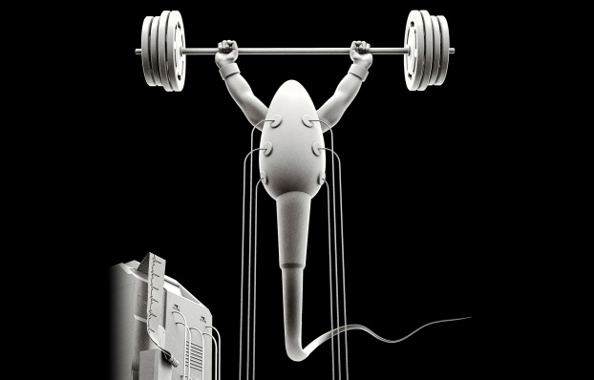
Artificial Insemination
Also called intrauterine insemination (IUI)
Semen is released into the uterus by a catheter, being inserted through the cervix.
Occurs 4 days around time ovulation is expected
70%-80% using AID eventually have child by this method (common & high pregnancy rate)
Risk: possible transmission of disease from donor to recipient
Donors screened for STIs, genetic diseases, mental problems & general health
Donor can be anonymous

Slide 8
Circumstances requiring Artificial Insemination
Males with low sperm count of decreased mortality
Ejaculation dysfunctions
Sperm stored and frozen due to males absence or needing to undergo treatment such as chemotherapy or radiotherapy
Female cervical scarring
Hostile cervical mucus
Same sex couples
Single females

Slide 9
Treatments that require assisted fertilisation

Slide 10
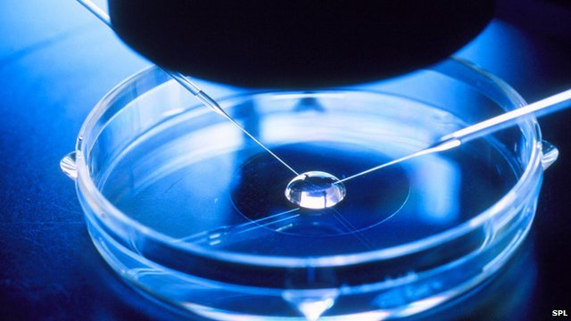
Assisted Reproductive Technologies
ART (Assisted reproductive technology), refers not only to IVF but also to variations of this
In-Vitro Fertilisation (IVF)
Sperm used to fertilise woman’s egg in glass dish
35 years ago- first implantation into woman’s uterus and 9 months later: 25 July 1978, first “test tube baby’’

Slide 11
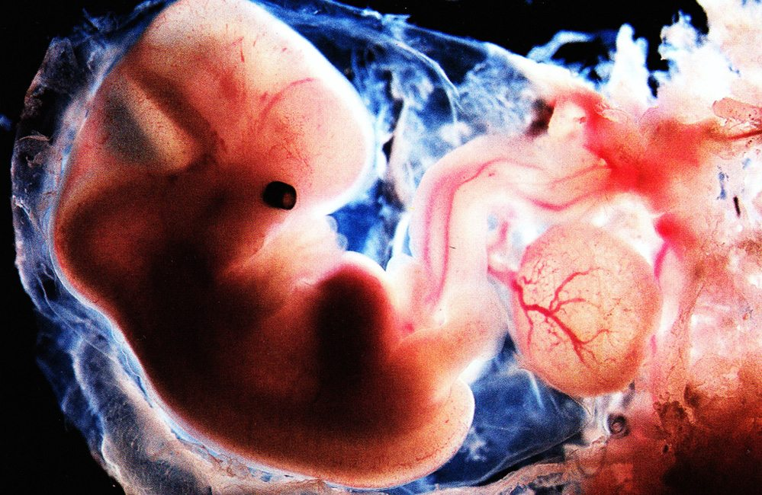
Assisted Reproductive Technologies
Donor Egg or embryo
Used when woman can not use own egg
Donated egg mixed with her partner’s sperm
Resulting embryo transplanted in uterus

Slide 12
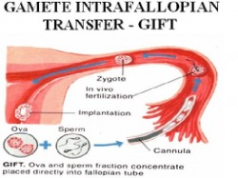
Assisted Reproductive Technologies
Gamete Intrafallopian Transfer (GIFT)
Eggs & sperm are mixed together immediately after eggs are collected
Mixture injected into women’s uterine tubes
Allows egg & sperm to mix naturally
Fertilise eggs can then move down uterine tube in usual way

Slide 13
Assisted Reproductive Technologies
Most techniques require the female to take fertility drug to increase number of eggs produced by ovary
Due to chance of failure, a large number of eggs is required
Meaning more embryos are available than are required; excess embryos frozen
Currently in Australia, frozen embryos stored for upto 5 years
2011: media reported 120 000 frozen embryos stored
Can donate (other couple or research) or dispose

Slide 14
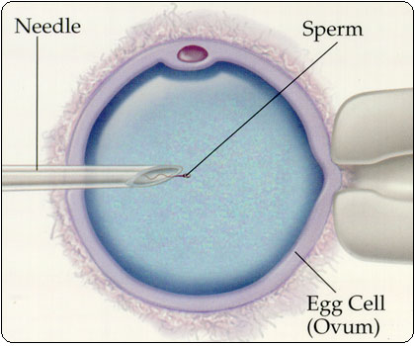
Assisted Reproductive Technologies
Intracytoplasmic sperm injection (ICSI)
Single sperm injected into single egg
Embryo transplanted into woman’s uterus
Fertilisation rates of 20-30% have been achieved
Concern this technique increases incidents of birth defects

Slide 15
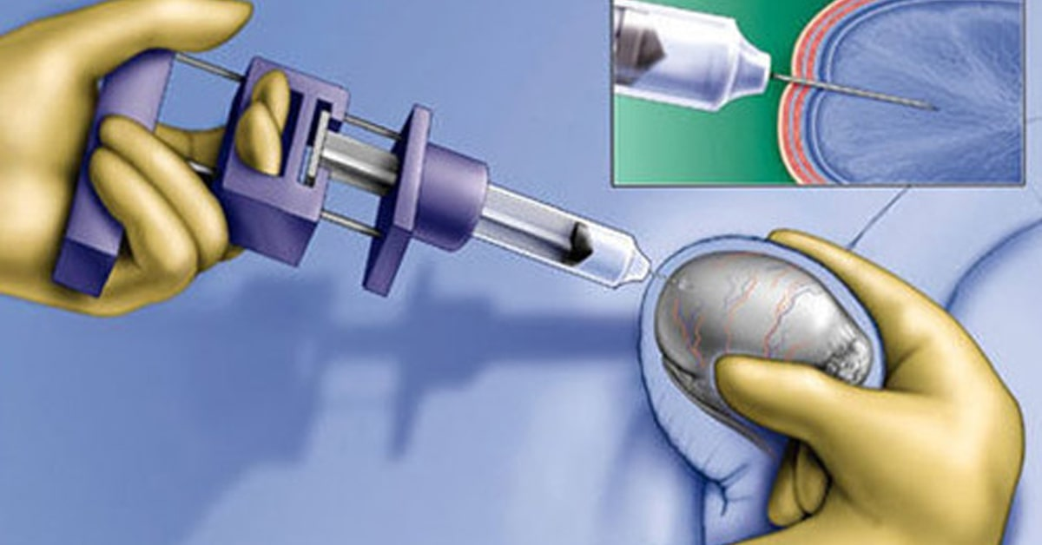
Surgical sperm retrieval
Some men are unable to ejaculate, or very low numbers of sperm are released
Sperm can be retrieved after a vasectomy
Sperm may be collected via surgery to be used for IVF or ICSI
A needle is used to collect sperm fro the epididymis or testes

Slide 16
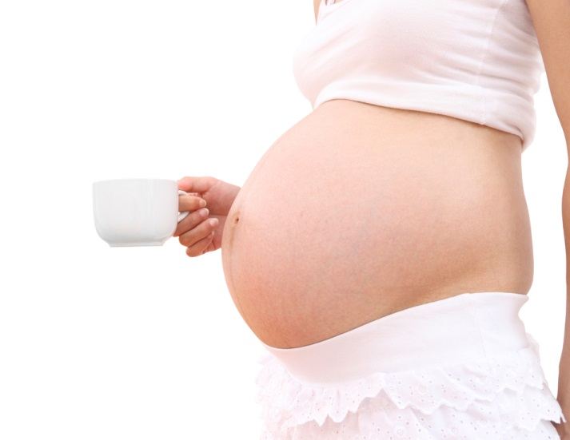
Surrogacy
Woman may agree to bear a child for another couple
Man provides sperm either naturally or through artificial insemination
Surrogate mother agrees to give child to couple (can be paid)
People travel to other countries for surrogacy due to strict Australian laws & cost

Slide 17
Ethical considerations

Slide 18
Frozen embryos
Embryos produced, but not used during IVF are typically frozen
The embryos stop developing and remain in the same stage until thawed
Embryos can be kept indefinitely, though there are regulations guiding this. Five years is the typical limit.
When the embryos are no longer needed, a decision must be made about what to do with them:
Dispose of embryos
Donate them to other couples
Donate them to research
Stem cells?
This creates ethical and moral considerations
There are many guidelines which also take into consideration various choices for those involved to accommodate different religious and personal beliefs.

Slide 19
Religious beliefs
Some religious considerations include:
The involvement in a third party in the process of fertilisation
Fate of the embryos
Separation of procreation and sexual function

Slide 20
Cost
Assisted reproductive technologies are expensive
Not accessible to all people due to financial status
Some costs include:
Specialist doctor consultations
Initial tests and screening
Medications
Fertility treatments (IVF, ICSI)
Surgery and hospital costs
Access to donor programs
Frozen sperm, egg or embryo storage
Some Medicare rebates are available but out-of-pocket costs are still high

