Slide 1
Australian Government

Slide 2
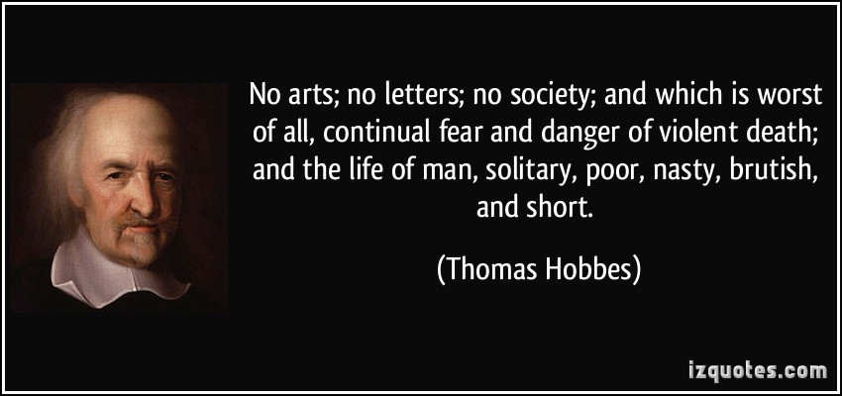
Notes:
Political philosopher quoting how society will function without laws/government. He didn’t have a very good opinion on how people treat each other. Link into places of anarchy – eg. Syria.

Slide 3
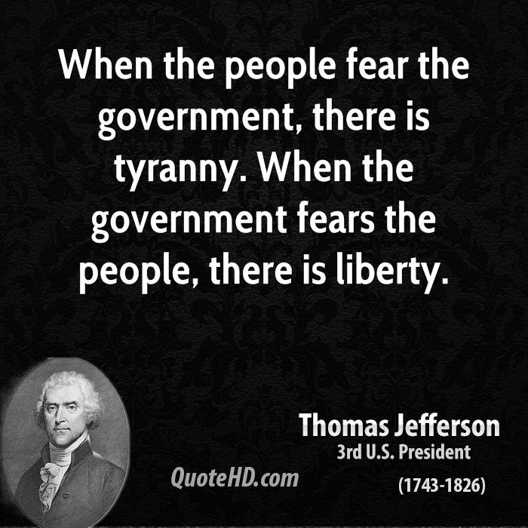
Notes:
Note: not actually said by Thomas Jefferson. Another internet myth.

Slide 4
Imagine and your family have been treated terribly by a ruler.
You, your family , and a few thousand other people have managed to escape, and have arrived in a new country with no other people on it.
You have the ability to make all the rules for how this new country is governed.
How will you do it? How can you give someone power to make decisions over you without giving them the power to make your life miserable?

Slide 5
One solution:
A famous philosopher thought about power and how people ruled.
He was the Baron Montesquieu. He believed true power comes from:
1. The power to make law.
2. The power to carry out law.
3. The power to interpret what the law means.

Slide 6
One solution:
If you separate these powers, giving people only the ability to make decisions in one of these areas, you will have a better government.
Each of these areas will act as a ‘check and balance’ on the other areas
Known as the Separation of Powers

Slide 7
Separation of Powers
Power | Role | Who is in it
Parliament | Makes and changes the law | Parliament (Legislature) is made up of the Queen (represented by the Governor-General), the Senate and the House of Representatives
Executive | Puts the law into action | Prime Minister and Cabinet (Senior politicians who are called ministers and given a position in Cabinet)
Judiciary | Interprets the law | The Australian court system

Slide 8
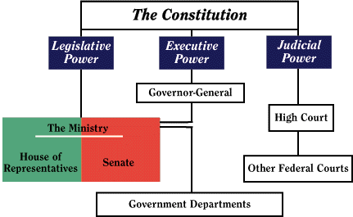

Slide 9
Legislature
Makes the laws
Meant to represent ‘the people’ : eg the poor, the middle class and the upper class, as well the religious, the military and the academics
Because they represent so many, overall, the laws made will be fair
The law should be written by people with specialist knowledge to ensure that it can be obeyed easily and judged correctly when it is broken.

Slide 10
Legislature
Australia has a bicameral (two chamber) law making body called Parliament
Made up of the House of Representatives (representing the people) and the Senate (representing the states).
The laws made in Parliament are known as 'statutes'.

Slide 11
Executive
The arm of government responsible for carrying out the law.
The executive runs the country in accordance with the law.
In Australia the Queen is the Head of State
The Head of State is the leader of the country
The Queen’s Governor General is the Head of the Executive
The GG appoints a Prime Minister from Parliament to actually run the country (the Head of Government).

Slide 12
Judiciary
The judiciary are the courts
They determine the intent of laws and hear charges against people of the law being broken.
The courts then decide if the law has been broken and apply an appropriate sanction.

Slide 13
Overview
The Legislative (Parliament) makes the Law
The executive makes these laws happen (eg – government departments)
The courts interpret the law and deal with those who break it

Slide 14
Three Pillars
Legislative
Executive
Judiciary

Slide 15
Westminster Model
The Westminster system is a system of government modelled after the politics of the United Kingdom.
This term comes from the Palace of Westminster, the seat of the Parliament of the United Kingdom.
The Australian government is based on the Westminster system

Slide 16
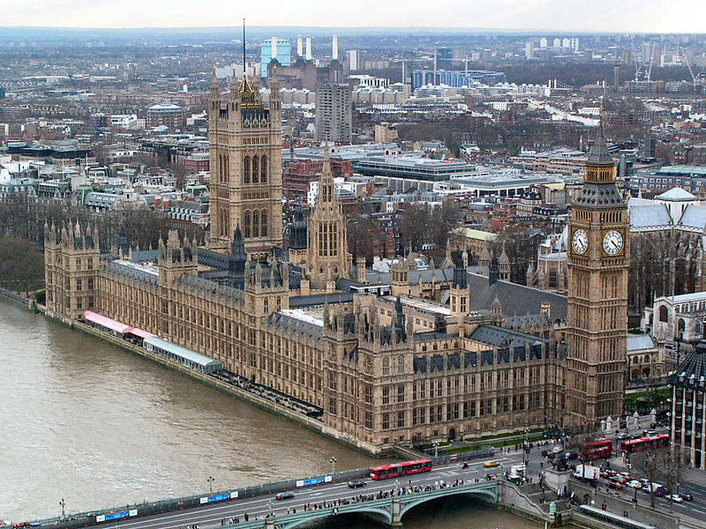

Slide 17
Westminster Model
A sovereign is the head of state, but whose daily duties mainly consist of ceremonial functions.
A head of government also known as the Prime Minister (if head of a country), Premier (if head of a state) or First minister (if head of a territory).
The head of government is appointed by the head of state
But that person is supported by the majority of elected Members of Parliament.
If more than half of elected MP’s belong to the same political party, then the person appointed is typically the head of that party.

Slide 18
Westminster Model
An Opposition party in parliament. The job of the Opposition party is to scrutinise the policies of the government and offer itself to the electorate as an alternative government.
An elected parliament. In a bicameral system, the lower house has the power to dismiss the government by passing a vote of ‘no confidence’ in the government.
Parliamentary privilege. This allows MP’s to discuss any matter without fear of being sued

Slide 19
Questions
What is the separation of powers?
What does bicameral mean?
What does the legislative do?
What does the executive do?
What does the judiciary do?
What is the Westminster System of government?
What is the benefit of the separation of powers?
Who is Australia’s Head of State?
Who is Australia’s Head of Government?

Slide 20
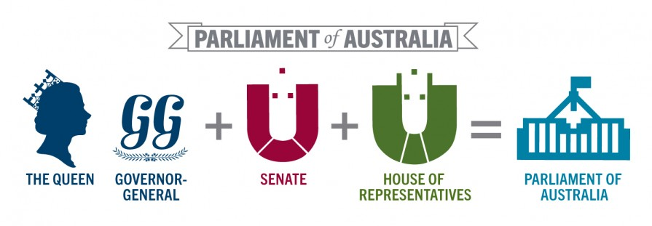

Slide 21
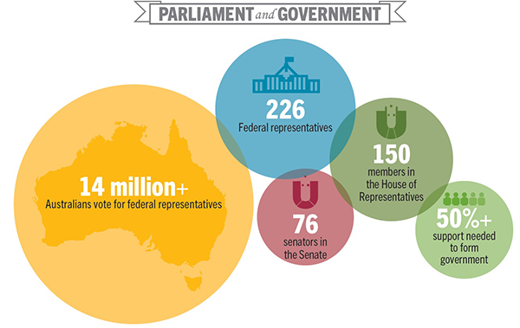

Slide 22
House of Representatives
House of Government – 150 Members
People’s House - representation based on population (Section 24 - Australian Constitution)
Single member electorates
Term of office - 3 years (maximum)
Absolute Majority needed to be elected (more than 50%)
Electoral boundaries are determined by AEC

Slide 25
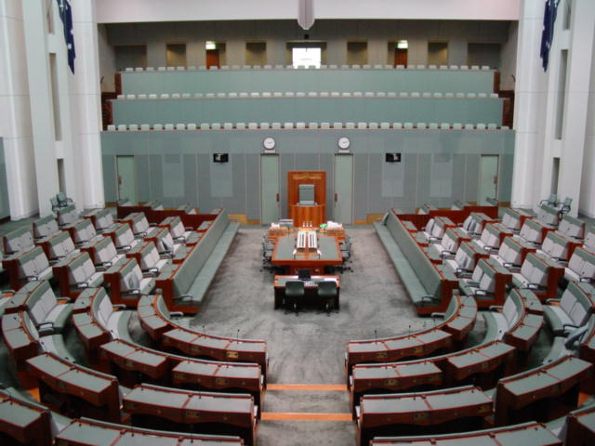

Slide 26
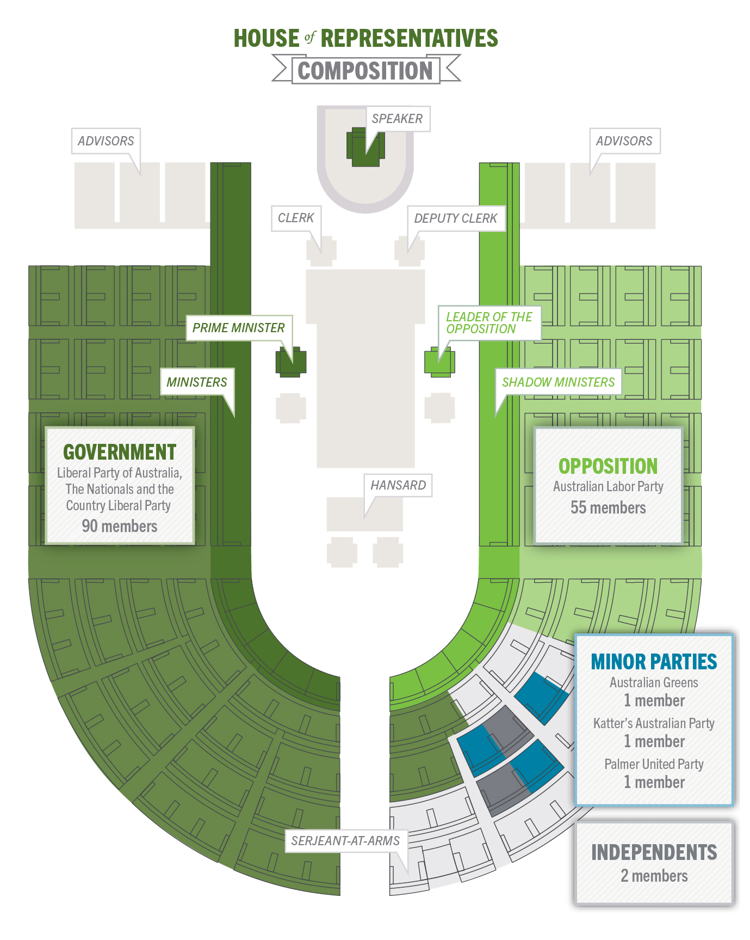

Slide 27
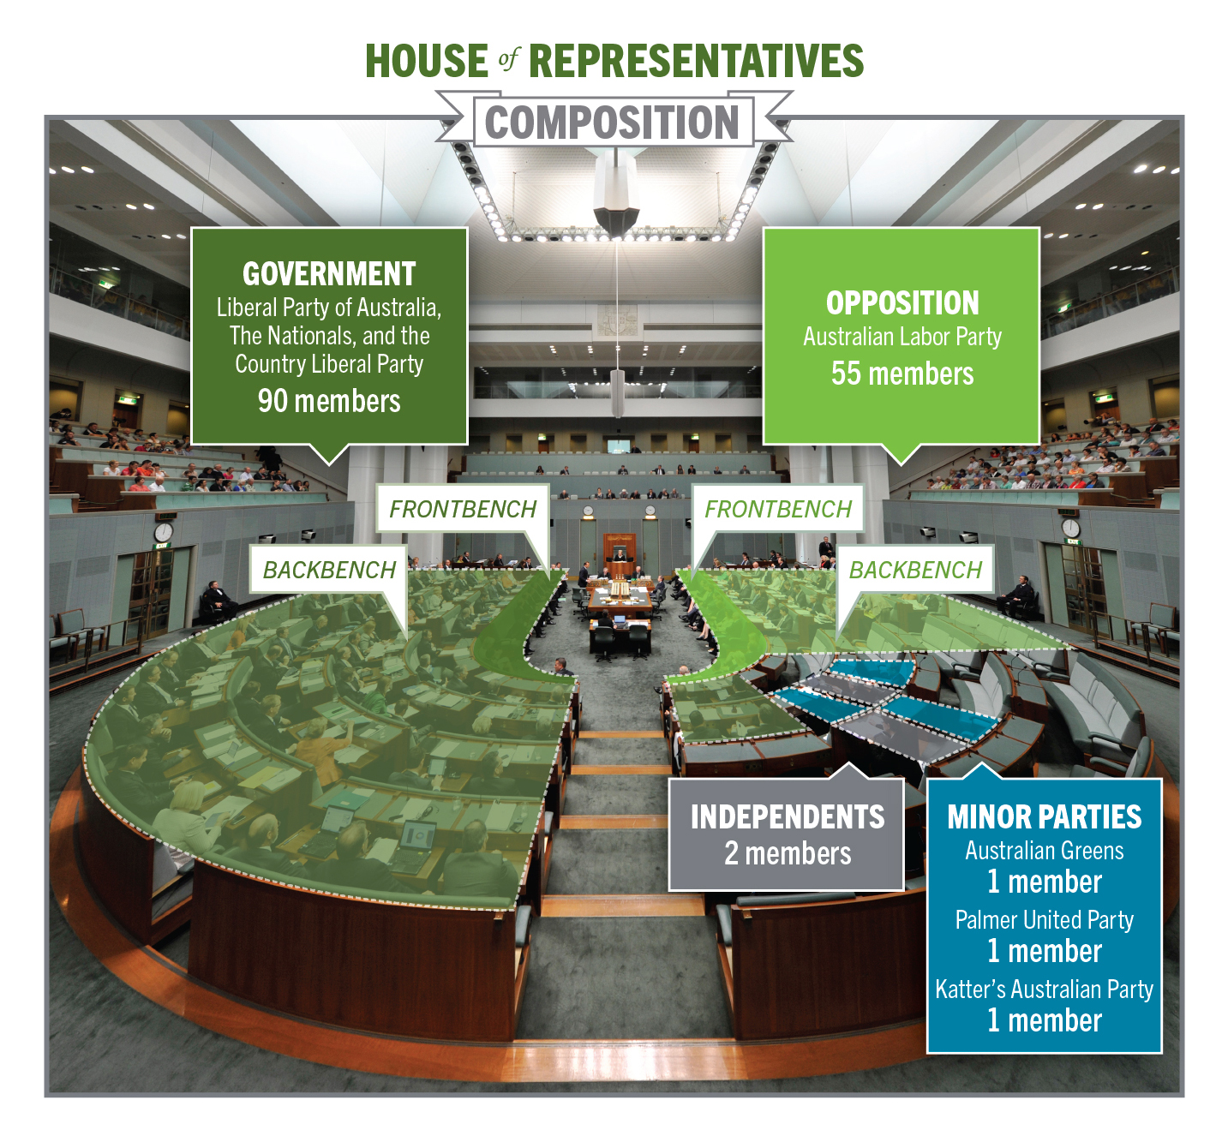

Slide 28
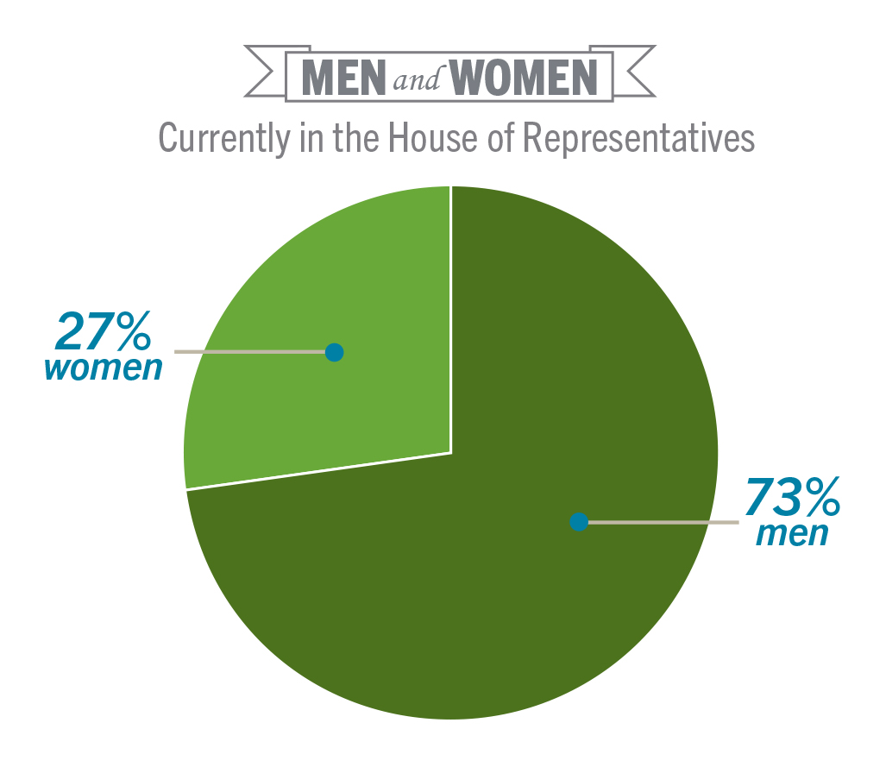

Slide 29
Senate
House of Review (makes sure the government is being fair)
76 members (12 each state, 2 each Territory)
States’ House - representation on a state basis
Multi member electorates
Term of office: 6 years for State Senators, 3 years for Territory Senators
Electoral boundaries are formed by state and territory borders

Slide 32
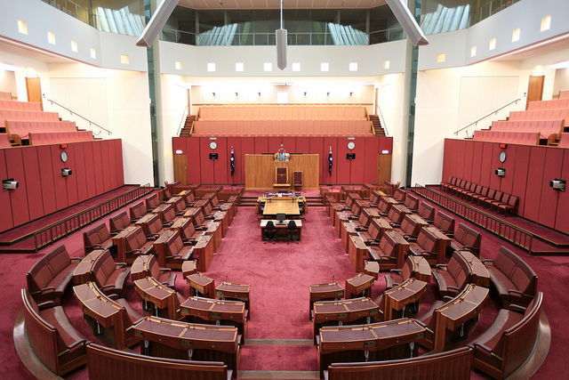

Slide 33
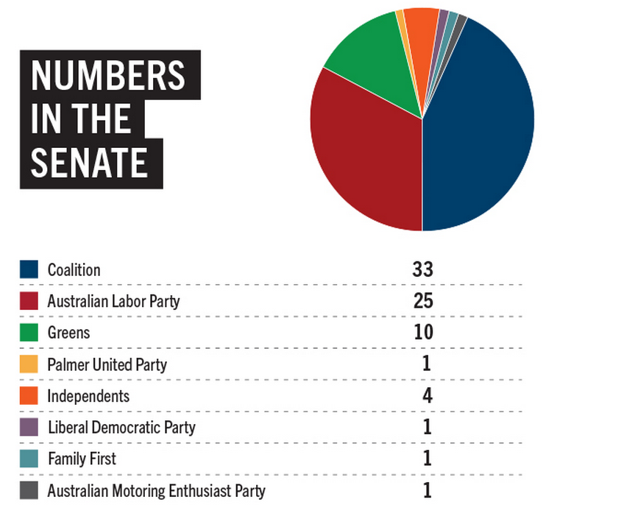

Slide 34
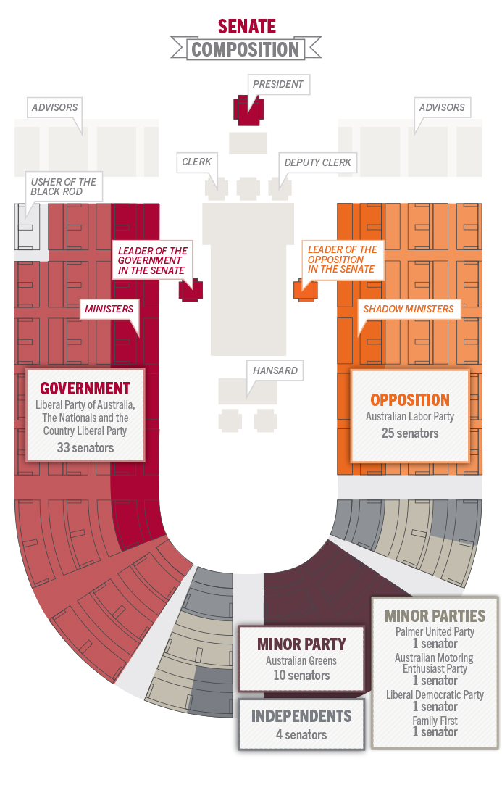

Slide 35
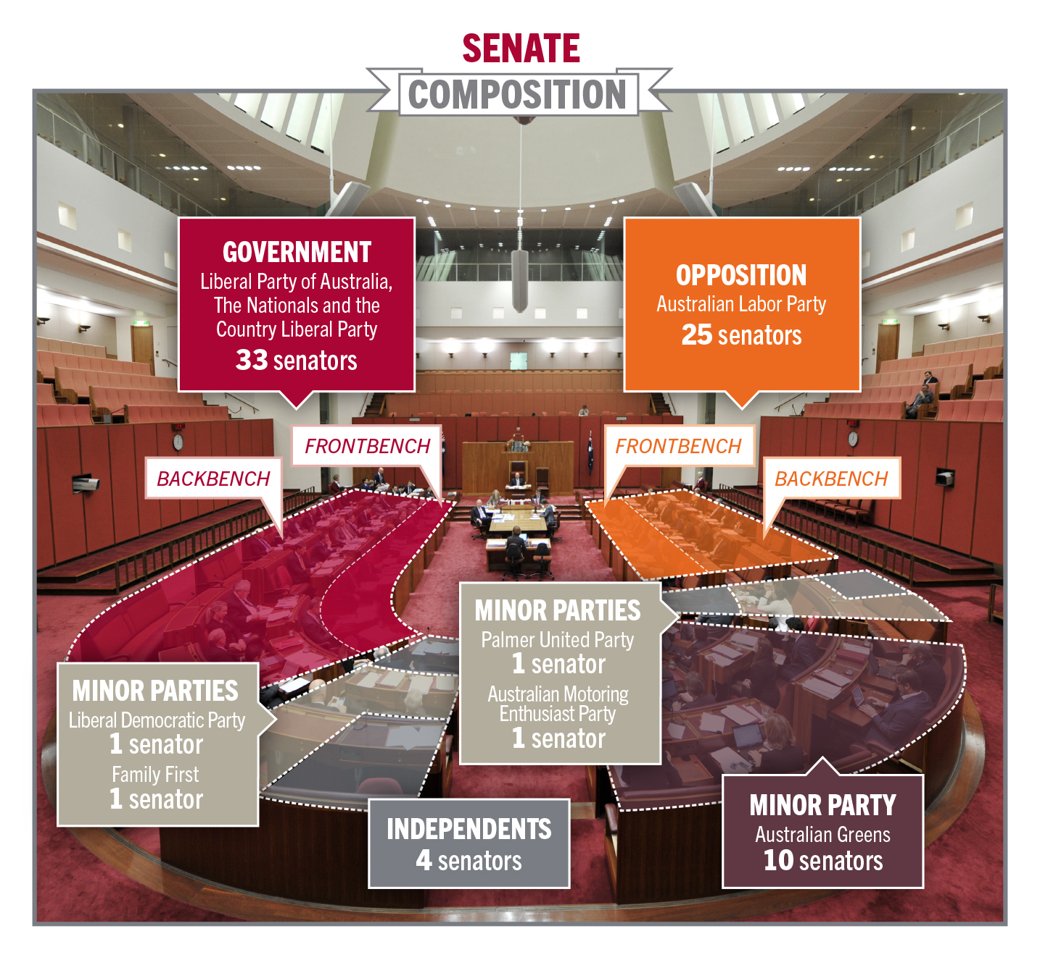

Slide 36
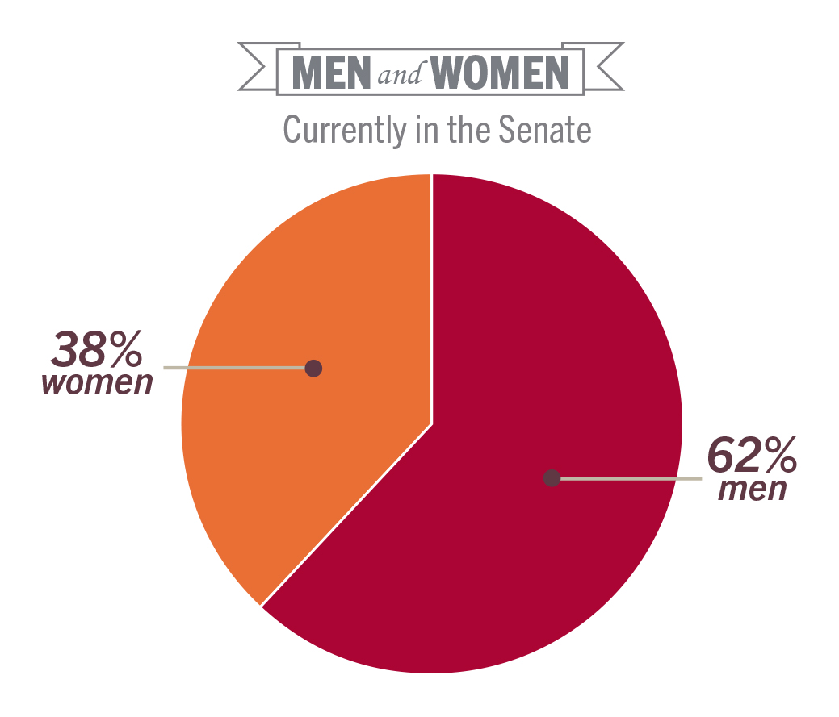

Slide 37
