Slide 1
what do these pictures say about humans and the environment?

Slide 2
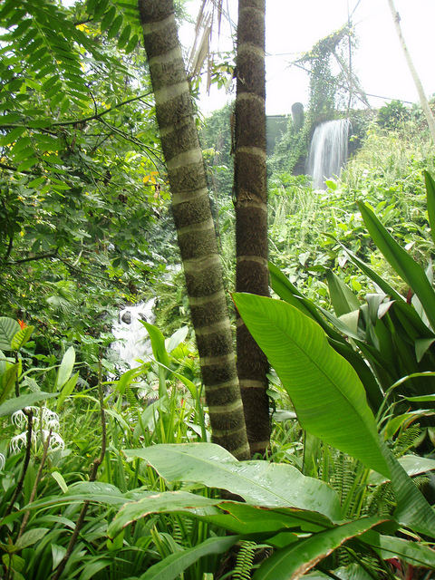
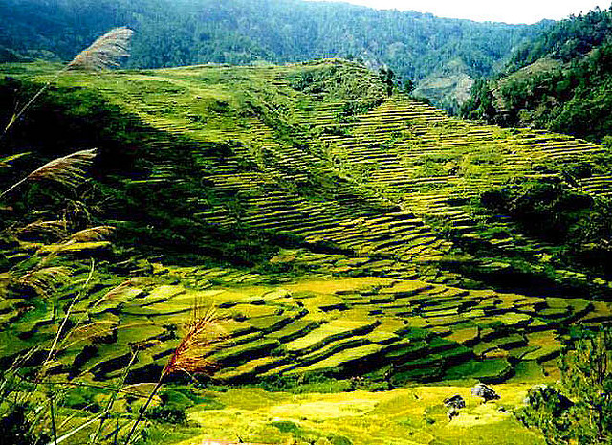
What is the connection?
Rainforest biome
Human activity
Palm oil
Notes:
Description:
The human alteration to biomes to produce food, industrial materials and fibres, and the environmental effects of these alterations.
The challenges to food production:
Land and water degradation
Increasing competition for land
Climate change

Slide 3
Palm oil – how have people changed the environment to grow palm oil in plantations.
http://splash.abc.net.au/media/-/m/525335/palm-oil
Notes:
Oil palm – sustainable palm oil
http://splash.abc.net.au/media/-/m/525335/palm-oil

Slide 4
Recap
Biome – a biome is defined as a community of various plants and animals that inhabit a particular type of geographic region of the Earth. Biomes are characterised by their distinctive vegetation type and the types of animals that live in the region.

Slide 5
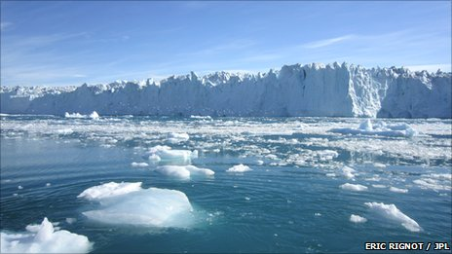
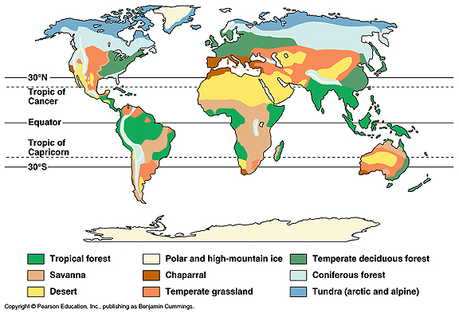
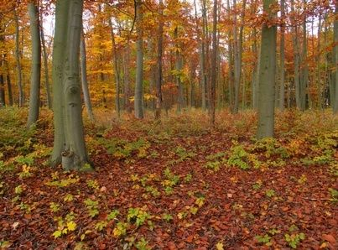
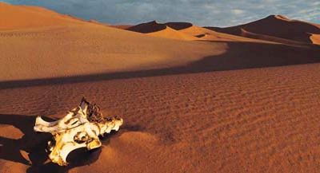
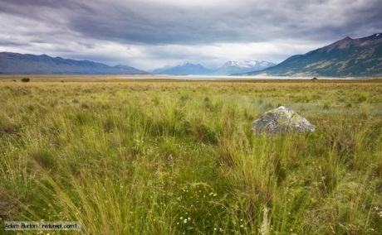
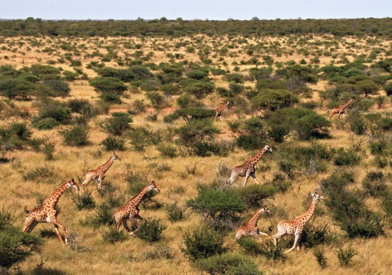
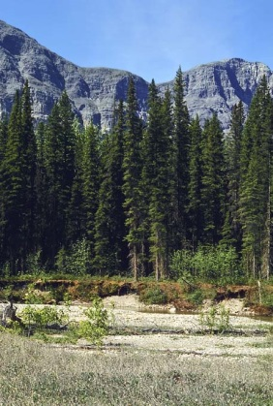
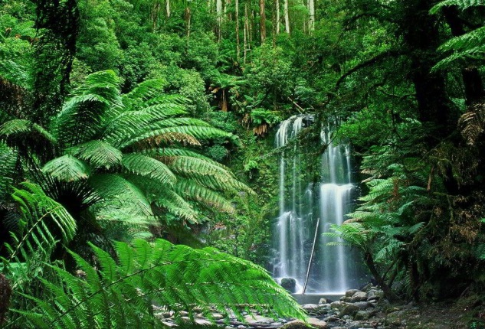
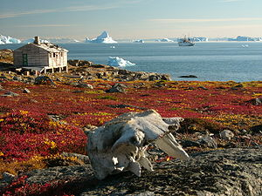
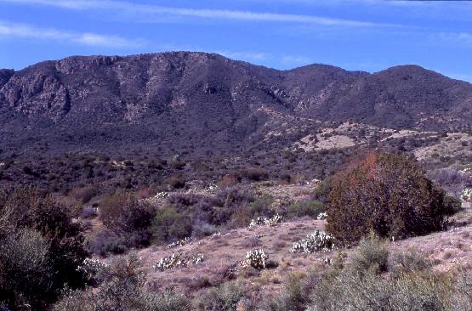
Notes:
Could add colour around each picture matching the key. Must draw a line to each
Using the laminated sheet as guidance, students to describe the global distribution of temperate deciduous, rainforest, desert plus one other biome.

Slide 6
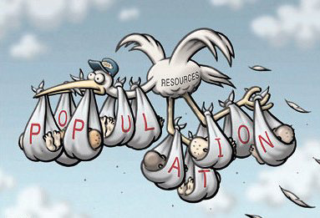
Human alterations to biomes
Why humans alter biomes?
Humans alter biomes in order to grow enough food to sustain the world’s growing population.
Notes:
As the world becomes industrialised and modernized, the demand for resources increases and this puts pressure on the natural environment.

Slide 7
How have humans altered biomes
Vegetation clearance
Land is cleared primarily for agriculture and is probably the most widespread cause of damage to biomes.
Most affected biome has been the temperate grasslands because of its flat surface and rich soil nutrient.

Slide 8
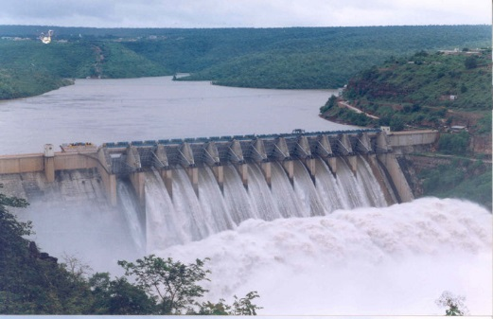
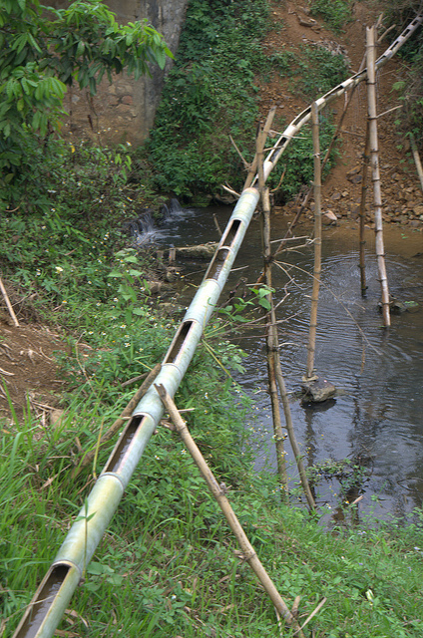
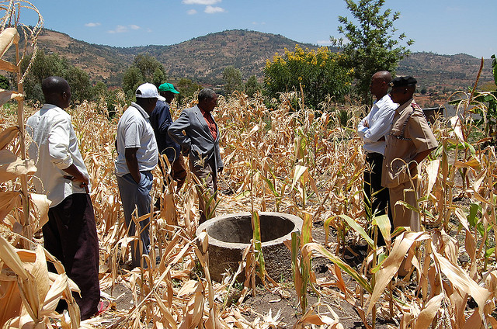
2. Sourcing water supplies
Water is a vital source for humans.
In order to increase food production, irrigated agriculture is used whereby water is artificially applied to the land and soil for the purpose of increasing food production. This can be done through:
Sinking wells or bores
Dams
Canals or irrigation pipelines

Slide 9
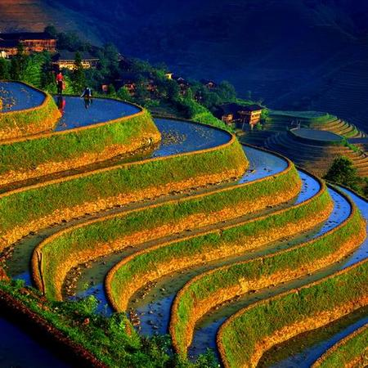
A terrace farm in Japan.
3. Terracing
Terracing is an ancient farming technique that has existed in China for as long as two thousand years.
It is a piece of sloped plane that has been cut into ta series of successively receding flat surfaces or platforms.

