Slide 1
Topic/Objective: The Water Cycle
9/3/2017

Slide 2
Essential Question:
wHAT DIFFERENT PARTS MAKE UP THE WATER CYCLE?

Slide 3
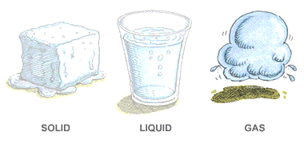
What different forms does water take?
Water is one of our most precious resources
It is an essential, renewable resource that occurs naturally on Earth
Water can exist as:
A solid (ice in a glacier)
A liquid (water in a river)
A gas (steam)
Liquid water is constantly being recycled through the atmosphere, rivers and oceans in a natural system known as the water cycle

Slide 4
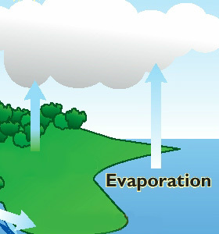
How does the water cycle work?
Water from the oceans and lakes is heated and evaporated by the sun.
The evaporated water vapour (like steam) rises until it reaches the cooler parts of the atmosphere.

Slide 5
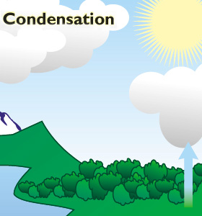
How does the water cycle work?
Cold air cannot hold as much moisture as warm air
Water vapour turns back into liquid water in a process known as condensation
This water then forms into clouds
Clouds may be carried over the land by wind and forced to rise

Slide 6
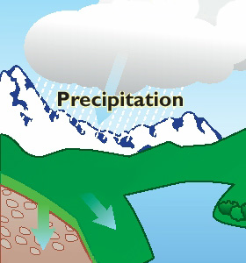
How does the water cycle work?
The colder air can no longer hold the condensed droplets of water
They fall as rain
Rainwater finds is way back to the world’s lakes and oceans through rivers and streams
The water cycle begins again

