Slide 1
7 Concepts of Geography

Slide 2
Place
Parts of the Earth’s surface that are identified and given meaning by people
No size limit (whole planet to this classroom)
Natural or built by humans
Determines our relationship with one another
Things that impact place: climate, landscapes, types of plants & resources, transport networks, entertainment venues, and workplace

Slide 3
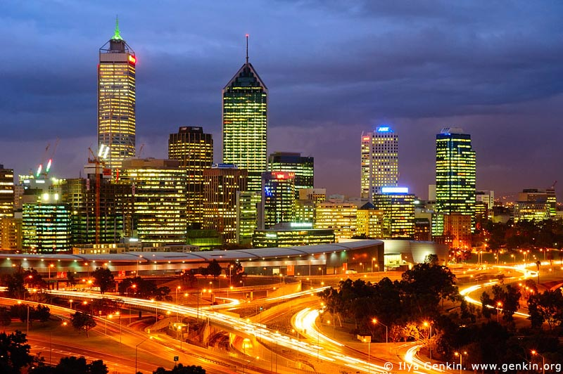
Place
Spiritual meaning for Indigenous Australians
Why did people setting there? How was the city built? How has the city changed?
Place is used to identify how important a city is
People influence place
Geographer’s investigate the outcomes of these changes
Perth: example of a built environment

Slide 4
Space
3 main elements: location, spacial distribution, and organisation
Location: where things are located on the Earth’s surface
Spacial Distribution: shapes & patterns in which things are arranged on the Earth’s surface
Organisation: how and why things are arranged and managed on the Earth’s surface by people

Slide 5
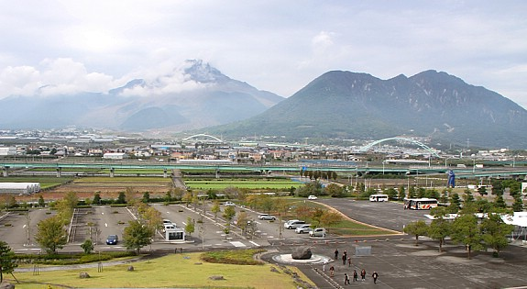
Space
How do people use & change the space that they live?
Different groups use space differently and changes over time
Ex: City of Shimabara in southern Japan
Places can be divided into spaces
Ex: city divided into space for houses, businesses, industry, entertainment, sport, and recreation
Helps us make sense of the world

Slide 6
Environment
Earth is made up of many different environments
Natural Environments: deserts, grasslands, mountains, coral reefs, forests, oceans, & ice caps
Soils, rocks, climate, plants and animals must remain mostly untouched by humans
Built Environments: changed by humans for few natural features remain
Large cities, towns, suburbs, farmland
Have their own climate

Slide 7
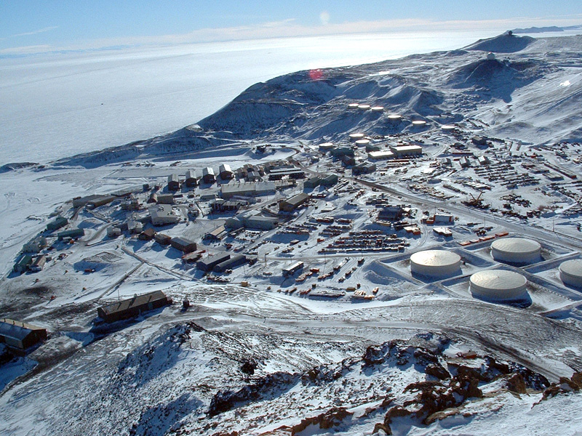
Environment
Most environments are a combination of built and natural
Ex: built structures in Antarctica, warming of planet causing melting ice shelves, pollution of ocean impacts animals.
Geographers analyse the changes humans make to the Earth & manage them
McMurdo Station in Antarctica. Combination of built & natural environment

Slide 8
Interconnection
How are human & natural processes connected?
Natural processes (water cycle & food chain)
Human activities (movement of people, production & trade of goods, flow of investment and money between countries)

Slide 9
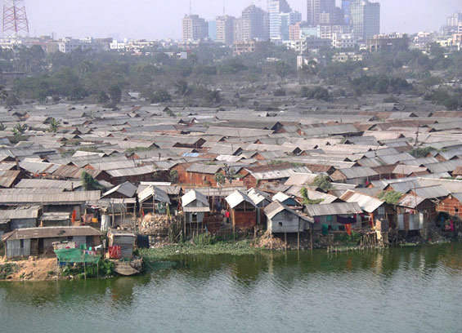
Interconnection
Every system on Earth is connected & depends on one another. If one thing changes, it can affect every other system.
Ex: rising temperatures causing problems for oceans, the land, and polar ice caps
Ex: Bangladesh is most vulnerable to climate change because of low elevation above sea level

Slide 10
Sustainability
The capacity of Earth to maintain life
Making sure all resources on Earth are used and managed responsibly
Most resources on Earth are non-renewable (one day they will run out)
Ex: oil, coal, natural gas
Other resources are renewable (they naturally replace themselves)
Ex: wind, forests, sunlight, & water

Slide 11
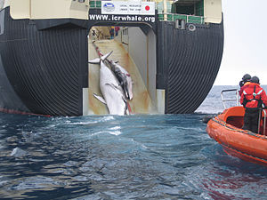
Sustainability
We need to think about the resources we use so we can take care of the Earth
Actions to improve sustainability:
Local: recycling paper
National: Australian gov. using wind farms
Global: protecting endangered whales
How resources are managed so we have them in the future

Slide 12
Change
Earth is constantly changing
Helps us understand what is going on around us
Can be caused by natural or human processes
Many levels: personal, local, national, global
Ex: creek flooding, tsunami, earthquake, global warming

Slide 13
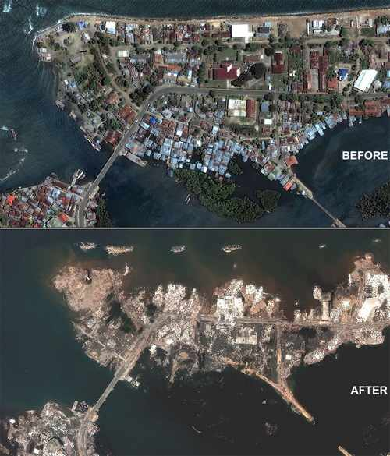
Change
We look at: types of change, why did it change, when did it change, will it change further?
Positive change: plant & animal conservation
Negative change: deforestation
Before & after a tsunami in Japan

Slide 14
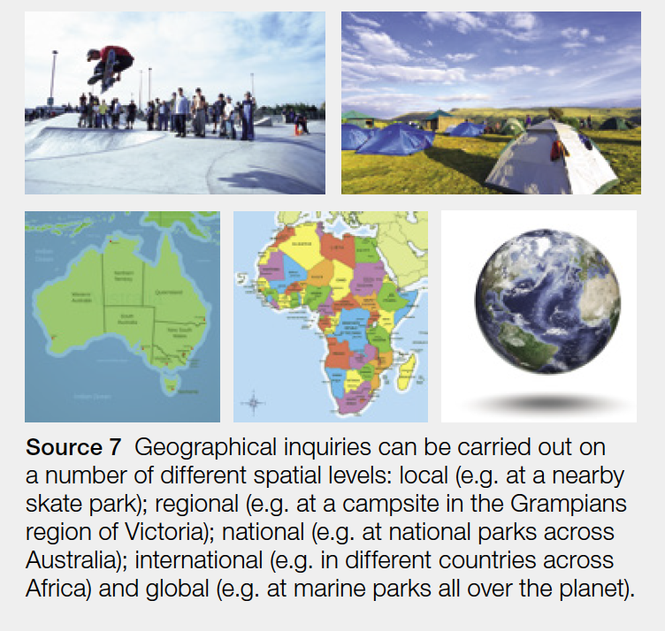
Scale
Study things that occur on many different levels
Ex: small areas (local park)
Large areas (use of oil & coal all over the world)

Slide 15
Scale
Range of scales:
Local: how many people go to the skate park and do the facilities meet their needs?
Regional: what kind of visitors stay at campsites and tourist parks in Western Australia?
National: how many people visit the national parks in Australia? How do visitors impact the national parks?
International: how is animal poaching being managed in Africa?
Global: how are marine parks being managed around the world? How well are they protecting endangered species?

