Slide 1
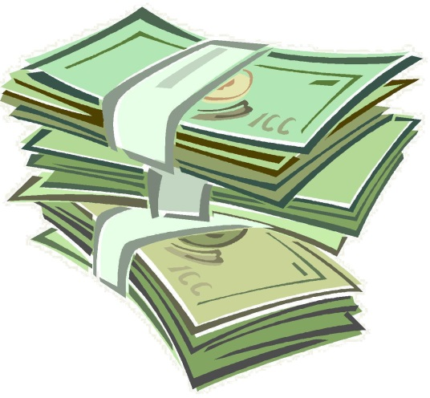
Let’s Talk About Money

Slide 2
Life Without Money
Barter was the means of trade long before money was invented.
Barter means ‘swapping or exchanging goods or services for another good or service’.
Complicated and time consuming process – requires a ‘coincidence of wants’.

Slide 3
Bartering Video
https://www.youtube.com/watch?v=ZXIuFpu72Nk

Slide 4
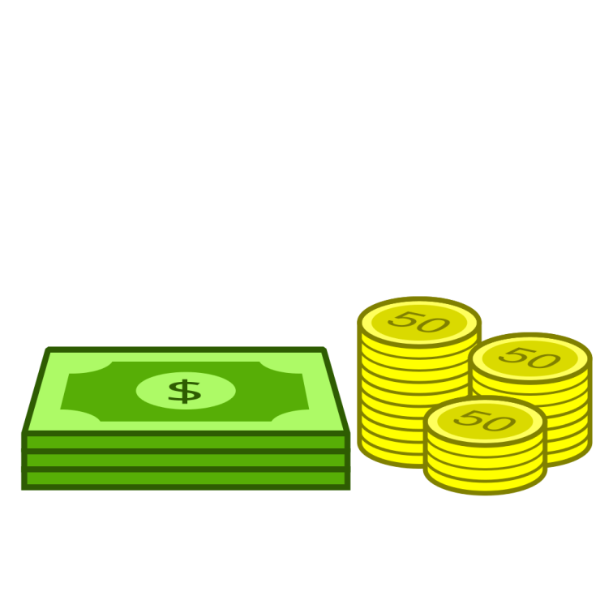
What is money?
Money is a medium that can be exchanged for goods and services.

Slide 5
Characteristics of Money
It should be:
Durable
Portable
Divisible
Scarce
Acceptable
Hard to forge

Slide 6
Functions of Money
Four specific functions:
A medium of exchange – quick and easy to make payments with.
A standard of value – measures value of items, attach prices to goods and services.
A store of value – allows people to save and spend in the future.
A means of deferred payment – allows people to buy items on credit.

