Slide 1
Topic/Objective: Short term impacts of the Industrial Revolution
27/2

Slide 2
Essential Question:
What were the short term effects of the industrial revolution?

Slide 3
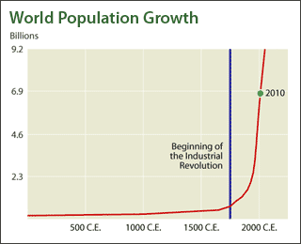
How did the population change?
There was a dramatic increase in world population.
1750: 5.5 million people in England and Wales
1900: 32.5 million people in England and Wales
There was a mass movement of people from rural areas into growing cities.
1801: 17% of Europe lived in cities
1891: 54% of Europe lived in cities

Slide 4
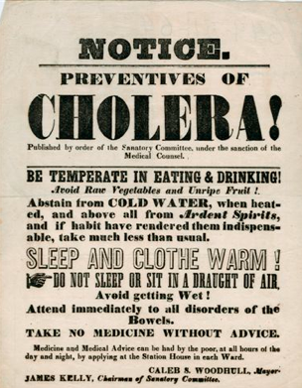
How did urban planning improve life in cities?
Urban planning was introduced after terrible problems with disease (small pox, cholera, tuberculosis, scarlet fever, typhus, scarlet fever)
Conditions improved in the urban slums
Overcrowded rooming houses were pulled down and replaced with new housing. This drastically improved conditions.

Slide 5
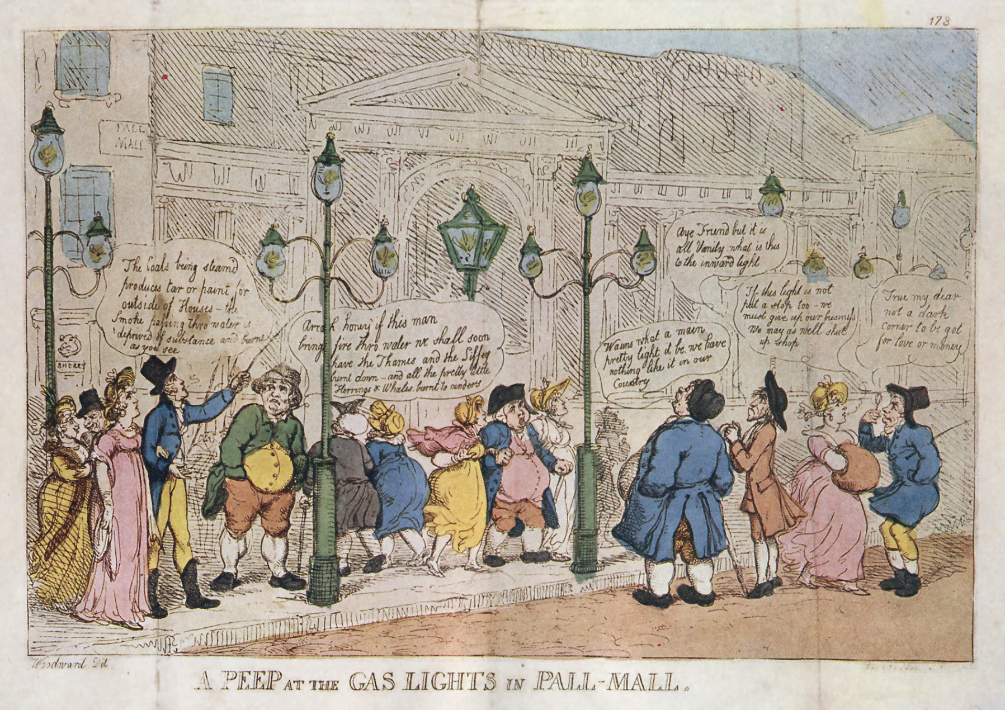
How did urban planning improve life in cities?
People now had access to running water, central heating and improved sewerage systems.
Open spaces were planned, drained, and uncluttered for sport entertainment
Gas powered & electric street lighting improved the atmosphere of cities at night, encouraging leisure activities after dark (theatre, music halls, etc.)
The development of suburbs & public transportation
People could live further away from where they worked
As population ⬆ so did transportation

Slide 6
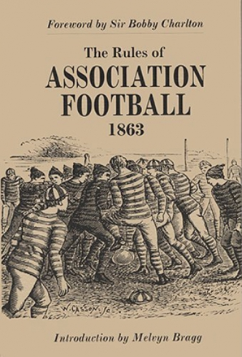
How did living standards improve?
Improvements in agriculture reduced the risk of famine. Increased food production = better more affordable food in larger quantities = helps people stay healthier.
Sport was encouraged in free time to keep workers healthy. Sport and recreation become more important in society as time goes on.
Mass entertainment (theatres & spectator sports), newspapers, and magazines developed for people of all classes.
Literature was finally no longer just for the wealthy

Slide 7
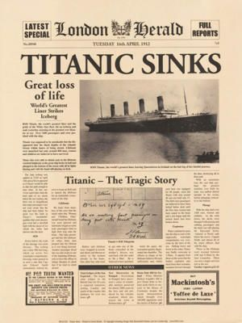
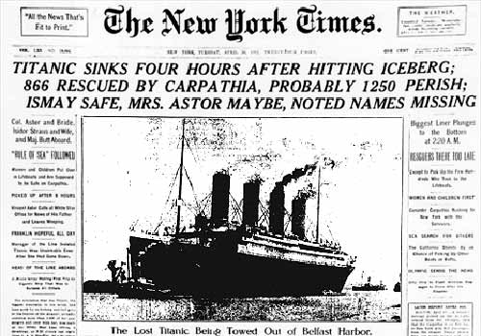
How did living standards improve?
Travel times were faster because of the development of railways
Travel for leisure became more affordable (even for the working class.
Mass produced consumer goods (clothing and cutlery) became more affordable.
News could be quickly reported from around the world because of the telegraph and telephone.
Immediate ways of communicating improved businesses and personal lives
Faster postal times from improved roads & railroads

Slide 8
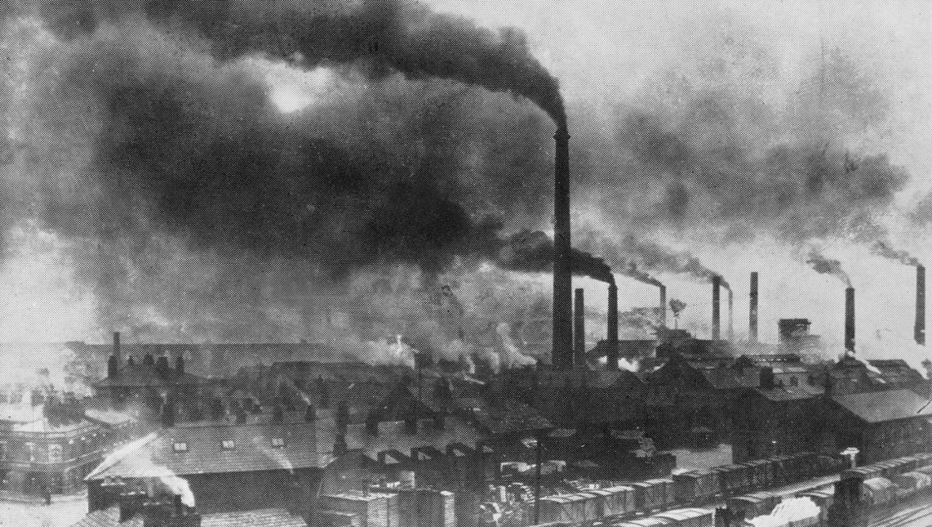
Were all short term effects positive?
No, there were still harsh working conditions, high rents, crowded living conditions, and pollution.

Slide 9
Now complete the summary section in your Cornell style notes
Make sure you address the essential question and use main ideas we identified in our notes.

Slide 10
Grab a book and read pages 276-277
Answer questions 1-4 in your notebook

