Slide 1
Geography: Deforestation

Slide 2
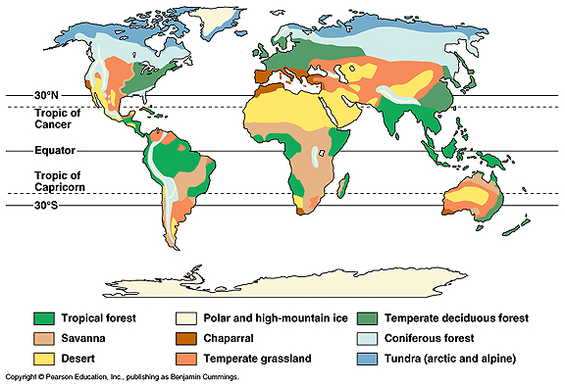
For another lesson

Slide 3
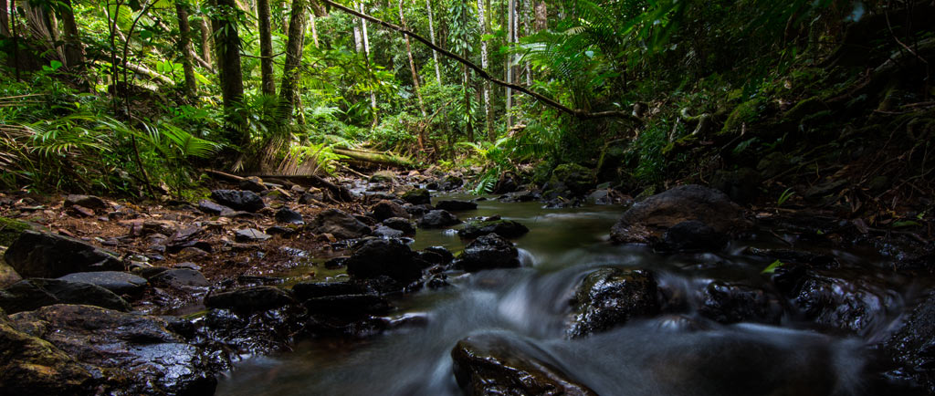

Slide 4
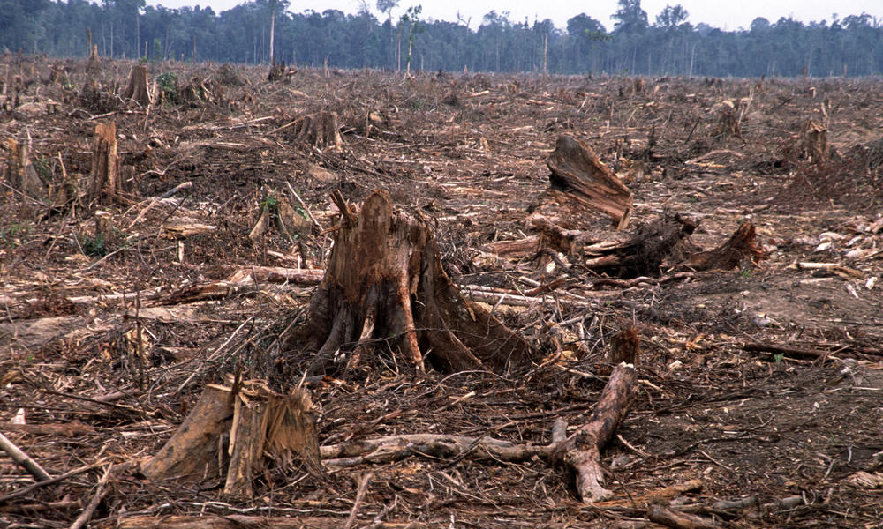

Slide 5
Deforestation
Is the clearance and removal of forest trees. The land is converted to a non-forest use.
This is primarily caused by humans clearing land for:
agricultural reasons
Urbanisation
Timber

Slide 6
Deforestation
About half the worlds forests have been cleared
Forest loss contributes between 12%-17% of annual greenhouse gas emissions
Deforestation can be done quickly by either burning, clear cutting or slash-and-burn
Slash-and-burn: cut down an area of trees. Burn them. Grow crops until the soil becomes degraded. Move on.
Notes:
Clear cutting – removal of all trees in an area.

Slide 7
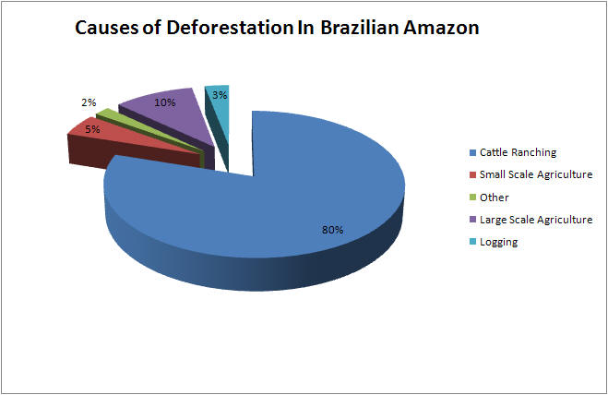

Slide 8
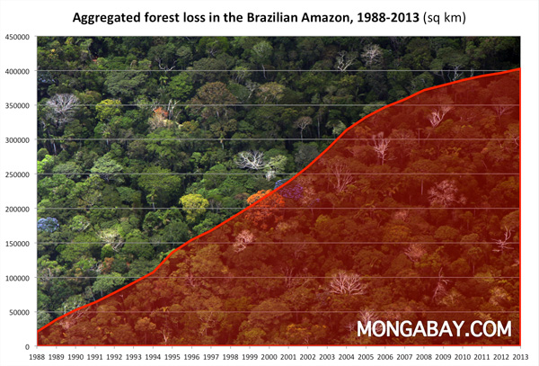

Slide 9
Effects of Deforestation
Loss of Species
Carbon Emissions
Water Cycle
Soil Erosion
Life Quality

Slide 10
Loss of Species
70% of the Earth’s plants and animals live in forests
They are loosing their habitat, leading to species extinction
This causes biodiversity problem, a loss of medical resources and causes local population issues

Slide 11
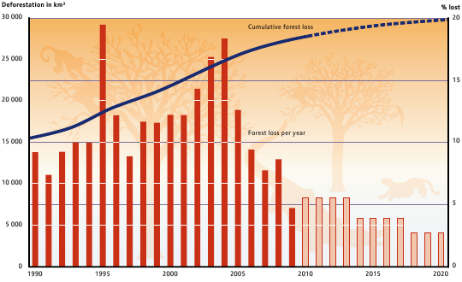

Slide 12
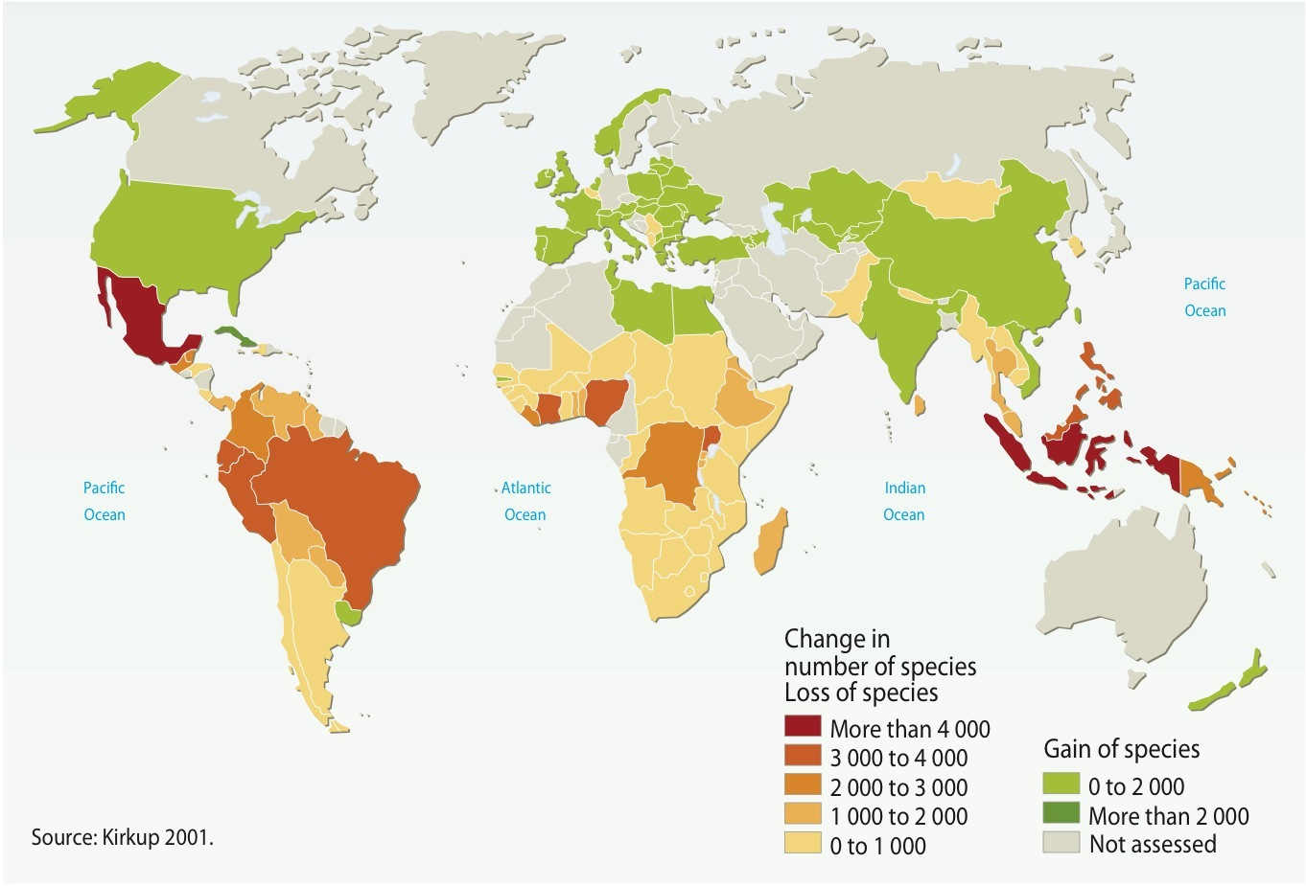

Slide 13
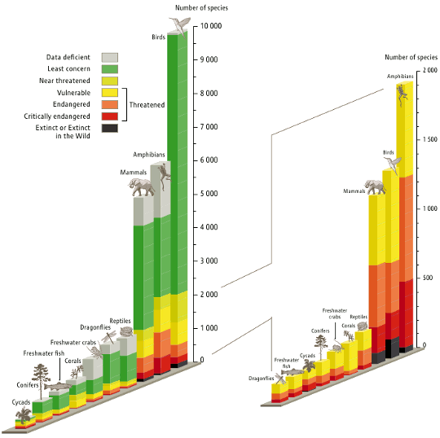

Slide 14
Carbon Emissions
Forests help absorb greenhouse gasses
Without trees, more carbon and GHGs enter the atmosphere
Also: trees hold carbon. When cut, burned or destroyed they release their carbon.
tropical forests hold more than 210 gigatons of carbon, and deforestation represents around 15 percent of greenhouse gas emissions

Slide 16
Water Cycle
Trees play an important part of the water cycle
They ground water in their root and release water into the atmosphere
In the Amazon, more then half of the ecosystem water is held in plants. Without plants the climate will become drier

Slide 17
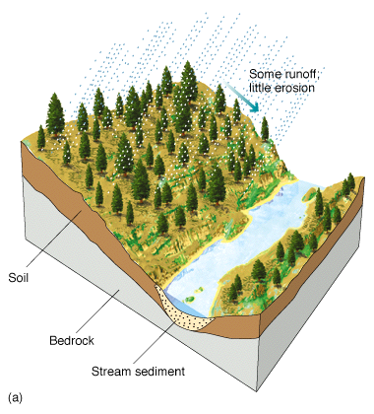
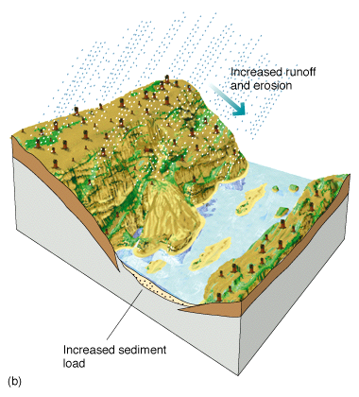
Forested
Deforested

Slide 18
Soil Erosion
Tree roots anchor soil and prevents it washing away
Trees prevent soil from drying.
An estimated 1/3 of the worlds arable land has been lost due to deforestation

Slide 19
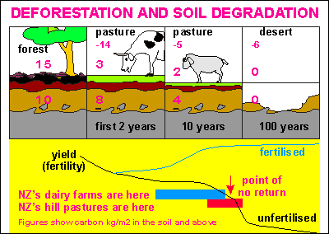

Slide 20
Life Quality
Soil erosion can cause silt to enter into lakes, streams and other water sources
This can decrease local water quality, causing poor health
Erosion and water cycle issues can cause damage to local economies
This can cause people movements

Slide 21
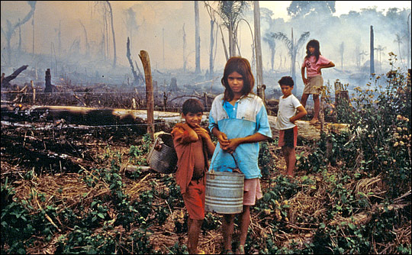

Slide 22
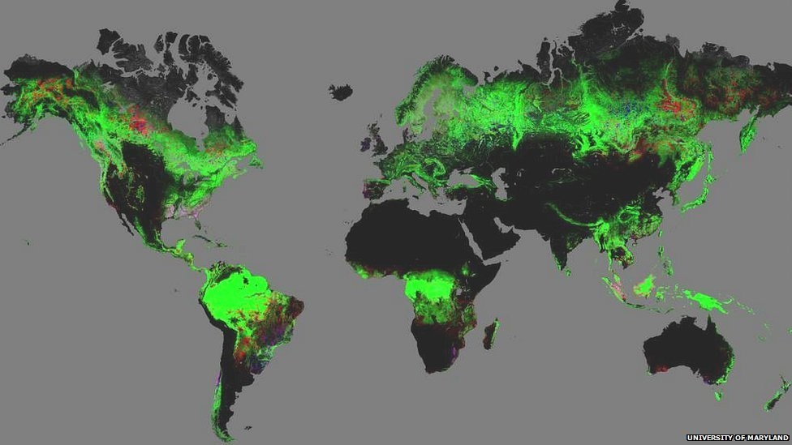
Notes:
This map shows forest change from 2000-12.
Green areas are forested;
red suffered forest loss;
blue showed forest gain;
pink experienced both loss and gain

